Slide 1
Communication
COMM
By Yudai Etsunaga

Slide 2
Outline
Background
Functions
Subsystem Block Diagram
Communication Link
Test and Evaluations
Communication Power Budge
Requirement Allocation Sheet (RAS)
Schedule for CDR

Slide 3
Background
Background
Provide a link to relay data findings and send commands
Satellite and Ground Station (GS)
Provide the interface between the satellite and ground systems
Receives and demodulates uplink signals and modulates and transmits downlink signals
Data Relayed
Payload mission data
House Keeping data
Operator commands (command data)
Main Objective
To establish efficient and effective link between the space and the ground segment

Slide 4
Functions
Receive uplink command from the Ground Station (GS)
and send the received command to the onboard computer (OBC)​
​
Transmit mission or payload data via downlink to the GS
​
Transmit Continuous Wave (CW) beacon to the GS

Slide 5
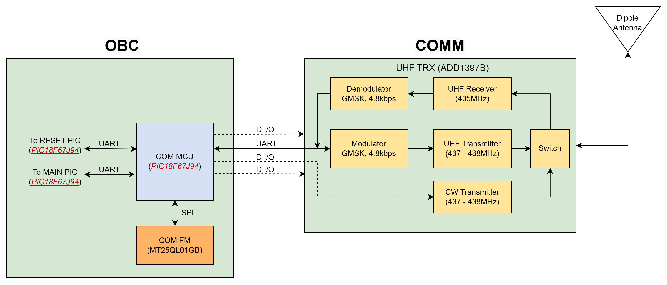
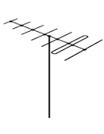
Block Diagram
UHF Dipole Antenna (435-438MHz)
Ground Station
Modes of operation
TX | CW | Mode
0 | 0 | GMSK RX
1 | 0 | GMSK TX
0 | 1 | CW Mode

Slide 6
Communication Links
 | Uplink (Receive Mode) | Downlink (Transmit Mode) | Beacon (CW Mode)
Frequency | 435 MHz | 437.375 MHz | 437.375 MHz
Bandwidth | 26 kHz | 26 kHz | 500 Hz
Modulation | GMSK | GMSK | CW Morse Code
Output Power | 50W (GS) | 800mW (29.03 dBm) | 100mW (20 dBm)
Rate | 4800 bps | 4800 bps | 20 wpm

Slide 7
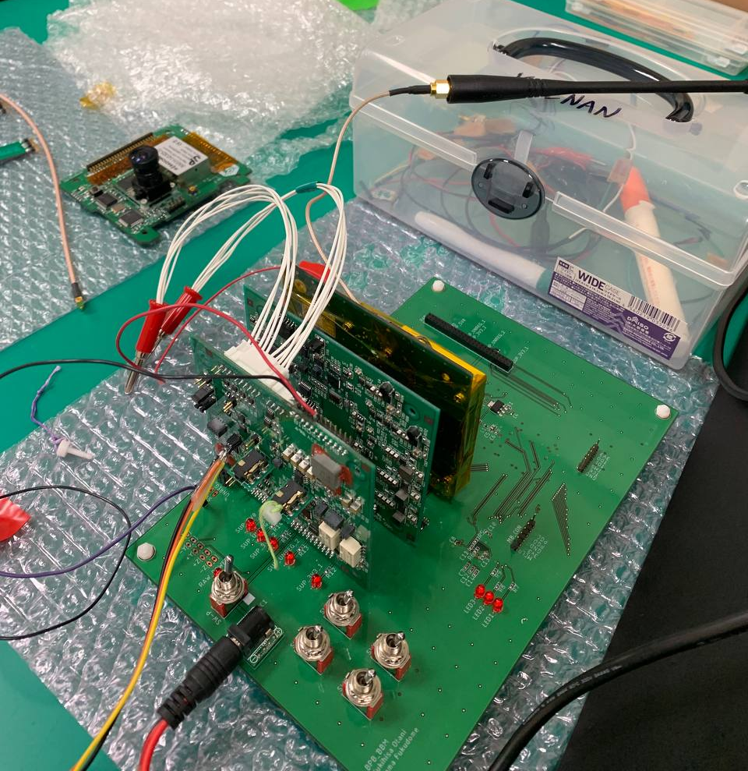
Check CW data (SR1.3)
TX (CW)
BIRDS5 COM
BIRDS3 FAB
BIRDS5 OBC

Slide 8
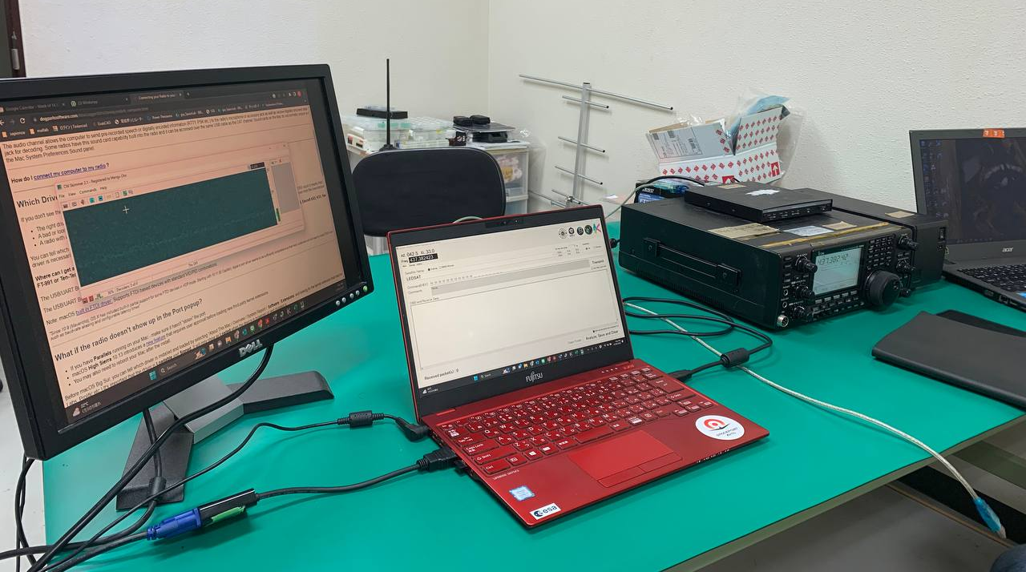
Check CW data (SR1.3)
RX (CW)
CW skimmer
Radio (ICOM)

Slide 9
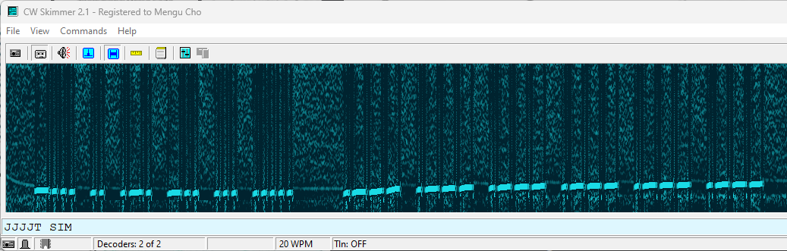
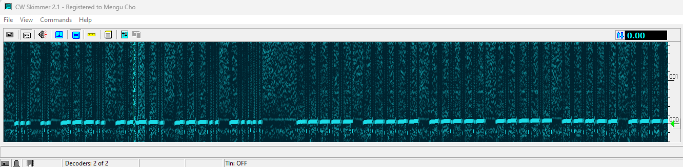
Check CW data (SR1.3)
B
I
R
D
S
5
J
J
J
J
J
J
S
I
8
9
8
6

Slide 10
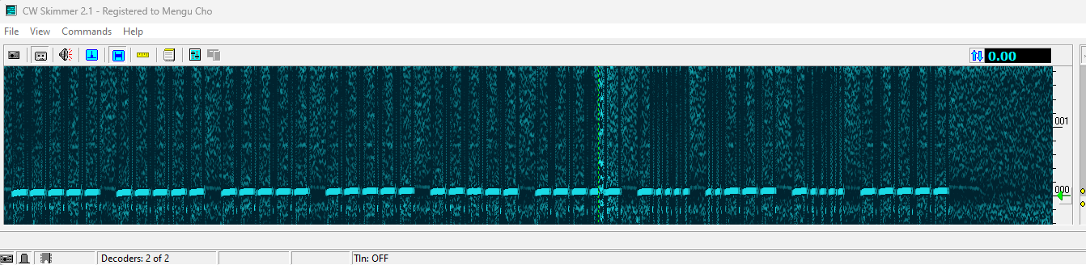
Check CW data (SR1.3)
0
0
0
0
0
0
6
2
6
0
HK (Type 1)

Slide 11
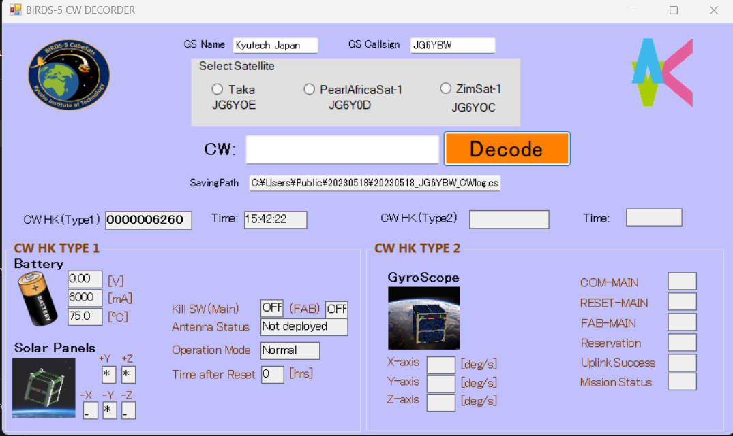
Check CW data (SR1.3)

Slide 12
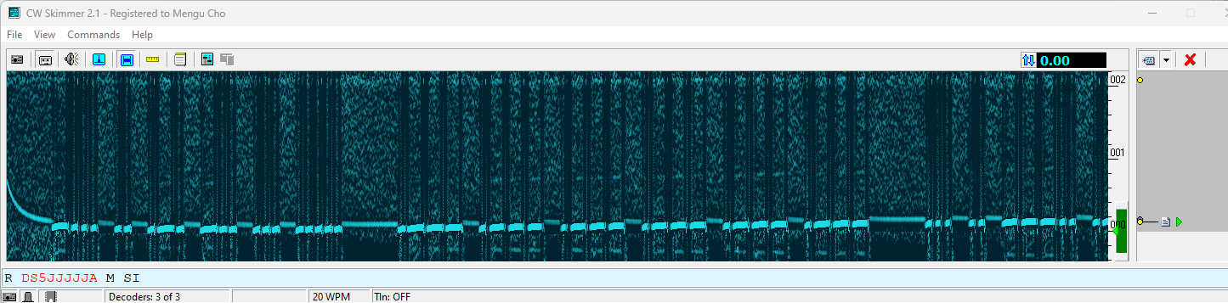
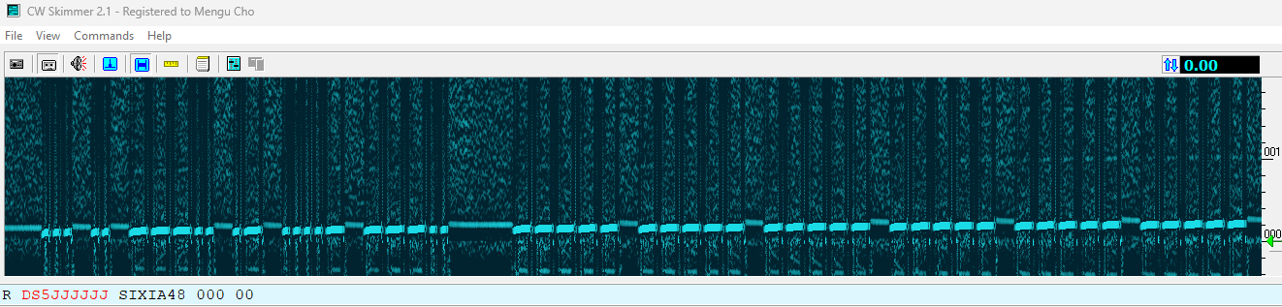
Check CW data (SR1.3)
B
I
R
D
S
5
J
J
J
J
J
J
S
I
8
A
4
8
12

Slide 13
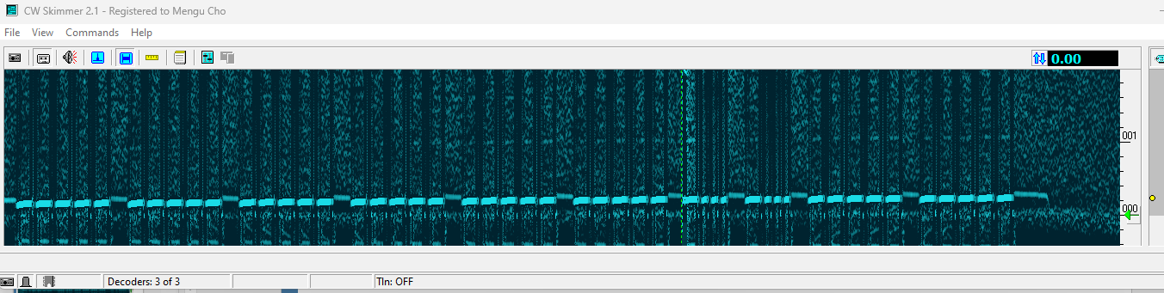
Check CW data (SR1.3)
0
0
0
0
0
0
B
B
0
0
HK (Type2)

Slide 14
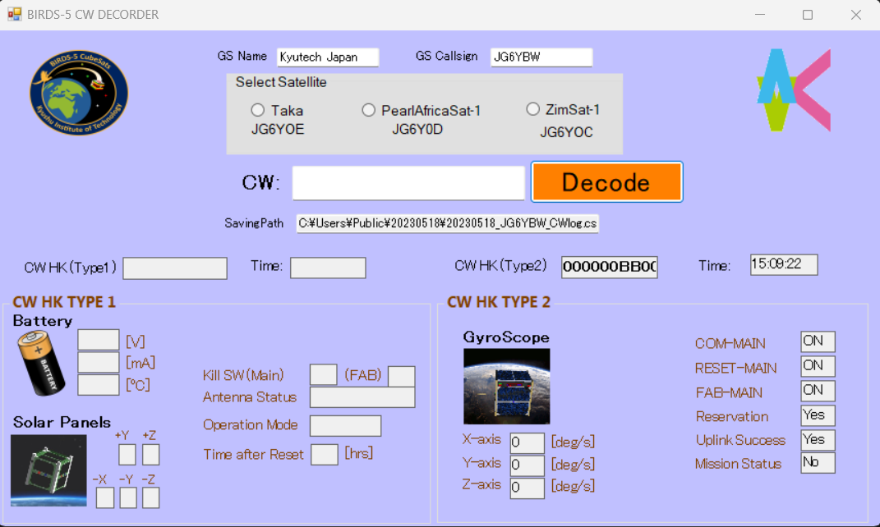
Check CW data (SR1.3)

Slide 15
COMM RAS
ID | System Requirements | ID | Design Requirements | ID | Verification Requirements | Verification Method | Result (〇, △, ✕)
SR1.1 | Satellite shall be able to receive uplink command from ground station. | DR1.1.1 | Antenna shall be dipole that receives uplink command at 435 MHz. | VR1.1.1.1 | Get the S11 parameter of the antenna. | □ Use simulation tool (e.g. CST, HFSS) □ Use Vector Network Analyzer (VNA) at anechoic chamber test | ✕ ✕
 |  |  |  | VR1.1.1.2 | Measure received signal power at the antenna. | □ Use Spectrum Analyzer(SA) at anechoic chamber test □ Use SA at Long Range Test(LRT) | ✕ ✕
 |  | DR1.1.2 | Modulation shall be GMSK at 4800 bps data rate. | VR1.1.2.1 | Confirm the output waveform at the transceiver(TRX) | □ Use SA to check the waveform | △
 |  | DR1.1.3 | Frame format shall be AX.25 Protocol. | VR1.1.3.1 | Determine the packet error | □ Send pre-defined data and inspect the received data for errors | ✕
 |  | DR1.1.4 | COM MCU shall send the command to OBC through UART | VR1.1.4.1 | Check UART communication between COMM MCU and OBC | □ Compare COMM MCU transmit data and OBC received data | △
 |  |  |  | VR1.1.4.2 | Conduct uplink success rate test | □ Count packets successfully received and transmitted at controlled environment and at LRT | ✕
 |  |  |  | VR1.1.4.3 | Conduct link budget computation | □ Compute for theoretical losses and gains at every critical points □ Measure the losses and gains at every critical points at controlled environment, and at LRT | ✕ ✕

Slide 16
COMM RAS
ID | System Requirements | ID | Design Requirements | ID | Verification Requirements | Verification Method | Result (〇, △, ✕)
SR1.2 | Satellite shall be able to transmit telemetry and mission data to ground station | DR1.2.1 | COMM MCU shall receive the telemetry data from OBC through UART | VR1.2.1.1 | Check UART communication between OBC and COMM MCU | □ Compare OBC trasnsmit data and COMM MCU received data | △
 |  | DR1.2.2 | Modulation shall be GMSK at 4800 bps data rate | VR1.2.2.1 | Confirm the output waveform at the TRX | □ Use SA to check the waveform | △
 |  | DR1.2.3 | Frame format shall be AX.25 Protocol | VR1.2.3.1 | Determine the packet error. | □ Send pre-defined data and inspect the received data for errors | ✕
 |  | DR1.2.4 | Antenna shall be dipole that receives downlink command at 437.375 MHz. | VR1.2.4.1 | Get the S11 parameter of the antenna. | □ Use simulation tool (e.g. CST, HFSS) □ Use Vector Network Analyzer (VNA) at anechoic chamber test | ✕
 |  |  |  | VR1.2.4.2 | Measure transmitted signal power at the antenna. | □ Use SA at anechoic chamber test. Use SA at LRT | ✕
 |  |  |  | VR1.2.4.3 | Conduct downlink success rate test. | □ Count packets successfully transmitted and received at controlled environment and at LRT | ✕
 |  |  |  | VR1.2.4.4 | Conduct link budget computation. | □ Compute for theoretical losses and gains at every critical points □ Measure the losses and gains at every critical points at controlled environment, and at LRT | ✕

Slide 17
COMM RAS
ID | System Requirements | ID | Design Requirements | ID | Verification Requirements | Verification Method | Result (〇, △, ✕)
SR1.3 | Satellite shall be able to send CW beacon | DR1.3.1 | CW shall contain housekeeping data | VR1.3.1.1 | Check read data | Check read display data | 〇
SR1.4 | COMM shall survive space environment. | DR1.4.1 | COMM shall be able to survive thermal test in the range of -10 deg C to 45C. | VR1.4.1.1 | Shall confirm the COMM can survive thermal test. | COMM operational test in the laboratory. | ✕
SR1.5 | COMM shall survive in vibration environment. | DR1.5.1 | COMM shall be able to survive in vibration test AT and QT. | VR1.5.1.1 | Shall confirm the COMM can survive vibration test. | COMM operational test in the laboratory. | ✕

Slide 18
CDR Schedule
TASK | 2022 |  |  |  |  |  |  |  |  |  |  |  |  |  |  |  |  |  |  |  |  |  |  |  |  |  |  |  |  |  | 2023
 | DEC |  |  |  |  | JANUARY |  |  |  |  | FEBRUARY |  |  |  | MARCH |  |  |  | APRIL |  |  |  | MAY |  |  |  |  | June |  |  |  | JULY |  |  |  | AUGUST |  |  |  |  | SEPTEMBER |  |  |  | OCTOBER
 | 48 | 49 | 50 | 51 | 52 | 1 | 2 | 3 | 4 | 5 | 6 | 7 | 8 | 9 | 10 | 11 | 12 | 13 | 14 | 15 | 16 | 17 | 18 | 19 | 20 | 21 | 22 | 23 | 24 | 25 | 26 | 27 | 28 | 29 | 30 | 31 | 32 | 33 | 34 | 35 | 36 | 37 | 38 | 39 | 40 | 41 | 42 | 43
Mission Definition Review (MDR)
Secure all components
Programming of COMM
Procurement
Preliminary Design Review (PDR)
EM Functinal Test, EM Integration
Long Range Test, End to End Test
Vibration Testing
Thermal Testing
After 30 mins Test
Critical Design Review (CDR)
← Now
CDR

