Slide 1
BIRDS-4 FM
APRS Long Range Test Report
Prepared by:
Marloun P. Sejera
15 December 2019

Slide 2
CONTENTS
Antenna Orientation
Effective Downlink Attenuation (EDA)
Effective Uplink Attenuation (EUA)
Uplink Sensitivity Test
Link Budget

Slide 3
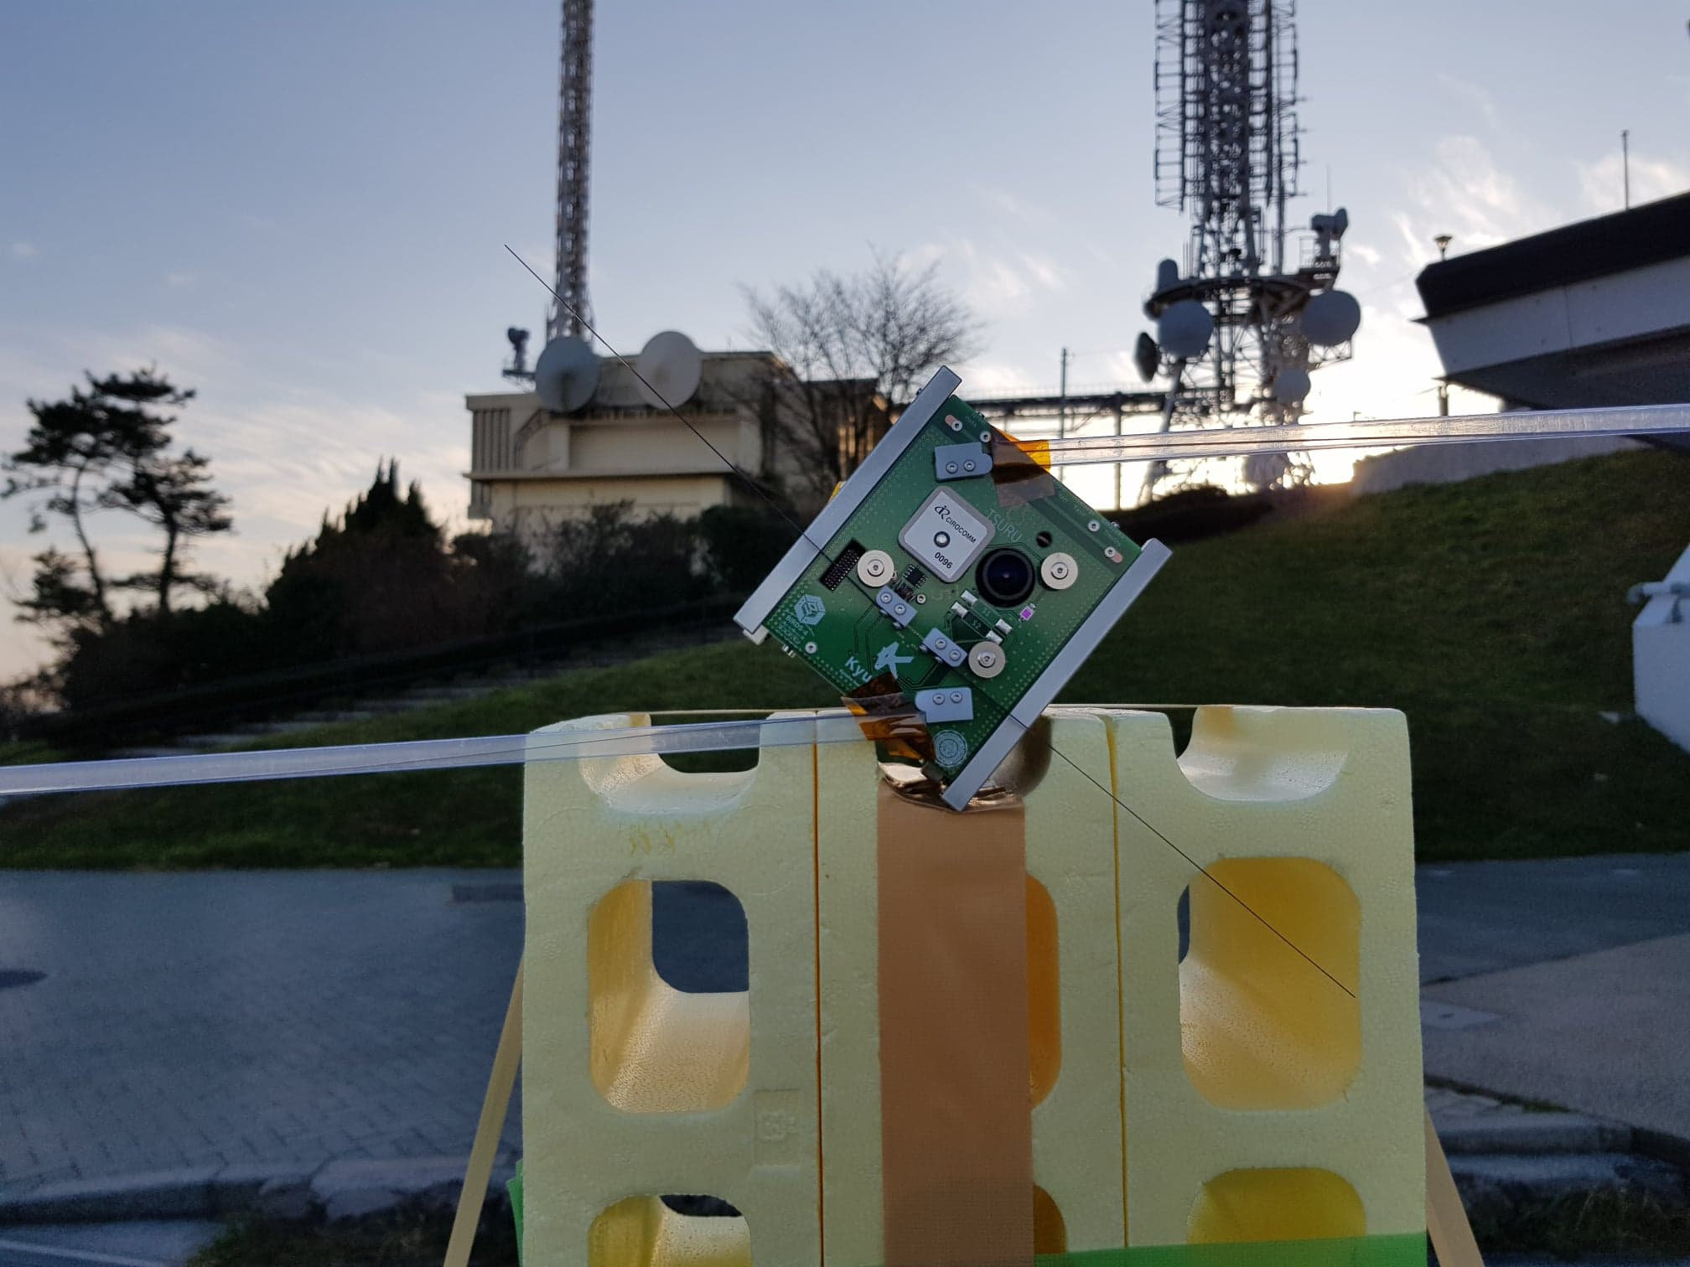
Antenna Orientation
Satellite was placed on the platform facing KyuTech GS with azimuth of 40⁰. VHF dipole is oriented horizontally
HORYU antenna was rotated facing Mt. Sarakaura.
VHF dipole
BIRDS-4 FM (JP) at Mt. Sarakura, facing KyuTech GS. VHF dipole (tuned at 146 MHz) is oriented horizontally

Slide 4
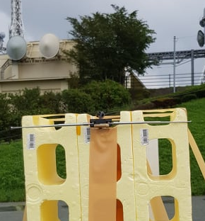
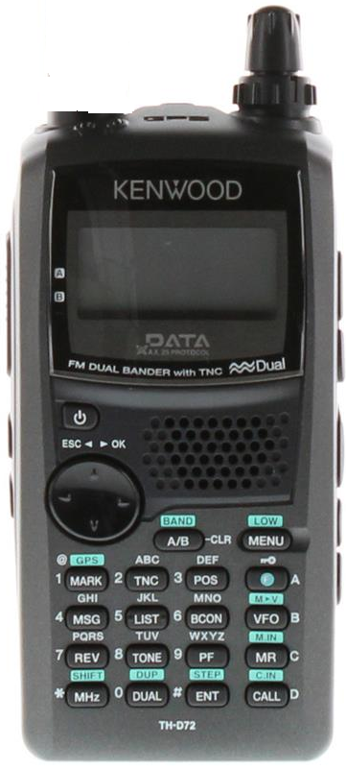
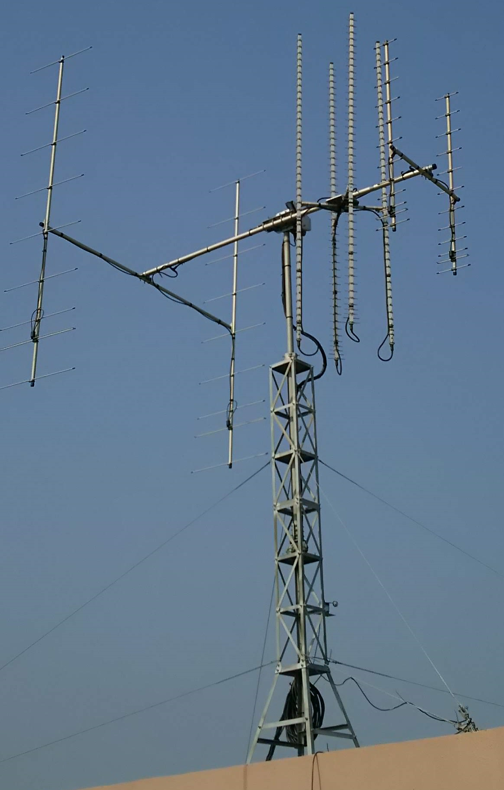
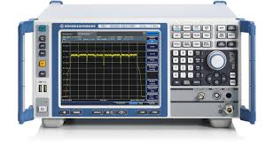
Effective Downlink Attenuation (EDA)
At Mt. Sarakura side, Kenwood TH-D72 hand-held radio (HHR) transmitted carrier signal (145.825 MHz) using dipole reference.
At KyuTech GS side, received power was measured using spectrum analyzer (SA).
Reference dipole*
Kenwood TH-D72
Reference dipole*
Kenwood TH-D72
Mt. Satakura side
EDA = P_{TX} (HHR) – P_{RX} (SA)
EDA = 36 dBm – (-40 dBm)
EDA = 76 dB
*Photo shows UHF reference dipole. Actual photo of VHF reference dipole is not available
Spectrum Analyzer
HORYU antenna
KyuTech GS side

Slide 5

Effective Uplink Attenuation (EUA)
At KyuTech GS side, Kenwood TH-D72 hand-held radio (HHR) was used to transmit carrier signal (145.825 MHz).
At Mt. Sarakura side, received power was measured using spectrum analyzer (SA).
Reference dipole*
Spectrum Analyzer
Mt. Satakura side
EUA = P_{TX} (HHR) – P_{RX} (SA)
EUA = 25.5 dBm – (-50 dBm)
EUA = 75.5 dB
*Photo shows UHF reference dipole. Actual photo of VHF reference dipole is not available
Kenwood TH-D72
HORYU antenna
KyuTech GS side

Slide 6
Effective Attenuation Summary
Effective Attenuation | FM (JP) | EM
Uplink (EUA) | 75.5 dB | 70.8 dB
Downlink (EDA) | 76 dB | 71.8 dB
BIRDS-4 FM effective attenuation (EUA and EDA) are almost similar.
Note:
For uplink, reference dipole was used to measure received signal and not satellite’s VHF dipole.
For downlink, HHR transmitted the signal and not from the satellite.

Slide 7
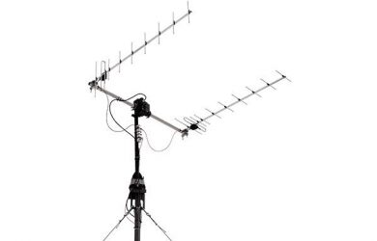
Uplink Sensitivity Test Setup
GS sends message using HHR. When ACK from satellite is received, it is considered success. Uplink command is sent 10 times .
Additional attenuator is placed and test is again conducted. This is repeated until success rate is zero.
Uplink sensitivity is defined at 50% success rate.
BIRDS4 FM
25.5 dBm
Att.
HORYU
antenna
Kenwood
TH-D72

Slide 8
Uplink Sensitivity Test Result
Added Attenuators in GS | Total Attenuation | P_{RX} at Mt. Sarakura (estimated) | Success Rate
40 dB | 115.5 dB | -90 dBm | 10/10
42 dB | 117.5 dB | -92 dBm | 10/10
45 dB | 120.5 dB | -95 dBm | 9/10
46 dB | 121.5 dB | -96dBm | 6/10
47 dB | 122.5 dB | -97 dBm | 0/10
P_{TX} (GS): 25.5 dBm
EUA: 75.5 dB
Total Attenuation = EUA + Added Attenuators
P_{RX} (estimated) = P_{T} (GS) – Total Attenuation

Slide 9
Uplink Sensitivity Comparison
Uplink Sensitivity | FM (JP) | EM
 | -96 dBm | -95 dBm
There is no significant difference on the uplink sensitivity of FM and EM satellites.
There is no significant improvement in uplink sensitivity when aluminium sheet is placed at the back of VHF TRX as an RF shield.

Slide 10
UpLink Budget
With the same setup as long range test at Mt. Sarakura except Pt = 37 dBm, successful uplink can be achieved at elevation angle of at least 30⁰

Slide 11
UpLink Budget (Ground Station Setup)
With 50W radio output power and 16 dB antenna gain, uplink success can be achieved at 10⁰ elevation.

Slide 12
UpLink Budget (HHR setup)
With 5W radio output power and 7 dBi antenna gain, uplink success cannot be achieved even at high elevation angle.

Slide 13
DownLink Budget
-105 dBm was based on BIRDS-2 test with satellite in orbit.
Successful downlink can be achieved even at 15⁰ elevation.

