Slide 1
APRS Reference Board (APRS-R)

Slide 2
Function and Performance
Purpose : Provide satellite APRS digipeating for Amateur Radio Community.
Function 1: Digipeater APRS packets from amateur radio stations on the ground.​
Performance 1a: Transmit satellite APRS beacon to ground​
Performance 1b: Receive and retransmit APRS packets from amateur radio stations.
Performance 1c: Transfer the received data packets to desired micro controller.

Slide 3
Function and Performace
Function 2 : Store the received data.​
Performance 2a: Store the data to satellite’s specified memory location.​
Function 3 : Send data to the main ground stations​.
Performance 3a: Transfer stored data to COMM MCU for download via UHF 4800 bps to ground stations.

Slide 4
PBS
APRS/R
Payload
1.1.2.3
APRS-R
1.1.2.3.1
APRS Capable Radio
1.1.2.3.2
VHF Antenna
1.1.2.3.1.5
MCU
1.1.2.3.1.3
TNC
1.1.2.3.1.2
Transceiver
1.1.2.3.1.1
Memory
1.1.2.3.1.4

Slide 5
WBS
APRS-R
1.1.2.3.1
Memory
1.1.2.3.1.4
MCU
1.1.2.3.1.3
TNC
1.1.2.3.1.2
Transceiver
1.1.2.3.1.1
Procurement
1.1.2.3.1.1.1
Assemble
1.1.2.3.1.1.2
Test
1.1.2.3.1.1.3
Procurement
1.1.2.3.1.2.1
Assemble
1.1.2.3.1.2.2
Test
1.1.2.3.1.2.3
Procurement
1.1.2.3.1.3.1
Assemble
1.1.2.3.1.3.2
Test
1.1.2.3.1.3.3
Procurement
1.1.2.3.1.4.1
Assemble
1.1.2.3.1.4.2
Test
1.1.2.3.1.4.3
VHF Antenna
1.1.2.3.1.5
Procurement
1.1.2.3.1.5.1
Assemble
1.1.2.3.1.5.2
Test
1.1.2.3.1.5.3

Slide 6
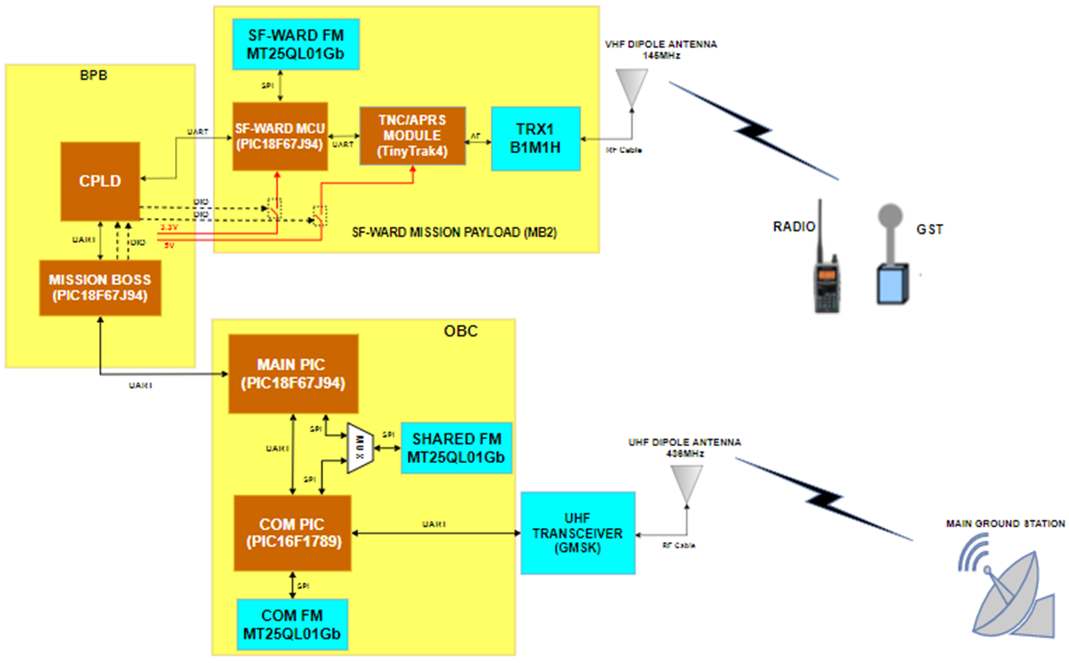
Block diagram

Slide 7
RAS
SR 1.1 – The schedule of operation of SF-WARD shall be controllable through an uplink command from a control ground station.
Design Requirements | Verification Requirements | Verification Method
Command will be sent from ground station using UHF uplink frequency | Measure receivable signal power of COMM transceiver | Using spectrum analyzer
OBC will relay the command to Mission Boss to activate APRS/SF-WARD payload | Check if the APRS/SF-WARD payload is activated/deactivated | Using Tera term to read APRS/SF-ward MCU

Slide 8
RAS
SR 1.2 – VHF transceiver operating in half-duplex will receive mission data from ground sensors.
Design Requirements | Verification Requirements | Verification Method
Receiver will demodulate FM signal received | Check AFSK output of Receiver | Using spectrum analyzer
TNC will decode received AFSK signal | Check data output of TNC | Display Serial Output of TNC through Serial Monitor on PC
APRS/SF-WARD payload will receive transmitted data and store it. | Check received data if it matches transmitted data through wired testing | Display received OBC data through Serial on PC
 | Check stored data in flash memory. | Read Flash Memory through APRS/SF-ward Serial Interface
SR 1.2 – VHF transceiver operating in half-duplex will receive mission data from ground sensors.

Slide 9
RAS
SR 1.3 – Payload shall store received packets (ground sensor data and APRS message) into memory
Design Requirements | Verification Requirements | Verification Method
APRS/SF-WARD MCU shall process received AX.25 frame into correct fields | Check processed data of APRS/SF-WARD MCU | Display processed data through serial interface
Flash memory capacity of at least 32MB | Check specification and writable memory | Through write operations
SR 1.2 – VHF transceiver operating in half-duplex will receive mission data from ground sensors.

Slide 10
RAS
SR 1.4 – Payload shall transmit stored data to ground station upon command from ground station using COM data downlink frequency
Design Requirements | Verification Requirements | Verification Method
COMM MCU shall read stored memory in APRS/SF-WARD Flash memory for downlink | Check data transmitted by COMM | Display received data
SR 1.2 – VHF transceiver operating in half-duplex will receive mission data from ground sensors.

