Slide 1
Ground Terminal (APRS-G)

Slide 2
Function and Performance
Purpose : Provide satellite data link for APRS packets for testing and data collected by ground sensors.
Function 1: Receive APRS packets from APRS satellites.​
Performance 1a: Receive and decode satellite APRS packets.
Performance 1b: Storage satellite APRS packets.
Function 2: Transmit APRS packets to APRS satellites.
Performance 2a: Encapsulate data on AX.25 protocol for transmission.
Performance 2b: Transmit at 1200 bps to satellite.
Function 3: Collect data from ground sensors for satellite transmission
Performance 3a: Read data collected by ground sensors.
Performance 3b: Prepare data on APRS format.

Slide 3
PBS
VHF Antenna
1.1.2.2.1.5
MCU
1.1.2.2.1.3
TNC
1.1.2.2.1.2
Transceiver
1.1.2.2.1.1
Memory
1.1.2.2.1.4
Ground Terminal
1.1.2.2.1
APRS/G
1.1.2.2
Sensors
1.1.2.2.2
Weather Station
1.1.2.2.2.1
Environmental Sensors
1.1.2.2.2.2

Slide 4
WBS
Ground Terminal
1.1.2.2.1
Memory
1.1.2.2.1.4
MCU
1.1.2.2.1.3
TNC
1.1.2.2.1.2
Transceiver
1.1.2.2.1.1
Procurement
1.1.2.2.1.1.1
Assemble
1.1.2.2.1.1.2
Test
1.1.2.2.1.1.3
Procurement
1.1.2.2.1.2.1
Assemble
1.1.2.2.1.2.2
Test
1.1.2.2.1.2.3
Procurement
1.1.2.2.1.3.1
Assemble
1.1.2.2.1.3.2
Test
1.1.2.2.1.3.3
Procurement
1.1.2.2.1.4.1
Assemble
1.1.2.2.1.4.2
Test
1.1.2.2.1.4.3
VHF Antenna
1.1.2.2.1.5
Procurement
1.1.2.2.1.5.1
Assemble
1.1.2.2.1.5.2
Test
1.1.2.2.1.5.3

Slide 5
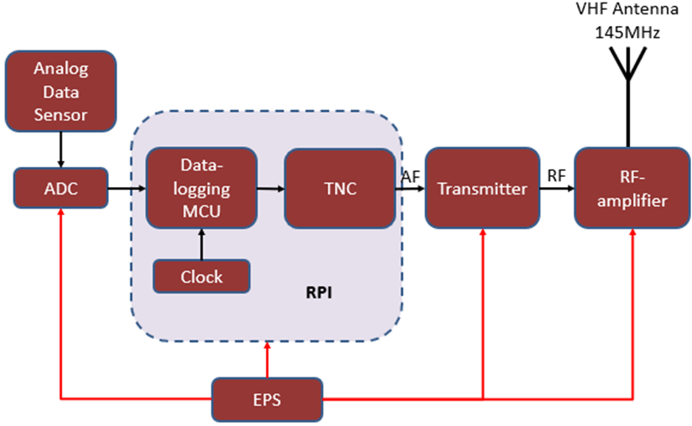
Block diagram

