Slide 1
VroCode
Department of Information Technology NITK, Surathkal IT254 : Web Technologies and Applications (minor) Mini Project Mid Evaluation
Team Number: 2
Team Members:
Abhishek Chavan 191MT001
Diptesh Banerjee 191ME298
Akshay Bistagond 191EC203

Slide 2
Outline
Introduction
Objectives
Requirement Analysis
System Design
Work Plan
Conclusion
References
Individual Contribution

Slide 3
INTRODUCTION
VroCode is a web application made specifically for programmers.
A platform to connect with other fellow programmers.
One can showcase their achievements and projects.
The user can redirect to multiple programming practice sites and courses.

Slide 4
Objectives
This web application is to give the competitive environment.
Ranks will be assigned based on particular criteria.
User can get inspired from different works being showcased.
A github repo button will redirect the users to the project of the post.
Connect with like-minded or people from same field.
Improve skills by getting access to different websites at one place.
Contribute to the programming/coding community.
Gig-economy integration for short-term jobs.
Access to multiple courses relative to the interest of the user.

Slide 5
Requirements Analysis
Functional Requirements
Register/login providing Security.
Personalization: User can choose the area of interest to be displayed.
Navigational: Easy to navigate UI so that the user can navigate between different pages.
Communication: The web application shall make it possible for the users to chat with each other.
Extensive interactability: Will have code battle feature where users can compete against each other to win.

Slide 6
Requirements Analysis
Non-functional Requirements
Performance
Reliability
Maintainability
Efficiency & Scalability
Interoperability
Usability, Portability & Compatibility
UI : Easy to use
Evolution

Slide 7
Requirements Analysis
Use Case Scenarios
For making connections with like minded people with common interests.
To compete with fellow coders in code battles
Other Software Engineering Methodologies
Agile Model: Agile Model is a combination of the Iterative and incremental model. This model focuses more on flexibility while developing a product rather than on the requirement.

Slide 8
System Design
Design Goals
To provide a platform where clients can share their projects.
To provide a platform where clients can chat and connect with each other.
To provide an online IDE so that client can run and test project code.
To provide a platform where client can integrate all other websites like coding practice websites, github, etc.

Slide 9
Design Method
Systems Development Life Cycle (SDLC):
Requirements Analysis – Establishes a high-level view of the intended project. It includes the analysis of end-user information needs.
Design – Describes desired features & operations in detail, including screen layouts, mock-ups and style decisions.
Implementation - Interactive components (Front-end) and Back-end.
Testing – Stage to checks for errors, interoperability and usability.
Evolution – Future opportunities are looked at, that then feed back into another cycle starting at an new requirements analysis.

Slide 10
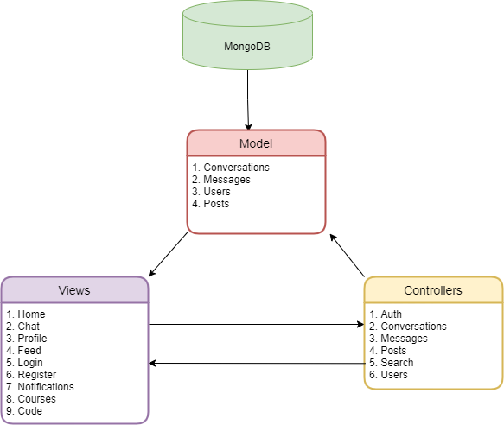
System Architecture
Model-Controller-View Architecture (MVC):
It is an architectural pattern that separates an application into three main logical components: the model, the view, and the controller. Each of these components are built to handle specific development aspects of an application.

Slide 11
Work Plan
Further we plan to polish the Frontend and tweak the design a bit.
We plan to implement an express backend with a mongoDB database to save user data.
Integration of front-end and back-end.
Carry out few standard performance tests.
Optimize the web application based on the results.
If time permits, we will add a codebattle page where two users can challenge each other for different programming battles.

Slide 12
Conclusion
We expect the end result to be a website which will act as a platform for individual developers or group of developers to showcase their skills and form a productive community to mutually help each other for the welfare of everyone.
The website will have facilities to chat with people, integrations with various websites, share projects directly from github and seek help from other developers for various projects.

Slide 13
References
https://reactjs.org/docs/getting-started.html
https://dribbble.com/
https://stackoverflow.com/
https://github.com/maxrjohnson23/Code-Battle
https://github.com/safak/youtube/tree/mern-social-app

Slide 14
Individual Contribution (Till Midsems)
Abhishek Chavan 191MT001 :
Set up a Login and Register page frontend
Styling of the navbar/topbar
Profile page Frontend (Ongoing)
Diptesh Banerjee 191ME298 :
Designing one on one and group chat system.
Styling the chat UI(Ongoing)
Akshay Bistagond 191EC203 :
Setting up the Project
Set up routing and made navbar/topbar component
Made Home page Frontend (Ongoing)

