Slide 1
DATA STRUCTURES & ALGORITHM
Self Paced
GeeksforGeeks
Under the guidance of
Mr. Sandeep Jain

Slide 2
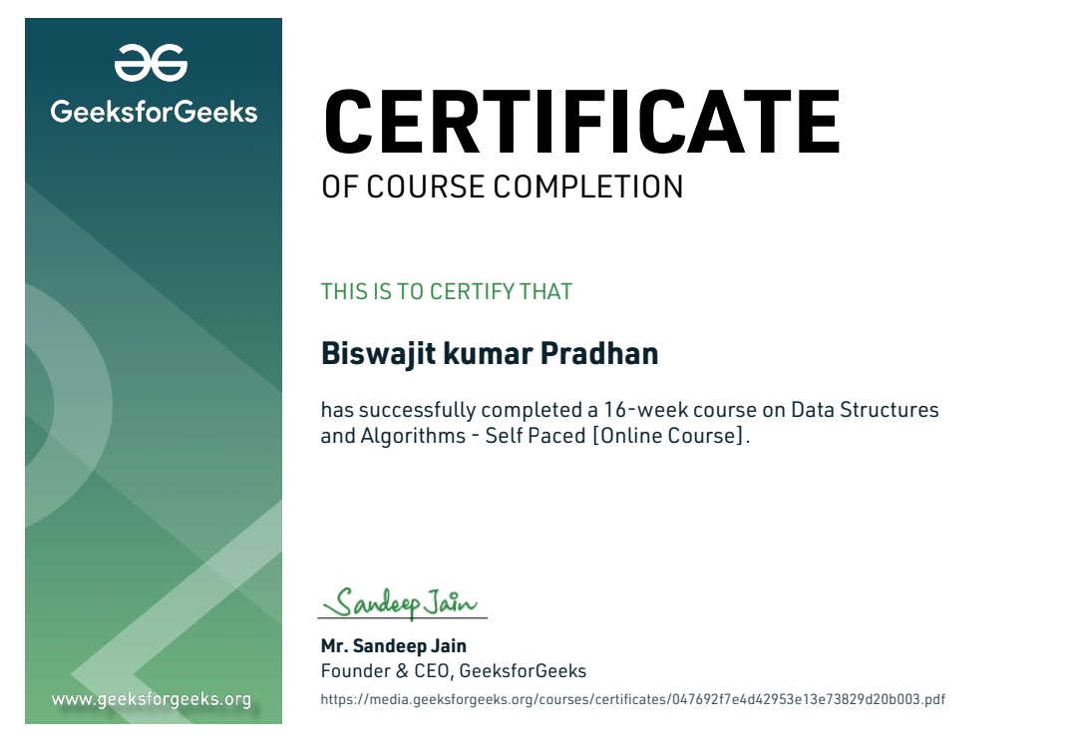
Link | https://www.geeksforgeeks.org/certificate/047692f7e4d42953e13e73829d20b003

Slide 3
What is Data Structure?
Definition: A Data Structure is a way of organizing and storing data in a computer so that it can be accessed and modified efficiently.
Example:
String: "Virat" is a data structure used to store a sequence of characters.
Integer: 26 is a data structure representing a numeric value.

Slide 4
What is an Algorithm?
Definition: An algorithm is a step-by-step procedure or formula for solving a problem.
Explanation:
Algorithms are expressed through pseudocode or flowcharts before implementation in a programming language.
Example of a simple algorithm: Steps to find the maximum of three numbers.

Slide 5
Technology Learned: Analysis of Algorithms
Concepts:
Understanding time and space complexity.
Order of Growth: How the performance of an algorithm scales with input size.
Asymptotic Notations:
Big O Notation: Upper bound on the time complexity.
Omega Notation: Lower bound on the time complexity.
Theta Notation: Exact bound on the time complexity.

Slide 6
Mathematics in DSA
Key Concepts:
Arithmetic Progression (AP): Sequence of numbers with a constant difference between consecutive terms.
Geometric Progression (GP): Sequence of numbers where each term after the first is found by multiplying the previous one by a fixed, non-zero number.
Prime Numbers: Numbers greater than 1 with no divisors other than 1 and itself.
Factorials: The product of all positive integers up to a given number (n!).

Slide 7
Bit Magic
Bitwise Operations:
Operations that directly manipulate bits in binary representations of numbers.
Common operations include AND, OR, XOR, NOT, and bit shifts.
Example Problem:
Check if the Kth bit is set in a given integer: Use bitwise AND to check if a specific bit is 1 or 0.

Slide 8
Arrays
Definition: An array is a collection of items stored at contiguous memory locations.
Types:
Fixed-sized Arrays: Size is defined at compile-time.
Dynamic-sized Arrays: Size can change during runtime.
Common Operations:
Searching: Finding an element in an array.
Insertion: Adding an element at a specific position.
Deletion: Removing an element.
Reversing: Changing the order of elements.

Slide 9
Searching & Sorting
Binary Search:
A search algorithm that finds the position of a target value within a sorted array.
Types:
Iterative Binary Search: Uses a loop to divide the array.
Recursive Binary Search: Function calls itself with subarrays.
Sorting Algorithms:
Insertion Sort: Builds the final sorted array one item at a time.
Merge Sort: Divides the array into halves, sorts them, and merges them back together.
Quick Sort: Selects a 'pivot' and partitions the array into sub-arrays around the pivot.

Slide 10
Hashing
Definition: Hashing is a technique to uniquely identify a specific object from a group of similar objects.
Applications:
Used in implementing data structures like hash tables.
Collision Handling:
Chaining: Multiple elements stored at the same position using a linked list.
Open Addressing: Finds the next available slot when a collision occurs.
Double Hashing: Uses a second hash function to resolve collisions.

Slide 11
Strings & Linked Lists
Strings:
Sequence of characters stored as a data structure.
Common operations include concatenation, substring extraction, and character replacement.
Linked Lists:
A linear data structure where each element points to the next.
Types:
Singly Linked List: Each node points to the next.
Doubly Linked List: Each node points to both the next and the previous node.
Circular Linked List: The last node points back to the first node.
Common Problems:
Detecting and removing loops in a linked list.

Slide 12
Stacks & Queues
Stack:
A LIFO (Last In, First Out) data structure.
Common operations: Push (insert), Pop (remove), and Peek (view top element).
Queue:
A FIFO (First In, First Out) data structure.
Common operations: Enqueue (insert), Dequeue (remove), and Peek (view front element).
Implementation:
Stacks and Queues can be implemented using arrays or linked lists.

Slide 13
Tree Structures
Trees:
A hierarchical data structure with a root node and child nodes.
Binary Trees: Each node has at most two children.
Tree Traversals:
Inorder Traversal: Left, Root, Right.
Preorder Traversal: Root, Left, Right.
Postorder Traversal: Left, Right, Root.

Slide 14
Dynamic Programming & Backtracking
Dynamic Programming:
A method for solving complex problems by breaking them down into simpler subproblems.
Example: The N-Queen Problem where N queens must be placed on an N×N chessboard such that no two queens threaten each other.
Backtracking:
An algorithmic technique for solving problems recursively by trying to build a solution incrementally.
Example: Rat in a Maze problem where the rat must find a path through the maze.

Slide 15
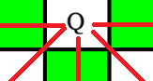
Project | N-Queen Visualizer
Problem
N-Queen is the problem of placing N-chess queens on an N×N chessboard so that no two queens attack each other (No Queen on same Diagonal and four directions)
Backtracking Algorithm
The idea is to place queens one by one in different columns, starting from the leftmost column. When we place a queen in a column, we check for clashes with already placed queens. In the current column, if we find a row for which there is no clash, we mark this row and column as part of the solution. If we do not find such a row due to clashes, then we backtrack and return false.

Slide 16
Project | N-Queen Visualizer
Algorithm
Start in the leftmost column
If all queens are placed return true
Try all rows in the current column.
Do following for every tried row.
1. If the queen can be placed safely in this row, then mark this [row, column] as part of the solution and recursively check if placing queen here leads to a solution.
2. If placing the queen in [row, column] leads to a solution then return true.
3. If placing queen doesn't lead to a solution then unmark this [row, column] (Backtrack) and go to step (1) to try other rows.
If all rows have been tried and nothing worked, return false to trigger backtracking.

Slide 17
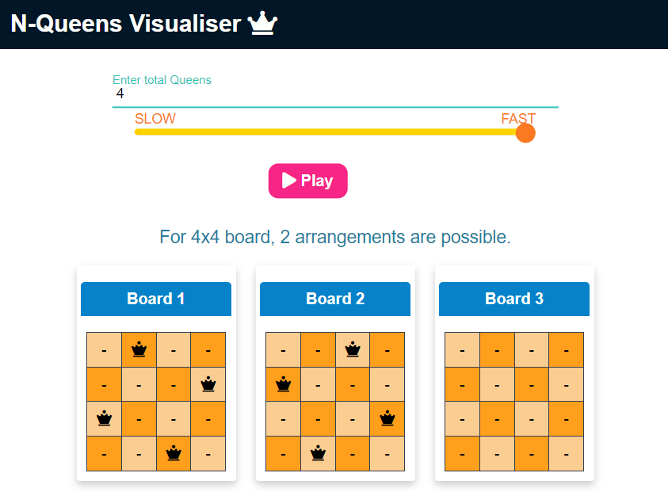
Project | N-Queen Visualizer
GitHub Repo | https://github.com/BISWAJIT69K/N-Queen-Visualizer

Slide 18
Thank You

