Slide 2
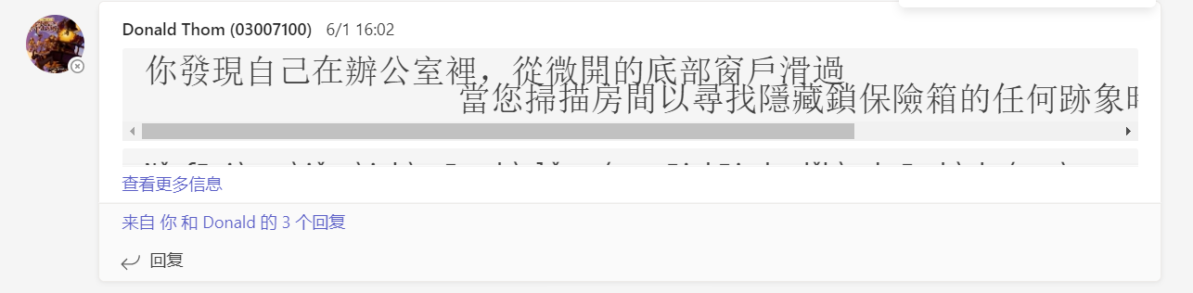
Challenge for me
First, the language problem.
Second, there are cultural differences.

Slide 3
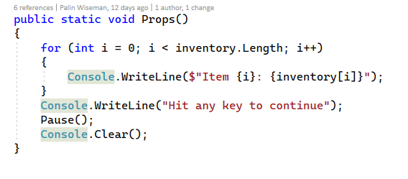
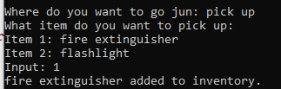
props
Put the items picked up by players in the room into the inventory through this item bar.

Slide 4
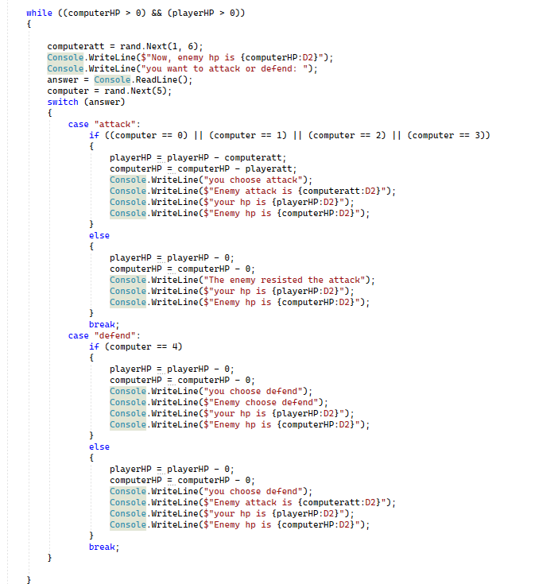
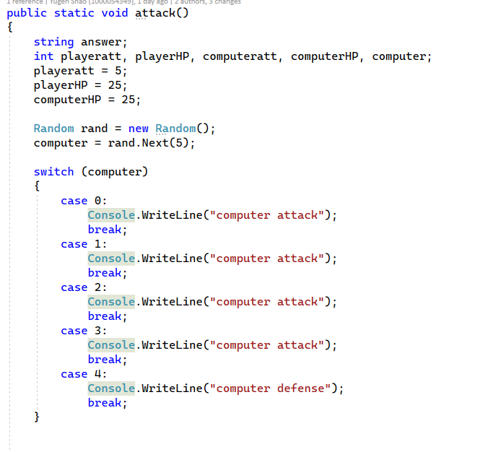
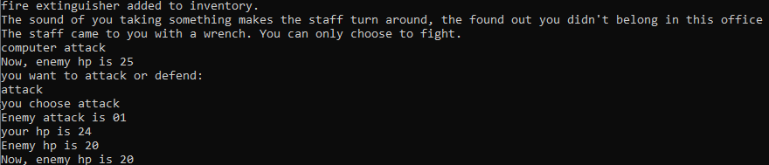
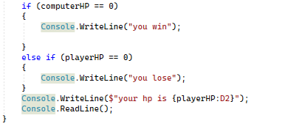
attack system
This system is used when the player encounters enemies in some rooms, in which the damage caused by enemy attacks is random. Players can choose to attack or defend during combat, as do enemies.

Slide 5
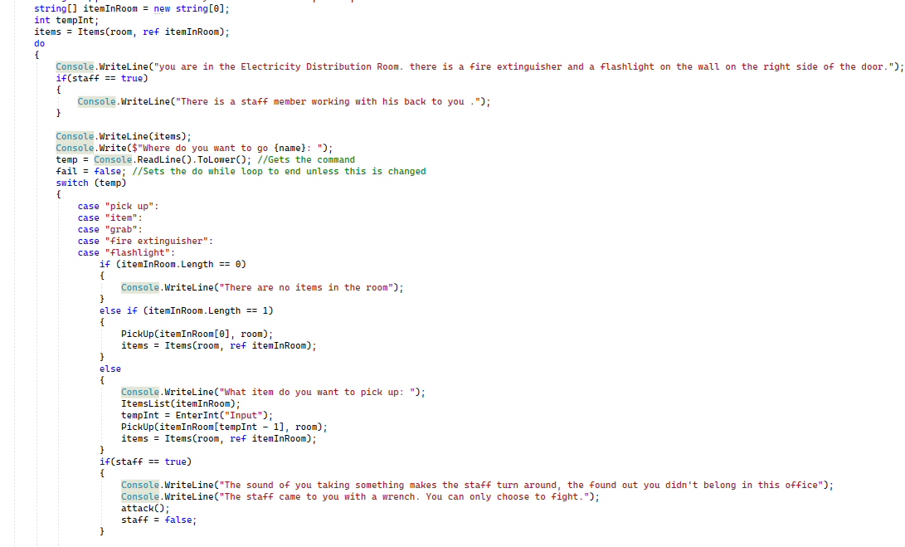
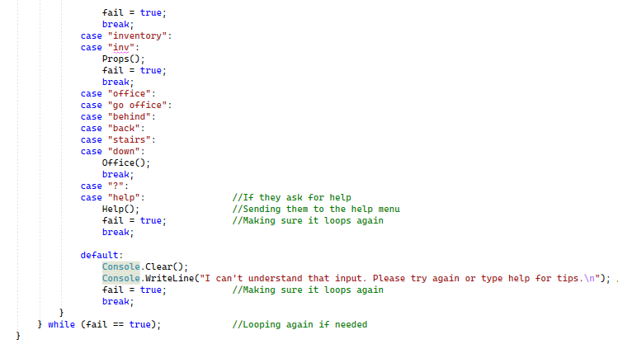
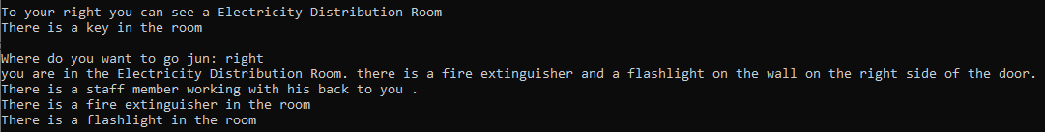
Electricity Distribution Room
This room is located on the right side of the office. It is a power distribution room. Players will pick up a fire extinguisher or a flashlight in this room. and an enemy

