Slide 1
BUG FIXING
ATTEMPTED
By Palin Wiseman

Slide 2

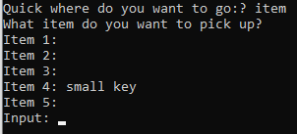
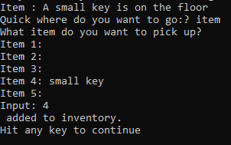
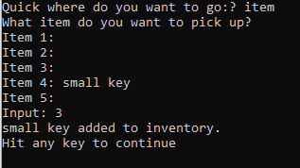
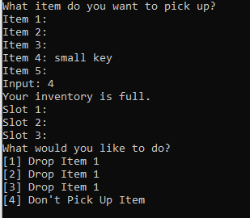

Inventory system issues

Slide 3



Inventory system issues Part 2

Slide 4
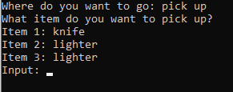


Inventory system issues Part 2

Slide 5
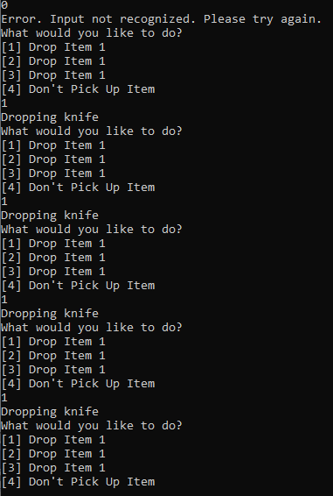
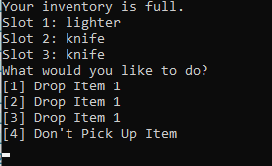
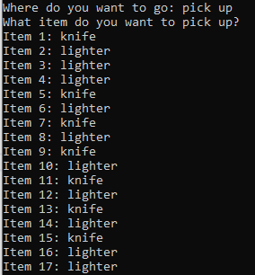
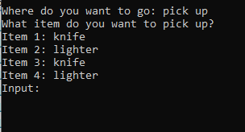
Inventory system issues Part 2

Slide 6
Bug fixing
In conclusion:
It’s important.
They’ll be back.

