Slide 1
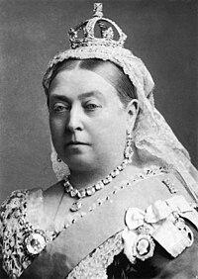
link:
Victoria
wikidata_id:
Q9439
image:
Queen Victoria by Bassano.jpg
sex or gender:
female (Q6581072)
father:
Prince Edward Augustus, Duke of Kent and Strathearn (Q157009)
mother:
Princess Victoria of Saxe-Coburg-Saalfeld (Q58067)
date of birth:
1819-05-24
place of birth:
Kensington Palace (Q207385)
date of death:
1901-01-22
place of death:
Osborne House (Q565155)
wiki_en:
Queen Victoria
label_en:
Victoria
source:
WikiData
Notes:
place of birth (P19) = Kensington Palace (Q207385)
sex or gender (P21) = female (Q6581072)
place of death (P20) = Osborne House (Q565155)
father (P22) = Prince Edward Augustus, Duke of Kent and Strathearn (Q157009)
mother (P25) = Princess Victoria of Saxe-Coburg-Saalfeld (Q58067)
date of birth (P569) = 1819-05-24
date of death (P570) = 1901-01-22
monogram (P1543) = Royal Monogram of Queen Victoria of Great Britain.svg
signature (P109) = Queen Victoria Signature.svg

Slide 2
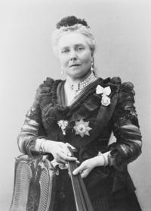
link:
Victoria, Princess Royal
wikidata_id:
Q116728
image:
Empress Viktoria of Germany (1840-1901).png
sex or gender:
female (Q6581072)
father:
Albert, Prince Consort (Q152245)
mother:
Queen Victoria (Q9439)
date of birth:
1840-11-21
date of death:
1901-08-05
place of death:
Schlosshotel Kronberg (Q510121)
wiki_en:
Victoria, Princess Royal
label_en:
Victoria, Princess Royal
source:
WikiData
Notes:
date of birth (P569) = 1840-11-21
date of death (P570) = 1901-08-05
place of birth (P19) = [http://www.wikidata.org/entity/Q42182 (item), http://www.wikidata.org/entity/Q84 (item)]
monogram (P1543) = Royal Monogram of Empress Victoria of Germany.svg
sex or gender (P21) = female (Q6581072)
place of death (P20) = Schlosshotel Kronberg (Q510121)
signature (P109) = Signature of Princess Royal Victoria.svg
father (P22) = Albert, Prince Consort (Q152245)
mother (P25) = Queen Victoria (Q9439)

Slide 3
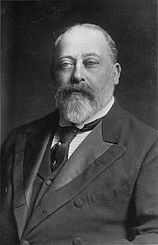
link:
Edward VII
wikidata_id:
Q20875
image:
King-Edward-VII (cropped).jpg
sex or gender:
male (Q6581097)
father:
Albert, Prince Consort (Q152245)
mother:
Queen Victoria (Q9439)
date of birth:
1841-11-09
place of birth:
Buckingham Palace (Q42182)
date of death:
1910-05-06
place of death:
Buckingham Palace (Q42182)
wiki_en:
Edward VII
label_en:
Edward VII
source:
WikiData
Notes:
place of birth (P19) = Buckingham Palace (Q42182)
sex or gender (P21) = male (Q6581097)
place of death (P20) = Buckingham Palace (Q42182)
father (P22) = Albert, Prince Consort (Q152245)
mother (P25) = Queen Victoria (Q9439)
date of birth (P569) = 1841-11-09
date of death (P570) = 1910-05-06
monogram (P1543) = Cypher of Edward VII.svg
signature (P109) = EdwardVII Signature.svg

Slide 4
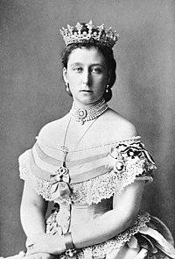
link:
Princess Alice of the United Kingdom
wikidata_id:
Q155566
image:
Alice, Princess Louis of Hesse.jpg
sex or gender:
female (Q6581072)
father:
Albert, Prince Consort (Q152245)
mother:
Queen Victoria (Q9439)
date of birth:
1843-04-25
place of birth:
Buckingham Palace (Q42182)
date of death:
1878-12-14
place of death:
Darmstadt (Q2973)
wiki_en:
Princess Alice of the United Kingdom
label_en:
Princess Alice of the United Kingdom
source:
WikiData
Notes:
date of birth (P569) = 1843-04-25
date of death (P570) = 1878-12-14
place of birth (P19) = Buckingham Palace (Q42182)
sex or gender (P21) = female (Q6581072)
place of death (P20) = Darmstadt (Q2973)
signature (P109) = Princess Alice's signature.svg
father (P22) = Albert, Prince Consort (Q152245)
mother (P25) = Queen Victoria (Q9439)

Slide 5
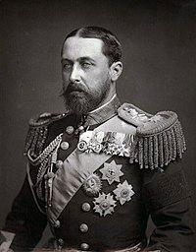
link:
Alfred, Duke of Saxe-Coburg and Gotha
wikidata_id:
Q158143
image:
Alfred duke of Edinburgh.jpg
sex or gender:
male (Q6581097)
father:
Albert, Prince Consort (Q152245)
mother:
Queen Victoria (Q9439)
date of birth:
1844-08-06
place of birth:
Windsor Castle (Q42646)
place of death:
Schloss Rosenau (Q449510)
wiki_en:
Alfred, Duke of Saxe-Coburg and Gotha
label_en:
Alfred, Duke of Saxe-Coburg and Gotha
source:
WikiData
Notes:
date of birth (P569) = 1844-08-06
date of death (P570) = [1900-07-30 (Prec.: day [-0 .. +0], PCal: Gregorian), 1900-07-31 (Prec.: day [-0 .. +0], PCal: Gregorian)]
place of birth (P19) = Windsor Castle (Q42646)
monogram (P1543) = ["Royal Monogram of Prince Alfred as Duke of Edinburgh.svg", "Royal Monogram of Prince Alfred as Duke of Saxe-Coburg and Gotha.svg"]
sex or gender (P21) = male (Q6581097)
place of death (P20) = Schloss Rosenau (Q449510)
signature (P109) = Prince Alfred's signature.svg
father (P22) = Albert, Prince Consort (Q152245)
mother (P25) = Queen Victoria (Q9439)

Slide 6
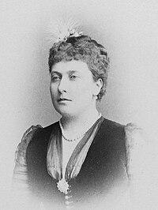
link:
Princess Helena of the United Kingdom
wikidata_id:
Q160539
image:
Helena, Princess Christian of Schleswig-Holstein, 1887.jpg
sex or gender:
female (Q6581072)
father:
Albert, Prince Consort (Q152245)
mother:
Queen Victoria (Q9439)
place of birth:
Buckingham Palace (Q42182)
place of death:
Schomberg House (Q7432105)
wiki_en:
Princess Helena of the United Kingdom
label_en:
Princess Helena of the United Kingdom
source:
WikiData
Notes:
sex or gender (P21) = female (Q6581072)
place of death (P20) = Schomberg House (Q7432105)
signature (P109) = Princess Helena's signature.svg
father (P22) = Albert, Prince Consort (Q152245)
mother (P25) = Queen Victoria (Q9439)
date of birth (P569) = [1846-05-25 (Prec.: day [-0 .. +0], PCal: Gregorian), 1846-05-26 (Prec.: day [-0 .. +0], PCal: Gregorian), 1846-01-01 (Prec.: year [-0 .. +0], PCal: Gregorian)]
date of death (P570) = [1923-06-09 (Prec.: day [-0 .. +0], PCal: Gregorian), 1923-01-01 (Prec.: year [-0 .. +0], PCal: Gregorian)]
place of birth (P19) = Buckingham Palace (Q42182)

Slide 7
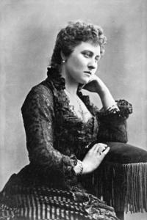
link:
Princess Louise, Duchess of Argyll
wikidata_id:
Q161167
image:
Princess Louise 1881.png
sex or gender:
female (Q6581072)
father:
Albert, Prince Consort (Q152245)
mother:
Queen Victoria (Q9439)
wiki_en:
Princess Louise, Duchess of Argyll
label_en:
Princess Louise, Duchess of Argyll
source:
WikiData
Notes:
date of birth (P569) = [1848-03-18 (Prec.: day [-0 .. +0], PCal: Gregorian), 1848-01-01 (Prec.: year [-0 .. +0], PCal: Gregorian)]
date of death (P570) = [1939-12-03 (Prec.: day [-0 .. +0], PCal: Gregorian), 1939-01-01 (Prec.: year [-0 .. +0], PCal: Gregorian)]
place of birth (P19) = [http://www.wikidata.org/entity/Q42182 (item), http://www.wikidata.org/entity/Q84 (item)]
monogram (P1543) = Royal Monogram of Princess Louise of Great Britain.svg
sex or gender (P21) = female (Q6581072)
place of death (P20) = [http://www.wikidata.org/entity/Q207385 (item), http://www.wikidata.org/entity/Q84 (item)]
signature (P109) = Signature of Princess Louise, Duchess of Argyll.svg
father (P22) = Albert, Prince Consort (Q152245)
mother (P25) = Queen Victoria (Q9439)

Slide 8
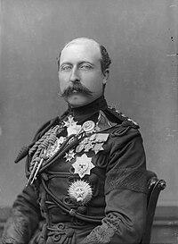
link:
Prince Arthur, Duke of Connaught and Strathearn
wikidata_id:
Q160558
image:
Prince Arthur, 1st Duke of Connaught and Strathearn.jpg
sex or gender:
male (Q6581097)
father:
Albert, Prince Consort (Q152245)
mother:
Queen Victoria (Q9439)
date of birth:
1850-05-01
place of birth:
Buckingham Palace (Q42182)
date of death:
1942-01-16
place of death:
Bagshot Park (Q582085)
wiki_en:
Prince Arthur, Duke of Connaught and Strathearn
label_en:
Prince Arthur, Duke of Connaught and Strathearn
source:
WikiData
Notes:
date of birth (P569) = 1850-05-01
date of death (P570) = 1942-01-16
place of birth (P19) = Buckingham Palace (Q42182)
sex or gender (P21) = male (Q6581097)
place of death (P20) = Bagshot Park (Q582085)
signature (P109) = Prince Arthur's signature.svg
father (P22) = Albert, Prince Consort (Q152245)
mother (P25) = Queen Victoria (Q9439)

Slide 9
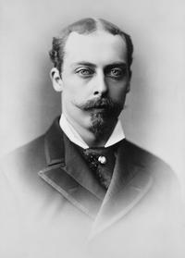
link:
Prince Leopold, Duke of Albany
wikidata_id:
Q160541
image:
Prince Leopold, Duke of Albany.png
sex or gender:
male (Q6581097)
father:
Albert, Prince Consort (Q152245)
mother:
Queen Victoria (Q9439)
date of birth:
1853-04-07
place of birth:
Buckingham Palace (Q42182)
date of death:
1884-03-28
place of death:
Cannes (Q39984)
wiki_en:
Prince Leopold, Duke of Albany
label_en:
Prince Leopold, Duke of Albany
source:
WikiData
Notes:
sex or gender (P21) = male (Q6581097)
place of death (P20) = Cannes (Q39984)
signature (P109) = Prince Leopold's signature.svg
father (P22) = Albert, Prince Consort (Q152245)
mother (P25) = Queen Victoria (Q9439)
date of birth (P569) = 1853-04-07
date of death (P570) = 1884-03-28
place of birth (P19) = Buckingham Palace (Q42182)

Slide 10
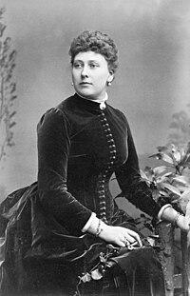
link:
Princess Beatrice of the United Kingdom
wikidata_id:
Q158140
image:
Princess Beatrice 1886.jpg
sex or gender:
female (Q6581072)
father:
Albert, Prince Consort (Q152245)
mother:
Queen Victoria (Q9439)
date of birth:
1857-04-14
place of birth:
Buckingham Palace (Q42182)
date of death:
1944-10-26
place of death:
Brantridge Park (Q2547961)
wiki_en:
Princess Beatrice of the United Kingdom
label_en:
Princess Beatrice of the United Kingdom
source:
WikiData
Notes:
monogram (P1543) = Royal Monogram of Princess Beatrice of Battenberg.svg
sex or gender (P21) = female (Q6581072)
place of death (P20) = Brantridge Park (Q2547961)
signature (P109) = Princess Beatrice's signature.svg
father (P22) = Albert, Prince Consort (Q152245)
mother (P25) = Queen Victoria (Q9439)
date of birth (P569) = 1857-04-14
date of death (P570) = 1944-10-26
place of birth (P19) = Buckingham Palace (Q42182)

