Slide 1
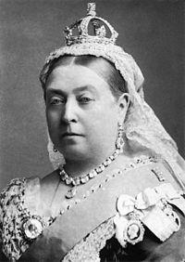
link:
Queen Victoria
wikidata_id:
Q9439
image:
Queen Victoria by Bassano.jpg
sex or gender:
female (Q6581072)
father:
Prince Edward Augustus, Duke of Kent and Strathearn (Q157009)
mother:
Princess Victoria of Saxe-Coburg-Saalfeld (Q58067)
date of birth:
1819-06-24
place of birth:
Kensington Palace (Q207385)
date of death:
1901-02-22
place of death:
Osborne House (Q565155)
wiki_en:
Queen Victoria
label_en:
Queen Victoria
source:
WikiData
Notes:
date of birth (P569) = 1819-06-24
date of death (P570) = 1901-02-22
place of birth (P19) = Kensington Palace (Q207385)
monogram (P1543) = Royal Monogram of Queen Victoria of Great Britain.svg
sex or gender (P21) = female (Q6581072)
signature (P109) = Queen Victoria Signature.svg
place of death (P20) = Osborne House (Q565155)
father (P22) = Prince Edward Augustus, Duke of Kent and Strathearn (Q157009)
mother (P25) = Princess Victoria of Saxe-Coburg-Saalfeld (Q58067)

Slide 2
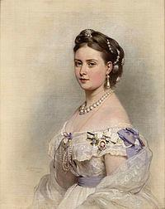
link:
Victoria, Princess Royal
wikidata_id:
Q116728
image:
Victoria, Princess Royal.jpg
sex or gender:
female (Q6581072)
father:
Albert, Prince Consort (Q152245)
mother:
Queen Victoria (Q9439)
date of birth:
1840-12-21
date of death:
1901-09-05
place of death:
Schlosshotel Kronberg (Q510121)
wiki_en:
Victoria, Princess Royal
label_en:
Victoria, Princess Royal
source:
WikiData
Notes:
sex or gender (P21) = female (Q6581072)
place of death (P20) = Schlosshotel Kronberg (Q510121)
father (P22) = Albert, Prince Consort (Q152245)
mother (P25) = Queen Victoria (Q9439)
date of birth (P569) = 1840-12-21
date of death (P570) = 1901-09-05
place of birth (P19) = [http://www.wikidata.org/entity/Q42182 (item), http://www.wikidata.org/entity/Q84 (item)]

Slide 3
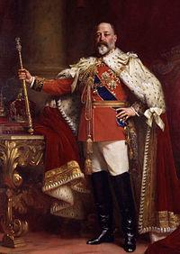
link:
Edward VII
wikidata_id:
Q20875
image:
Edward VII in coronation robes.jpg
sex or gender:
male (Q6581097)
father:
Albert, Prince Consort (Q152245)
mother:
Queen Victoria (Q9439)
date of birth:
1841-12-09
place of birth:
Buckingham Palace (Q42182)
date of death:
1910-06-06
place of death:
Buckingham Palace (Q42182)
wiki_en:
Edward VII
label_en:
Edward VII
source:
WikiData
Notes:
monogram (P1543) = Royal Monogram of King Edward VII of Great Britain.svg
sex or gender (P21) = male (Q6581097)
signature (P109) = EdwardVII Signature.svg
place of death (P20) = Buckingham Palace (Q42182)
father (P22) = Albert, Prince Consort (Q152245)
mother (P25) = Queen Victoria (Q9439)
date of birth (P569) = 1841-12-09
date of death (P570) = 1910-06-06
place of birth (P19) = Buckingham Palace (Q42182)

Slide 4
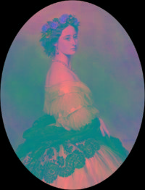
link:
Princess Alice of the United Kingdom
wikidata_id:
Q155566
image:
Princess Alice 1861.png
sex or gender:
female (Q6581072)
father:
Albert, Prince Consort (Q152245)
mother:
Queen Victoria (Q9439)
date of birth:
1843-05-25
place of birth:
London (Q84)
date of death:
1879-01-14
place of death:
Darmstadt (Q2973)
wiki_en:
Princess Alice of the United Kingdom
label_en:
Princess Alice of the United Kingdom
source:
WikiData
Notes:
sex or gender (P21) = female (Q6581072)
place of death (P20) = Darmstadt (Q2973)
father (P22) = Albert, Prince Consort (Q152245)
mother (P25) = Queen Victoria (Q9439)
date of birth (P569) = 1843-05-25
date of death (P570) = 1879-01-14
place of birth (P19) = London (Q84)

Slide 5
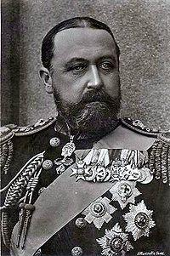
link:
Alfred, Duke of Saxe-Coburg and Gotha
wikidata_id:
Q158143
image:
Alfred-sachsen-coburg-gotha.jpg
sex or gender:
male (Q6581097)
father:
Albert, Prince Consort (Q152245)
mother:
Queen Victoria (Q9439)
place of birth:
Windsor Castle (Q42646)
date of death:
1900-08-30
place of death:
Schloss Rosenau (Q449510)
wiki_en:
Alfred, Duke of Saxe-Coburg and Gotha
label_en:
Alfred, Duke of Saxe-Coburg and Gotha
source:
WikiData
Notes:
sex or gender (P21) = male (Q6581097)
place of death (P20) = Schloss Rosenau (Q449510)
father (P22) = Albert, Prince Consort (Q152245)
mother (P25) = Queen Victoria (Q9439)
date of birth (P569) = [1844-08-06 (Prec.: day [-0 .. +0], PCal: Gregorian), 1844-08-08 (Prec.: day [-0 .. +0], PCal: Gregorian)]
date of death (P570) = 1900-08-30
place of birth (P19) = Windsor Castle (Q42646)

Slide 6
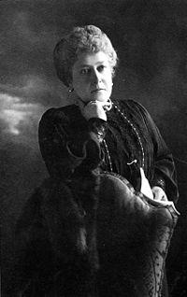
link:
Princess Helena of the United Kingdom
wikidata_id:
Q160539
image:
Helena scan.jpg
sex or gender:
female (Q6581072)
father:
Albert, Prince Consort (Q152245)
mother:
Queen Victoria (Q9439)
place of birth:
Buckingham Palace (Q42182)
date of death:
1923-07-09
place of death:
London (Q84)
wiki_en:
Princess Helena of the United Kingdom
label_en:
Princess Helena of the United Kingdom
source:
WikiData
Notes:
date of birth (P569) = [1846-05-25 (Prec.: day [-0 .. +0], PCal: Gregorian), 1846-05-26 (Prec.: day [-0 .. +0], PCal: Gregorian)]
sex or gender (P21) = female (Q6581072)
place of death (P20) = London (Q84)
father (P22) = Albert, Prince Consort (Q152245)
mother (P25) = Queen Victoria (Q9439)
date of death (P570) = 1923-07-09
place of birth (P19) = Buckingham Palace (Q42182)

Slide 7
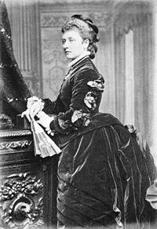
link:
Princess Louise, Duchess of Argyll
wikidata_id:
Q161167
image:
Princess Louise 1901 copy.jpg
sex or gender:
female (Q6581072)
father:
Albert, Prince Consort (Q152245)
mother:
Queen Victoria (Q9439)
date of birth:
1848-04-18
place of birth:
Buckingham Palace (Q42182)
date of death:
1940-01-03
place of death:
London (Q84)
wiki_en:
Princess Louise, Duchess of Argyll
label_en:
Princess Louise, Duchess of Argyll
source:
WikiData
Notes:
monogram (P1543) = Royal Monogram of Princess Louise of Great Britain.svg
sex or gender (P21) = female (Q6581072)
place of death (P20) = London (Q84)
father (P22) = Albert, Prince Consort (Q152245)
mother (P25) = Queen Victoria (Q9439)
date of birth (P569) = 1848-04-18
date of death (P570) = 1940-01-03
place of birth (P19) = Buckingham Palace (Q42182)

Slide 8
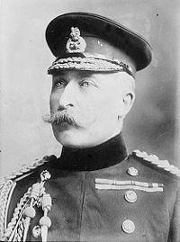
link:
Prince Arthur, Duke of Connaught and Strathearn
wikidata_id:
Q160558
image:
Duke of Connaught and Strathearn.jpg
sex or gender:
male (Q6581097)
father:
Albert, Prince Consort (Q152245)
mother:
Queen Victoria (Q9439)
date of birth:
1850-06-01
place of birth:
Buckingham Palace (Q42182)
date of death:
1942-02-16
place of death:
Bagshot Park (Q582085)
wiki_en:
Prince Arthur, Duke of Connaught and Strathearn
label_en:
Prince Arthur, Duke of Connaught and Strathearn
source:
WikiData
Notes:
sex or gender (P21) = male (Q6581097)
place of death (P20) = Bagshot Park (Q582085)
father (P22) = Albert, Prince Consort (Q152245)
mother (P25) = Queen Victoria (Q9439)
date of birth (P569) = 1850-06-01
date of death (P570) = 1942-02-16
place of birth (P19) = Buckingham Palace (Q42182)

Slide 9
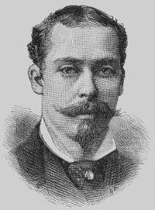
link:
Prince Leopold, Duke of Albany
wikidata_id:
Q160541
image:
Prince Leopold, Duke of Albany - Project Gutenberg eText 13103.jpg
sex or gender:
male (Q6581097)
father:
Albert, Prince Consort (Q152245)
mother:
Queen Victoria (Q9439)
date of birth:
1853-05-07
place of birth:
Buckingham Palace (Q42182)
date of death:
1884-04-28
place of death:
Cannes (Q39984)
wiki_en:
Prince Leopold, Duke of Albany
label_en:
Prince Leopold, Duke of Albany
source:
WikiData
Notes:
date of birth (P569) = 1853-05-07
sex or gender (P21) = male (Q6581097)
place of death (P20) = Cannes (Q39984)
father (P22) = Albert, Prince Consort (Q152245)
mother (P25) = Queen Victoria (Q9439)
date of death (P570) = 1884-04-28
place of birth (P19) = Buckingham Palace (Q42182)

Slide 10
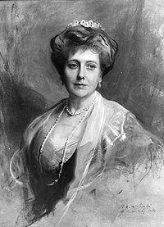
link:
Princess Beatrice of the United Kingdom
wikidata_id:
Q158140
image:
Laszlo - Princess Henry of Battenberg.jpg
sex or gender:
female (Q6581072)
father:
Albert, Prince Consort (Q152245)
mother:
Queen Victoria (Q9439)
date of birth:
1857-05-14
place of birth:
Buckingham Palace (Q42182)
date of death:
1944-11-26
place of death:
Brantridge Park (Q2547961)
wiki_en:
Princess Beatrice of the United Kingdom
label_en:
Princess Beatrice of the United Kingdom
source:
WikiData
Notes:
date of birth (P569) = 1857-05-14
monogram (P1543) = Royal Monogram of Princess Beatrice of Battenberg.svg
sex or gender (P21) = female (Q6581072)
place of death (P20) = Brantridge Park (Q2547961)
father (P22) = Albert, Prince Consort (Q152245)
mother (P25) = Queen Victoria (Q9439)
date of death (P570) = 1944-11-26
place of birth (P19) = Buckingham Palace (Q42182)

