Slide 1
ClearSight
Deciding how much to discount end-of-season stock — and when.
An AI-assisted markdown copilot for multi-store seasonal retailers
MBA ZG583 · Management of AI Products
Notes:
Intro: 20 seconds. Name the workflow problem, not the technology. Say "this is a product for seasonal retailers generally — my employer is the seed customer, not the scope."

Slide 2
THE PROBLEM
One national discount. Three hundred different stores.
At end of season, planners decide markdown depth and timing in spreadsheets, at national level. Analysing thousands of items across hundreds of stores by hand is not feasible — so one schedule is applied to all of them.
1
Cut too early
2
Cut too late
Margin given away on stock that would have sold closer to full price.
Stock clears at or below cost, having eaten store and warehouse space.
Markdown is one of the largest controllable margin levers in seasonal retail — and this decision repeats for every seasonal item, every season.
Notes:
Stakes first. Do not mention AI yet. The repeated-decision point is what makes this a product opportunity rather than a one-off analysis.

Slide 3
THE USER
Priya has been burned in both directions
What she needs
Seasonal Merchandise Planner
A defensible reason for each decision, and the ability to say no to the tool.
3–4 categories
~2,000 seasonal items a year
300+ stores
Runs exit planning in Excel
Answers to a trading manager for every markdown taken
What loses her
One confidently wrong recommendation she followed and had to explain upward.
Why that matters
Error cost is asymmetric. Over-discounting a winner loses margin now; holding a loser clogs stores. The design has to respect both.
Notes:
The scoring sheet asks whether the user feels credible rather than generic. Lead with what would make her abandon the tool — that framing drives every design choice later.

Slide 4
THE AI CASE
Why not just a better rule?
Flat markdown schedule
Assumes stores behave alike. Weather, demographics and local competition say otherwise.
Sell-through rules
Rules need history. Private-label seasonal ranges are substantially new each year.
Dashboards / BI
Show what happened. Cannot estimate what happens under a 20% cut now vs 35% in three weeks.
More analysts
The volume is the problem. People do not scale, and do not make the decision consistent.
The AI task: predict residual sell-through per store cluster at candidate price points — generalising from product attributes where direct history does not exist.
Notes:
This is the slide the rubric asks for by name. The generalisation-from-attributes point is the answer to "why not a rule" — rules cannot handle items with no history.

Slide 5
THE PRODUCT
It recommends. A person decides.
Rank items
by risk
→
Forecast
by cluster
→
Recommend
depth + timing
→
Show
confidence
→
Planner
approves or
overrides
No automatic repricing. Below a confidence threshold, ClearSight shows no recommendation at all — and says why.
MVP — deliberately narrow
Product, not project
One category, one exit window, one market
Ranked worklist, projected sell-through, confidence band
Approve / adjust / reject with a reason code
Core: forecasting, ranking, confidence routing, override capture
Customisation: category taxonomy, store clusters, integration
Fixed cost spreads across customers, not carried by the first
Notes:
Say "it recommends, a person decides" out loud — it is the governance claim and the trust model in one sentence. The product-not-project split is the point the instructor made in session 13.

Slide 6
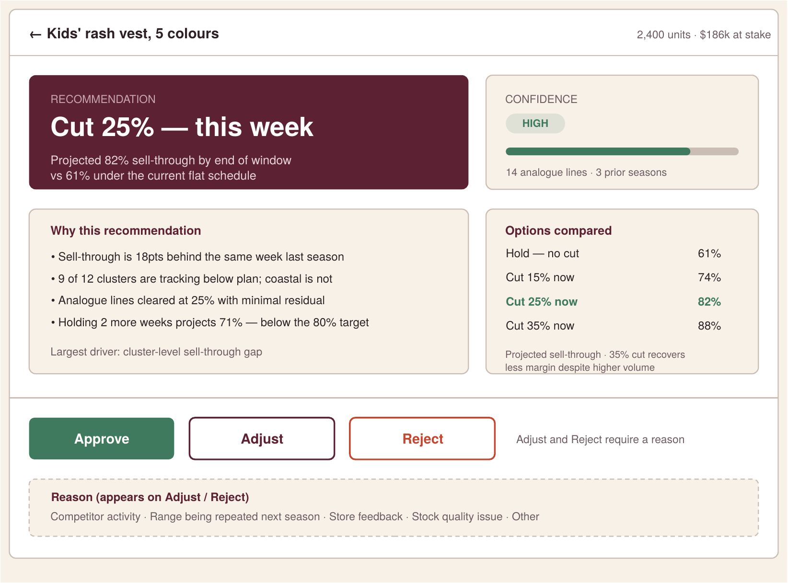
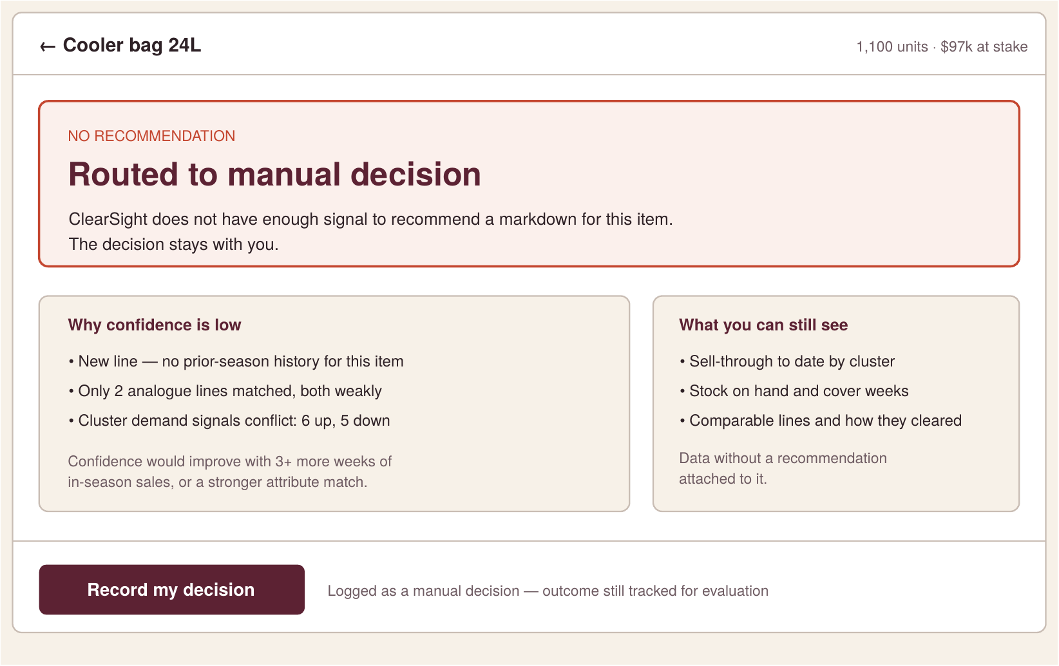
WHAT THE PLANNER SEES
Confident — and not confident
The same screen when the model lacks signal
No recommendation at all — and it says why. The decision stays with her, with the evidence still shown.
A recommendation, its confidence, and the alternatives
The planner can approve, adjust, or reject — each one click
This second screen is the product.
Notes:
Show, do not narrate. Left: a normal recommendation. Right: the same product refusing to guess. Say "that second screen is the product" and stop — it lands harder than explaining it. Five more screens are in the repo: worklist, override capture, outcome tracking, backtest evidence, cluster configuration.

Slide 7
DATA & EVALUATION
Beat the current rule — or stop
The AI task
The baseline
Forecasting + recommendation: residual sell-through per store cluster at candidate price points, generalised from product attributes and analogue lines.
The retailer’s own flat markdown schedule, plus last-season analogue matching. If the model cannot beat both on held-out seasons, it does not ship.
Technical
Forecast error by cluster · calibration of the confidence signal
Business
Margin recovered vs baseline · terminal stock share
Trust
Override rate and reasons · high-confidence recommendations that went wrong
Capstone data: synthetic or public multi-store retail data only. No confidential employer data — workflow knowledge is context, not input.
Notes:
Name the baseline before anyone asks for it. The synthetic-data line is the confidentiality answer — volunteer it rather than waiting for the question.

Slide 8
ECONOMICS
Priced on margin recovered — not per recommendation
Annual platform fee
Not per recommendation
Per banner, plus a per-category fee — sized as a clear fraction of conservatively estimated margin recovered.
Usage billing creates cost anxiety — and would suppress exactly the careful review behaviour the product depends on.
Cost shape
Variable
Inference and data pipeline — scales with catalogue size
Fixed per customer
Store clustering setup, integration, planner onboarding
Notes:
Monetisation was most of session 13. The refusal of per-use pricing is a judgment call, not a default — say that explicitly.

Slide 9
RISK & GOVERNANCE
What could go wrong — and what stops it
Confidently wrong at scale
A high-confidence recommendation the planner trusted and should not have. The failure mode that ends the product.
Confidence thresholds · mandatory manual routing below them · no automatic price execution
Rubber-stamping
If every recommendation is accepted, the human-in-the-loop control is nominal.
Acceptance rate monitored as a health signal with a ceiling — not maximised · reason capture on every override
Feedback loops
After season one, the model observes outcomes of prices it influenced. Naive retraining bakes in its own errors.
Holdout categories retained · drift monitoring from pilot onwards
Launch blocker: if expected loss from high-confidence wrong recommendations exceeds expected gain from the rest, it stays in pilot.
Notes:
The rubric scores risk maturity separately. Naming a launch blocker — a condition under which you refuse your own product — is what "launch discipline" looks like.

Slide 10
RECOMMENDATION
Prototype — then a hard gate before anything else
Phase 1
Phase 2
Phase 3
Backtest against historical seasons. No interface.
Planner MVP in shadow mode. Decisions not applied.
Live pilot, one category, matched control group.
GATE · Beat the flat rule — or stop here.
GATE · Planners engage and give real override reasons.
GATE · Margin outcome vs control. No high-value failures.
A backtest that cannot beat a flat schedule ends the project. That is a finding, not a failure.
Where I would value feedback
Is the store-cluster wedge narrow enough for one capstone? · Does outcome-anchored pricing hold up without live retailer data?
Notes:
Close decisively — the scoring sheet asks for it. Then hand back with two specific questions; the instructor said his worry is teams going the wrong direction with no chance to course-correct. Asking is what buys the correction.

