Slide 1

GSMA MENA IGNITE OPEN GATEWAY HACKATHON · PHASE 1
Smart Profits
AI-Driven Financial Analytics & Telco-Secured Merchant Platform
The merchant’s CFO in the chat. Bank-grade SIM-swap defence on the login. CAMARA APIs via Nokia Network-as-Code. Decisions by an AI Agent — not by SMS.
SIM Swap
Number Verification
Location Verification
AI Agent
Theme 4
Bitsandbytesdude Software Agency · Gaza / MENA · August 2026
Smart Profits · GSMA MENA Ignite · Theme 4
01 / 10

Slide 2
1. PROBLEM STATEMENT AND CONTEXT
The P&L lives in Excel. So does the fraud.
Financial blindness
Profit leakage
Account takeover
Independent MENA merchants run shops from messy Arabic and English Excel, CSV, PDF and photos. Rent, salaries and utilities are missing. Phantom profit looks healthy. Dead stock and wrong prices drain cash. There is no CFO.
Weak SKUs, unexamined margins and unplanned OpEx hide the real net profit. A ‘good month’ in the sales sheet can still be a cash-negative month for the store.
A SIM swap beats SMS OTP. The attacker then opens the advisor, downloads P&L reports, changes prices, or steals the sales files that are the business. A login from another country uploading ‘the monthly file’ can be a hijacked account.
Banks already buy network APIs. The SaaS that holds the merchant’s books usually does not. That is the Theme 4 gap: financial files without telco-grade identity, on the same login that SMS OTP cannot protect.
Smart Profits · GSMA MENA Ignite · Theme 4
02 / 10

Slide 3
2. SOLUTION AND NOKIA CAMARA APIS
One platform. Two brains. Three network APIs.
Financial AI
Smart Guard AI Agent
Cleans messy Excel/CSV/PDF. Diagnoses store health, profit leaks, inventory and a 30-day plan. Answers questions from the currently open file — in Arabic or English.
On login, reset, upload, export and price change, the agent calls Nokia Network-as-Code and decides Allow / Step-up / Freeze. SMS is never the source of truth.
Nokia / CAMARA API | When it is called | What the agent does
Number Verification | Login and step-up identity (silent 4G/5G, no SMS) | Confirm the live network number. Do not trust a spoofed SMS.
SIM Swap | Login, password reset, price change, sensitive actions | Recent swap → freeze the session. SMS OTP is untrusted.
Location Verification | Excel/CSV/PDF upload and P&L export | Must match the usual store / branch area, or the file never lands.
Testing and prototype validation will utilize Nokia Network-as-Code developer portal simulators for SIM Swap, Location Verification, and Number Verification — then map one-to-one onto production CAMARA endpoints.
Smart Profits · GSMA MENA Ignite · Theme 4
03 / 10

Slide 4
3. AI AGENT DESIGN
Smart Guard decides. It does not caption.
The agent is the orchestration brain required by the hackathon: it calls CAMARA tools, combines them with financial context, and executes policy.
1
2
3
4
Sense
Query
Decide
Act
Merchant action: login, reset, file upload, P&L export, price change.
Call Number Verification, SIM Swap and Location Verification via Nokia NaC.
Fuse network risk with file sensitivity. Output: Allow · Step-up · Freeze.
If freeze: do not store the workbook. Explain in Arabic or English. Wait for network identity.
Freeze loop (example)
action: upload monthly_sales.xlsx → agent.check(SIM Swap, Number Verification, Location Verification) → SIM Swap = recent OR location ≠ store geofence → decision = FREEZE → file is not stored · merchant is notified · recover with Number Verification on the trusted line
Smart Profits · GSMA MENA Ignite · Theme 4
04 / 10

Slide 5
4. TECHNICAL ARCHITECTURE
Next.js + PostgreSQL + Nokia NaC + AI Agent
Merchant app · Next.js / TypeScript · Arabic RTL + English · Dashboard, advisor, upload, export
Smart Guard AI Agent Orchestrates CAMARA tools + financial context Allow / Step-up / Freeze
Financial engine Parse Excel/CSV/PDF · P&L · leaks · Q&A on open file
PostgreSQL Users, files, P&L, risk event log
Nokia Network-as-Code Single developer path to operator CAMARA APIs
CAMARA SIM Swap · Number Verif. Location Verification
The agent is the only path to login step-up, financial file upload and report export. Prototype testing runs on Nokia Network-as-Code developer portal simulators.
Smart Profits · GSMA MENA Ignite · Theme 4
05 / 10

Slide 6
5. BUSINESS MODEL & MONETIZATION
Try the books. Then pay for the guard.
FULL PRODUCT
THE MERCHANT PLAN
MULTI-BRANCH
7-day free trial
Pro · $49 / month
Business · $99 / month
Upload, diagnosis, bilingual advisor and Smart Guard demo. No card required to start. Converts into Pro unless cancelled.
Ongoing P&L, profit leaks, inventory advice, open-file Q&A, and telco-secured login / upload / export for a single store.
Several locations, tighter Location Verification geofences, team seats, and priority freeze review.
Why this monetizes Open Gateway
SaaS subscription is the merchant revenue. CAMARA calls are the security cost of goods — and a future B2B2X path with operators (usage-based Number Verification / SIM Swap / Location on every sensitive action). Smart Profits is incubated as a product line of Bitsandbytesdude, not a one-hack demo.
Smart Profits · GSMA MENA Ignite · Theme 4
06 / 10

Slide 7
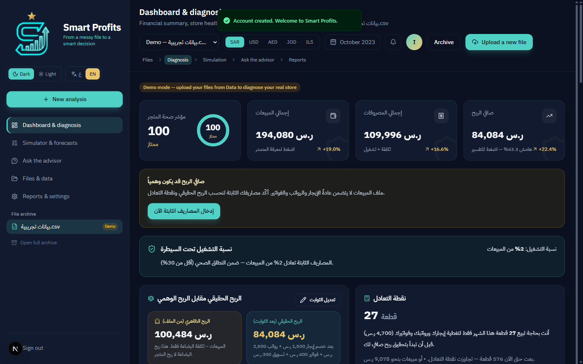
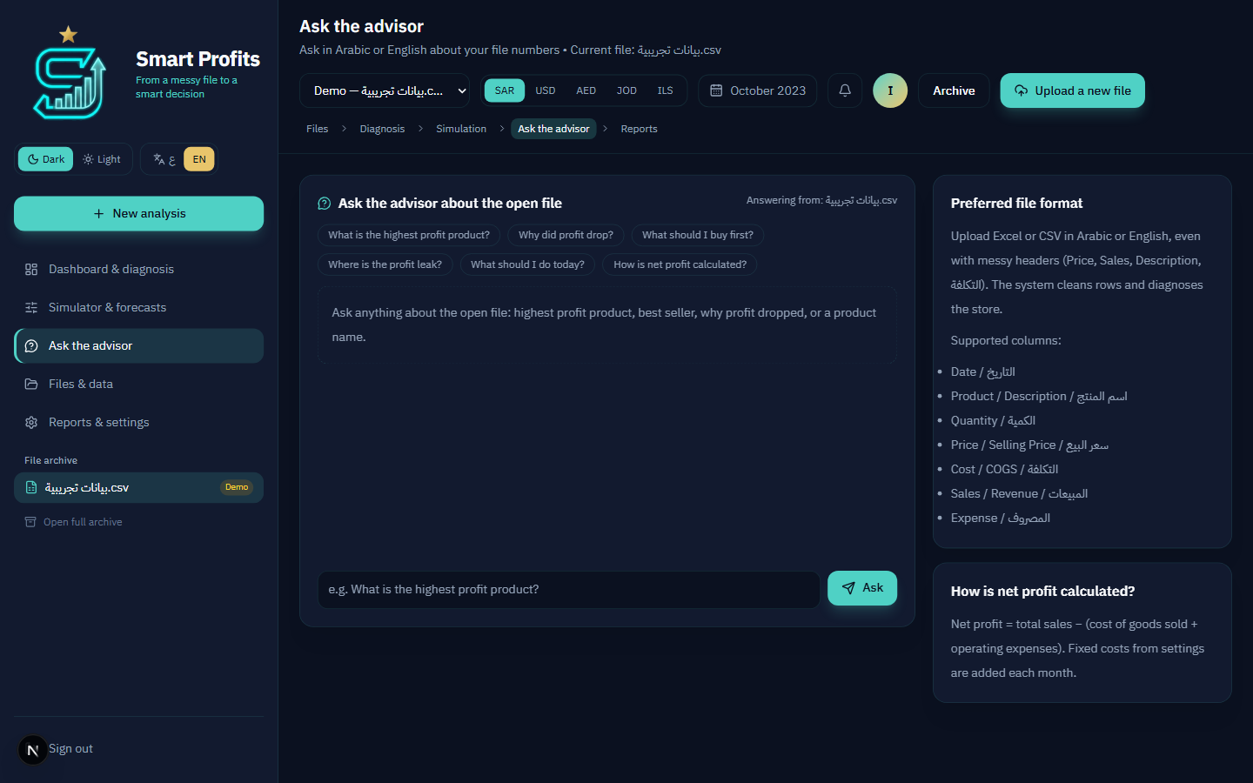
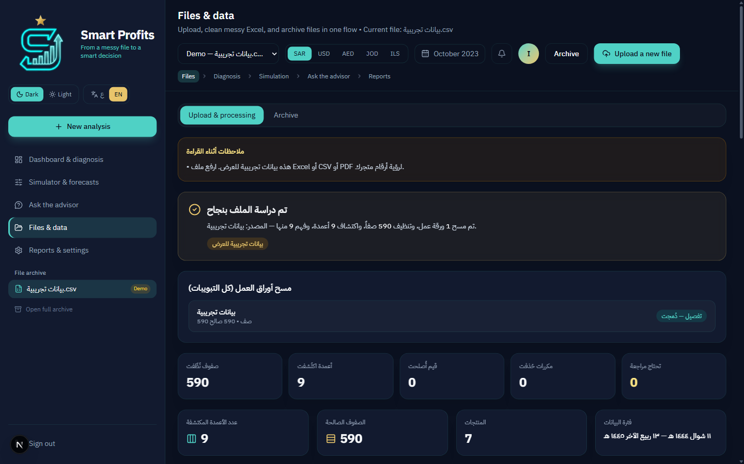
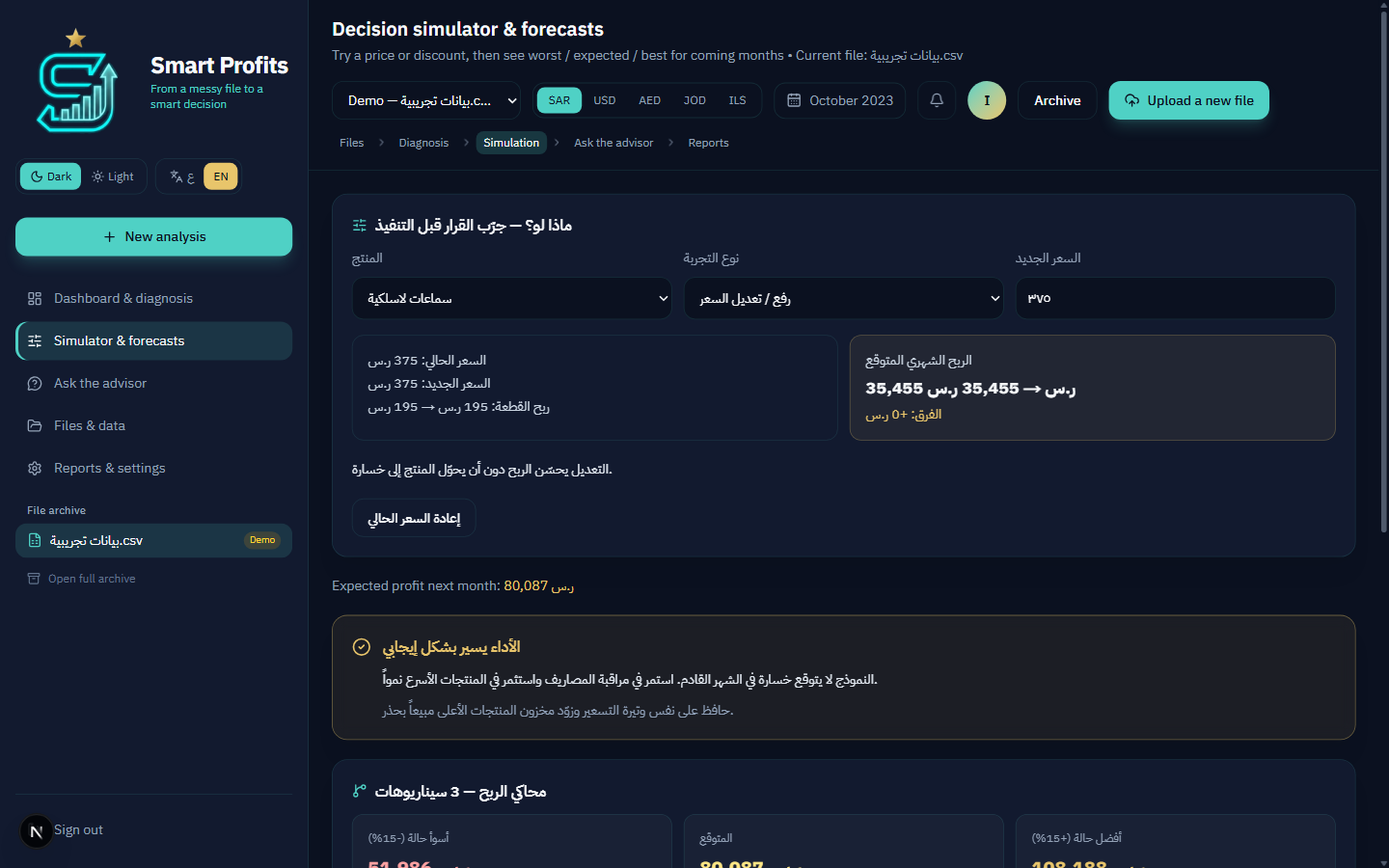
6. DEMO SCREENSHOTS
A working merchant product — not a slide-only idea
Dashboard — health, P&L, phantom vs real profit
Advisor — file-grounded Q&A
Files — messy Excel cleaned automatically
Simulator — what-if pricing and forecast
Smart Profits · GSMA MENA Ignite · Theme 4
07 / 10

Slide 8
6. DEMO WALKTHROUGH & LINKS
What judges will see in three minutes
1 Analyse
Upload a messy furniture ledger. Ask the advisor for the highest-profit SKU. See phantom vs real net profit.
2 Attack
Nokia NaC simulator: SIM Swap = true. Upload and export freeze. The agent explains why SMS OTP is untrusted.
3 Place
Location mismatch vs store geofence. The financial file never lands. Number Verification recovers the trusted line.
Product repository: https://github.com/BITSANDBYTESDUDE/Smart-Profits Studio / company: https://bitsandbytesdude.vercel.app/ Network layer: Nokia Network-as-Code developer portal simulators (SIM Swap, Number Verification, Location Verification)
Smart Profits · GSMA MENA Ignite · Theme 4
08 / 10

Slide 9
7. TEAM BIOS AND ROLES
A Gaza product, inside a shipping software studio
FOUNDER / PRODUCT LEAD
PRINCIPAL / TECHNICAL CO-FOUNDER
Israa Nael Hamad
Mir Kashif
Software Engineering · final year
Bitsandbytesdude Software Agency
University of Palestine, Gaza. Owns product vision, merchant UX, bilingual (AR/EN) FinTech experience, and the Theme 4 narrative: phantom Excel profit vs SIM-swap takeover of the same files. Smart Profits is her product, brought into the studio as a core line.
Leads engineering through the studio: full-stack platforms, AI & agent workflows, and cloud delivery. Smart Profits is being added to the Bitsandbytesdude product portfolio — Next.js architecture, agent orchestration, and Nokia NaC integration under one shipping team.
Studio: Bitsandbytesdude — high-performance software, AI automation and product systems. https://bitsandbytesdude.vercel.app/ · bitsandbytesdude@gmail.com · Remote-first, MENA-rooted
Smart Profits · GSMA MENA Ignite · Theme 4
09 / 10

Slide 10
THE ASK
Advance Smart Profits under Theme 4.
A real merchant SaaS. A real AI Agent. Real CAMARA APIs through Nokia Network-as-Code. Next: NaC simulator freeze demo · path to MWC Doha 2026.
CAMARA via Nokia NaC — used
AI Agent orchestration — used
MENA inclusion — AR + EN
Israa Nael Hamad · Mir Kashif · Bitsandbytesdude · University of Palestine, Gaza
Smart Profits · GSMA MENA Ignite · Theme 4
10 / 10

