Slide 1



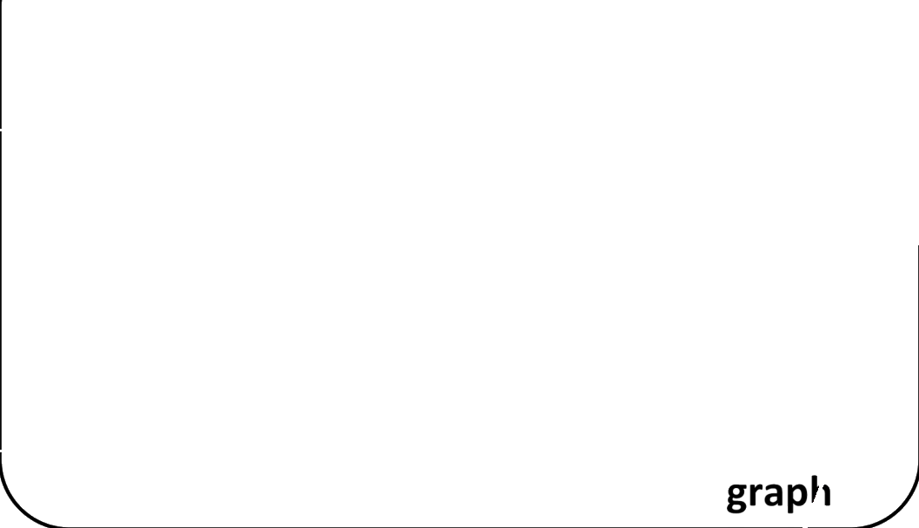
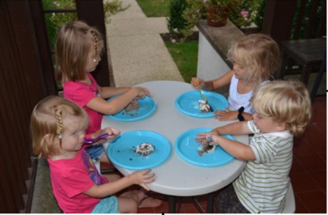



























Visual Description Module
/Attribute Fusion Module
Image
Object
blond young
green white
Vinvl
little child
六Striped shirt
Loss-vqa
Attribute
Semantic
@blond young
shirt
Attention
BLIP2
Caption
graph
small little bo
1
blond small
1
blond hair
Answer
1
Image
young little girl a
four
|| mPLUG-Owl
1
Prediction
1
Description
1
Attention
Of Oop
Multimodal
Visual’
Vi
Encoder
Caption/Image Description
Question
how many small children
Implicit
VLP
that are enjoying a small
knowledge
snack?
ontrastive Knowledge Distillation Module
Loss-cl
Notes:
从原图及同名GT布局标注批量重建。文字由Tesseract识别为原生可编辑文本框；图形和箭头为原生对象。复杂插图及低置信文字为可独立替换图片。OCR可能存在错字、公式和上下标错误，请对照原图校对；未使用整页截图作为背景。

