Slide 1


SharePoint Migration Options
#CollabDaysBE
Robi Vončina | @R0b3r70SP
Robi.voncina@kompas-xnet.si
CollabDays Belgium 2022 by BIWUG

Slide 3

Who? Me?
Robi Vončina (robi.voncina@kompas-xnet.si)
SharePoint MVP from 2013
Kompas Xnet
Kids, pool, swimming,…

Slide 4
Agenda
Intro
PowerShell
SPMT
ShareGate
Metalogix
How about tenant to tenant
Mover.io
Quest on demand

Slide 5
Intro
Challenges
Why use tools
How did I select tools to compare
Comparison based on:
Price
Complexity
Different configuration options

Slide 6
PowerShell
Main challenge to write code on your own
Suitable to move file shares
Challenge to migrate files from SharePoint
Permissions
Versions
Modules
SharePoint Online PowerShell module
AzureAD
PnP.PowerShell

Slide 7
Demo - PowerShell

Slide 8
SMAT & SPMT

Slide 9
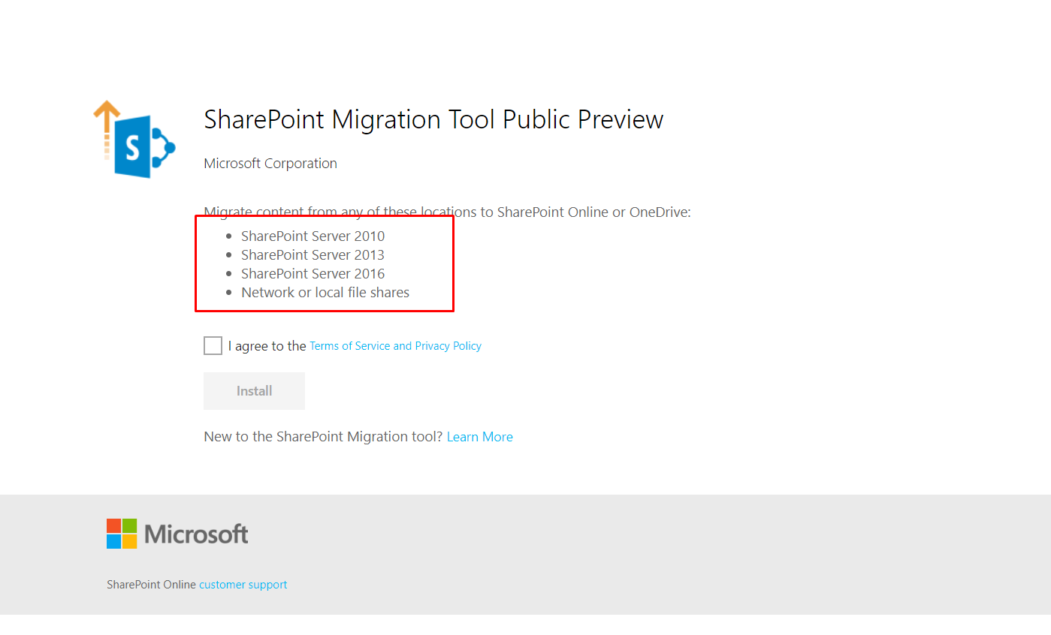
SPMT
Free tool provided from MS
Source:
SP on premise 2010, 2013, 2016
No 2019 support (currently)
File shares
Destination
SharePoint Online (Teams)
OneDrive
As of today

Slide 10
Permissions required
Destination
Global admin or SharePoint Admin
Source
Read access to SharePoint content
Preferred full control to not accidentally skip content

Slide 11
SPMT
Release notes
https://learn.microsoft.com/sl-si/sharepointmigration/new-and-improved-features-in-the-sharepoint-migration-tool
For planning
Assessment tool
https://www.microsoft.com/en-us/download/details.aspx?id=53598&751be11f-ede8-5a0c-058c-2ee190a24fa6=True
User mapping

Slide 12
SPMT
Supports migrating workflows to PowerAutomate
Only OOTB (Approval, Collect feedback)
Migration
UI
PowerShell
Requires to pre-create destination sites

Slide 13
Demo – SPMT, SMAT
Assessment Tool
Migration tool
PowerShell

Slide 14
ShareGate

Slide 15
ShareGate
Main advantage
Easy to use
Great UI
Easy PowerShell
Reorganize content in O365
Pricing
Free tool* but you pay support
Yearly subscription
No data limit
Per user license

Slide 16
ShareGate
Needs user mapping file
Wrote a script to be more exact with mapping
Includes
Reports
Planning tool

Slide 17
ShareGate
Destination sites must be precreated
Allows tenant 2 tenant migration
In my experience
Support too slow
It can take a day or two to respond

Slide 18
Demo - ShareGate
Planning, reports
Copy site
PowerShell

Slide 19
Metalogix

Slide 20


Metalogix
Pricing
Per GB migrated
~35€/GB
Main advantage
Great support for older SP versions
Many different options
Can cover complex scenarios
PowerShell
Better support than ShareGate

Slide 21
Metalogix
Easily create incremental jobs
Mapping file for identities
Script to map on-prem identities with online ones
PowerShell is much more complex than Metalogix

Slide 22
Demo - Metalogix
Create job
Create incremental job
PowerShell

Slide 23
Mover.IO

Slide 24
Mover.io
Part of the O365 licensing
Not primarily meant for migrating SharePoint sites
Useful in “tenant 2 tenant” migrations to move files
Not able to migrate lists (at least by my knowledge)
A bit clumsy to get used to

Slide 25
Demo – mover.io
Copy document library from one site to another

Slide 26
Quest - OnDemand
SaaS tool
Migration
Reporting
License management
https://www.quest.com/on-demand/

Slide 27


https://collabdays.be
Please rate this session and have a chance to win an awesome prize
#CollabDaysBE

Slide 28

#CollabDaysBE

