Slide 1
Continuous Integration: Tools
Self-hosted
Sass
Cloud Service
Code repo

Slide 2
. Introduction

Slide 3
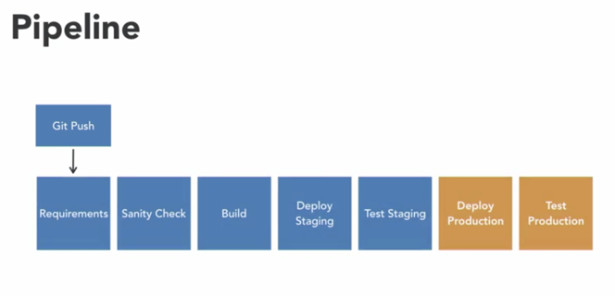
Building your CI/CD pipeline
Continuous integration, continuous delivery, and continuous deployment are fundamental concepts in modern software development. More commonly known as CI/CD, technologists of all kinds use these automated approaches to produce applications efficiently and reliably.
The process is often described as a pipeline, representing the flow of code and artifacts as they move through the different steps required to build, test, and deploy a complete application.
Because this process is so important, there are dozens and dozens of CI/CD tools available, and often finding the right tool for you and your team can be difficult.
Hi, I'm Shouton Eulle, a computer engineer with experience in building CI/CD pipelines and supporting the tools behind them.
In this course we'll be discussing several popular continuous integration tools from a variety of categories.
By the end of this course you'll know how to categorize CI/CD tools and the pros and cons of each category. You'll also see how an experimental pipeline gets implemented in several different CI/CD applications. We've got a lot of ground to cover, so let's get started.

Slide 4
What you should know
To get the most out of this course, there are a few things you'll want to be familiar with before diving in.
It'll be helpful if you're familiar with application development and the software development process. If you already have some experience building, testing, and deploying applications, you'll be fine.
Many CI/CD tools are configured with scripts and other codes. So if you're good with scripting, you'll be ready to configure tools and automate build steps.
It will also be helpful if you're familiar with source code management tools like Git, Mercurial, or Subversion.
Most tools start their processes when changes are applied to a code base, so you'll want to know how to commit changes and push them to a code repository. This could will be more of an overview than a tutorial.
Instead of an in-depth analysis of each tool, we'll be noting some of their key features and then demonstrating how to make use of them.
Exercise files are available if you'd like to take a closer look at some of the configuration files or the applications that are mentioned during our discussion.
Before we get to the tools, let's discuss the meaning of continuous integration, continuous delivery, and continuous deployment.
With continuous integration, developers work on their code in a local environment and commit their changes to a shared repository on a regular basis. Their code can then be combined or, in other words, integrated with code from other members of the team or any existing code. The new code is tested along with existing code and checked for errors. Using this method, developers can find and resolve problems more quickly compared to waiting until all the code for an application is complete and integrating everything at once.
Continuous delivery is a partner to the continuous integration process. Continuous delivery enables developers to build, test, and release their software with every new change. By including tests in the delivery process, engineers can be confident that the final product meets requirements and doesn't have any unintended features, also known as bugs. Once the application is delivered, it can be deployed as needed. When a deployment completes without human interaction, it's referred to as continuous deployment. In this case, the application is automatically built, tested, and deployed into a production environment.

Slide 5
Landscape of CI/CD tools and CI/CD tool categories
With plenty of CI CD tools to choose from, we won't be able to explore all of them. But we can start narrowing our focus a bit by sorting tools into four categories.
Self-hosted tools run on your hardware. This could mean the tool runs on a server in your company's data center, a VM in the cloud, or it could be on your local workstation.
Whatever the platform you are responsible for installing the tool and maintaining it. Tools that fit into the software as a service or SaaS category, offer an alternative to self-hosting.
In this case, a vendor provides and maintains the tool and allows you to access it. The next category is an extension of the software as a service category, cloud service providers offer SaaS-based CI CD tools, but they also offer other cloud-based services like virtual machines, container registries, and cloud storage. If you think of a code repository, your first thought is probably of a place where you can store your code. But along with giving you a place to track and manage your code, many modern repositories also provide CI CD tools for turning that code into software.
Now let’s take a look at some of the pros and cons of tools in each of these categories.

Slide 6
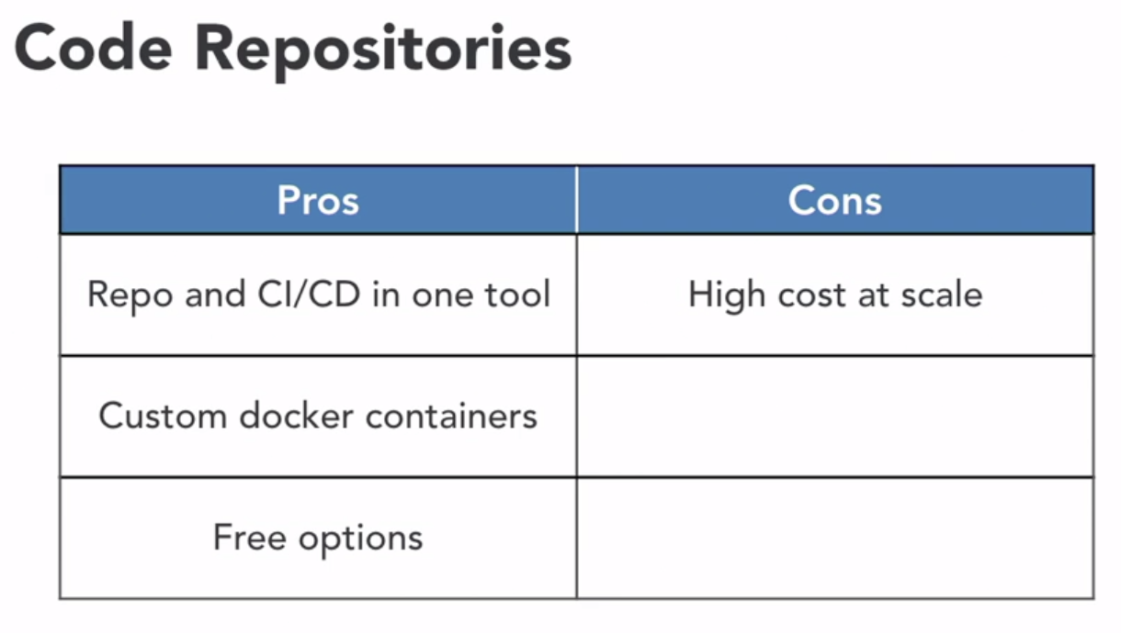
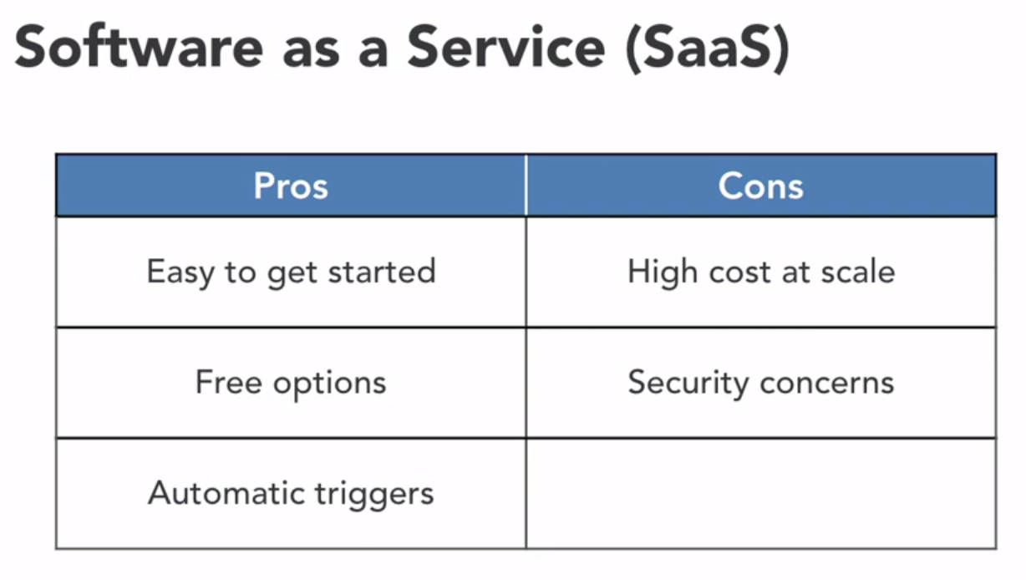
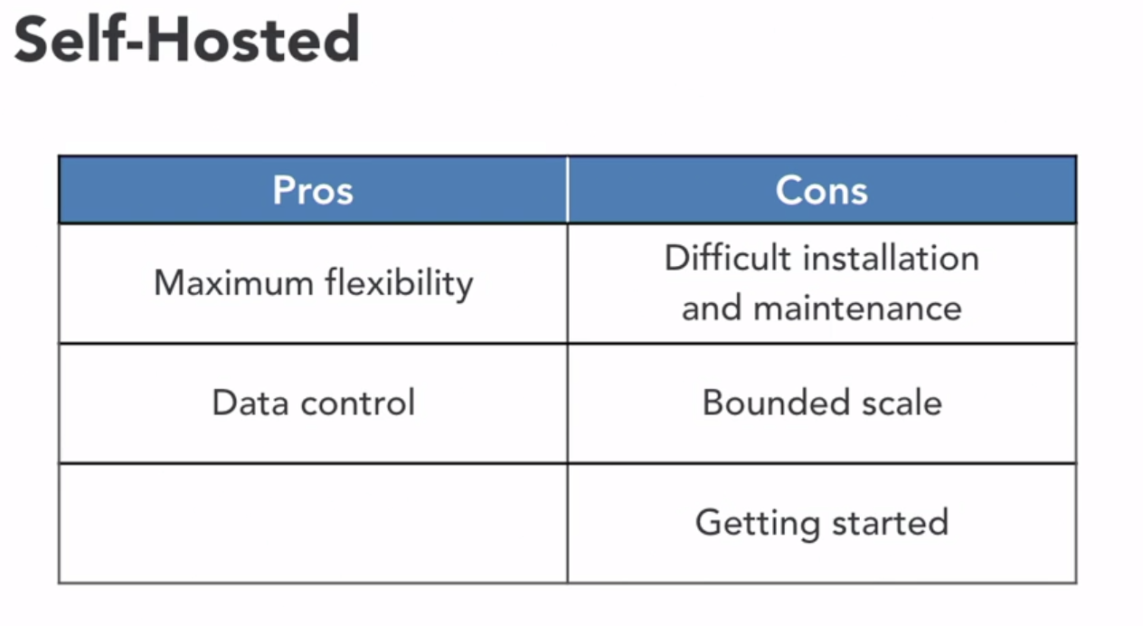
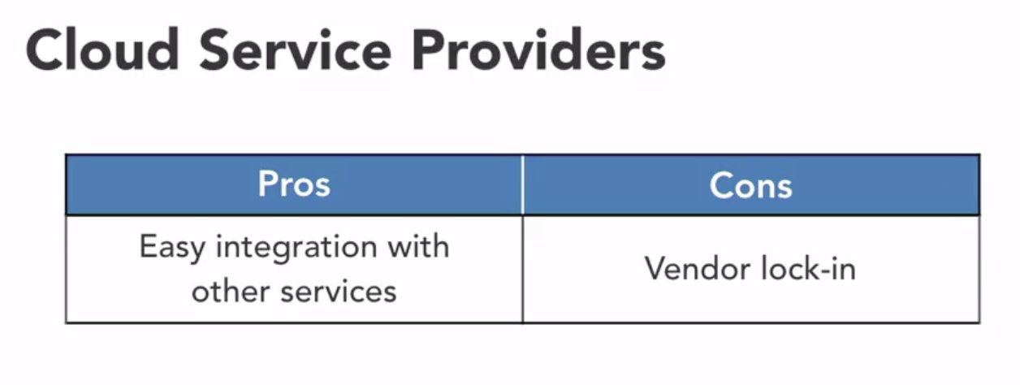
Pros and Cons
Let's discuss a few of the benefits and drawbacks to using tools from each of the CI/CD tool categories.
Self-Hosted
Hosting your own CI/CD tools gives you the most flexibility in comparison to any other option. You can specify the entire technology stack, including the software, the hardware, and the network. You also have more control over any data that flows into or out of the tool. You won't have to worry as much about unexpected data leaks or potentially harmful exposures. That flexibility and peace of mind comes at a price though. Since you own the entire technology stack, you also have to maintain it. This can be difficult if you don't have the time or the inclination to install and administer a full blown CI/CD system along with your normal duties. You'll also be bounded by the skill of the infrastructure you have on hand. If all of a sudden, you need to increase the throughput of your pipelines, you'll be limited to the capacity of your existing system. Also, getting started with self-hosted tools can be intimidating for the uninitiated, causing difficulties with bringing resources online.
SaaS
Software as a Service options, on the other hand, do their best to make it super easy to get started. All the heavy lifting of maintaining the tool is abstracted away and all you need to do is worry about coding your application. There are also plenty of free or reasonably priced SaaS CI/CD services available. And maybe it's just me, but I love the fact that the SaaS CI/CD tools create triggers from your repo automatically. For me, that's just one less thing to think about. SaaS tools might be free or have low fees to start, but they can become expensive over time. As your team or rate of development increases you can see large bills from the CI/CD service provider. And lastly, there may security concerns when running your data through a system that could be maybe even on the other side of the world. Honestly, security vulnerabilities have the potential to pop up in all of these systems, so just assume that's the case for the other categories, as well.
Cloud Service
If you're using a Cloud Service Provider's CI tool, you'll be more likely to use their other services, as well. With easy integration, it just makes sense to keep everything under the same roof. And along with the additional resources, Cloud Service Providers may offer better control over who's viewing your projects and more. Using identity and access management, you'll be able to control who can push code to your repos and start appointments, for example. Cloud Service Providers also have unlimited resources. Well, maybe not totally unlimited, but certainly more than the average person. On the flip side, some may argue that hosting builds on Cloud Service Providers leads to vendor lock-in. That could be the case, but considering how every CI/CD system has a different configuration format or some other nuance, choosing any one provider will lead to different levels of vendor lock-in, no matter who you choose.
Code Repositories
When it comes to CI/CD, Code Repositories have the unique position of having your code and the CI/CD tool all in one place. You might also be able to create custom docker containers to run your build and there are plenty of free or low fee options to get started. One downside though is that CI/CD services based in Code Repositories can get expensive, when used at larger scales.

Slide 7
Experimental Pipeline
As we explore CICD tools, it's helpful to have a sample pipeline to work with. We'll be configuring a pipeline that builds, tests, and deploys a web application. Our application is a Python script that serves JSON data over a simple API. The application will be packaged as a Docker container, and then deployed to an AWS Elastic Beanstalk environment. If you have access to the exercise files, you can find the complete Python script there. For now, we won't worry too much about the application. Instead, we'll be focusing on the steps needed to build it, test it, and deploy it to the target environment.
Our pipeline will have seven steps.
We'll trigger the pipeline by pushing an update to the Git repository where the application code is stored. Or, in some cases, we may trigger the pipeline manually if needed.
In the first two stages, we'll put any required libraries in place and do a sanity check. We'll scan our code against Python linters, and run some unit tests to make sure the specification has been followed correctly. It makes sense to do these checks early in the pipeline to keep from building and deploying bad code. This is the integration part of our CICD pipeline. At this stage, we can also include additional tests that improve the quality of our application. We could run security tests by a scan for vulnerabilities or checking to make sure secrets like passwords or API keys have not been committed to the repository.
In the third stage, we'll build the application. We'll bundle the contents of the working directory into a ZIP file and upload the ZIP to an S3 bucket. Then we'll trigger Elastic Beanstalk to store the bundle as a new version of our app. This step is the delivery portion of our CICD pipeline since we're making a new version available to deployed. And you might've guessed what comes next.
Deployment. We'll use stages four and five to deploy our application to a staging environment.
In this environment, we'll be able to run tests on the application before it goes live in production. If those tests pass, then our application will be ready for the big time.
In the last stages of the pipeline, we can confidently deploy our application to a production environment. By this time, the code has been integrated, linted, tested at the unit level, built into a deliverable artifact, and deployed and tested in a staging environment.
Just to make sure nothing went wrong, we'll run one more test on the live site. As you're viewing this course, you might already have a pipeline in mind that you're looking to implement. Just know that all the stages I've mentioned here might not apply to your project. But at the least, they should give you an idea of some of the building blocks of a typical CICD pipeline. Are you ready to explore? Let's get started.

Slide 8
1. Self hosted

Slide 9
Jenkins
pipeline {
agent any
environment {
AWS_ACCESS_KEY_ID = credentials('AWS_ACCESS_KEY_ID')
AWS_SECRET_ACCESS_KEY = credentials('AWS_SECRET_ACCESS_KEY')
AWS_DEFAULT_REGION = 'us-west-2'
}
stages {
stage('Requirements') {
steps {
sh('''#!/bin/bash
python3 -m virtualenv local
source ./local/bin/activate
pip install --upgrade --requirement requirements.txt
''')
}
}
stage('Check') {
parallel {
stage('Check:Lint') {
steps {
sh('''#!/bin/bash
source ./local/bin/activate
flake8 --ignore=E501,E231 *.py tests/*.py
pylint --errors-only --disable=C0301 --disable=C0326 *.py tests/*.py
''')
}
}
stage('Check:UnitTest') {
steps {
sh('''#!/bin/bash
source ./local/bin/activate
python -m unittest --verbose --failfast
''')
}
}
}
}
stage('Build') {
steps {
sh('''#!/bin/bash
source ./local/bin/activate
./upload-new-version.sh
''')
}
}
stage('Deploy Staging') {
steps {
sh('''#!/bin/bash
source ./local/bin/activate
./deploy-new-version.sh staging
''')
}
}
stage('Test Staging') {
steps {
sh('''#!/bin/bash
source ./local/bin/activate
./test-environment.sh staging
''')
}
}
stage('Deploy Production') {
steps {
sh('''#!/bin/bash
source ./local/bin/activate
./deploy-new-version.sh production
''')
}
}
stage('Test Production') {
steps {
sh('''#!/bin/bash
source ./local/bin/activate
./test-environment.sh production
''')
}
}
}
}
When developers think of tools for continuous integration Jenkins is likely the first to come to mind. It's easily one of most well known and widely used automation tools available. More than one million users around the world turn to Jenkins for their automation needs, including continuous integration and delivery. Price is one of the reasons that keep application developers and software engineers turning to Jenkins. It's free and open source.
Enterprise support for Jenkins is available through CloudBees, the company founded by the original creator of Jenkins. CloudBees is also one of the largest contributors to the Jenkins opensource project. Jenkins is essentially an automation framework that can be extended through plugins. If the base functionality doesn't cover what you need there's probably a plugin that can do the job for you. There are nearly 1,500 plugins available in the plugin index. One plugin we'll be using to enhance our pipeline experience is the Blue Ocean plugin.
Blue Ocean is actually a collection of plugins that enhances the Jenkins user interface. Specifically for visualizing pipelines. Jenkins includes a pipeline viewer out of the box but Blue Ocean provides a more modern and up to date interface. We can model our pipeline in the Jenkins web interface or with a Jenkins file stored with our code. The Jenkins file format is based on the Groovy programing language and uses a declarative approach to describe the stages of a pipeline and the actions needed to complete the stage.
Jenkins file
Let's get started by taking a look at our experimental pipeline as implemented in the Jenkins file. The Jenkins file format is easy to follow. With each configuration element working out into bracketed sections. At the top we have environment details that inject our AWS credentials into the process running our pipeline. So that the credentials are exposed as environment variables. The actual values of the credentials are stored securely in Jenkins so they aren't exposed here. Beneath that, we have our stages. I've modeled our experimental pipeline to follow the seven stages used to get the application code and run some quick tests, build a new version of application and then deploy and test in the staging and production environments. Each of our stages contains the steps that actually run the commands or scripts needed to fulfill the actions for that stage. In the check stage I've used the parallel directive to tell Jenkins to run the lenting and unit test at the same time. Using parallel steps will help speed up the build. Now let's run our pipeline.
In the default pipeline view, Jenkins provides a nice visualization of the pipeline. Showing each of the stages we've defined in our Jenkins file. However, we can use the Blue Ocean plugin for what I'll call a more aesthetic pipeline visualization. To get that view, I'll click the open Blue Ocean in this menu on the left. In the Blue Ocean view our pipeline home page shows past runs along with results, commit messages and other details. We also have this handy run button to start the pipeline process. We could also set up a web hook with our get repo so the pipeline runs automatically whenever the code is changed but for this demo I'll just use the run button. We can also see the stages of our pipeline by clicking into the running job. In this view, we can see each stage of our pipeline along with the status. The green and white check marks let us know the stages have passed and the blinking blue icon lets us know which stage is active. The log for each stage is displayed below. And we can expand the form to follow the log in real time. Now let's wait for the build to finish. The green color in the banner at the top lets us know all stages of the pipeline have completed successfully. With a clear pipeline is code format and extensive plugin library and pipeline visualizations with Blue Ocean plugin Jenkins remains a viable tool for continuous integration.

Slide 10
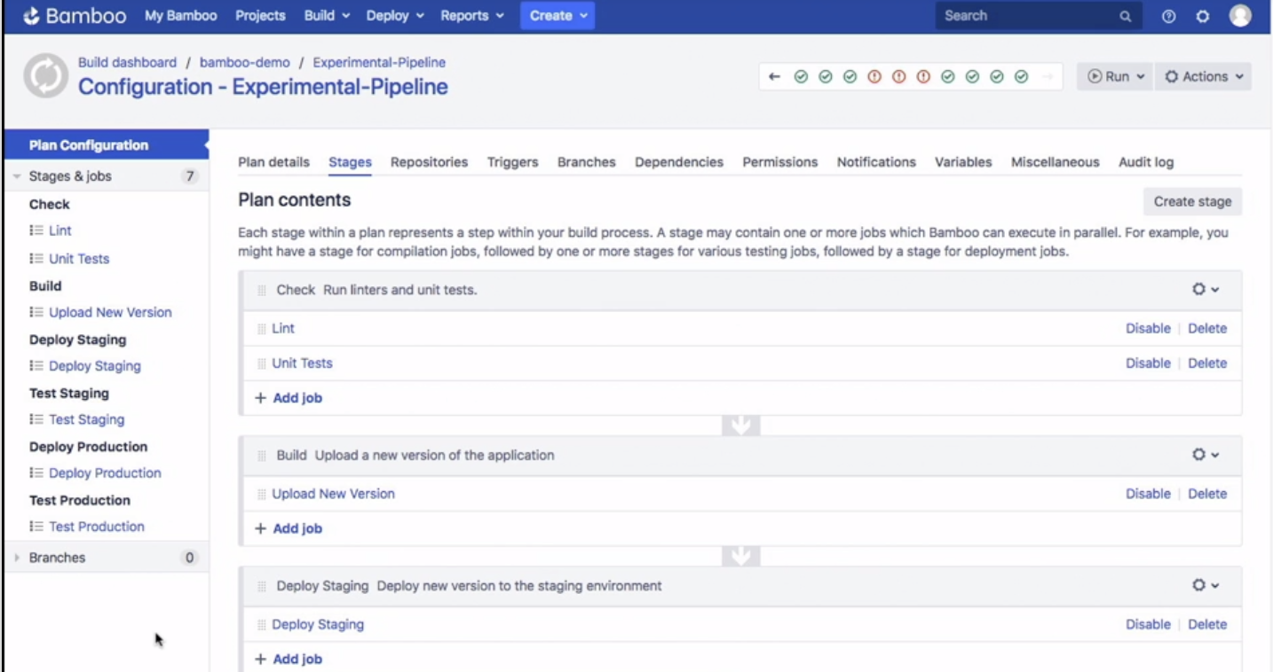
Bamboo
- [Instructor] Bamboo is a self-hosted, CI CD solution developed by Atlassian, the company behind applications like Confluence, Jira, and Bitbucket. For teams that are using other Atlassian products, Bamboo is a nice fit for adding a CI CD server to project management and issue tracking workflows. Work assigned in Jira for example, can be directly associated with a pipeline in Bamboo. Bamboo also provides integrations with Bitbucket, Atlassian's source code repository product. Bamboo is a paid product. And the pricing ranges from $10 for small teams into the thousands of dollars for larger teams. The pricing scheme is based on the number of jobs available to run and the number of remote agents a Bamboo server can connect to. At the lowest tier, Bamboo can run up to 10 jobs using an agent running on the same server that's running Bamboo. This might be okay for small teams running just a few jobs but larger teams will certainly benefit from isolating the Bamboo server and distributing their jobs over more agents. To extend functionality, Atlassian provides a marketplace for Bamboo plug ins. Some plug ins are free while others have a cost associated with them. Out of the box, Bamboo pipelines are configured from the web interface. However, Bamboo also supports spec files that can be stored along with the application code. Spec files can be written in YAML or Java with both of these formats having their benefits. YAML is easy to read and understand, even for someone that might not be familiar with programming. Java might be a bit more complicated to read but is a popular language and many developers are familiar with it. Let's see how we can implement our experimental pipeline in Bamboo. Bamboo pipelines are called plans. I've configured the plan for our experimental pipeline using the web interface. To get a better view I'll click actions and then configure plan. In this view, we can see our plan's stages on the left and the jobs that each stage contains. I've modeled our experimental pipeline in six stages. Most stages have one job. With the check stage having two jobs that run in parallel to speed up the build. One thing that should be noted about these stages is that each one runs in an isolated directory on the server's file system. So each stage needs to check out it's own copy of the code. In the deploy staging job, for example, we can see that there are two tasks for this job, a source code checkout and then a script run. And if I click test staging, we can see that this stage follows the same pattern. Let's start a build by running this plan. I'll click run and then run plan. While the build is running we get this nice progress bar at the top of the page to see the overall progress of the build. On the left, we can see the different stages and jobs running. If we click into a stage that's actively running we can follow the logs in the middle of the page. Once the stage is complete we get a nice indicator with a stage's status. Now let's wait for the rest of the build to finish. If there were any stages that failed we could go to the logs tab, to download or view the logs for debugging. I also wanted to point out that Bamboo provides a specific type of project for deployments. And we'll find that under deploy and all deployment projects. This is useful if your builds produce artifacts that need to be deployed into specific environments. Bamboo has plenty of capabilities on it's own and can do even more when paired with other Atlassian products. If you're working in a shop that uses Confluence, or Jira, for example, Bamboo might be the perfect choice for your software integration needs.

Slide 11
2. Sass

Slide 12
3. Cloud Service Provider

Slide 13
4. Cloud Service Provider

