Slide 1

11 teeth. Thin
G1B
Motor 1 Base Gear
x1

Slide 2

9 teeth. Thick
G1P
Motor 1 Potentiometer Gear
x1

Slide 3

11 teeth. Thick
G2B
Motor 2 Base Gear
x1

Slide 4

11 teeth. Thin
G2P
Motor 2 Potentiometer Gear
x1

Slide 5

17 teeth. Thick
G3B
Motor 3 Base Gear
x1

Slide 6

21 teeth. Thin
G3p
Motor 3 Potentiometer Gear
x1

Slide 7

G5B
Motor 5 Base Gear
x1

Slide 8

8 teeth. Thin
G5iA
Motor 5 Small Idle gear
x2

Slide 9

15 teeth. Thin
G5iB
Motor 5 Large Idle Gear
x2

Slide 10

15 teeth. Thin
g5p
Motor 5 Potentiometer Gear
x1

Slide 11

H1
Potentiometer 1 Holder
x1

Slide 12
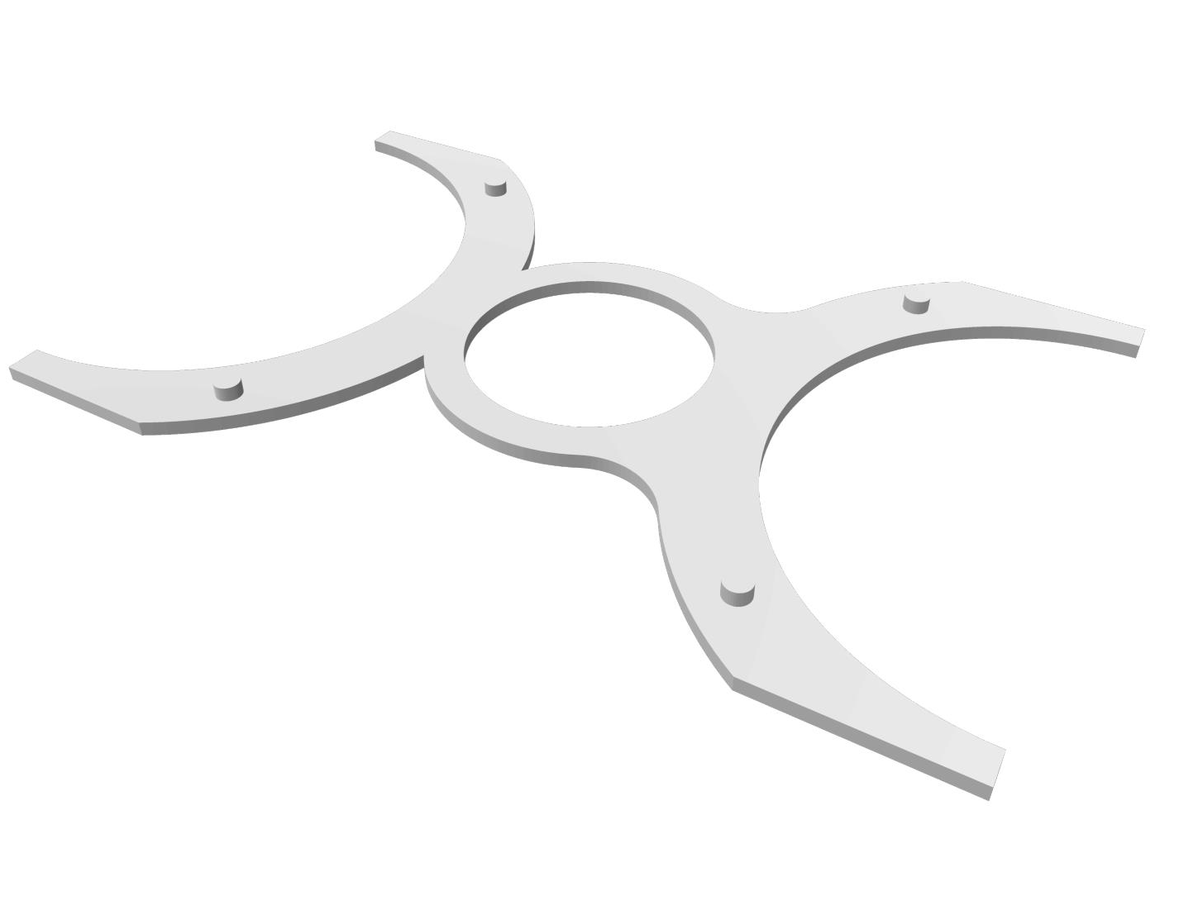
H2
Potentiometer 2 Holder
x1

Slide 13

H3a
Potentiometer 3 Holder
x1

Slide 14
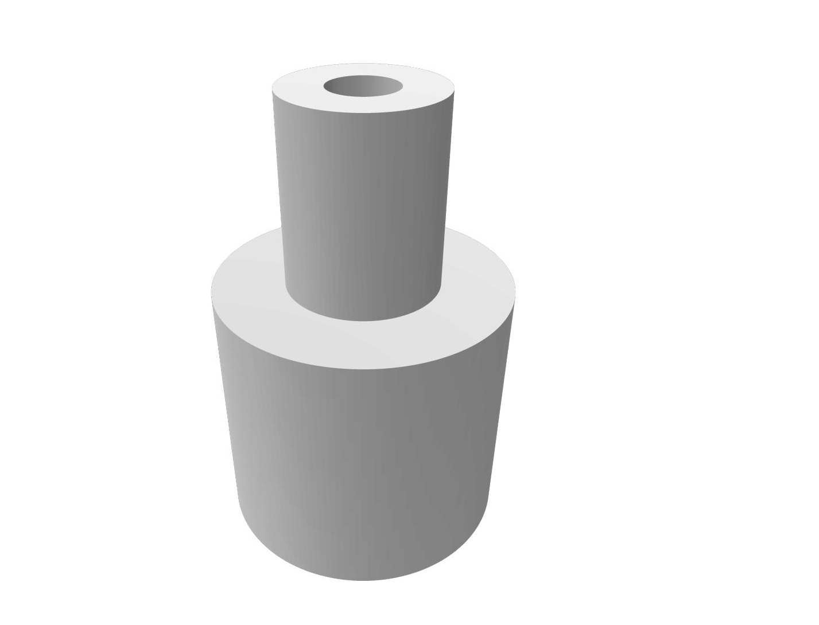
H3b
Potentiometer 3 Gear Holder
x1

Slide 15
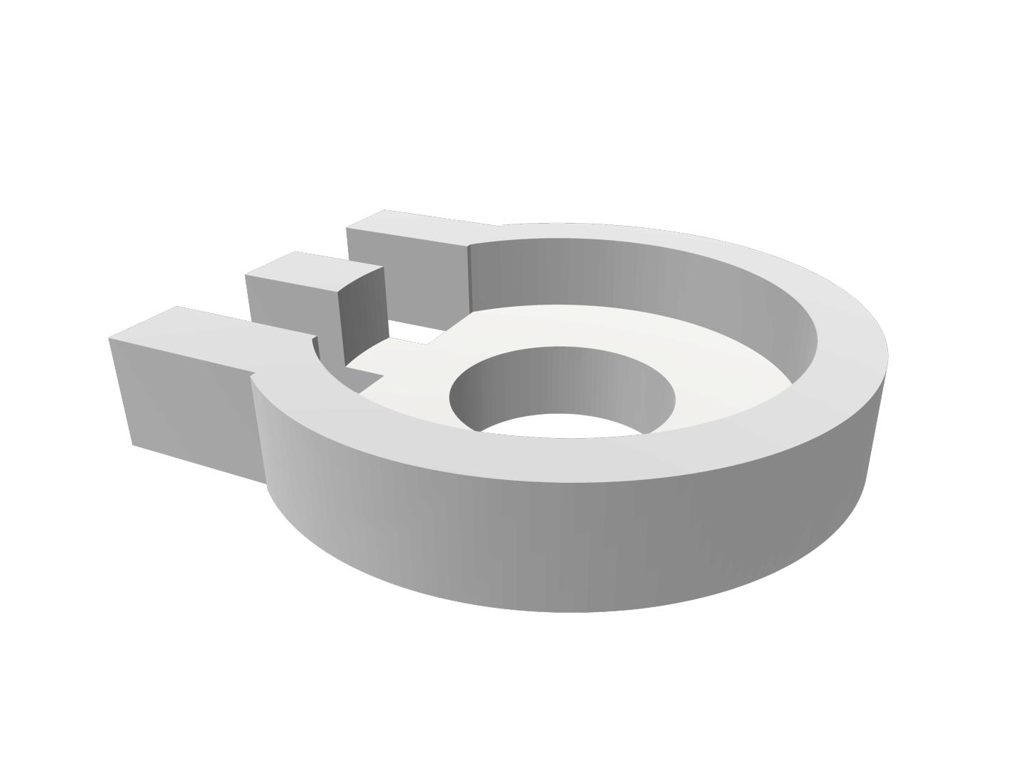
h4a
Potentiometer 4 Base Holder
x1

Slide 16

h4b
Potentiometer 4 Tip Holder
x1

Slide 17
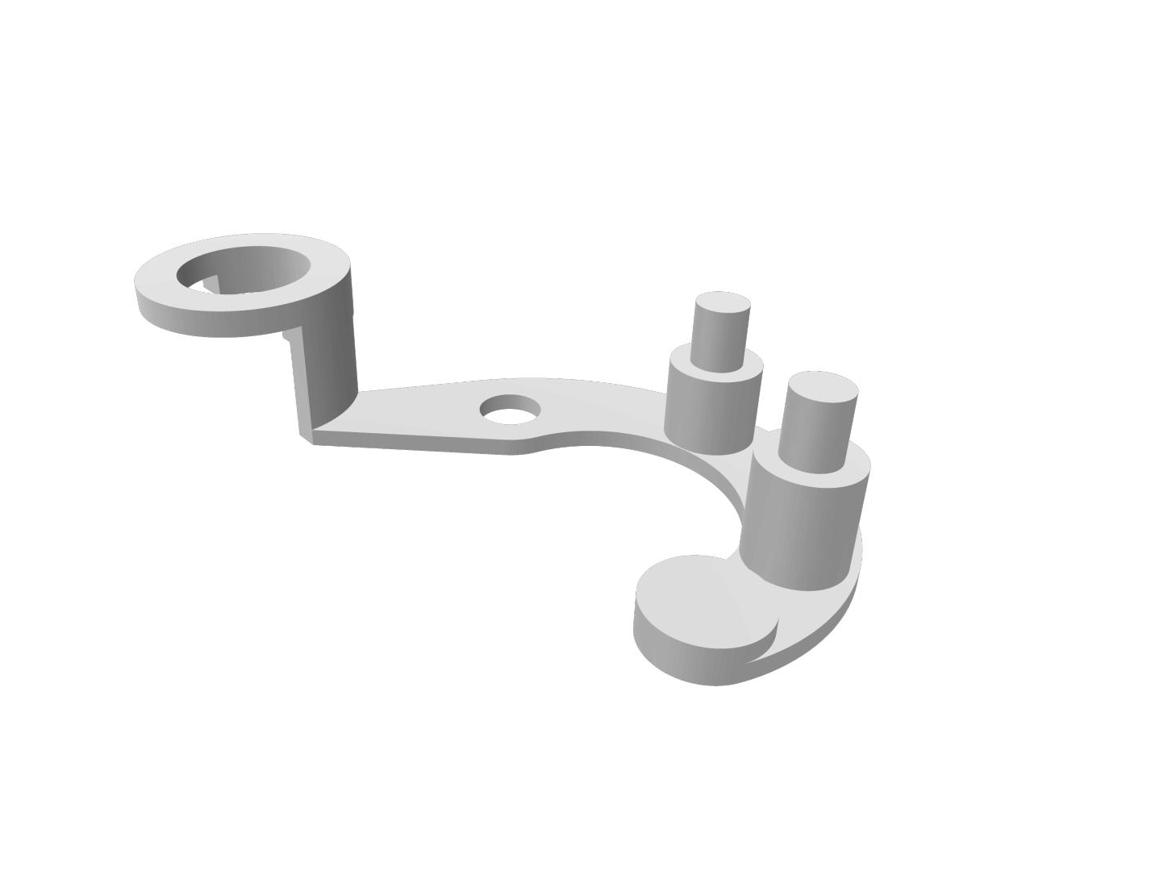
H5a
Potentiometer 5 Holder
x1

Slide 18
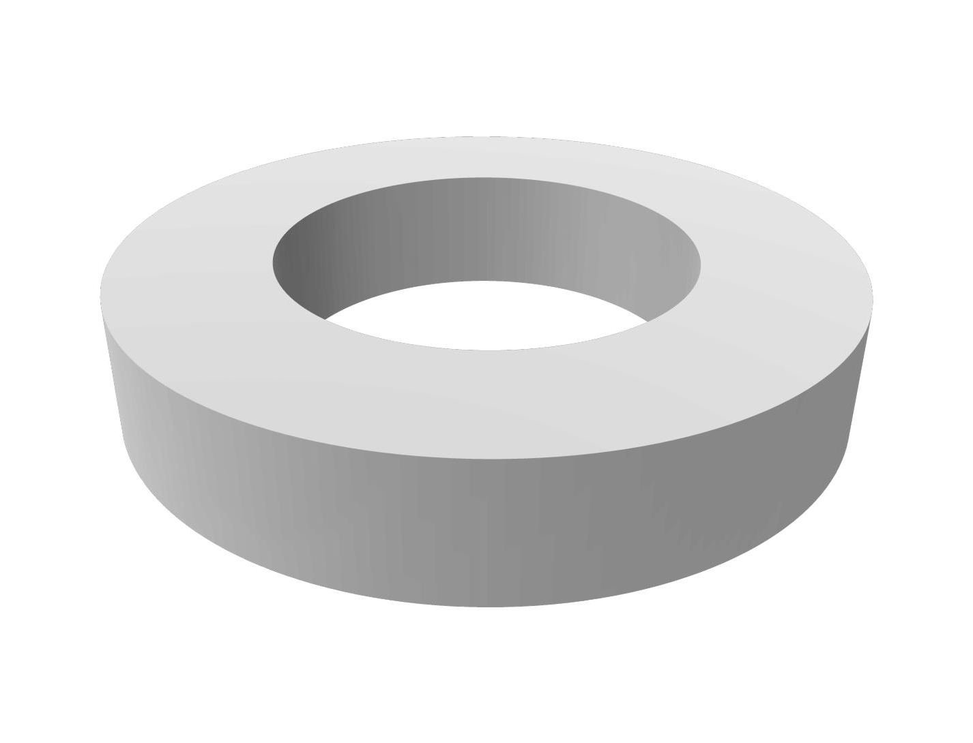
H5b
Potentiometer 5 Gear Locks
x2

