Slide 1
Hacking – Spring 2021 Lesson 11

Slide 2
Hacking Defined
Definition of Hacking
Any intentional gaining of unauthorized access to computing systems from which the Confidentiality, Integrity, or Availability of the system, or data within, could be compromised.

Slide 3
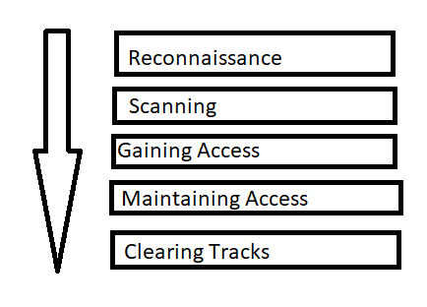
Phases of Hacking

Slide 4
Reconnaissance
The first step, no matter the method of the attack
Learn about the organization
Try to get credentials through social engineering
Enumerate publicly-available systems and services
Identify third-party systems (e.g. SaaS for Payroll, HR, CRM)
Methods
Active Reconnaissance | Passive Reconnaissance
Port Scanning | DNS Searches
SNMP Walking | Information Inquiries
Network Mapping

Slide 5
Active vs Passive Reconnaissance
Advantages/Disadvantages
Active Reconnaissance | Passive Reconnaissance
Advantages: Speed May immediately expose vulnerability | Advantages: Activity is legal Target unaware of activity
Disadvantages: Activity is illegal Target may be aware and take countermeasures | Disadvantages: Slow collection of data Does not provide obvious vulnerability

Slide 6
Scanning
Academically recognized as the second phase of a hacking attempt, following reconnaissance
Very fuzzy line between the activities of reconnaissance and the activities of scanning
Scanning is considered a far more aggressive type of reconnaissance
There is terminology and tools that are used interchangeably in reconnaissance and scanning

Slide 7
Gaining Access
Recognized as the third phase
Sometimes comes earlier, such as the result of social engineering scam

Slide 8
Maintaining Access
Recognized as the fourth phase
There are many activities in this phase
Additional discovery of the environment
Attempts to elevate access and gain new access
Initiating/maintaining exfiltration of information
Establishing backdoors

Slide 9
Clearing Tracks
While the last phase:
Often occurs during maintaining access
But the truly last phase:
Ensure evidence is destroyed
Remove backdoors
Doing the above may be accomplished through very destructive means

Slide 10
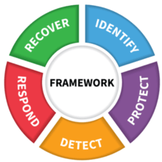
Phases and Risk Management

Slide 11
Phases and Risk Management and Control Objectives
IDENTIFY
PROTECT DETECT
RESPOND
RECOVERY
https://www.youtube.com/watch?v=j0EZpH_eIsY

Slide 12
Cyber Kill Chain
What is it?
The cyber kill chain is a series of steps that trace stages of a cyberattack from the early reconnaissance stages to the exfiltration of data. The kill chain helps us understand and combat ransomware, security breaches, and advanced persistent attacks (APTs)

Slide 13
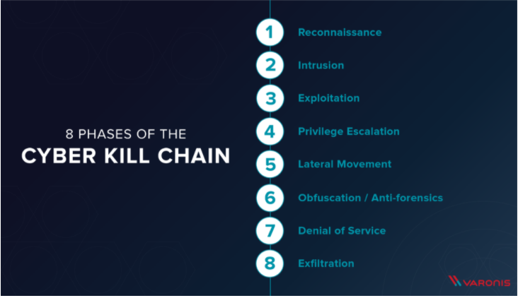
Cyber Kill Chain

Slide 14
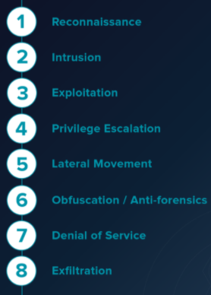
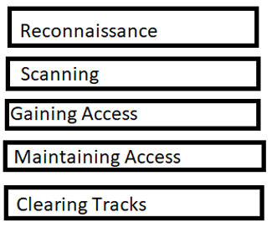
Cyber Kill Chain mapped to Hacking Phases

Slide 15
Cyber Kill Chain – Security Controls

Slide 16
Cyber Kill Chain – Security Controls
Antiphishing
Anti Malware
IDS/IPS
Trained Users/NDAs
Logging/Monitoring

Slide 17
Cyber Kill Chain – Security Controls

Slide 18
Cyber Kill Chain – Security Controls
Anti Malware
IPS
Trained Users
WAF
Firewall
Network segmentation
Removable Media Device Control
Logging/Monitoring
Strong Authentication

Slide 19
Cyber Kill Chain – Security Controls

Slide 20
Cyber Kill Chain – Security Controls
NIPS
Secure Coding
System Hardening
Anti Malware
Sandboxing
Strong Authentication
Access Controls
Host Firewalling
Logging and Monitoring

Slide 21
Cyber Kill Chain – Security Controls

Slide 22
Cyber Kill Chain – Security Controls
Secure Coding
System Hardening
Strong Authentication PIM Controls (like Strong Auth)
Network segmentation
Logging and monitoring
Encryption

Slide 23
Cyber Kill Chain – Security Controls

Slide 24
Cyber Kill Chain – Security Controls
Secure Coding
System Hardening
Strong Authentication Firewalling / Network Segmentation
Zero-Trust
NIPS
Logging/Monitoring

Slide 25
Cyber Kill Chain – Security Controls

Slide 26
Cyber Kill Chain – Security Controls
Secure Coding
System Hardening
Access Controls
Systems with Nonrepudiation

Slide 27
Cyber Kill Chain – Security Controls

Slide 28
Cyber Kill Chain – Security Controls
Secure Coding
System Hardening
Network Segmentation
NIPS
Logging and Monitoring

Slide 29
Cyber Kill Chain – Security Controls

Slide 30
Cyber Kill Chain – Security Controls
Network Segmentation
NIPS
Logging and Monitoring
Firewall

Slide 31
MITRE Att&ck Chain
MITRE – est. 1958 - nonprofit that manages research centers that support federal projects
ATT&CK: Adversarial Tactics, Techniques & Common Knowledge
Provides a more prescriptive knowledgebase of methods to conduct a successful attack
Successful attack:
Get in, Get Stuff, Get Out --- All While Staying Hidden

Slide 32
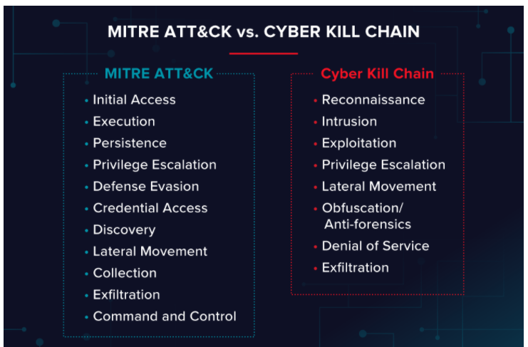
MITRE Att&ck Chain vs Cyber Kill Chain

Slide 33
MITRE Att&ck Example
The attackers infect the target with malware using Replication Through Removable Media
With the malware in place, the attackers have access to a computer on the network, and they use PowerShell to search for privileged accounts.
When the attackers find a privileged account target, they will use an Exploitation for Privilege Escalation to gain access to the account
With access to a privileged account, the attackers use the Remote Desktop Protocol to access other machines on the network to find data to steal.
The attackers collect and exfiltrate data back to home base. They could use data compression to collect the sensitive files and then pass the data back home using an Exfiltration Over Alternative Protocol technique.

Slide 34
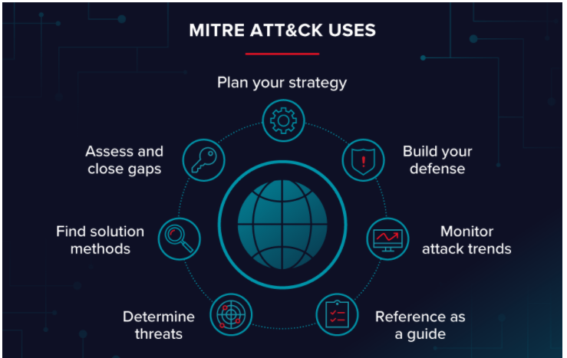
MITRE Att&ck Chain – in Defense

Slide 35
Lesson 11 Concepts
Knowing the five phases of an attack
Understanding the activities in each phase
Understanding passive/active reconnaissance
Mapping of Cyber Kill Chain to Phases of Hacking
Identifying controls against the various chain phases
Implies you also understand “the activity” of the chain phase
Distinguishing Cyber Kill Chain from MITRE ATT&CK Chain
Purpose of MITRE ATT&CK Chain

