Slide 1
Security Issues in Cloud Computing– Spring 2021 Lesson 13

Slide 2
TERMS
“The Cloud”: Infrastructure, platforms and software that are accessible to people over the Internet or private circuit. These services reside in data center(s).
“Cloud Computing”: Term that describes the on-demand nature of infrastructure, platform, and software that requires minimal user interaction.

Slide 3
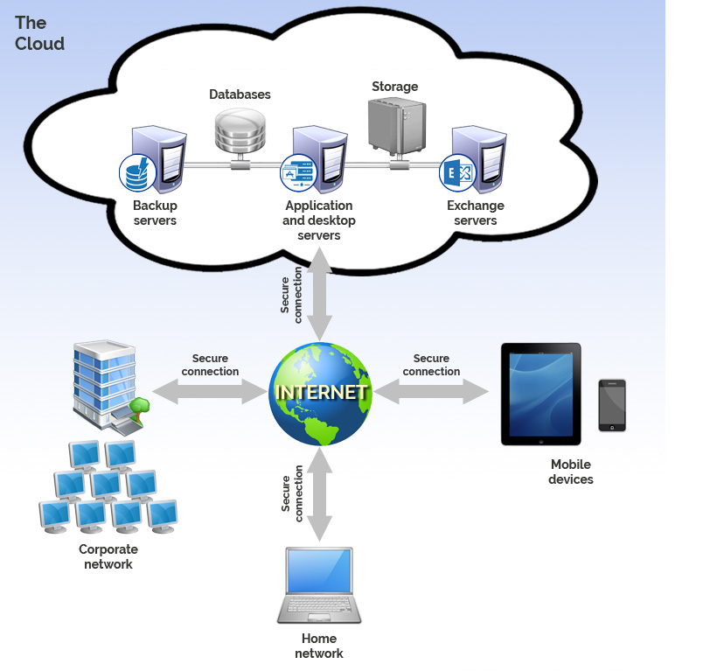
The Cloud
An Extension of Your On-Premises IT Capabilities

Slide 4
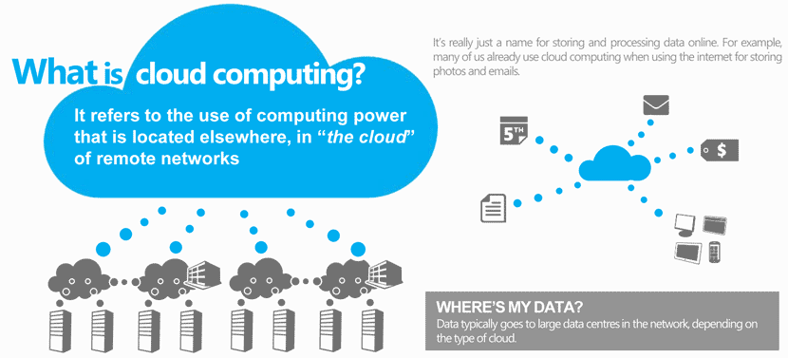
The Cloud

Slide 5
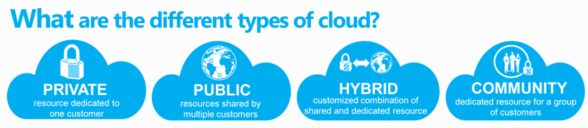
Types of Cloud

Slide 6
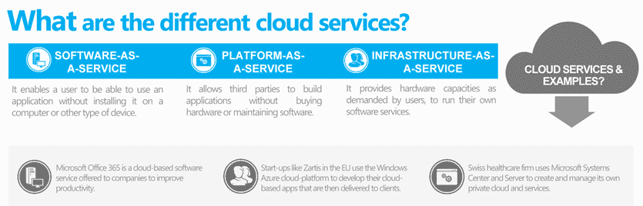
Types of Cloud Services

Slide 7
Types of Cloud Services
Examples
SaaS PaaS
Gmail - Facebook
Canvas - Azure
DropBox AWS
Docusign
IaaS
Rackspace
Azure
AWS

Slide 8
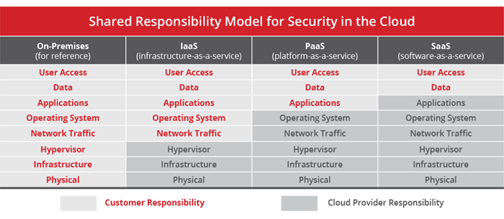
Types of Cloud Services

Slide 9
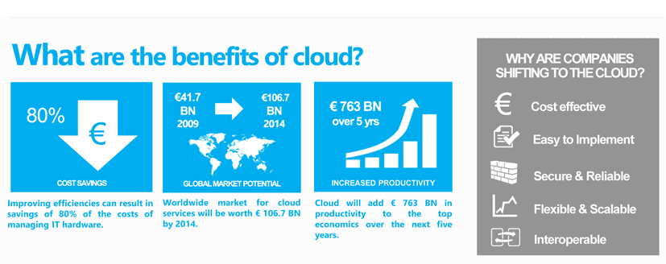
Promised Benefits of The Cloud

Slide 10
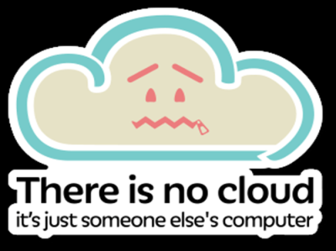
The Security Problem with the Cloud

Slide 11
The Challenges of the Cloud
Data and System Visibility
What data
Where is the data
How is the data moving
What systems are in production (On-Demand Self-Service)
Removal of data

Slide 12
The Challenges of the Cloud
System Configuration and Hardening
Assurance of software security and configuration
How do I do that in SaaS?
How do I do that in PaaS?

Slide 13
The Challenges of the Cloud
Access Controls
- Especially with ubiquitous application/data access
- Multi-Tenant systems and applications

Slide 14
The Challenges of the Cloud
Extension of Controls and Resource Issues
Trying to replicate the same controls as those on premises

Slide 15
The Challenges of the Cloud
Advanced threats to cloud app providers
Larger target / more rewards

Slide 16
The Challenges of the Cloud
Compliance
Assurance of standards being met

Slide 17
Addressing the Security Issues
Mix of Old and New Methods
Old:
Consider the environment
Consider the threats
Consider the vulnerabilities
Identify the controls in place
Be very clear on control objective
New:
The controls available / not available from “control catalog”
The methods of control assurance will change
Risk tolerance may have to be re-examined

Slide 18
Newer Controls
Third party risk management and assurance
What are the potential threats/vulnerabilities/risk criticalities?
What activities can I do to ensure the cloud provider is doing what they are required to do?
CASB
Sits between users and cloud services to monitor activity and enforce security policies
Virtualized controls
Firewalls, IPS,
User behavior analytics

Slide 19
Summary
Cloud and Cloud Computing definitions
Implied business benefits of cloud
Different types of cloud
Different cloud services and how to distinguish them
Unique security challenges with the cloud
Approaches for addressing those challenges
Trends for new controls and capabilities
Questions?

