Slide 1
Internet of Things – Spring 2021 Lesson 14

Slide 2
Internet of Things
Kevin Ashton – 1999 – Proctor & Gamble
Talking about RFID
Took about 10 years before the term meant something
2010 – Chinese announces IoT as strategic in five-year-plan
2011 – Gartner announces emergence of IoT
2012 – European Conference “Le Web” has IoT as its theme
2014 – Google buys Nest and CES in Las Vegas does “IoT”

Slide 3
Internet of Things
Other Terms
M2M (Machine to machine) communication
Web of Things
Industry 4.0
Industrial internet (of Things)
Smart systems
Pervasive computing
Intelligent systems
Internet of Everything

Slide 4
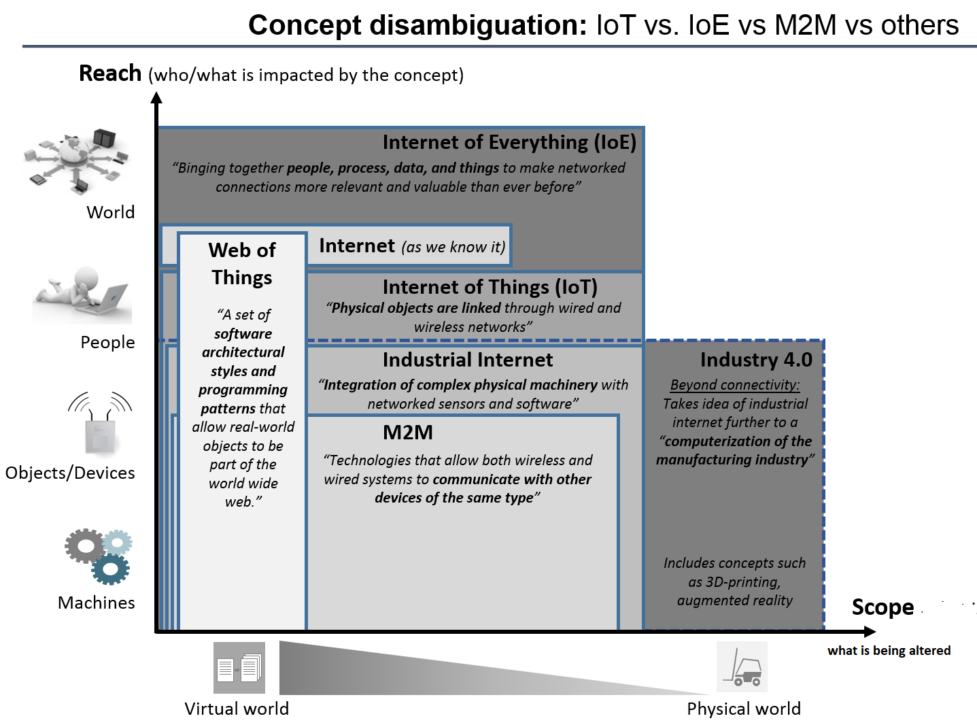
Clarifying Some of the Terms

Slide 5
What Makes IoT Work
Connectivity and Processing
Conceptually – any device connects to the Internet and transmits data
That data is received and processed
Messages and commands are sent back to the originating device and other devices
The receiving devices process the information or execute the command
THAT last action results in all of these devices transmitting new data for processing

Slide 6
What is Needed for IoT Capabilities?
Common connectivity standards
Common communication platforms
Common data standards
Common security standards
Application integration standards and capabilities

Slide 7
How It Works Video
https://www.youtube.com/watch?v=QSIPNhOiMoE

Slide 8
Discussion – Threats/Vulns/Risks
Are these definitions still valid in the world of IoT?
Threat - an event, action, actor, that searches for, identifies, and/or exploits vulnerabilities in a target environment or system which results in derogatory/harmful outcomes
Vulnerability – a weakness in a system or environment that could be exploited by a threat which would derogatorily impact confidentiality, integrity or availability of information or information systems
Risk - the culminated potential harm due to the presence of a threat and a vulnerability

Slide 9
Discussion – Risk Measurement
Is risk prioritization still valid in the world of IoT?
Quantitative Risk – Probability * Impact
Qualitative Risk – Scale of potential harmful outcomes

Slide 10
Discussion – Risk Management
Is risk management lifecycle still valid in the world of IoT?
Identify and Inventory the Environment
Identify Threats and Vulnerabilities and Controls
Identify and Measure Risk
Prioritize Risk
Identify Control Objectives to Mitigate Priority Risks
Apply Controls
Measure Efficacy of the Controls
Repeat

Slide 11
Discussion – Control Objectives
Are Control Objectives still valid in the world of IoT?
Ensure each individual accessing a system can be uniquely identified
Validate that the individual gaining access is the actually the individual (authentication)
Protect from unauthorized access due to compromised passwords
Prevent data from leaving the environment where reduced controls could lead to unauthorized disclosure
Allow only desired network traffic into a particular network/network zone
Maintain confidentiality of communications between a transmitter and recipient
Prevent disclosure of information in unprotected areas such as garbage bins, and during transport to/from garbage bins
Maintain system availability
Allow desired traffic, for the protection of different classes of assets

Slide 12
Discussion – Controls
Are common information security controls still relevant?
Password
Password Expiration
Data Sharing Policy
Firewall
Encryption for data in transit
Document Shredding
Maintain redundancy (hot available, backups)
Network segmentation

Slide 13
From Lesson 13 – Cloud Computing
Mix of Old and New Methods
Old:​
Consider the environment​
Consider the threats​
Consider the vulnerabilities​
Identify the controls in place​
Be very clear on control objective​
​
New:​
The controls available / not available from “control catalog”​
The methods of control assurance will change​
Risk tolerance may have to be re-examined

Slide 14
Discussion
What is the challenge of security?

Slide 15
Discussion
What is the challenge of security?
Constant communication
Need for embedded authentication
Constant update of access control
Ensuring confidentiality
Switch from “customer info” to availability/integrity

Slide 16
Discussion
What is the challenge of privacy?

Slide 17
Discussion
What is the challenge of privacy?
Data sharing is essential for IoT to function
Data unrelated to the function is collected and not needed

Slide 18
Discussion
Mobile Security
Challenge:
Identification
Authentication
Authorization
Privacy
Why? Mobile nodes are constantly moving from cluster to cluster
Attacks?
Replay, eavesdropping, and tracking or location privacy attacks

Slide 19
What are common security controls

Slide 20
What are common security controls?
At the developer layer:
Secure and hardened coding
Develop in authentication
All data encrypted in transit
Provide for automated patching
Use secure source code/open source code
At the user level:
Access controls
Identity spoofing controls
Segment IoT devices
Control traffic

Slide 21
Match the Hack with the Needed Control
https://www.iotforall.com/5-worst-iot-hacking-vulnerabilities
At the developer layer:
Secure and hardened coding
Develop internal authentication
All data encrypted in transit
Provide for automated patching
Use secure source code/open source code
At the user level:
Access controls
Identity spoofing controls
Segment IoT devices
Control traffic

Slide 22
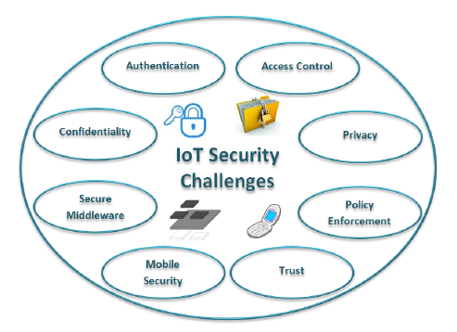
Recap of Lesson 14
Top Concepts
What is needed for IoT to work
Threats, risks, risk management, control objectives overlap with traditional information security
Controls are relatively unique over information security

