Slide 1
Compliance and Risk Management CSS310b – Spring 2021 Lesson 9

Slide 2
Risk Management Lifecycle
Identify and Inventory the Environment
Identify Threats and Vulnerabilities and Controls
Identify and Measure Risk
Prioritize Risk
Identify Control Objectives to Mitigate Priority Risks
Apply Controls
Measure Efficacy of the Controls
Repeat

Slide 3
Identify and Inventory the Environment
What is the business and how important is security?
What does it do?
Will there be international or multi-state implications?
What kind of risks are likely to be most important to the organization?
This will lead directly to understanding compliance requirements

Slide 4
Identify and Inventory the Environment
After all that is done ---- here is the question
What do I have to do?
THIS IS CALLED COMPLIANCE
What do I want to do?
THIS IS CALLED RISK MANAGEMENT

Slide 5
Compliance
What you have to do.
If you don’t do it, you could suffer fines, sanctions, higher cost of business.
Is Compliance a threat?
I would consider the lack of compliance – the sanctions that come from it – a risk

Slide 6
Define Risk Management
The process that allows security managers to balance the operational and economic costs of protective measures and achieve gains in mission capability by protecting the IT systems and data that support their organizations’ missions.
Remember: Risk is either
Mitigated
Transferred
Accepted

Slide 7
Where does Compliance exist is lifecycle?
I identify the compliance requirement. It will have all the controls/control objectives listed for me that it requires.
After I look at my threats and vulnerabilities, I look at the required Compliance controls, whether I have them in the organization, and whether they meet the Compliance control objective
Note: Compliance does not tell you to put in a control in order to mitigate risk to an acceptable level. Compliance doesn’t talk risk mitigation at all. When measuring a Compliance control, you examine whether it meets a control standard.

Slide 8
Where does Compliance exist is lifecycle?
If the control meets the Compliance control objective, I validate whether it meets the risk management control objective. If it does, great. If not, I tune the current control or I add more controls.
If the control does NOT meet the Compliance control objective, I put in a control with the intent to meet the Compliance control objective AND the risk management control objective.

Slide 9
Compliance Standards
PCI-DSS
HIPAA Security Rule
SOX 404
FISMA

Slide 10
Compliance Standard
PCI-DSS
Set of controls for entities that stores, processes, or transmits credit card data
Considers assets that store/process/transmit data an “in-scope” asset for the standard
Any asset that is not segmented from an “in-scope” asset is also “in scope”. The entire network segment of an “in-scope” asset is part of the cardholder data environment
https://www.pcisecuritystandards.org/documents/PCI_DSS_v3-2-1.pdf?agreement=true&time=1602093190080

Slide 11
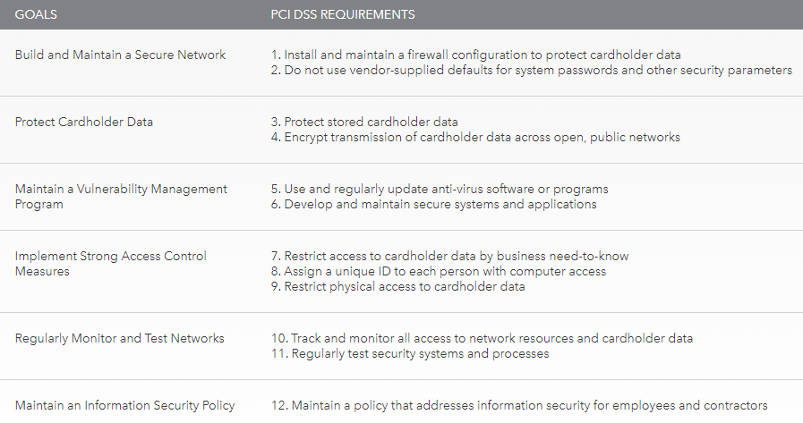
Compliance Standard
PCI-DSS

Slide 12
Compliance Standard
PCI-DSS
Network Diagram

Slide 13
Compliance Standard
HIPAA – Security Rule
Health Insurance Portability and Accountability Act
Set of controls for most healthcare organizations (“covered entity”)
The objective is to protect electronic patient health information (ePHI)
The Security Rule is located at 45 CFR Part 160 and Subparts A and C of Part 164.
Set of administrative, physical and technical controls
Controls are labeled to indicate level of flexibility organization has in applying the control (required/flexible)
https://www.govinfo.gov/content/pkg/CFR-2011-title45-vol1/pdf/CFR-2011-title45-vol1-part164.pdf

Slide 14
Compliance Standard
Sarbanes-Oxley (SOX) 404
Passed by congress on July 30, 2002 to help protect investors from fraudulent financial reporting by corporations
The Sarbanes-Oxley Act of 2002 is a complex and lengthy piece of legislation. Three of its key provisions are commonly referred to by their section numbers: Section 302, Section 404, and Section 802
Section 404 requires that management and auditors establish internal controls and reporting methods to ensure the adequacy of those controls.
https://pcaobus.org/About/History/Documents/PDFs/Sarbanes_Oxley_Act_of_2002.pdf

Slide 15
Compliance Standard
Sarbanes-Oxley (SOX) 404
Establish safeguards to prevent data tampering
Establish safeguards to establish timelines
Establish verifiable controls to track data access
Ensure that safeguards are operational
Periodically report the effectiveness of safeguards
Detect security breaches
Disclose security safeguards to auditors
Disclose security breaches to auditors
Disclose failure of safeguards to auditors

Slide 16
Compliance Standard
Federal Information Security Management Act (FISMA)
Passed in 2002
Focused on federal agencies for the protection of data
Has expanded to state agencies that administer federal programs (e.g. Medicare)
In 2010, the Office of Management and Budget required agencies to provide real-time information to assure compliance in between audits and assessments
TITLE III of https://www.govinfo.gov/content/pkg/PLAW-107publ347/pdf/PLAW-107publ347.pdf

Slide 17
Compliance Standard
Federal Information Security Management Act (FISMA)
Maintain an inventory of information systems.
Categorize information and information systems according to risk level.
Maintain a system security plan.
Implement security controls (NIST 800-53)
Conduct risk assessments.
Certification and accreditation.
Conduct continuous monitoring.

Slide 18
Compliance Controls and Risk Controls
COMPLIANCE CONTROLS
RISK CONTROLS

Slide 19
Compliance Controls and Risk Controls
IN A HIGHLY REGULATED ENVIRONMENT
COMPLIANCE CONTROLS
RISK CONTROLS

Slide 20
Questions

Slide 21
Take Aways
Basic difference between compliance and risk management
That when doing risk management, you assess whether your compliance-based controls are appropriately effective
The industry/situation for the four compliance controls reviewed

Slide 22
Practice Quiz
Lessons 6-9

