Slide 1
CSS310 –Information Assurance and CyberSecurity Spring 2021
Lesson 18
BLOCKCHAIN

Slide 2
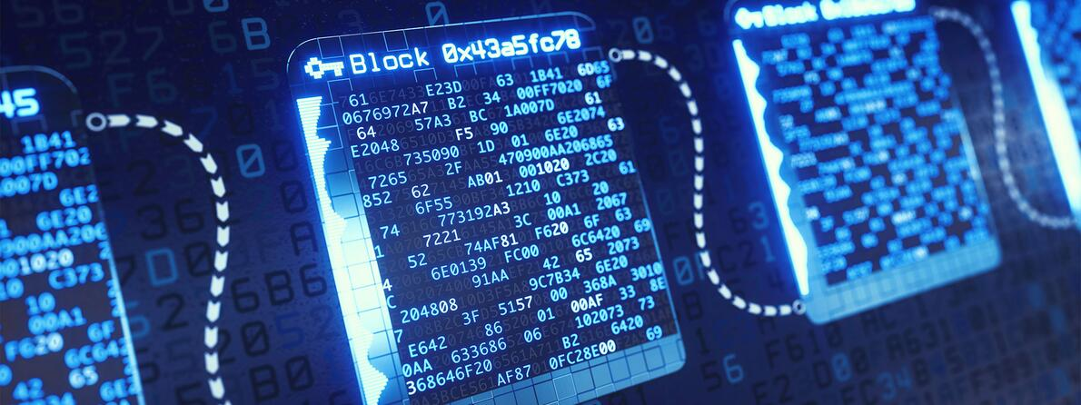
Blockchain- Defined
A way to keep records of transactions across multiple computers in a peer-to-peer (aka “community”) network.

Slide 3
Simple explanation
https://www.youtube.com/watch?v=SSo_EIwHSd4

Slide 4
Concept - Decentralization
Multiple users are in a “community”. They are authorized to be part of this community through some form of action or activity
Once part of the community, the ledger of all transactions (“blocks”) that have and will occur is shared with that computer/user.
The ledger is not centralized by one authority
When a transaction (“block”) conducted by a user in the community is added to the ledger, all users of the community get a copy of that transaction

Slide 5
Concept - Immutability
When a transaction is added to the ledger, aspects of the new transaction and aspects of the preceding transaction are collected
An algorithm is run against those aspects
The transactions are tagged with a code that is generated from that transaction
That tagging is also shared
The codes that are annotated make up the “chain”
If a transaction that is already in the ledger is modified, the code(s) on those transactions will not be correct.

Slide 6
Security Question
The blockchain stores data (the “block”)
With regards to the CIA triad, which realms of security are being addressed specifically by this data storage mechanism?
What is not being addressed and what would be a method to address that?

Slide 7
Bitcoin
Money is something we trade in exchange or something of value.
Money has intrinsic value because the more of this thing you have, the more you can leverage to trade for something you want.
Nobody wants just money. Think about that

Slide 8
Bitcoin
Bitcoin is something you trade
People will give you something of value for that coin. Meaning Bitcoin has “value”.
See historical value
https://en.wikipedia.org/wiki/History_of_bitcoin

Slide 9
Bitcoin
How do you get Bitcoin?
You “mine” it. This is you doing a proof-of-work and solving an intense problem in order to get “coin”. When your have your coin – it is put on the ledger

Slide 10
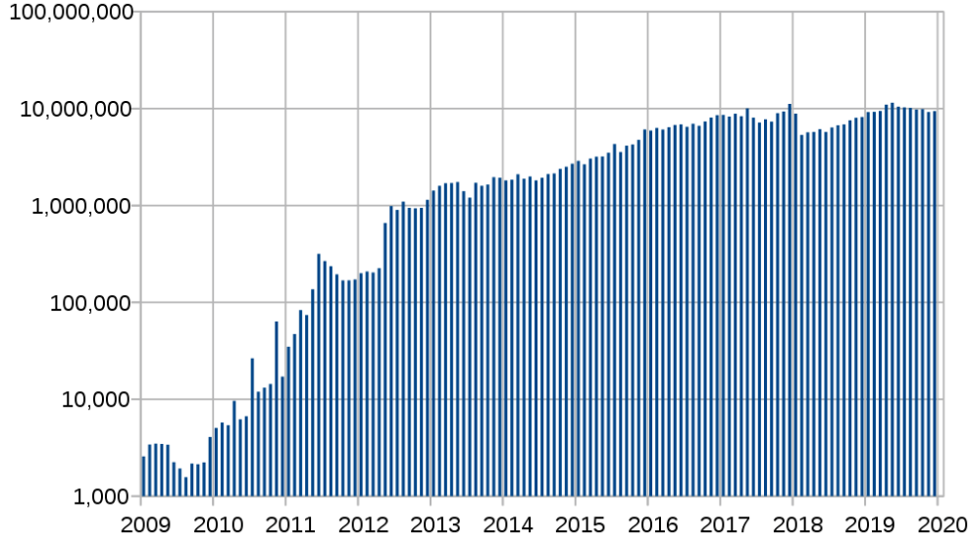
Bitcoin
Here’s the catch…the difficulty of mining always changes
Upon its launch, Bitcoin (BTC) mining difficulty was 1. However, as of 3 November 2020, the difficulty level is around 16.7 trillion. Meaning the chances of your computer mining new BTC units is 1 in 16 trillion. Also, mining difficulty is adjusted roughly every two weeks, i.e. after 2,106, new blocks are added.

Slide 11
Bitcoin
Here’s the catch…the difficulty of mining always changes
Upon its launch, Bitcoin (BTC) mining difficulty was 1. However, as of 3 November 2020, the difficulty level is around 16.7 trillion. Meaning the chances of your computer mining new BTC units is 1 in 16 trillion. Also, mining difficulty is adjusted roughly every two weeks, i.e. after 2,106, new blocks are added.
144 blocks per day are mined on average, and there are 6.25 bitcoins per block. 144 x 6.25 is 900, so that's the average amount of new bitcoins mined per day.
Crescent Electric estimates that bitcoin has an average mining cost of $4,161 per bitcoin. You saw in your reading, “As of April 2020, if bitcoin were a country, it would rank 35th in annual electricity consumption in the world, more than all of Finland and just behind Pakistan”

Slide 12
Bitcoin
To get the cash for your Bitcoin, you use a cryptocurrency exchange, such as Coinbase or Kraken. This is the easiest method if you want to sell bitcoin and withdraw the resulting cash directly to a bank account.

Slide 13
Security Implications
SCAMS
Because it's easy for companies to take peoples' money, and then not pay out. A company can claim to be a cloud mining company without any proof of actually owning any hardware. So remember: 99.9% of cloud mining companies are scams.
Entities can claim to be a cryptocurrency exchange
Giving away the private (secret) key

Slide 14
Security Implications
BOTS
Cybercriminals need computing power to do Bitcoin mining. What if they could develop a botnet to do the mining for them? They ARE doing that.
DDOS
Imagine attacking a mining platform such that the platform cannot perform the computations needed – giving attackers an advantage
DIRECT ATTACKS ON BITCOIN STORES
Wallets – software and hardware. Software simply has vulnerabilities and if a vulnerability can be exploited, massive amounts of Bitcoin can be stolen.

Slide 15
Blockchain- The Future
May be the way that we remove uncertainty and increase trust in order to exchange items of value with others.
Traditional methods:
Banks
Government
Commerce Platforms
Escrows
Reputation/Performance Review Capabilities
NOTE: All of these are centralized institutions. All of them have significant weaknesses in removing uncertainty.
Blockchain: Decentralized and no real understandable weakness WITHIN THE CHAIN

Slide 16
Blockchain- The Future
May be the way that we remove uncertainty and increase trust in order to exchange items of value with others.
How about our identity? How many identities do you have? What if you had just one – and the aspects of your identity were secure?
The impact to scams The impact to anonymity online (good and bad)
The impact to online reputation

Slide 17
Cryptocurrency - The Future
Think of a future where:
We do banking, with no banks
Ecommerce without Ebay and listing fees
Gambling without a Casino
Transportation services without Uber/Lyft
Stock trading without a stock market like Nasdaq
Today, the aggregate value of all significant cryptocurrencies (there are about 6600 coins today) is now over $2 trillion

Slide 18
Blockchain- Disadvantages
Data is decentralized, but not in a distributed manner
Scalability concerns
Energy consumption
Immutable data – is that good or bad in a practical sense?
Could be very disruptive or costly to implement

Slide 19
Cryptocurrency - The Issues
Cryptocurrency and the environment
https://www.cnbc.com/2021/02/05/bitcoin-btc-surge-renews-worries-about-its-massive-carbon-footprint.html
Bitcoin mining produces 36.95 megatons of carbon dioxide annually (comparable to New Zealand) and it is estimated that in 30 years Bitcoin mining alone could alone increase global temperatures 2 degrees Celsius. About 65 percent of cryptocurrency mining occurs in China, where electricity is cheap.

Slide 20
Cryptocurrency - The Issues
Bitcoin / Cryptocurrency and Profiteering
https://www.moneycontrol.com/news/business/cryptocurrency/ethereums-co-founder-vitalik-buterin-becomes-the-worlds-youngest-crypto-billionaire-6854951.html
What will people do in a market of competition?
https://www.coindesk.com/steem-community-mobilizes-popular-vote-in-battle-with-justin-sun

Slide 21
Cryptocurrency - The Issues
A Method to Be Paid
Will cryptocurrency be the way that organizations reward us for our value? This kind of stuff is happening right now.
Our business Our data Our attention Our computers
*PASSIVE INCOME*
STEEM – for social media and content-based applications
GONG – buying and selling cloud computing
STORJ – buying cloud storage

Slide 22
Cryptocurrency - The Issues
A method to be paid
More cryptocurrency accepting industries
https://cryptoslate.com/cryptos/storage/
How about WINK and WIN? Passive income
https://cryptoslate.com/coins/wink-tronbet/

