Slide 1
Risk Management CSS310 – Spring 2021 Lesson 2

Slide 2
AGENDA
REVIEW KEY TERMINOLOGY FROM LESSON 1
Risk Management Lifecycle

Slide 3
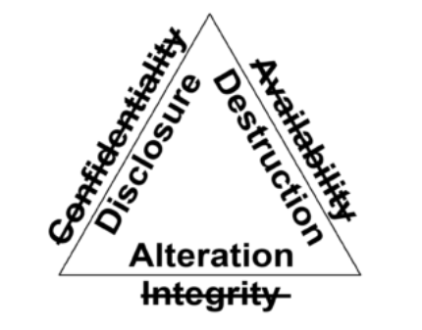
The CIA Triad
The recognized scope of protective responsibility that security professionals have for the implementation of controls to meet control objectives

Slide 4
C – I – A
Confidentiality - only the people who are authorized to do so can gain access to data.
Integrity – data is not modified in an unauthorized or harmful manner throughout its lifecycle
Availability – data and systems are available to authorized individuals

Slide 5
Threats/Vulnerabilities/Risks
Threat - an event, action, actor, that searches for, identifies, and/or exploits vulnerabilities in a target environment or system which results in derogatory/harmful outcomes
Vulnerability – a weakness in a system or environment that could be exploited by a threat which would derogatorily impact confidentiality, integrity or availability of information or information systems
Risk - the culminated potential harm due to the presence of a threat and a vulnerability

Slide 6
Controls and Control Objectives
CONTROL | CONTROL OBJECTIVE
UserID | Ensure each individual accessing a system can be uniquely identified
Password | Validate that the individual gaining access is the actually the individual (authentication)
Password Expiration | Protect from unauthorized access due to compromised passwords
Data Sharing Policy | Prevent data from leaving the environment where reduced controls could lead to unauthorized disclosure
Firewall | Allow only desired network traffic into a particular network/network zone
Encryption for data in transit | Maintain confidentiality of communications between a transmitter and recipient
Document Shredding | Prevent disclosure of information in unprotected areas such as garbage bins, and during transport to/from garbage bins
Maintain redundancy (hot available, backups, worms) | Maintain system availability
Network segmentation | Allow desired traffic, for the protection of different classes of assets

Slide 7
Questions
Is an insecurely coded application a risk?
When I use checksum on a hash of data, what aspect of the data am I protecting?
Confidentiality, Integrity, or Availability?
Is this a good control objective statement?
“The organization will configure systems to not execute undesired/unplanned software”

Slide 8
Moving On to Lesson 2
We understand CIA scope of info sec responsibility
We understand threats/vulnerabilities/risks
We understand control objectives and controls Let’s explore the risk management lifecycle

Slide 9
Risk Management Lifecycle
Identify and Inventory the Environment
Identify Threats and Vulnerabilities and Controls
Identify and Measure Risk
Prioritize Risk
Identify Control Objectives to Mitigate Priority RIsks
Apply Controls
Measure Efficacy of the Controls
Repeat

Slide 10
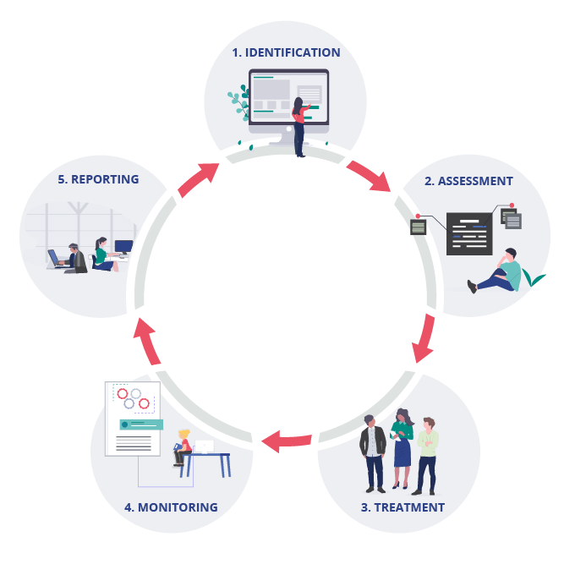
Variations
https://www.ideagen.com/company/blog/the-key-stages-to-the-risk-management-lifecycle

Slide 11
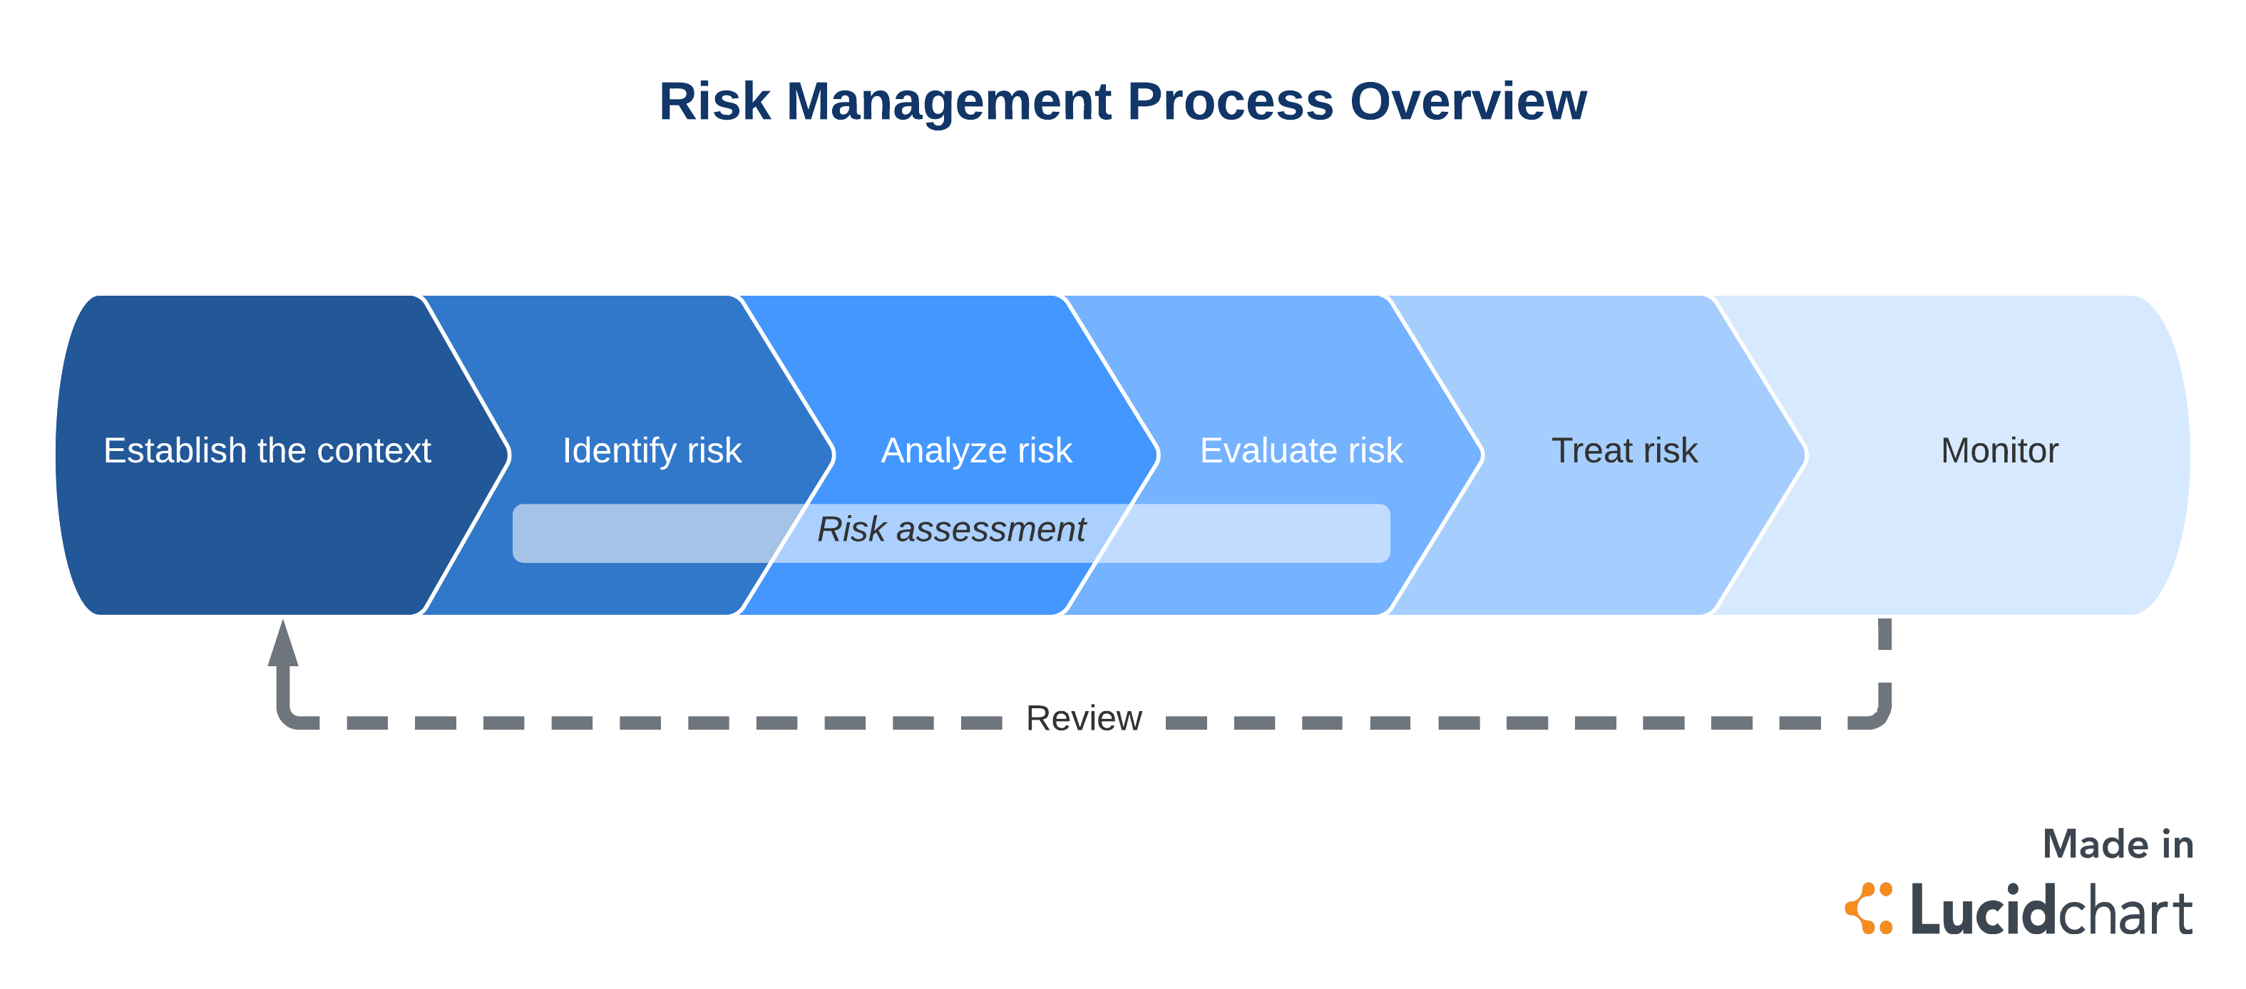
Variations
https://www.lucidchart.com/blog/risk-management-process

Slide 12
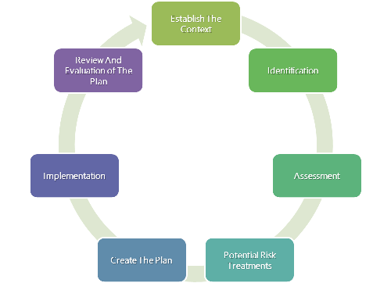
Variations
https://www.iedunote.com/risk-management

Slide 13
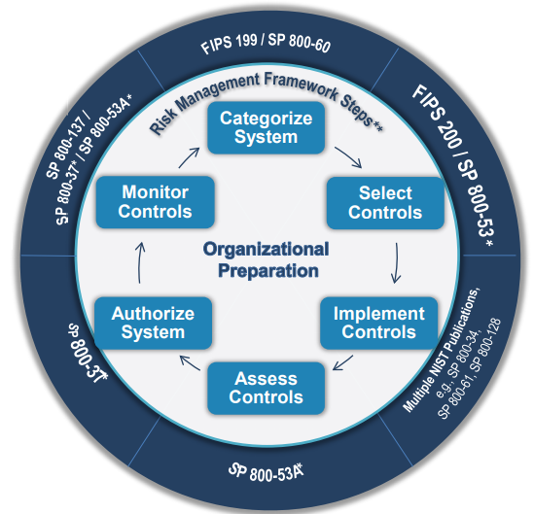
Variations
https://www.nist.gov/system/files/documents/2018/03/28/vickie_nist_risk_management_framework_overview-hpc.pdf

Slide 14
Risk Management Lifecycle
Identify and Inventory the Environment*
What is the business and how important is security?
What are the systems, applications, and data?
Categorization and Classification
Who uses them
Where are they (on-prem, cloud, SaaS)
Network architecture / Vendors
Who are the third-parties?
Data and service providers
Who you share data with
*Understand the context of the organization

Slide 15
Identify and Inventory the Environment
What is the business and how important is security?
What does it do?
Will there be international or multi-state implications?
What kind of risks are likely to be most important to the organization?
This will lead directly to understanding compliance requirements

Slide 16
Identify and Inventory the Environment
What are the systems, applications, and data?
How complex is the IT environment?
Do they mitigate risks themselves or offload it?
What is the kind of data being handled? Are there compliance requirements surrounding them? What kinds of risks are inherent with that kind of data?

Slide 17
Identify and Inventory the Environment
Who are the third parties?
Who is providing them service?
What kind of services? Are any inherently risky?
Will be looking at whether the organization is properly protected from this kind of risk.

Slide 18
Identify and Inventory the Environment
Once you are done
You can identify the area of interest in an environment that will be going through “risk management”
Maybe all
Maybe components
You have a lay of the land about what you will need to look at
Systems, data types, third-parties, current security abilities
You are able to understand relevant threats
Which becomes the next part of the document

Slide 19
TRANSITION
Writing
Neutral – remove first-person
Always establish an introduction
The reader doesn’t know about “the assignment”
The reader doesn’t know about “the article”
Don’t use judgmental adjectives
“The hacker’s incompetence was obvious when he left traces of his activity”
Don’t add “flare”. Reader’s don’t want to hear “your voice”. They want to hear their voice.
“This horrific risk to Netflix…”

Slide 20
TRANSITION
Writing
APA – do it. When there is a fact from a third-party in a paper, I want inline citation. I want full citation at the end. Best resource I know for help is
https://owl.purdue.edu/owl/research_and_citation/apa_style/apa_formatting_and_style_guide/general_format.html
I want double-space.
I don’t care about running heads, abstracts, page numbers.

Slide 21
TRANSITION
Writing
MEAL PLAN
Main Point
Evidence
Analysis
Linkage

Slide 22
TRANSITION
MEAL
(M) The hacker conducted the activities that are associated with a notable threat category; reconnaissance. (E) Reconnaissance is any activity that occurs against a system and is a threat when the activity is intended to or could result in damage to the system (Cooper, 2020). (A) Utilizing publicly-available information the attacker was able to gain important information about Target’s environment. This included information about the type of point of sale system utilized, how third-party providers could gain some level of entry into a Target system, and what kind of software the company utilized for maintaining security updates and configurations on its system. (L) This kind of reconnaissance allowed the attacker to plan the approach for the attack and identify the kind of vulnerabilities that it could expect in Target’s environment.

Slide 23
TRANSITION
MEAL
(M) The final threat type that contributed to this breach was the insider. (E) An insider threat does not have to be an individual with malicious intent, but one whose actions can result in a derogatory outcome (Cohen 2019). (A) What made the insider in Target’s case and especially significant threat is because of the threats that the insider succumbed to. The insider, a Fazio Mechanical employee, succumbed to a social engineering threat through a phishing email which provided means for the presentation of malware to the employee. When the employee didn’t recognize the social engineering threat, the malware became a threat. (L) Interestingly, Krebs (2014) notes that Fazio Mechanical utilized a free-ware version of antimalware for their computers with outdated signatures and no host-based firewall protection enabled.

