Slide 1
Introduction to Threats CSS310b – Spring 2021 Lesson 3

Slide 2
Today’s Agenda
Review of Lesson 2
Introduction to Threats

Slide 3
Risk Management Lifecycle
Identify and Inventory the Environment*
What is the business and how important is security?
What are the systems, applications, and data?
Categorization and Classification
Who uses them
Where are they (on-prem, cloud, SaaS)
Network architecture / Vendors
Who are the third-parties?
Data and service providers
Who you share data with
*Understand the context of the organization

Slide 4
Identify and Inventory the Environment
What is the business and how important is security?
What does it do?
Will there be international or multi-state implications?
What kind of risks are likely to be most important to the organization?
This will lead directly to understanding compliance requirements

Slide 5
Identify and Inventory the Environment
What are the systems, applications, and data?
How complex is the IT environment?
Do they mitigate risks themselves or offload it?
What is the kind of data being handled? Are there compliance requirements surrounding them? What kinds of risks are inherent with that kind of data?

Slide 6
Identify and Inventory the Environment
Who are the third parties?
Who is providing them service?
What kind of services? Are any inherently risky?
Will be looking at whether the organization is properly protected from this kind of risk.

Slide 7
Identify and Inventory the Environment
Once you are done
You can identify the area of interest in an environment that will be going through “risk management”
Maybe all
Maybe components
You have a lay of the land about what you will need to look at
Systems, data types, third-parties, current security abilities
You are able to understand relevant threats
Which becomes the next part of the document

Slide 8
Risk Management Lifecycle
Identify and Inventory the Environment
Identify Threats and Vulnerabilities and Controls
Identify and Measure Risk
Prioritize Risk
Identify Control Objectives to Mitigate Priority RIsks
Apply Controls
Measure Efficacy of the Controls
Repeat

Slide 9
Types of Threats
Hacking Types
Black Hat
are criminals who break into computer networks with malicious intent. They may also release malware that destroys files or steals passwords
Grey Hat
Individuals who often identity vulnerabilities and weaknesses in systems. Will normally delay any exploitation or publicity for a period of time, allowing for vulnerability to be addressed
White Hat
aka Ethical Hackers/Pen Testers – work for organizations to identify vulnerabilities and exploits

Slide 10
Hacking Myths
What Hacking Is NOT
https://www.youtube.com/watch?v=Q1CzCQ4eT0g

Slide 11
Hacking Reality
What Hacking Is
https://www.youtube.com/watch?v=j0EZpH_eIsY

Slide 12
Types of Threats
Malware
Malware is a general term for software that is specifically designed to disrupt, damage, or gain unauthorized access to a computing system

Slide 13
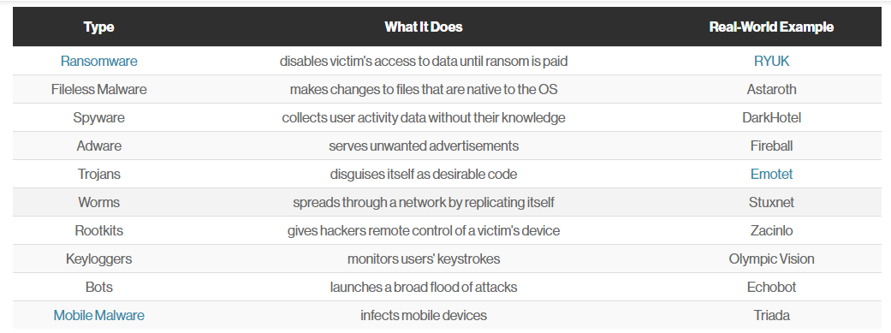
Types of Malware

Slide 14
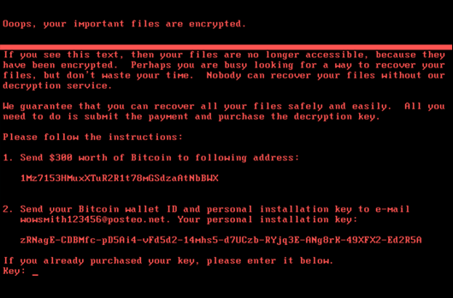
Types of Malware
Ransomware
uses encryption to disable a target’s access to its data until a ransom is paid

Slide 15
Types of Malware
Fileless Malware
doesn’t install anything initially, instead, it makes changes to files that are native to the operating system, such as PowerShell or WMI. Because the operating system recognizes the edited files as legitimate, a fileless attack is not caught by antivirus software

Slide 16
Types of Malware
Spyware
collects information about users’ activities without their knowledge or consent. This can include passwords, pins, payment information and unstructured messages.
The use of spyware is not limited to the desktop browser: it can also operate in a critical app or on a mobile phone

Slide 17
Types of Malware
Adware
tracks a user’s surfing activity to determine which ads to serve them. Although adware is similar to spyware, it does not install any software on a user’s computer, nor does it capture keystrokes

Slide 18
Types of Malware
Trojan
disguises itself as desirable code or software. Once downloaded by unsuspecting users, the Trojan can take control of victims’ systems for malicious purposes. Trojans may hide in games, apps, or even software patches, or they may be embedded in attachments included in phishing emails.

Slide 19
Types of Malware
Worms
target vulnerabilities in operating systems to install themselves into networks. They may gain access in several ways: through backdoors built into software, through unintentional software vulnerabilities, or through flash drives. Once in place, worms can be used by malicious actors to launch DDoS attacks, steal sensitive data, or conduct ransomware attacks

Slide 20
Types of Malware
Virus
a piece of code that inserts itself into an application and executes when the app is run. Once inside a network, a virus may be used to steal sensitive data, launch DDoS attacks or conduct ransomware attacks
A virus cannot execute or reproduce unless the app it has infected is running. This dependence on a host application makes viruses different from trojans, which require users to download them, and worms, which do not use applications to execute. Many instances of malware fit into multiple categories: for instance, Stuxnet is a worm, a virus and a rootkit

Slide 21
Types of Malware
Rootkit
a piece of code that inserts itself into an application and executes when the app is run. Once inside a network, a virus may be used to steal sensitive data, launch DDoS attacks or conduct ransomware attacks

Slide 22
Types of Malware
Keylogger
a type of spyware that monitors user activity. Keyloggers have legitimate uses; businesses can use them to monitor employee activity and families may use them to keep track of children’s online behaviors.
However, when installed for malicious purposes, keyloggers can be used to steal password data, banking information and other sensitive information. Keyloggers can be inserted into a system through phishing, social engineering or malicious downloads

Slide 23
Types of Malware
Bots/Botnets
a software application that performs automated tasks on command. They’re used for legitimate purposes, such as indexing search engines, but when used for malicious purposes, they take the form of self-propagating malware that can connect back to a central server.
Usually, bots are used in large numbers to create a botnet which is a network of bots used to launch broad remotely-controlled floods of attacks, such as DDoS attacks. Botnets can become quite expansive

Slide 24
Types of Malware
Mobile Malware
General category for all the aforementioned types of malware, but targeting mobile devices. They are distributed through phishing and malicious downloads and are a particular problem for jailbroken phones, which tend to lack the default protections that were part of those devices’ original operating systems

Slide 25
Types of Threats
Social Engineering
a non-technical strategy cyber attackers use that relies heavily on human interaction and often involves tricking people into breaking standard security practices
Popular types:
Phishing Quid pro Quo
Baiting Tailgating
Spear Phishing Spear Phishing
Scareware Pretexting
https://phoenixnap.com/blog/what-is-social-engineering-types-of-threats

Slide 26
Types of Social Engineering
Phishing
When a website, article, or online community is presented to a targeted individual as authentic and secure but instead uses a URL that is not official

Slide 27
Types of Social Engineering
Baiting
Baiting is used in both the digital and physical world.
Baiting consists of leaving devices in public areas that are packed with malware, spyware, or other damaging software which is then used to steal and collect the information of users who are tempted to see the contents of the device

Slide 28
Types of Social Engineering
Spear Phishing
Spear phishing is designed to personally attack an individual or organization to appear more authentic and legitimate than just a phishing attack
Spear phishing attacks often utilize a user’s personal information or details about an individual to gain the trust and curiosity of the user before stealing information, installing malware, or delivering a keylogger to the individual’s hard drive

Slide 29
Types of Social Engineering
Tailgating
Tailgating is a social engineering threat that is purely physical and involves real-world interaction to work. When a hacker is interested in obtaining the information of a specific individual or organization, they may follow them to local cafes or locations where free Wi-Fi is available..and then hack into the Wi-Fi.
Other forms of tailgating may include leveraging an individual’s access pass to enter a building

Slide 30
Types of Social Engineering
Scareware
Scareware is extremely successful in obtaining user information and financial details.
Often presented as popups or programs while prompting users with warnings or threats to receive information such as names, credit card details, and even social security numbers

Slide 31
Types of Social Engineering
Pretexting
Pretexting scams are used to collect personal information from individuals by impersonating police, government officials, bank account managers, or even co-workers.
Hackers use pretexting to target unsuspecting individuals who are likely to feel threatened or fearful of retribution if they do not share the requested information
Business Email Compromise (BEC) is a combination of phishing, spear phishing, and pretexting. The business email system itself may/may not be compromised

Slide 32
Types of Social Engineering
Quid pro Quo
Quid pro quo involves hackers requesting information from unsuspecting individuals with the promise of offering something in return.
Individuals presented with a quid pro quo attack are likely to receive offers of compensation, free vacations, or gifts such as new products that are most relevant to the individual’s lifestyle

Slide 33
Types of Threats
Insider
Insiders can violate the confidentiality, integrity, or availability of data in an organization. The reasons for any kind of disruptive action varies, but are commonly due to dissatisfaction with the workplace, or for personal financial gain

Slide 34
Types of Threats
Reconnaissance
taking actions to identify systems, assets, and their configurations for further malicious purpose

Slide 35
Types of Threats
Man-in-the-Middle
a general term for when a perpetrator positions himself in a conversation between a user and an application—either to eavesdrop or to impersonate one of the parties, making it appear as if a normal exchange of information is underway

Slide 36
Types of Threats
Denial of Service / Distributed Denial of Service
a cyber-attack in which the perpetrator seeks to make a machine or network resource unavailable to its intended users by temporarily or indefinitely disrupting services of a host connected to the Internet. Most commonly, the attack consists of flooding a system with so much traffic that it is unable to process the traffic

Slide 37
Review
https://www.youtube.com/watch?v=jTIUgshJjds

Slide 38
Getting Literal – Self Quiz
Answer this by yourself. Record your answer as “yes” or “no” on paper or notepad
Is a breach of data a threat?
Is an autonomous scanner a threat?
Is a crashed system a threat?
Is a grey hat hacker a threat?
Is an unpatched system a threat?

Slide 39
Getting Literal - Answers
Is a breach of data a threat?
No – it is a risk
Is an autonomous scanner a threat?
Yes – it has malicious intent to find exploits
Is a crashed system a threat?
No – it is a risk
Is a grey hat hacker a threat?
Yes – it is the threat actor
Is an unpatched system a threat?
No – it is a vulnerability

