Slide 1
Introduction to Vulnerabilities CSS310a – Spring 2021 Lesson 4

Slide 2
AGENDA
Review of Threats
Introduction to Vulnerabilities

Slide 3
Risk Management Lifecycle
Identify and Inventory the Environment
Identify Threats and Vulnerabilities and Controls
Identify and Measure Risk
Prioritize Risk
Identify Control Objectives to Mitigate Priority RIsks
Apply Controls
Measure Efficacy of the Controls
Repeat

Slide 4
Types of Threats
Hacking Types
Black Hat
are criminals who break into computer networks with malicious intent. They may also release malware that destroys files or steals passwords
Grey Hat
Individuals who often identity vulnerabilities and weaknesses in systems. Will normally delay any exploitation or publicity for a period of time, allowing for vulnerability to be addressed
White Hat
aka Ethical Hackers/Pen Testers – work for organizations to identify vulnerabilities and exploits

Slide 5
Reminder
For this course and for your understanding of how the industry views things:
In the greatest sense, there is actually just two threats– the “bad actor”. That is anyone who does wrong with their access or attempts to damage the CIA of an environment/data. And physical threats.
But, we must understand and be competent in the other things that are considered “threats” by the industry
We will use the industry as our standard for conversation, papers, analysis, exams

Slide 6
Types of Threats
Malware
Malware is a general term for software that is specifically designed to disrupt, damage, or gain unauthorized access to a computing system

Slide 7
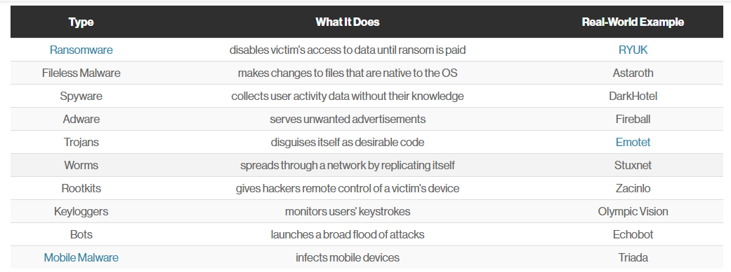
Types of Malware

Slide 8
Virus v Worm v Trojan Horse
Virus attaches to a program – changes how the program executes. Requires human action to cause the intended damage (e.g. execute the changed program). Fire it up and it disables A/V, opens ports for communication, does an install, for an example.
Worm – a type of virus – but it spreads without human interaction. It is active and can traverse automatically.
One example would be for a worm to send a copy of itself to everyone listed in your e-mail address book. Then, the worm replicates and sends itself out to everyone listed in each of the receiver's address book, and the manifest continues on down the line
A Trojan horse is not a virus. It is a destructive program that looks as a genuine application. Unlike viruses, Trojan horses do not replicate themselves but they can be just as destructive. Trojans also open a backdoor entry to your computer which gives malicious users/programs access to your system, allowing confidential and personal information to be theft

Slide 9
Types of Threats
Social Engineering
a non-technical strategy cyber attackers use that relies heavily on human interaction and often involves tricking people into breaking standard security practices
Popular types:
Phishing Quid pro Quo
Baiting Tailgating
Spear Phishing Spear Phishing
Scareware Pretexting
https://phoenixnap.com/blog/what-is-social-engineering-types-of-threats

Slide 10
Types of Threats
Insider
Insiders can violate the confidentiality, integrity, or availability of data in an organization. The reasons for any kind of disruptive action varies, but are commonly due to dissatisfaction with the workplace, or for personal financial gain

Slide 11
Types of Threats
Reconnaissance
taking actions to identify systems, assets, and their configurations for further malicious purpose

Slide 12
Types of Threats
Man-in-the-Middle
a general term for when a perpetrator positions himself in a conversation between a user and an application—either to eavesdrop or to impersonate one of the parties, making it appear as if a normal exchange of information is underway

Slide 13
Types of Threats
Denial of Service / Distributed Denial of Service
a cyber-attack in which the perpetrator seeks to make a machine or network resource unavailable to its intended users by temporarily or indefinitely disrupting services of a host connected to the Internet. Most commonly, the attack consists of flooding a system with so much traffic that it is unable to process the traffic

Slide 14
Vulnerabilities
Different Vulnerabilities
Complicated user interface
Default passwords not changed
Disposal of storage media without deleting data
Equipment sensitivity to changes in voltage
Equipment sensitivity to moisture and contaminants
Equipment sensitivity to temperature
Inadequate cabling security
Inadequate capacity management
Inadequate change management
Inadequate classification of information
Inadequate control of physical access
Inadequate maintenance

Slide 15
Vulnerabilities
Different Vulnerabilities
Inadequate network management
Inadequate or irregular backup
Inadequate password management
Inadequate physical protection
Inadequate protection of cryptographic keys
Inadequate replacement of older equipment
Inadequate security awareness
Inadequate segregation of duties
Inadequate segregation of operational and testing facilities
Inadequate supervision of employees
Inadequate supervision of vendors
Inadequate training of employees
Incomplete specification for software development

Slide 16
Vulnerabilities
Different Vulnerabilities
Insufficient software testing
Lack of access control policy
Lack of clean desk and clear screen policy
Lack of control over the input and output data
Lack of internal documentation
Lack of or poor implementation of internal audit
Lack of policy for the use of cryptography
Lack of procedure for removing access rights upon termination of employment
Lack of protection for mobile equipment
Lack of redundancy
Lack of systems for identification and authentication
Lack of validation of the processed data

Slide 17
Vulnerabilities
Different Vulnerabilities
Location vulnerable to natural disaster
Poor selection of test data
Single copy
Too much power in one person
Uncontrolled copying of data
Uncontrolled download from the Internet
Uncontrolled use of information systems
Undocumented software
Unmotivated employees
Unprotected public network connections
User rights are not reviewed regularly

Slide 18
Vulnerabilities
Catalog of Different Vulnerabilities
Identity
Authorization
Access Control
Data Storage and Transmission
System Configuration (hardware, OS, infrastructure)
Coding (applications, services)
Nonrepudiation
Policies
Physical environment

Slide 19
Note: Vulnerabilities
Threats we don’t talk about generally
Natural disaster
Impacts availability
Why don’t we talk about these things enough in the realm of information security?

Slide 20
Conversation
Why isn’t a poor incident response capability not seen as a vulnerability in my catalog?
What is the category of vulnerability that is being exploited by a DDOS attack?
Why isn’t outdated malware considered a vulnerability?

Slide 21
Conversation
An employee is disgruntled and going to leave the company for a competitor. The employee grabs a thumbdrive and downloads the entire customer database to the drive and then leaves the company with it.
Identify the threat
Identify the vulnerability(ies) that was/were exploited

Slide 22
Conversation
An attacker activates a distributed denial-of-service attack against your organization’s e-commerce website infrastructure. The site is rendered unusable for customers.
Identify the vulnerability(ies) that was/were exploited

Slide 23
Conversation
What were the two ACTUAL threats?
Person with access with malicious or unintended actions or an individual trying to gain access
What is the vulnerability associated with an individual with access who intends to do harm or makes a mistake?

Slide 24
Summary
Multiple threat types
Theoretically, there are three…but we will understand the larger number from an industry-accepted standard
Multiple vulnerabilities
Should be able to condense them down to one of a finite number of categories identified here. For the purposes of different current/future assignments – these are solid categories
Be able to identify an incident, identify the threat, and the vulnerability category that was exploited

Slide 25
Looking Forward
Monday 4/12 – Lesson 6 OWASP Vulnerabilities
Wednesday 4/14 – Lesson 7 Practice Quiz & Control Objectives
Monday 4/19 – First full quiz – Lessons 1 - 6

Slide 26
Questions on Assignment

