Slide 1


Dox Homeless Shelter Site
By Eduardo Ponce De Leon , Bisrat Asefaw

Slide 2




Background
Our idea came about helping homeless people during the COVID-19 pandemic. We wanted to create a system which could be used by the staff at shelters to perform everyday tasks. Some of the functionality include a chat system, database (to keep records), calendar, maps, COVID-19 information, air quality index, weather, humidity, google translate, and much more.

Slide 3
Lessons Learned
> Using Azure services. We believe that learning this is very important in the industry because Azure is a service that offers a lot of technologies that companies use.
> Through the many courses we have taken at UW, we’ve learned different topics. Taking on a project like this allowed us to put together all the pieces in the puzzle together.
> We were able to experience and learn from the different technologies we used such as PHP and SQL

Slide 4
Challenges
> Costs: Our project required a database, server, and website host. We couldn’t find any funding for our project, so we had to pay a lot of out pocket costs
> Complexity: Our website has a lot of functionality and the website is very complex, especially the CSS portion. Iit became very hard to keep track of where some code was located and the changes we were making to the site.
> Accessibility: We both needed to have access to our project resources which were hosted on Azure and Dropbox. This because a problem because only one student was able to access the Dropbox where our site files were kept and synced into Azure

Slide 5
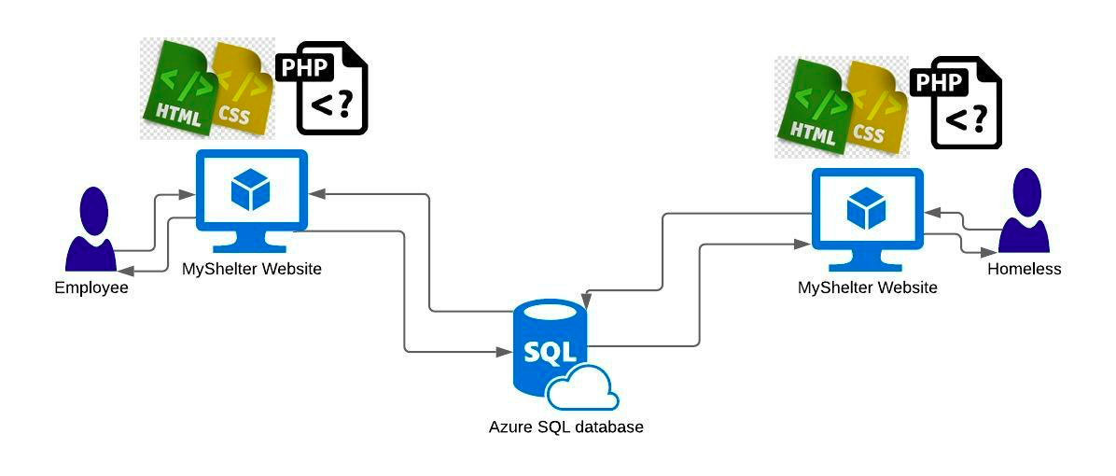
Software Architecture
Notes:
The two pages employee side and the homeless side are developed using HTML,CSS and PHP.
Database is developed using SQL. We developed the database depending on a 5+ homeless intake, employee information and donation forms we gathers from different states. We normalize the tables, create a relational algebra and SQL query languages.

Slide 6
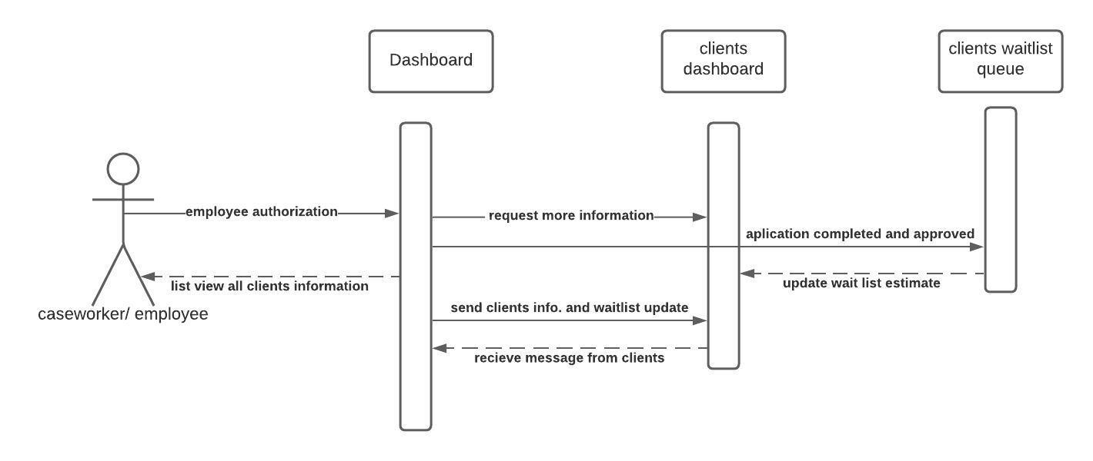
Sequence Diagram
Notes:
After a homeless person submits his/her homeless shelter intake form, the employee of the homeless shelter reviews the forms and if there is extra information required or need like corona virus test result, the employee can send a notification to the homeless person to include necessary forms. If the form is complete and all information are provided by the homeless person, the employee confirms the form and puts his request in waiting list queue depending on the homeless persons current conditions.
Another activities that can occur between caseworker and homeless person is exchanging information that relates to wait list like estimated wait time.

Slide 7
Demo
https://doxsite.azurewebsites.net/

Slide 8
Special Thanks
> Dr. Arnold Lund: Faculty Advisor
> Janet McDaniel: Capstone Advisor

