Slide 1
Internship Recommendation
Predicting Internship requirement for students based on their skills and push notification
Submitted by: Itishree Behera
Regd no:1805106012
MCA 6th sem
Guided by : Dr. Jibitesh Mishra
(HOD,CSA)

Slide 2
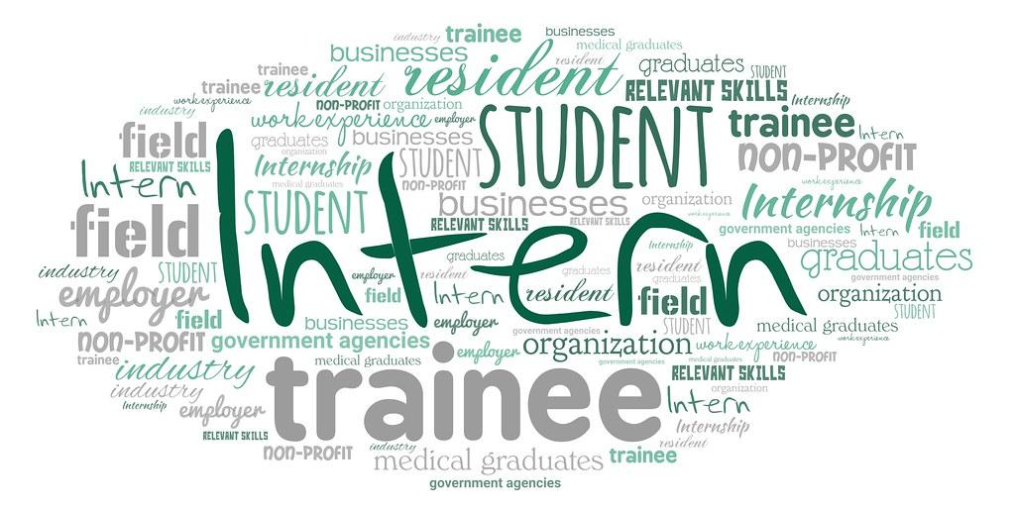
Abstract:
When a student wants an internship, it is often difficult since there is too much internship available with different skill sets. To select an appropriate internship and then submit a resume is a tedious job. It is particularly difficult for students since they normally are unfamiliar with the job market . To deal with the information overload for students during their transition into work, an internship recommendation system can be very valuable. While its a difficult job for the company to verify the resume of each and every applied students and filter out the best matched profile.This system can automate the task of matching the student’s profile with the company’s requirements based on the skill set.

Slide 3

Proposed system:
We have proposed a student skill based internship recommendation system where students are recommended a list of potential internships based on their skill set.
When a new internship is posted by the company, based on the company requirement the system will recommend the internship to the students having those required skills and push notification through email. In this system we are using jaccard similarity to create the ranking framework.
When one student apply the particular internship ,the system will show the matching skill percentage to the company.
When one company accepts the student’s application , the system will generate one certificate of acceptance and send the certificate to the particular student.

Slide 4
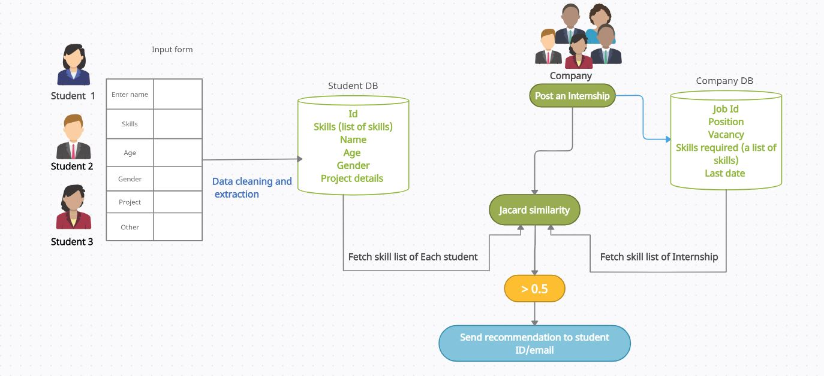
Architecture:

Slide 5
Jaccard similarity:
The Jaccard index is a statistic used for comparing the similarity and diversity of sample sets. The Jaccard coefficient measures similarity between finite sample sets, and is defined as the size of the intersection divided by the size of the union of the sample sets.
In this scenario,
A represents student skill-sets and B represents internship requirements skill list.

Slide 6
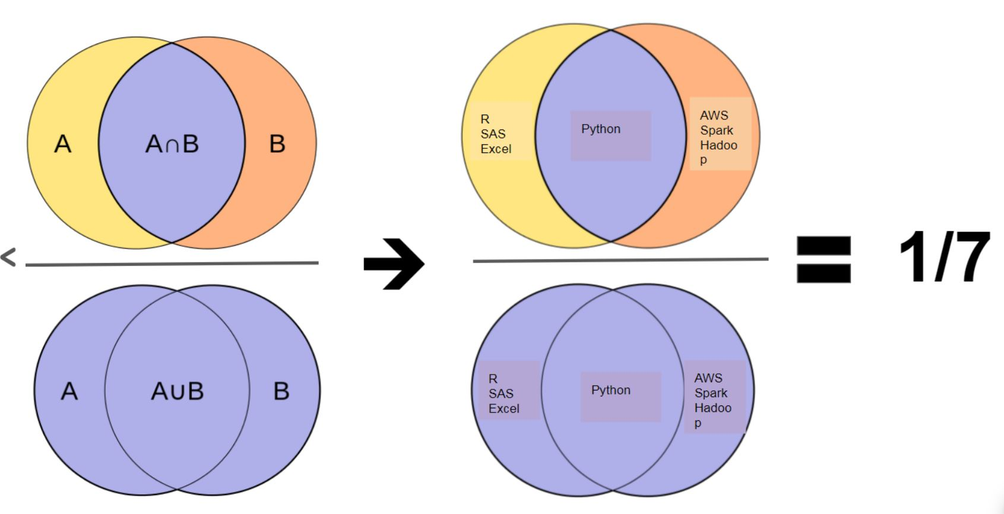

Slide 7
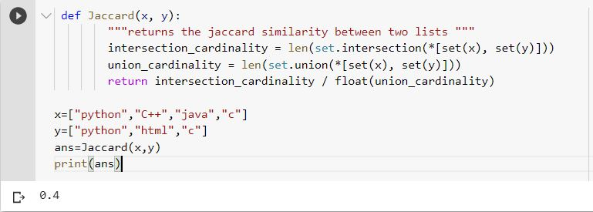
X: list of skills a student have
Y: List of skills required for a particular internship by the company

Slide 8
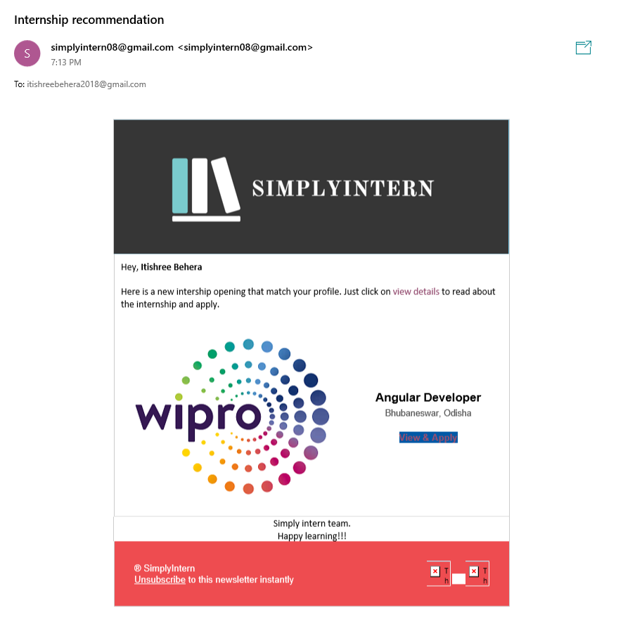
Push Notification:

Slide 9
send_mail()
send_mail(subject,
message,
from_email,
recipient_list,
fail_silently=False,
auth_user=None, auth_password=None, connection=None, html_message=None

Slide 10
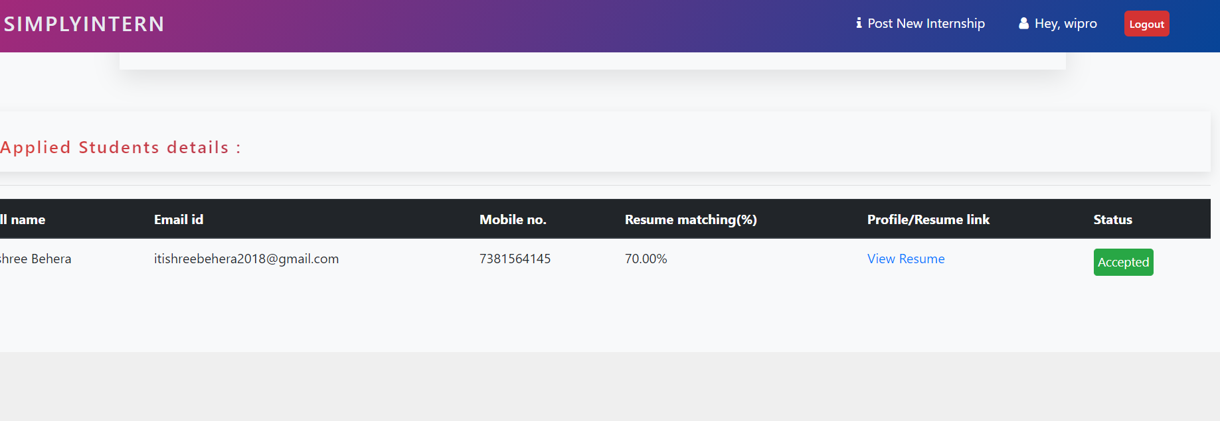
Profile Matching:

Slide 11
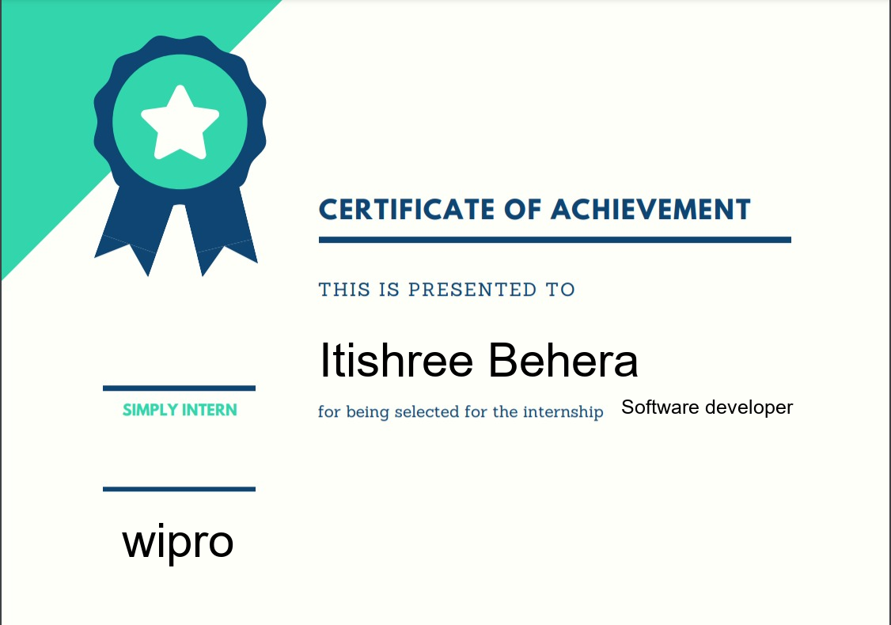
Certificate Generation:

Slide 12
font = ImageFont.truetype('arial.ttf', 60) img = Image.open('company/static/images/certificate.jpeg') draw = ImageDraw.Draw(img) draw.text(xy=(403, 421), text='{}'.format(name), fill=(0, 0, 0), font=font) draw.text(xy=(785, 500), text='{}'.format(post.title), fill=(0, 0, 0), font=ImageFont.truetype('arial.ttf', 25)) draw.text(xy=(154, 649), text='{}'.format(post.company), fill=(0, 0, 0), font=font) img_name=name+post.title img.save('{}.png'.format(img_name))

