Slide 1


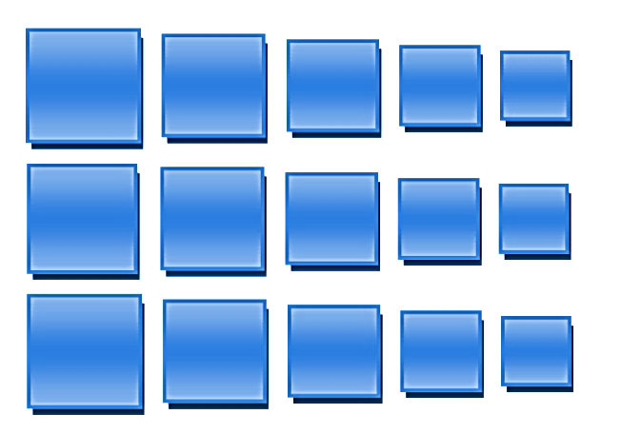
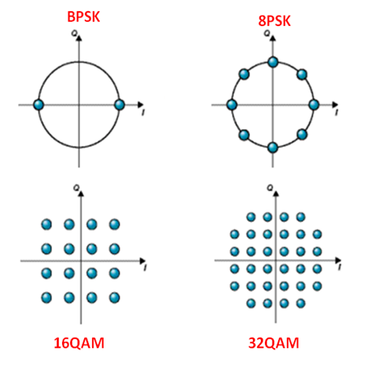
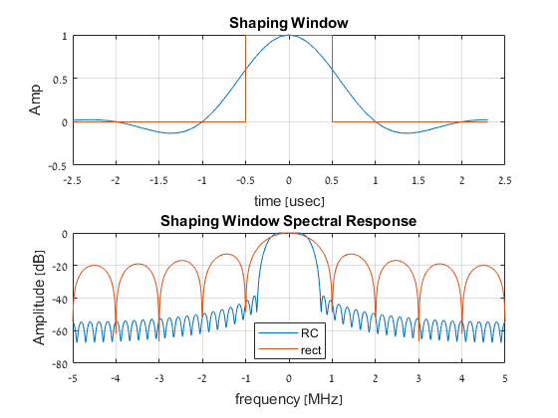
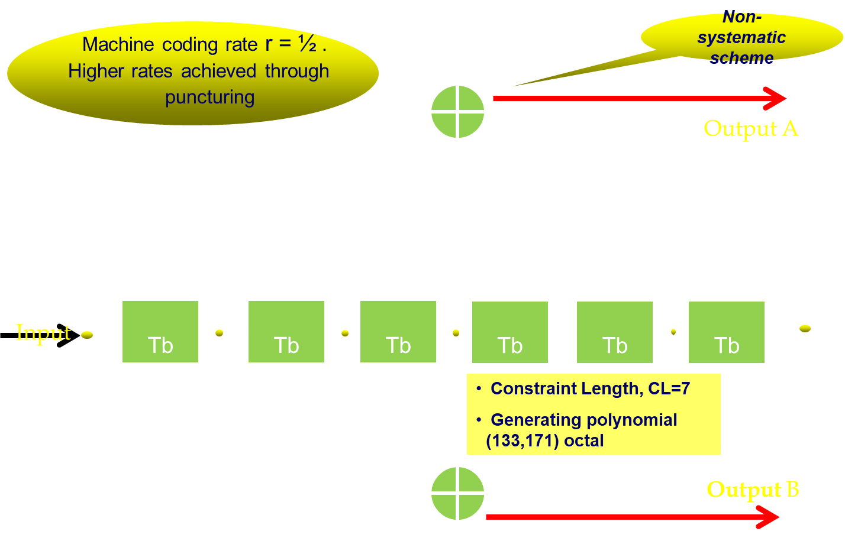
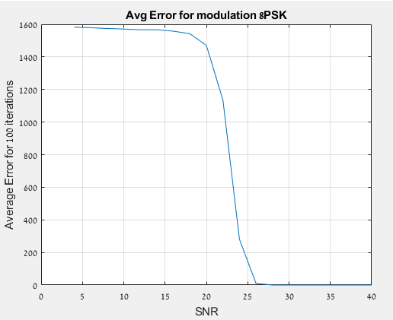
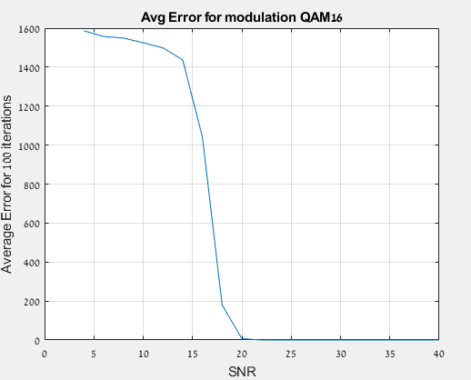
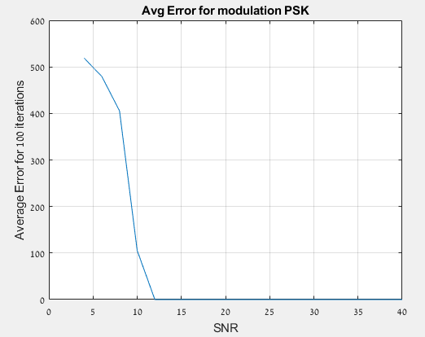
The Andrew & Erna Viterbi Faculty of
Electrical Engineering
Electronics
Computers
Communications
Coding and decoding Technics of binary data
Idan Tzachi &Dan ben-David Supervised by: Avi Biran
Background
Project Goals
The demand for binary data transmission in modern digital systems is growing at a high rate,
That alongside high frequency clocks is requiring the development of advanced coding and decoding technics- in order to grantee high speed efficient and reliable data transportation(above 1.00 GHz) between the components of the digital systems.
Theoretical part:
writing matalb code that implements encoding, modulating and pulse shaping of binary data in time domain.
Simulation of channel distoration
Building decoder
Practical part
Using HSDSL lab equipment in order to implement the signals.
Receiving the signals samples using the lab equipment through PC.
Pulse Modulation
Pulse Shaping
Phase Modulation
4PSK(QPSK)
8PSK
16PSK
32PSK
Pulse shapes:
Raised cosine :ISI zero, bandwidth is limited.
Rectangular window: simple, ISI zero, stable, not bandlimited.
Pulse Amplitude Modulation:
PSK
QPSK
QAM16
QAM64
Convoluting encoder
Results
SNR limit | Shaping window | Modulation
12 | Rect | PSK
14 | RC | PSK
14 | Rect | QPSK
14 | RC | QPSK
26 | Rect | 8PSK
42 | Rect | 32PSK
20 | Rect | QAM16
26 | Rect | QAM64
encoder with coding rate r=1/2 which lowers the BER.
The algorithm stability of ranning
100 times per SNR/Window/SNR
*rights preserve to Avi Biran

