Slide 1





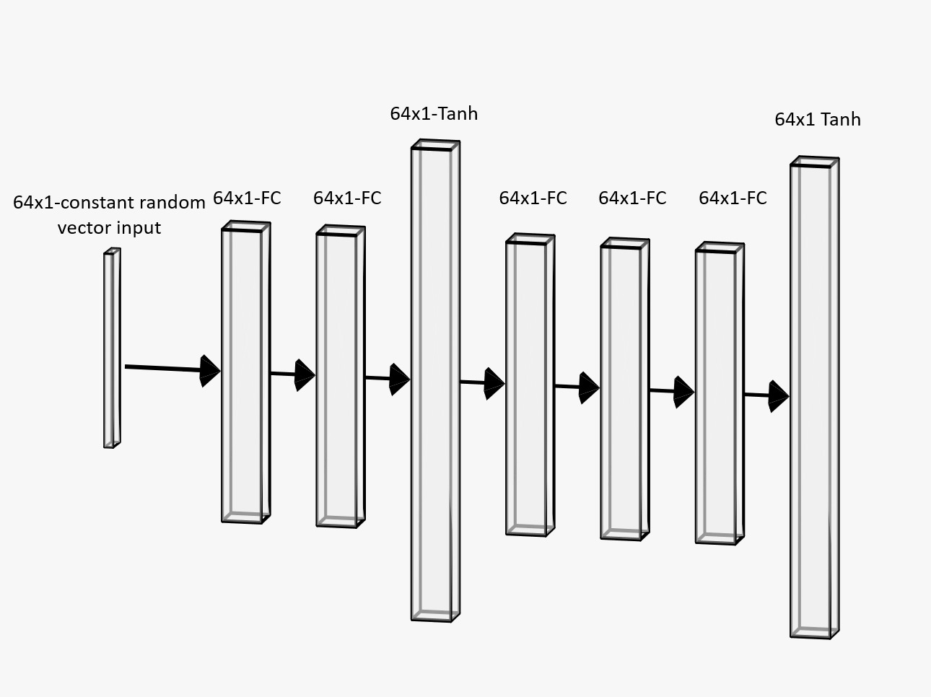
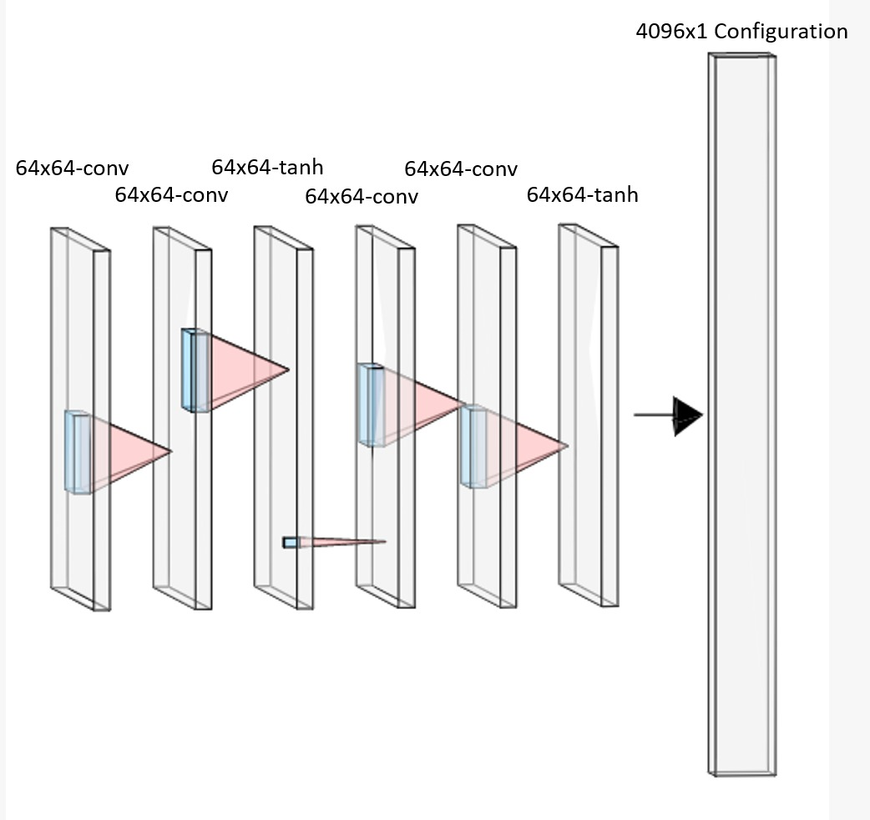
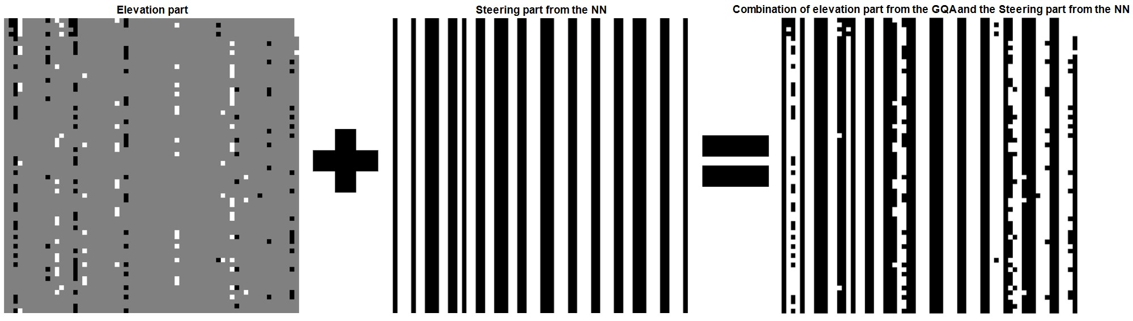
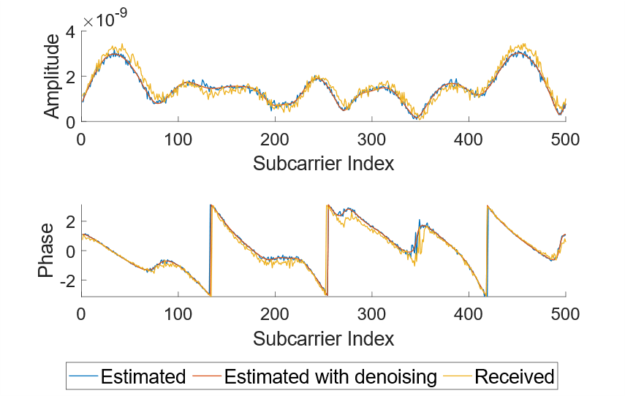
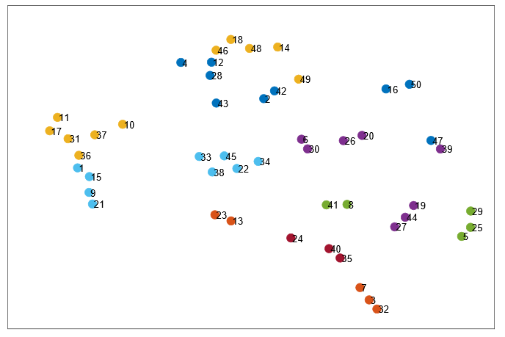
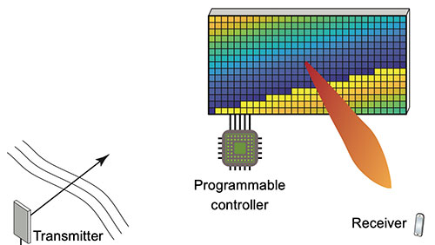
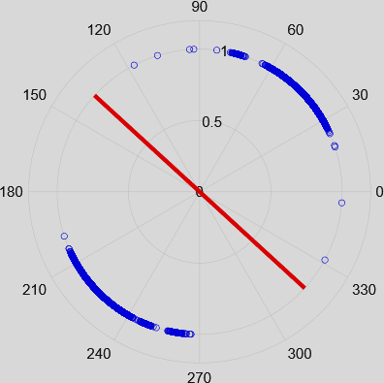
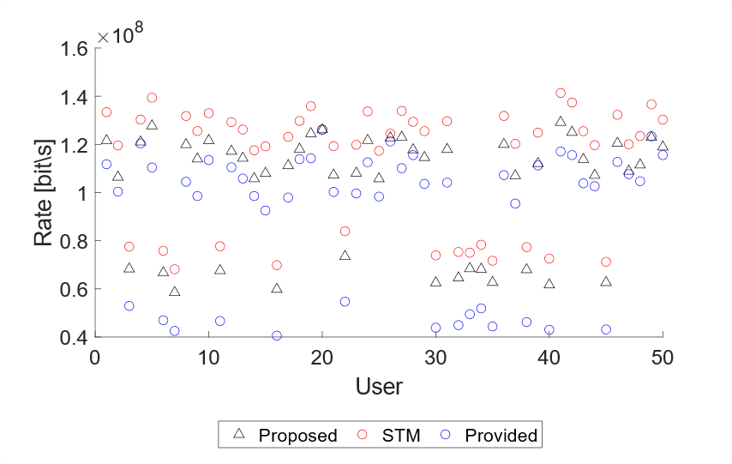
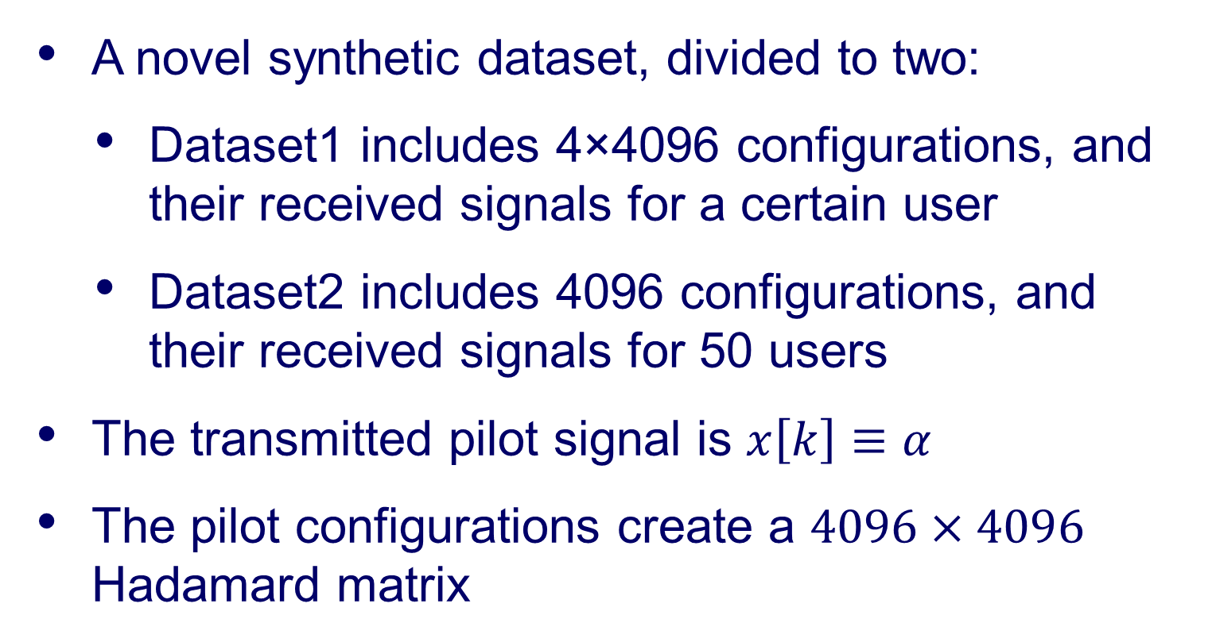
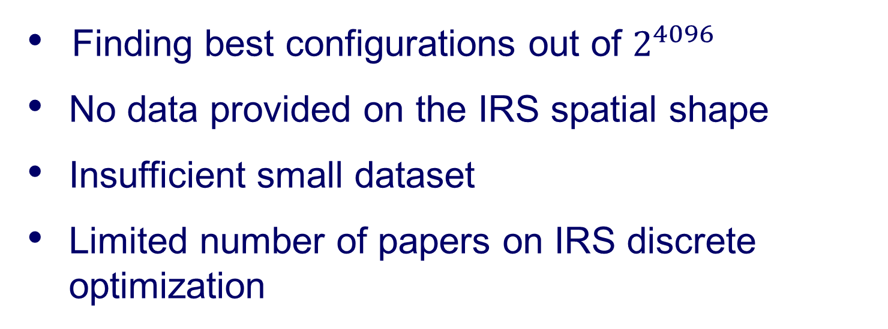
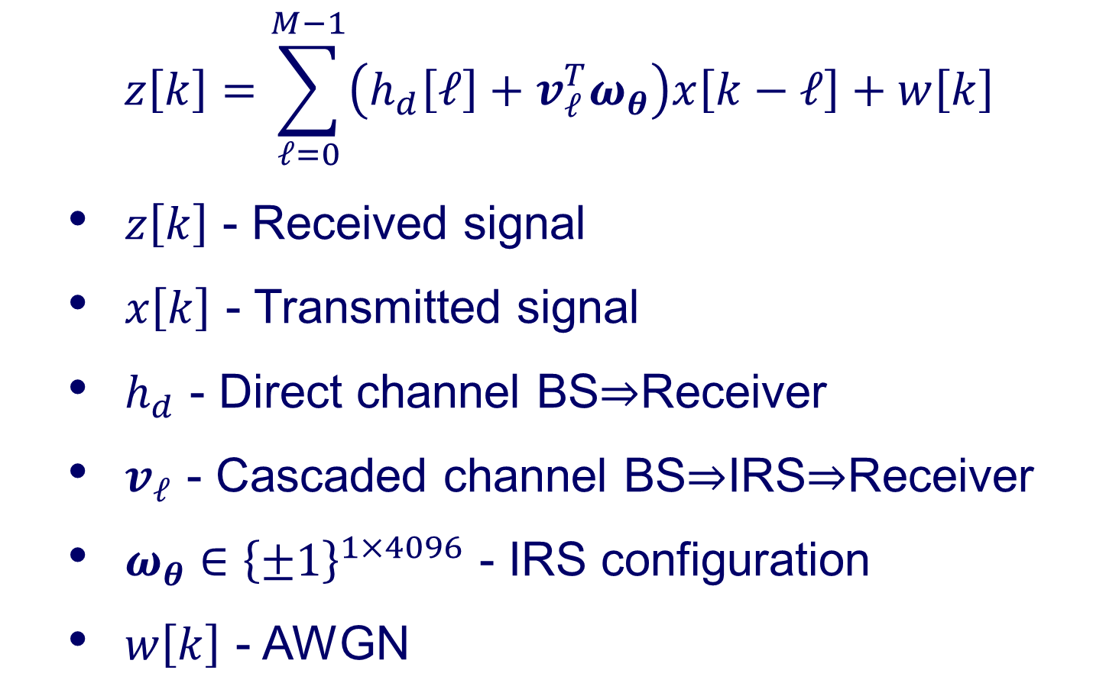
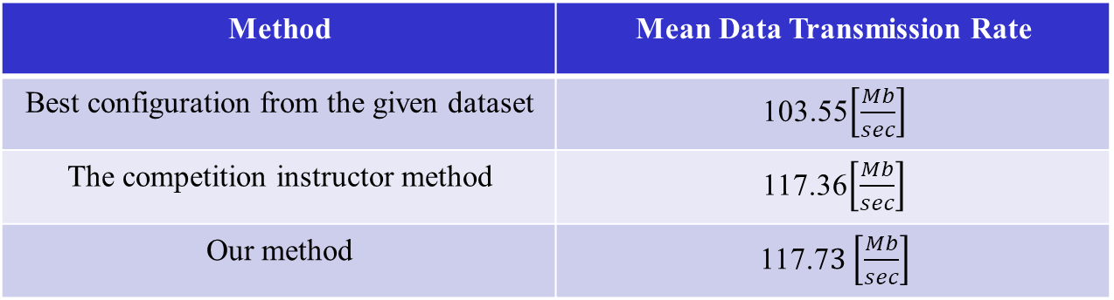

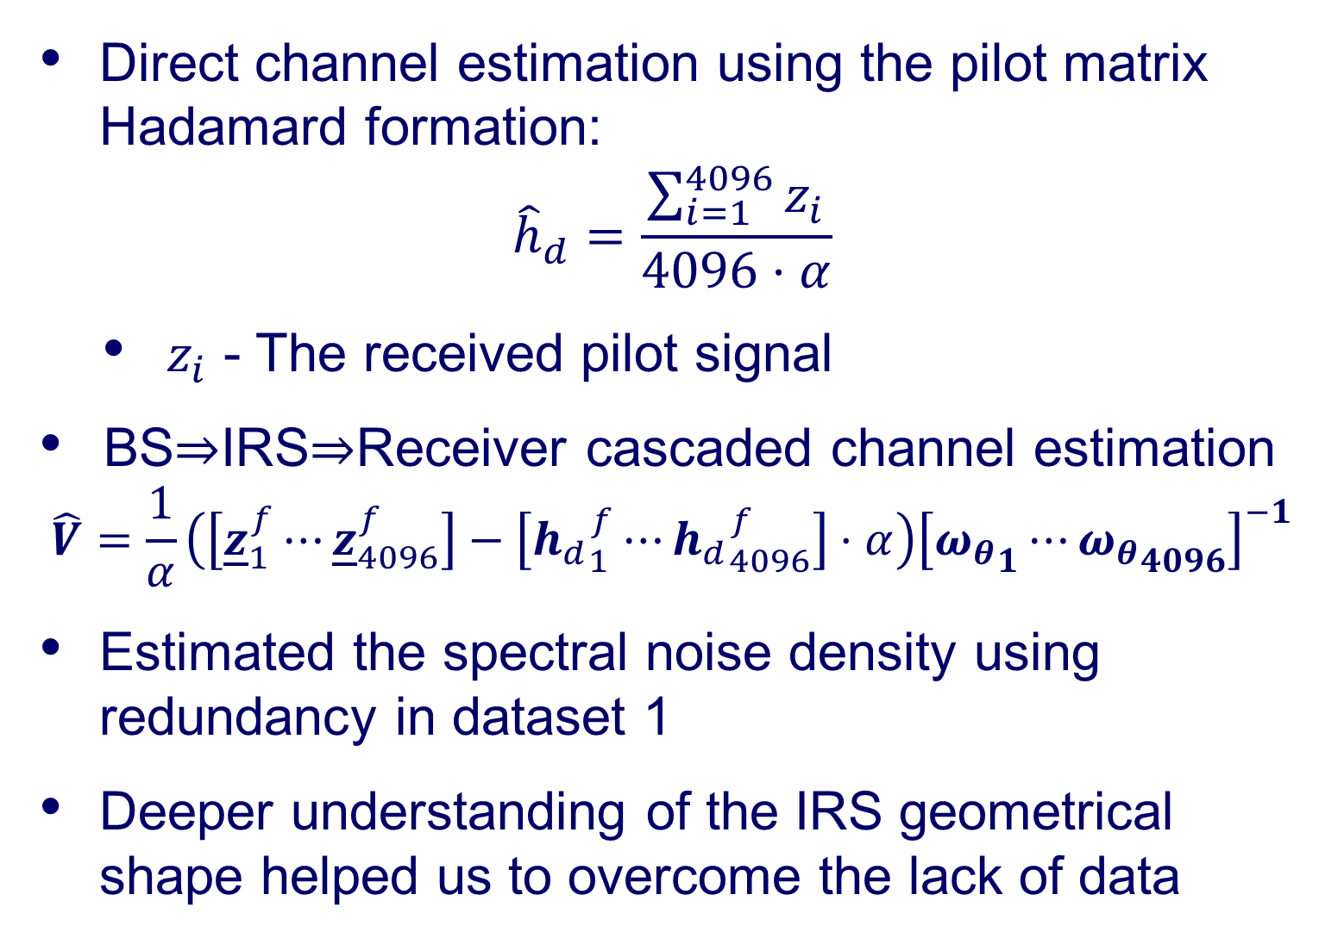
Signal and Image Processing Lab
Optimizing a Binary Intelligent Reflecting
Surface for OFDM Communications
Tomer Fireaizen, Dan Ben-David, Shaked Hadad, Nir Kurland and Sima Etkind Mentored by Prof. Israel Cohen and Supervised by Yair Moshe and Pavel Lipshitz
IEEE SP Cup
Data Set
Generative Neural Network
The most prestigious competition in signal processing for undergraduate students
Solving real-world problems with signal processing methods
The competition finals take place at the ICASSP conference
A novel synthetic dataset, divided to two:
Dataset1 includes 4×4096 configurations, and their received signals for a certain user
Dataset2 includes 4096 configurations, and their received signals for 50 users
The transmitted pilot signal is $x\left[k\right]≡α$
The pilot configurations create a $4096×4096$ Hadamard matrix
A novel method for configuration optimization
Based on the known paper “Deep Image Prior” [Ulyanov et al., 2018],
Use an untrained CNN as a regulator
Optimize the weights to get maximal data transmission rate
The output of the first NN is a constant-columns steering configuration
We used the second NN to fine tune the configuration
Goals
Characterize the behavior of an intelligent reflecting surface
Develop a control algorithm to configure the surface
For each user, find a configuration that gives the highest data transmission rate
Obtain highest score among all the competitors
Channel Estimation
Direct channel estimation using the pilot matrix Hadamard formation:
$${\hat{h}}_{d}=\frac{\sum_{i=1}^{4096}{z_{i}}}{4096⋅α}$$
$z_{i}$ - The received pilot signal
BS$⇒$IRS$⇒$Receiver cascaded channel estimation
$$\hat{V}=\frac{1}{α}\left(\left[{\underline{z}}_{1}^{f}⋯{\underline{z}}_{4096}^{f}\right]−\left[{h_{d}}_{1}^{f}⋯{h_{d}}_{4096}^{f}\right]⋅α\right){\left[{ω_{θ}}_{1}⋯{ω_{θ}}_{4096}\right]}^{−1}$$
Estimated the spectral noise density using redundancy in dataset 1
Deeper understanding of the IRS geometrical shape helped us to overcome the lack of data
Challenges
Finding best configurations out of $2^{4096}$
No data provided on the IRS spatial shape
Insufficient small dataset
Limited number of papers on IRS discrete optimization
First NN output example
Second NN output example
Intelligent Reflective Surface
Localization of users
An Intelligent Reflecting Surface (IRS) is a two-dimensional array of metamaterial
Consists of an array of controllable passive elements
Can alter the amplitude and/or phase of the reflected signal
Helps to overcome the problem of signal attenuation in 6G communication
It is possible to locate the relative positions of the users based on the similarity between their optimal configuration
Gradient-Quantization Algorithm
Efficient heuristic solution exist for the continuous phase case – Strongest Tap Maximization (STM) [Zheng & Zhang, 2020]
Initialize: STM continuous phase configuration
Find best separating line for the quantized phases
Our novel algorithm consists of two steps that repeat until all IRS elements are fixed :
Quantizae of the most ambiguous element
Optimize the unquantized element using gradient-descent
Results
Finished in the $6^{th}$ place in the competition
Mean Data Transmission Rate | Method
103.55$\left[\frac{Mb}{sec}\right]$ | Best configuration from the given dataset
117.36$\left[\frac{Mb}{sec}\right]$ | The competition instructor method
117.7$3\left[\frac{Mb}{sec}\right]$ | Our method
$$z\left[k\right]=\sum_{ℓ=0}^{M−1}{\left(h_{d}\left[ℓ\right]+v_{ℓ}^{T}ω_{θ}\right)x\left[k−ℓ\right]}+w\left[k\right]$$
$z\left[k\right]$ - Received signal
$x\left[k\right]$ - Transmitted signal
$h_{d}$ - Direct channel BS$⇒$Receiver
$v_{ℓ}$ - Cascaded channel BS$⇒$IRS$⇒$Receiver
$ω_{θ}∈{\left\{±1\right\}}^{1×4096}$ - IRS configuration
$w\left[k\right]$ - AWGN

