Slide 1
Pre-Trained Models and Transfer Learning
COSCI 223 – Machine Learning 3 🧠
Sebastian C. Ibañez
sibanez@aim.edu
Asian Institute of Management

Slide 2
Outline
Pre-Trained Models
Transfer Learning

Slide 3
Pre-Trained Models

Slide 4
Pre-Trained Models
Pre-trained models (PTMs) are models that have been trained on a large dataset and can be reused for other tasks.
Large-scale PTMs can effectively store knowledge by encoding the information in huge parameters.

Slide 5
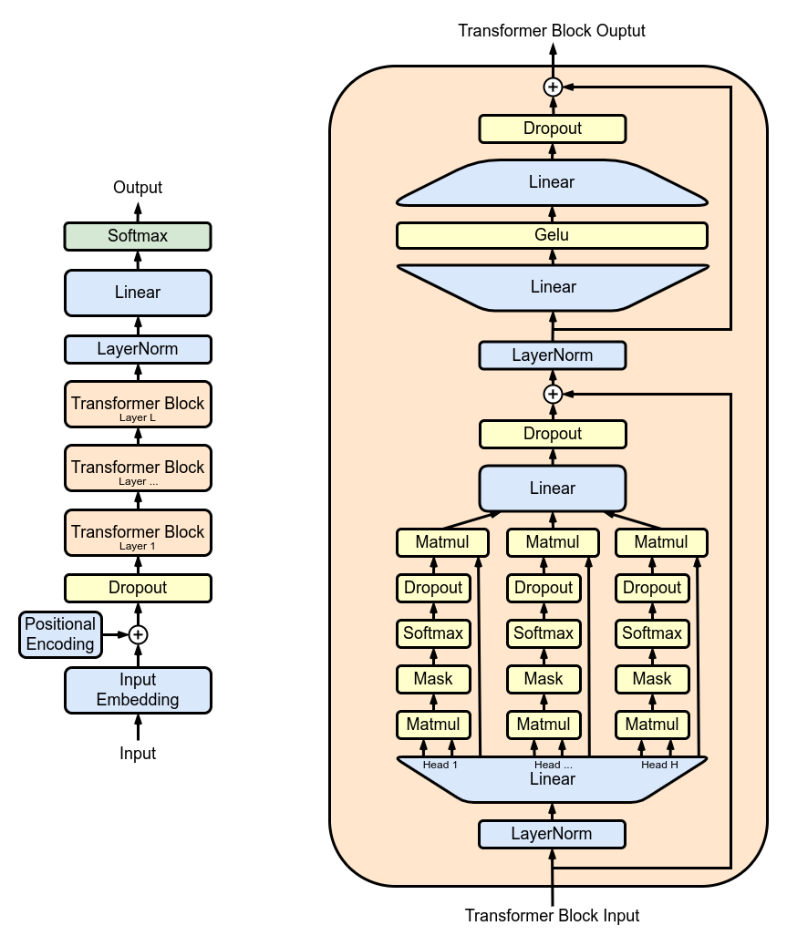
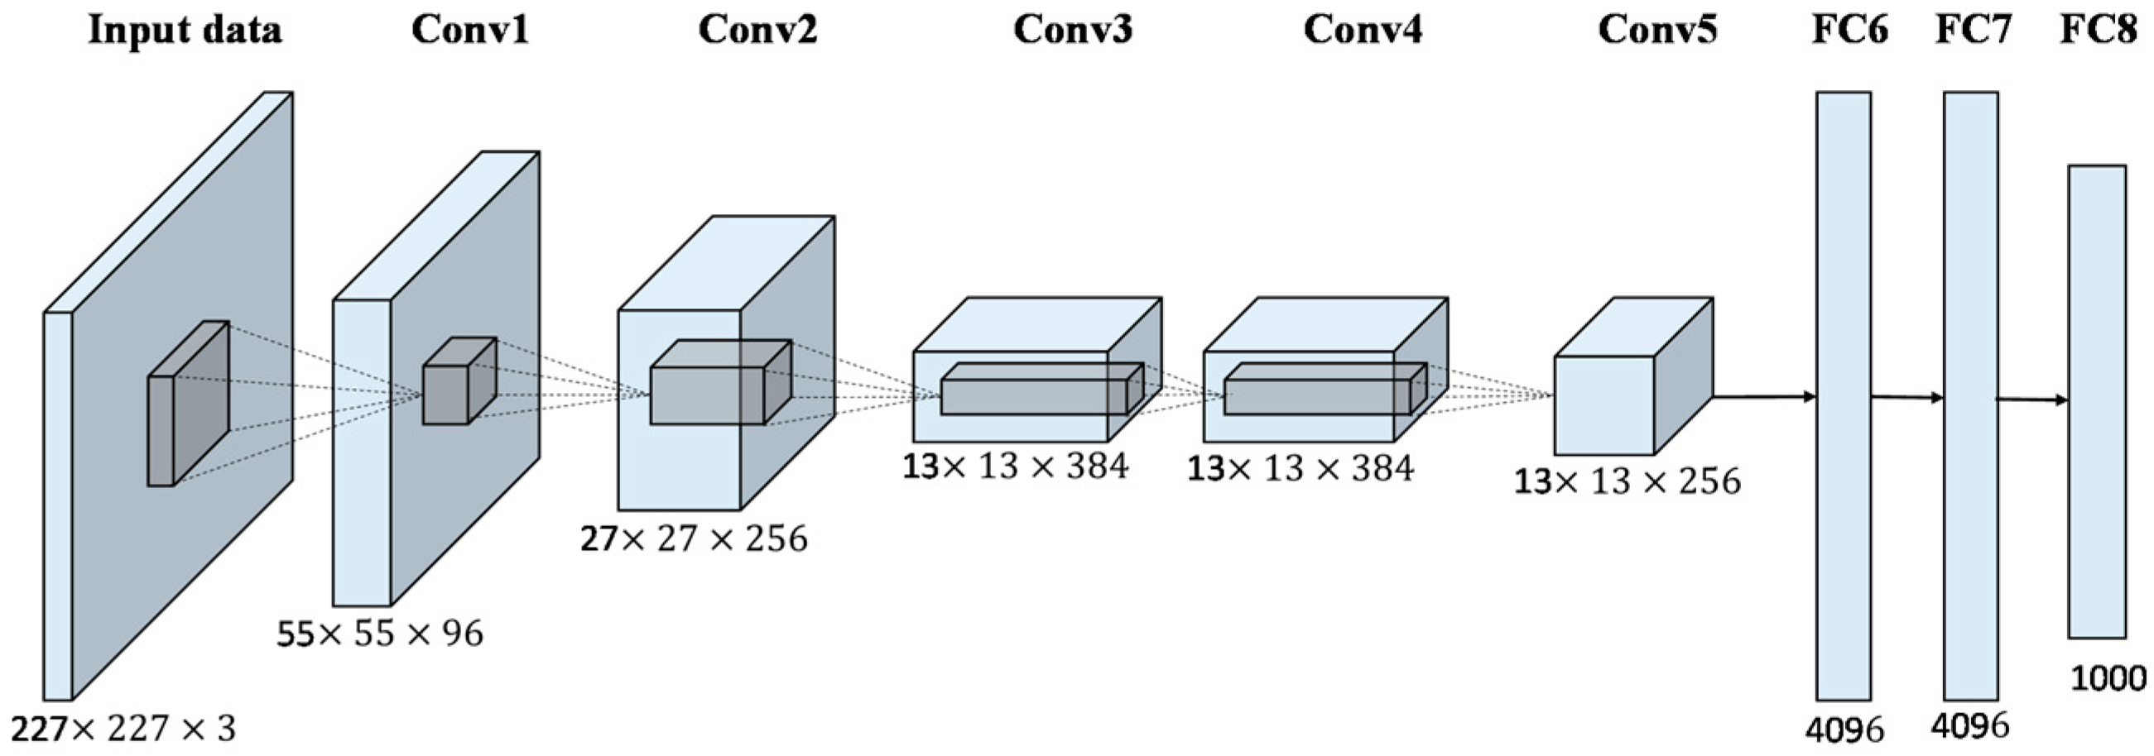
Pre-Trained Models

Slide 6
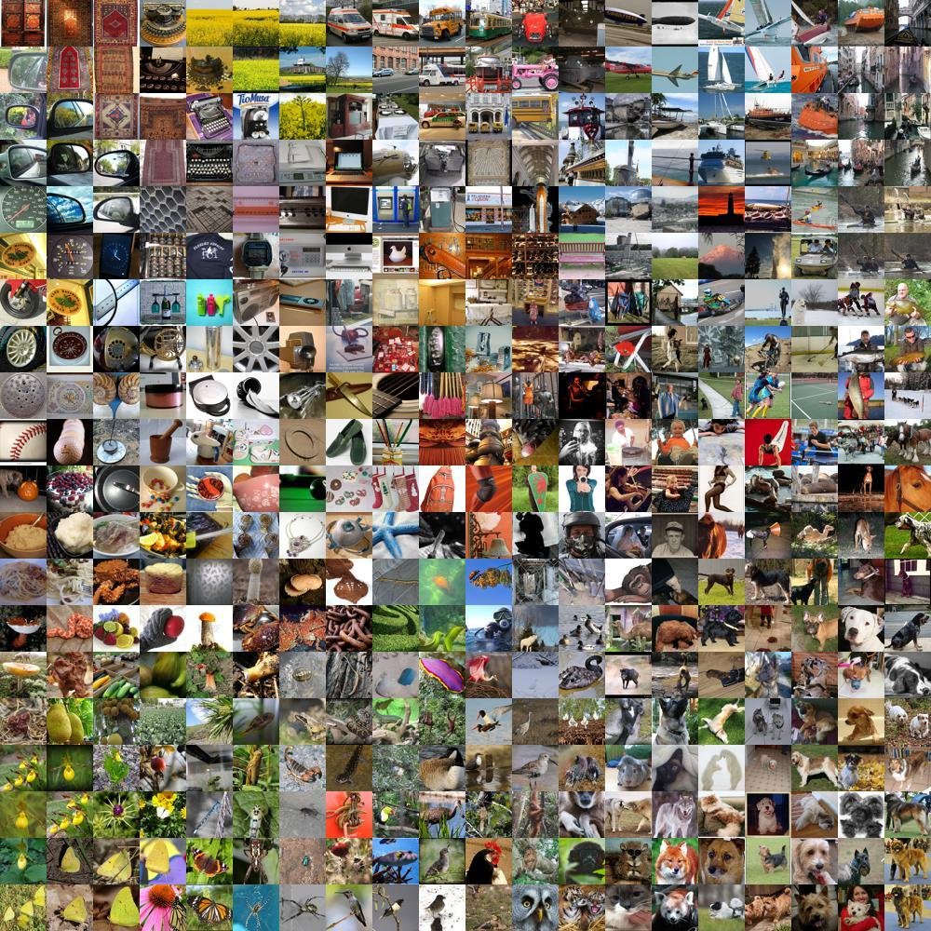
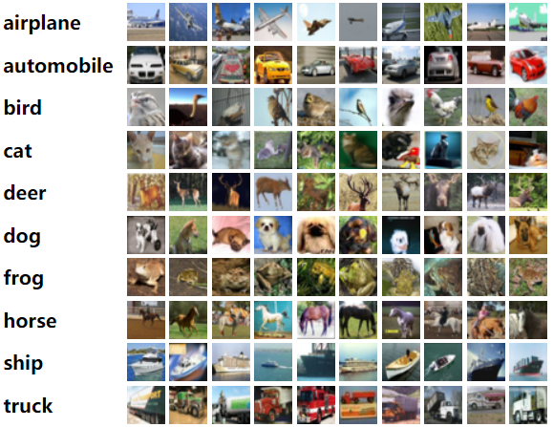
Image Classification Benchmarks

Slide 7
Image Classification Benchmarks
ImageNet: 14,197,122 images with 1000 classes
CIFAR-10 : 60,000 images with 10 classes

Slide 8
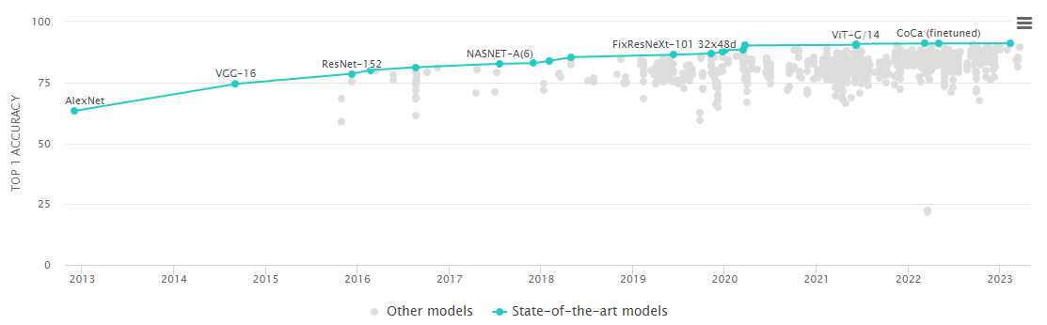
Image Classification on ImagetNet
Notes:
Since 2010, the annual ImageNet Large Scale Visual Recognition Challenge (ILSVRC) is a competition where research teams evaluate their algorithms on the given data set and compete to achieve higher accuracy on several visual recognition tasks.

Slide 9
AlexNet (2012)
Alex Krizhevsky, Ilya Sutskever, and Geoffrey Hinton
In 2011, SOTA Top-5 accuracy was around 75%.
In 2012, AlexNet achieved a Top-5 accuracy of 85%.
Considered as one of the main catalysts in spurring the use of GPUs to accelerate deep learning.

Slide 10
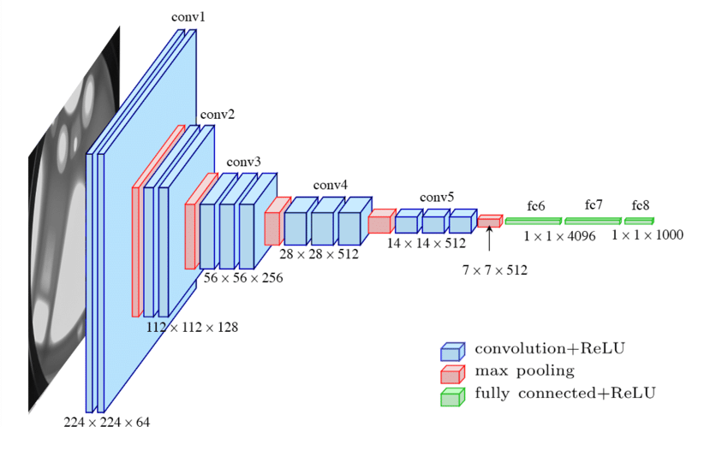
VGG (2014)
Big Idea: Deeper is better
Keeps it simple by using 3 x 3 convolutions
Comes in two flavors: VGG-16 and VGG-19

Slide 11
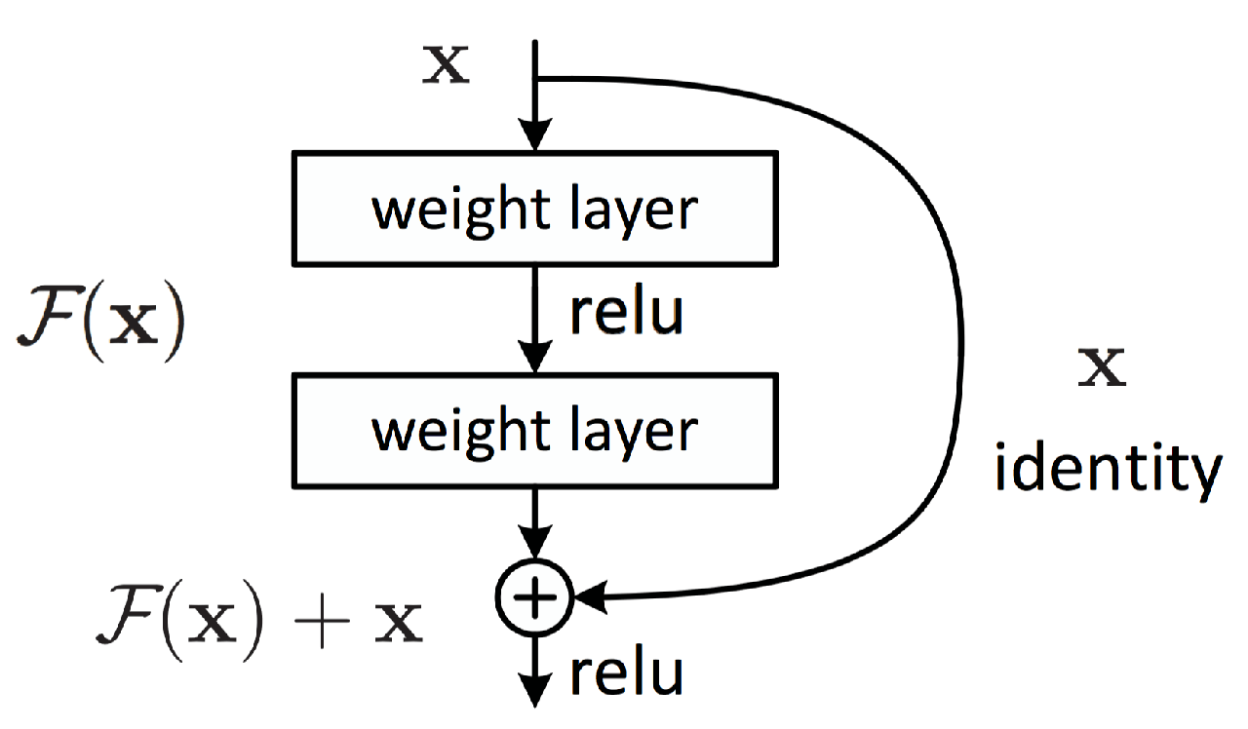
ResNet (2015)
Big Idea: Residual connections
Deeper is better, but too deep and the gradients will vanish
Add residual or skip connections to help with gradient flow

Slide 12
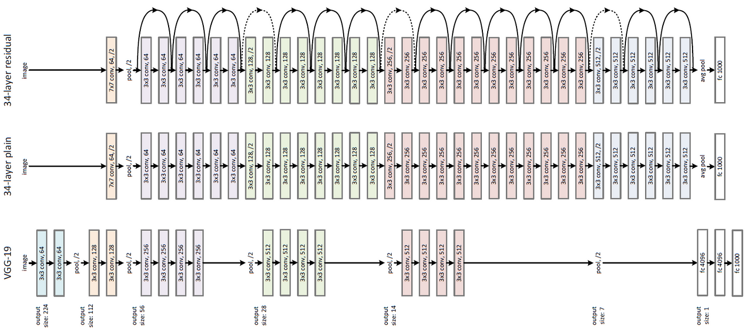
ResNet (2015)

Slide 13
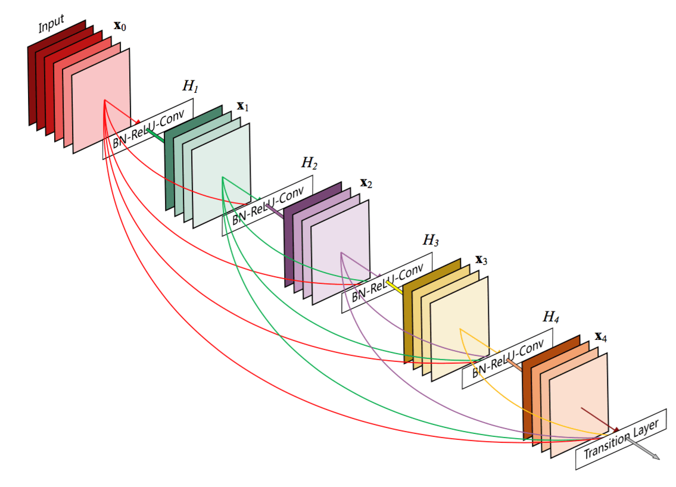
DenseNet (2016)
Big Idea: Even more residual connections
Connect entire blocks via residual connections

Slide 14
Transfer Learning

Slide 15
Transfer Learning
Transfer learning is a method of using a pre-trained model on another task by adapting their learned features.
If a model is trained on a large and broad enough dataset, it should learn features or embeddings of the data that generalizes well across different tasks.

Slide 16
Why Use PTM and Transfer Learning?
Save time and compute by leveraging existing knowledge
Get better performance by using high-quality features learned from large datasets
Overcome data scarcity issues by transferring knowledge across tasks

Slide 17
2 Main Approaches
Feature extraction
Fine-tuning

Slide 18
Feature Extraction
Use PTM as a fixed feature generator
Train a separate classifier using the features
Suitable when target task is similar to the source task, but the target dataset is small or different

Slide 19
Fine Tuning
Train the PTM along with the new classifier
Freeze earlier layers, retrain the model
Suitable when target task is different from the source task, but the target dataset is large and similar

