Slide 1
Sketching via Hashing: from Heavy Hitters to Compressive Sensing to Sparse Fourier Transform
Piotr Indyk
MIT

Slide 2
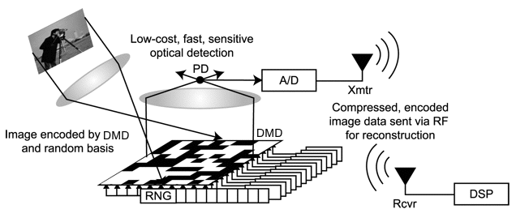
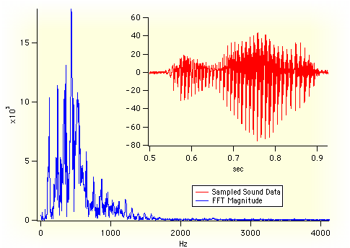
Outline
Sketching via hashing
Compressive sensing
Numerical linear algebra
(regression, low rank approximation)
Sparse Fourier Transform
c₁ … c_{m}
b
A

Slide 3
“Sketching via hashing”: a technique
Suppose that we have a sequence S of elements a₁..a_{s} from range {1…n}
Want to approximately count the elements using small space
For each element a, get an approximation of the count x_{a} of a in S
Method:
Initialize an array c=[c₁,…c_{m}]
Prepare a random hash function h: {1..n}→{1..m}
For each element a perform
c_{h(a)}=c_{h(a)}+inc(a)
Result: c_{j}=∑_{a: h(a)=j} x_{a} * inc(a)
To estimate x_{a} return
x*_{a} = c_{h(a)}/inc(a)
a₁, a₂, a₃, a₄, …………a_{s}
a
c₁ … c_{h(a)} … c_{m}

Slide 4
Why would this work?
We have
c_{h(a)} =x_{a}*inc(a)+noise
Therefore
x*_{a} = c_{h(a)}/inc(a) = x_{a}+noise/inc(a)
Incrementing options:
inc(a)=1 [FCAB98,EV’02,CM’03,CM’04]
Simply counts the total, no under-estimation
inc(a)=±1 [CFC’02]
Noise can cancel, unbiased estimator, can under-estimate
inc(a)=Gaussian [GGIKMS’02]
Noise has a nice distribution
x_{a}
c₁ … c_{h(a)} … c_{m}
c_{j}=∑_{a: h(a)=j} x_{a} * inc(a)
x*_{a} = c_{h(a)}/inc(a)

Slide 5
What are the guarantees?
For simplicity, consider inc(a)=1
Tradeoff between accuracy and space m
Definitions:
Let k=m/C
Let H be the set of k heaviest coefficients of x , i.e., the “head”
Let Tail₁^{k}=||x_{-H}||₁
(i.e., the sum of coeffs not in the head)
Will show that, with constant probability
x_{a} ≤ x*_{a} ≤x_{a} + Tail₁^{k}/k
Meaning:
For a stream with s elements, the error is always at most 1/k * s
Even better if head really heavy
Head
x_{a}
x_{a}*
c₁ … c_{m}
c_{j}=∑_{a: h(a)=j} x_{a}
x*_{a} = c_{h(a)}

Slide 6
Analysis
Head
We show how to get an estimate
x*_{a} ≤x_{a} + Tail / k
Pr[ |x*_{a}-x_{a}| > Tail/k] ≤ P₁+P₂, where
P₁ = Pr[ a collides with (another) head element ]
P₂ = Pr[ sum of tail elems colliding with a is
> Tail/k ]
We have
P₁ ≤ k/m =1/C
P₂ ≤ (Tail/m)/(Tail/k) = k/m = 1/C
Total probability of failure ≤ 2/C
Can reduce the probability to 1/poly(n) by log n repetitions
➔ space O(k log n)
x_{a}
x_{a}*
c₁ … c_{m}
c_{j}=∑_{a: h(a)=j} x_{a}
x*_{a} = c_{h(a)}

Slide 7
Compressive sensing

Slide 8
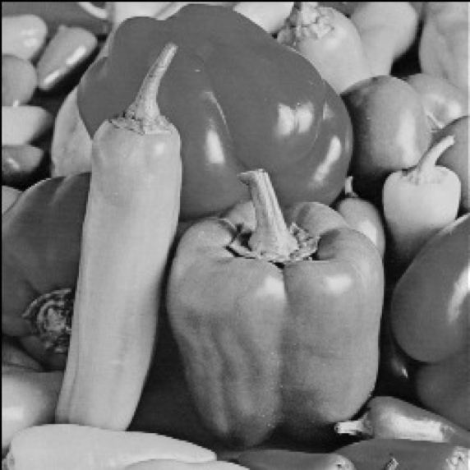
Compressive sensing [Candes-Romberg-Tao, Donoho] (also: approximation theory, learning Fourier coeffs, finite rate of innovation, …)
Setup:
Data/signal in n-dimensional space : x
E.g., x is an 256x256 image ⇒ n=65536
Goal: compress x into a “measurement” Ax ,
where A is a m x n “measurement matrix”, m << n
Requirements:
Plan A: want to recover x from Ax
Impossible: underdetermined system of equations
Plan B: want to recover an “approximation” x* of x
Sparsity parameter k
Informally: want to recover largest k coordinates of x
Formally: want x* such that e.g.
(L1/L1) ||x*-x||₁≤ C min_{x’} ||x’-x||₁ =C Tail₁^{k}
over all x’ that are k-sparse (at most k non-zero entries)
Want:
Good compression (small m=m(k,n))
Efficient algorithms for encoding and recovery
Why linear compression ?
A
=
Ax
x

Slide 9






Applications
Single pixel camera
[Wakin, Laska, Duarte, Baron, Sarvotham, Takhar, Kelly, Baraniuk’06]
Pooling Experiments [Kainkaryam, Woolf’08], [Hassibi et al’07], [Dai-Sheikh, Milenkovic, Baraniuk], [Shental-Amir-Zuk’09],[Erlich-Shental-Amir-Zuk’09], [Kainkaryam, Bruex, Gilbert, Woolf’10]…

Slide 10
Results
Scale:
Excellent
Very Good
Good
Fair
Paper | R/D | Sketch length | Recovery time | Approx
[Candes-Romberg-Tao’04] | D | k log(n/k) | n^{c} | l2 / l1
Notes:
emphasize arbitrary signals

Slide 11
Sketching as compressive sensing
Hashing view:
h hashes coordinates into “buckets” c₁…c_{m}
Each bucket sums up its coordinates
Matrix view:
A 0-1 mxn matrix A, with one 1 per column
The a-th column has 1 at position h(a), where h(a) be chosen uniformly at random from {1…m}
Sketch is equal to c=Ax
Guarantee: if we repeat hashing log n times then with high probability
||x*-x||∞≤ Tail₁^{k}/k
L∞ /L1 guarantee, implies L1/L1
x_{a}
x_{a}*
c₁ … c_{m}
n
0 0 1 0 0 1 0
1 0 0 0 1 0 0
0 1 0 0 0 0 1
0 0 0 1 0 0 0
m

Slide 12
Results
Scale:
Excellent
Very Good
Good
Fair
Paper | R/D | Sketch length | Recovery time | Approx
[Candes-Romberg-Tao’04] | D | k log(n/k) | n^{c} | l2 / l1
[CCF’02], [CM’06] | R | k log n | n log n | l2 / l2
[CM’04] | R | k log n | n log n | l1 / l1
……..
x_{i}
[NV’07], [DM’08], [NT’08], [BD’08], [GK’09], … | D | k log(n/k) | nk log(n/k) * log | l2 / l1
 | D | k log^{c} n | n log n * log | l2 / l1
x_{i}*
[IR’08], [BIR’08],[BI’09] | D | k log(n/k) | n log(n/k)* log | l1 / l1
c₁ … c_{m}
Insight: Several random hash functions form an expander graph
Notes:
emphasize arbitrary signals

Slide 13
Regression

Slide 14
Least-Squares Regression
A is an n x d matrix, b an n x 1 column vector
Consider over-constrained case, n >> d
Find d-dimensional x so that
||Ax-b||₂ ≤ (1+ε) min_{y} ||Ay-b||₂
Want to find the (approx) closest point in the column space of A to the vector b
b
A

Slide 15
Approximation
Computing the solution exactly takes O(nd²) time
Too slow, so ε > 0 and a tiny probability of failure OK
Approach: sub-space embedding [Sarlos’06]
Consider subspace L spanned by columns of A together with b
Want: mxn matrix S, m “small”, such that for all y in L
||Sy||₂ = (1± ε) ||y||₂
Then ||S(Ax-b)||₂ = (1± ε) ||Ax-b||₂ for all x
Solve argmin_{y} ||(SA)y – (Sb)||₂
Given SA, Sb, can solve in poly(m) time
b
A
Sb
SA

Slide 16
Fast Dimensionality Reduction
Need mxn dimensionality reduction matrix S such that:
m is “close to” d, and
matrix-vector product Sz can be computed quickly
Johnson-Lindenstrauss: O(nm) time
Fast Johnson-Lindenstrauss: O(n log n)
(randomized Hadamard transform)
[AC’06, AL’11, KW,11 ,NPW’12]
Sparse Johnson-Lindenstrass: O(nnz(z)*εm)
[SPD+09, WDL+09, DKS10, BOR10, KN12]
Surprise! For subspace embedding O~(nnz(z)) time and m=poly(d) suffices [CW13, NN13,MM13]
Leads to regression and low-rank approx algorithms with O~(nnz(A)+poly(d)) running time
Count-sketch-like matrix S:
[
[
0 0 1 0 0 1 0 0
1 0 0 0 0 0 0 0
0 0 0 -1 1 0 -1 0
0-1 0 0 0 0 0 1

Slide 17
Heavy hitters a la regression
Can assume columns of A are orthonormal
||A||_{F}² = d
Let T be any set of size O(d²) containing all rows indexes i in [n] for which the row A_{i} has squared norm Ω(1/d)
“Heavy hitter rows”
Suffices to ensure:
Heavy hitters do not collide – perfect hashing
Smaller elements concentrate
This gives sparse dimensionality reduction matrix with m=poly(d) rows
Clarkson-Woodruff: m=O~(d²)
Nelson-Nguyen: m=O~(d)
A
T

Slide 18
Sparse Fourier Transform

Slide 19
Fourier Transform
Discrete Fourier Transform:
Given: a signal x[1…n]
Goal: compute the frequency vector x’ where
x’_{f} = Σ_{t} x_{t} e^{-2πi tf/n}
Very useful tool:
Compression (audio, image, video)
Data analysis
Feature extraction
…
See SIGMOD’04 tutorial “Indexing and Mining Streams” by C. Faloutsos
Sampled Audio Data (Time)
DFT of Audio Samples (Frequency)

Slide 20
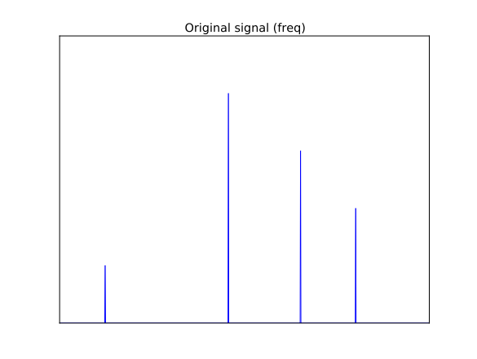
Computing DFT
Fast Fourier Transform (FFT) computes the frequencies in time O(n log n)
But, we can do (much) better if we only care about small number k of “dominant frequencies”
E.g., recover assume it is k-sparse (only k non-zero entries)
Algorithms:
Boolean cube (Hadamard Transform): [GL’89], [KM’93], [L’93]
Complex FT: [Mansour’92, GGIMS’02, AGS’03, GMS’05, Iwen’10, Akavia’10, HIKP’12,HIKP’12b, BCGLS’12, LWC’12, GHIKPL’13,…]
Best running times [Hassanieh-Indyk-Katabi-Price’12]
Exactly k-sparse signals: O(k log n)
Approx. k-sparse signals* : O(k log n * log(n/k))
*L2/L2 guarantee

Slide 21
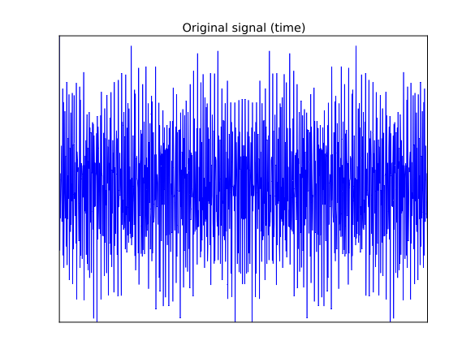
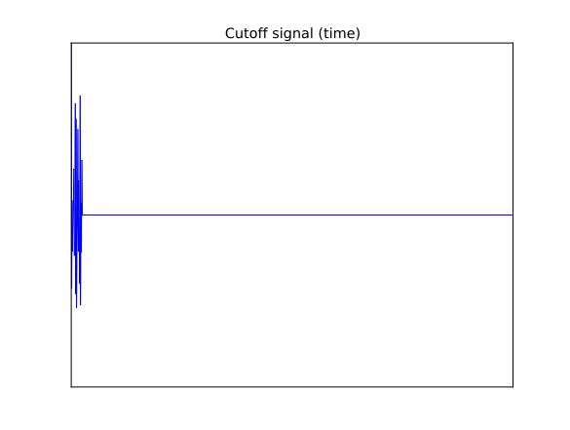
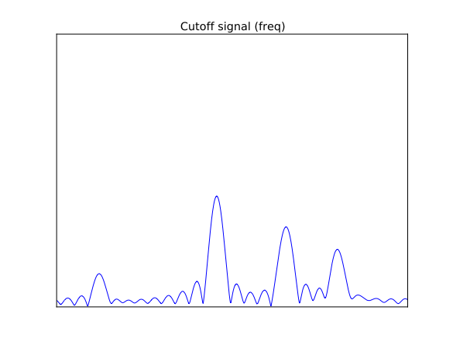
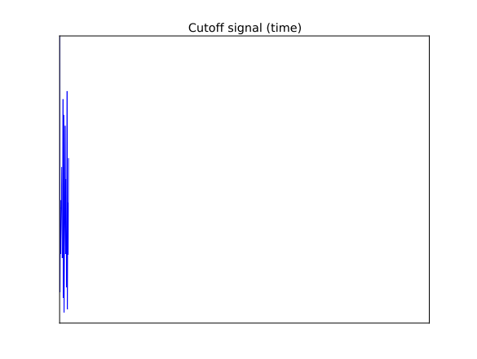
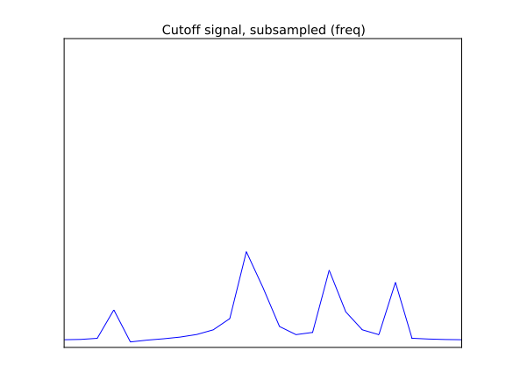
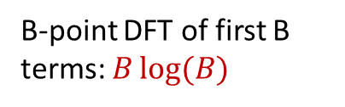







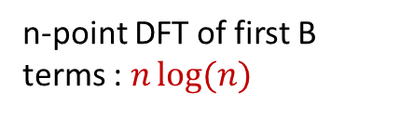
Intuition: Fourier
n-point DFT : $n\log{(n)}$
$$x$$
$$\hat{x}$$
‘
Time Domain Signal
Frequency Domain
n-point DFT of first B terms : $n\log{(n)}$
$x×$Boxcar
‘
$\hat{x} ∗$ sinc
Cut off Time signal
Frequency Domain
B-point DFT of first B terms: $B\log{(B)}$
Alias $\left(x× \text{Boxcar}\right)$
First B samples
Subsample $\left(\hat{x}∗\text{sinc}\right)$
Frequency Domain
‘

Slide 22
Main task
We we would like this
… to act like this:

Slide 23

Issues
“Leaky” buckets
“Hashing”: needs a random hashing of the spectrum
…

Slide 24
Filters: boxcar filter (used in[GGIMS02,GMS05])
Boxcar -> Sinc
Polynomial decay
Leaking many buckets

Slide 25
Filters: Gaussian
Gaussian -> Gaussian
Exponential decay
Leaking to (log n)^{1/2} buckets

Slide 26
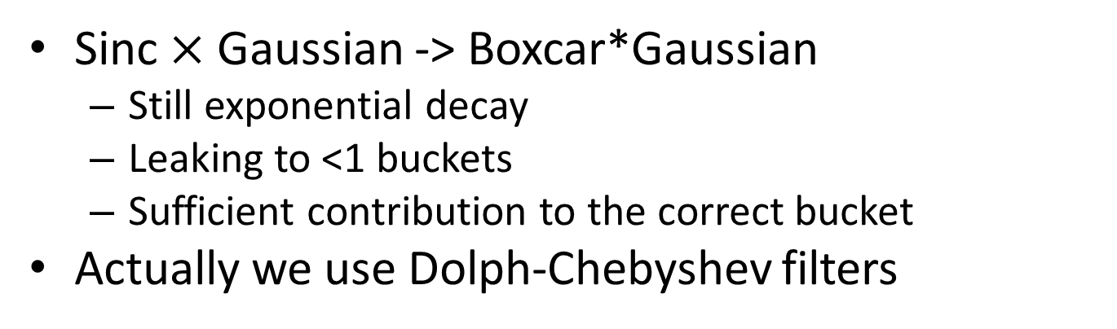

Filters: Sinc $×$ Gaussian
Sinc $×$ Gaussian -> Boxcar*Gaussian
Still exponential decay
Leaking to <1 buckets
Sufficient contribution to the correct bucket
Actually we use Dolph-Chebyshev filters

Slide 27
Conclusions
Sketching via hashing
Simple technique
Powerful implications
Questions:
What is next ?
c₁ … c_{m}
b
A

