Slide 1
Evaluation Metrics CS229
Yining Chen
(Adapted from slides by Anand Avati)
May 1, 2020

Slide 2
Topics
Why are metrics important?
Binary classifiers
Rank view, Thresholding
Metrics
Confusion Matrix
Point metrics: Accuracy, Precision, Recall / Sensitivity, Specificity, F-score
Summary metrics: AU-ROC, AU-PRC, Log-loss.
Choosing Metrics
Class Imbalance
Failure scenarios for each metric
Multi-class
Notes:
Only math necessary: Counting and ratios!

Slide 3
Why are metrics important?
Training objective (cost function) is only a proxy for real world objectives.
Metrics help capture a business goal into a quantitative target (not all errors are equal).
Helps organize ML team effort towards that target.
Generally in the form of improving that metric on the dev set.
Useful to quantify the “gap” between:
Desired performance and baseline (estimate effort initially).
Desired performance and current performance.
Measure progress over time.
Useful for lower level tasks and debugging (e.g. diagnosing bias vs variance).
Ideally training objective should be the metric, but not always possible. Still, metrics are useful and important for evaluation.

Slide 4
Binary Classification
x is input
y is binary output (0/1)
Model is ŷ = h(x)
Two types of models
Models that output a categorical class directly (K-nearest neighbor, Decision tree)
Models that output a real valued score (SVM, Logistic Regression)
Score could be margin (SVM), probability (LR, NN)
Need to pick a threshold
We focus on this type (the other type can be interpreted as an instance)

Slide 5
Score based models
Score = 1
 | Positive example
 | Negative example
Example of Score: Output of logistic regression.
For most metrics: Only ranking matters.
If too many examples: Plot class-wise histogram.
# positive examples
# positive examples + # negatives examples
Prevalence =
Score = 0
Notes:
Dots are examples: Green = positive label, gray = negative label.
Consider score to be probability output of Logistic Regression.
Position of example on scoring line based on model output. For most of the metrics, only the relative rank / ordering of positive/negative matter.
Prevalence decides class imbalance.
If too many examples, plot class-wise histogram instead.
Rank view useful to start error analysis (start with the topmost negative example, or bottom-most positive example).

Slide 6
Threshold -> Classifier -> Point Metrics
Label positive Label negative
Th
0.5
Th=0.5
Predict Negative Predict Positive
Notes:
Only after picking a threshold, we have a classifier.
Once we have a classifier, we can obtain all the Point metrics of that classifier.

Slide 7
Point metrics: Confusion Matrix
Label Positive Label Negative
9
2
Th
0.5
Th=0.5
Predict Negative Predict Positive
Properties:
Total sum is fixed (population).
Column sums are fixed (class-wise population).
Quality of model & threshold decide how columns are split into rows.
We want diagonals to be “heavy”, off diagonals to be “light”.
1
8
Notes:
All point metrics can be derived from the confusion matrix. Confusion matrix captures all the information about a classifier performance, but is not a scalar!
Properties:
Total Sum is Fixed (population).
Column Sums are Fixed (class-wise population).
Quality of model & selected threshold decide how columns are split into rows.
We want diagonals to be “heavy”, off diagonals to be “light”.

Slide 8
Point metrics: True Positives
Label positive Label negative
9
2
Th
0.5
TP
9
Th=0.5
Predict Negative Predict Positive
1
8
Notes:
TP = Green examples correctly identified as green.

Slide 9
Point metrics: True Negatives
Label positive Label negative
9
2
Th
0.5
TP
9
TN
8
Th=0.5
Predict Negative Predict Positive
1
8
Notes:
TN = Gray examples correctly identified as gray. “Trueness” is along the diagonal.

Slide 10
Point metrics: False Positives
Label positive Label negative
9
2
Th
0.5
TP
9
TN
8
FP
2
Th=0.5
Predict Negative Predict Positive
1
8
Notes:
FP = Gray examples falsely identified as green.

Slide 11
Point metrics: False Negatives
Label positive Label negative
9
2
Th
0.5
TP
9
TN
8
FP
2
FN
1
Th=0.5
Predict Negative Predict Positive
1
8
Notes:
FN = Green examples falsely identified as gray.

Slide 12
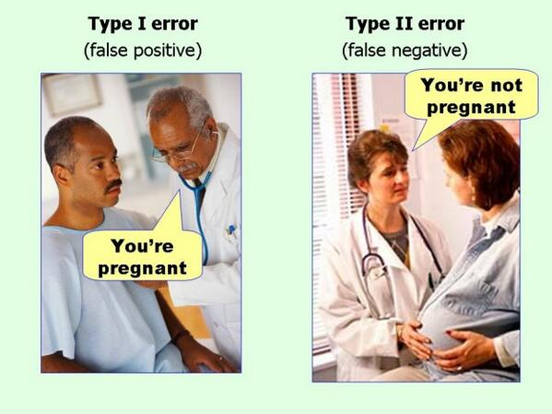
FP and FN also called Type-1 and Type-2 errors
Could not find true source of image to cite

Slide 13
Point metrics: Accuracy
Label positive Label negative
9
2
Th
0.5
TP
9
TN
8
FP
2
FN
1
Acc
.85
Th=0.5
Predict Negative Predict Positive
Equivalent to 0-1 Loss!
1
8
Notes:
Accuracy = what fraction of all predictions did we get right?
Improving accuracy is equivalent to having a 0-1 Loss function.

Slide 14
Point metrics: Precision
Label positive Label negative
9
2
Th
0.5
TP
9
TN
8
FP
2
FN
1
Acc
.85
Pr
.81
Th=0.5
Predict Negative Predict Positive
1
8
Notes:
Precision = quality of positive predictions.
Also called PPV (Positive Predictive Value).

Slide 15
Point metrics: Positive Recall (Sensitivity)
Label positive Label negative
9
2
Th
0.5
TP
9
TN
8
FP
2
FN
1
Acc
.85
Pr
.81
Recall
.9
Trivial 100% recall = pull everybody above the threshold.
Trivial 100% precision = push everybody below the threshold except 1 green on top.
(Hopefully no gray above it!)
Th=0.5
Predict Negative Predict Positive
1
8
Striving for good precision with 100% recall =
pulling up the lowest green as high as possible in the ranking.
Striving for good recall with 100% precision =
pushing down the top gray as low as possible in the ranking.
Notes:
Recall (sensitivity) - What fraction of all greens did we pick out? Terminology from lab tests: how sensitive is the test in detecting disease?
Somewhat related to Precision ( both recall and precision involve TP)
Trivial 100% recall = pull everybody above the threshold.
Trivial 100% precision = push everybody below the threshold except 1 green on top (hopefully no gray above it!).
Striving for good precision with 100% recall = pulling up the lowest green as high as possible in the ranking.
Striving for good recall with 100% precision = pushing down the top most gray as low as possible in the ranking.

Slide 16
Point metrics: Negative Recall (Specificity)
Label positive Label negative
9
2
Th
0.5
TP
9
TN
8
FP
2
FN
1
Acc
.85
Pr
.81
Recall
.9
Spec
0.8
Th=0.5
Predict Negative Predict Positive
1
8
Notes:
Negative Recall (Specificity) - What fraction of all negatives in the population were we able to keep away?
Note: Sensitivity and specificity operate in different sub-universes.

Slide 17
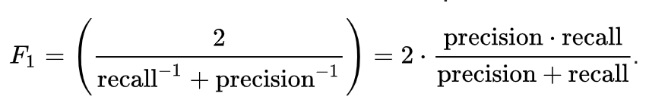
Point metrics: F1-score
Label positive Label negative
9
2
Th
0.5
TP
9
TN
8
FP
2
FN
1
Acc
.85
Pr
.81
Recall
.9
Spec
.8
F1
.857
Th=0.5
Predict Negative Predict Positive
1
8
Notes:
Summarize precision and recall into single score
F1-score: Harmonic mean of PR and REC
G-score: Geometric mean of PR and REC

Slide 18
Point metrics: Changing threshold
Label positive Label negative
7
2
Th
0.6
TP
7
TN
8
FP
2
FN
3
Acc
.75
Pr
.77
Recall
.7
Spec
.8
F1
.733
Th=0.6
Predict Negative Predict Positive
# effective thresholds = # examples + 1
3
8
Notes:
Changing the threshold can result in a new confusion matrix, and new values for some of the metrics.
Many threshold values are redundant (between two consecutively ranked examples). Number of effective thresholds = M + 1 (# of examples + 1)

Slide 19
Threshold Scanning
Threshold | TP | TN | FP | FN | Accuracy | Precision | Recall | Specificity | F1
1.00 | 0 | 10 | 0 | 10 | 0.50 | 1 | 0 | 1 | 0
0.95 | 1 | 10 | 0 | 9 | 0.55 | 1 | 0.1 | 1 | 0.182
0.90 | 2 | 10 | 0 | 8 | 0.60 | 1 | 0.2 | 1 | 0.333
0.85 | 2 | 9 | 1 | 8 | 0.55 | 0.667 | 0.2 | 0.9 | 0.308
0.80 | 3 | 9 | 1 | 7 | 0.60 | 0.750 | 0.3 | 0.9 | 0.429
0.75 | 4 | 9 | 1 | 6 | 0.65 | 0.800 | 0.4 | 0.9 | 0.533
0.70 | 5 | 9 | 1 | 5 | 0.70 | 0.833 | 0.5 | 0.9 | 0.625
0.65 | 5 | 8 | 2 | 5 | 0.65 | 0.714 | 0.5 | 0.8 | 0.588
0.60 | 6 | 8 | 2 | 4 | 0.70 | 0.750 | 0.6 | 0.8 | 0.667
0.55 | 7 | 8 | 2 | 3 | 0.75 | 0.778 | 0.7 | 0.8 | 0.737
0.50 | 8 | 8 | 2 | 2 | 0.80 | 0.800 | 0.8 | 0.8 | 0.800
0.45 | 9 | 8 | 2 | 1 | 0.85 | 0.818 | 0.9 | 0.8 | 0.857
0.40 | 9 | 7 | 3 | 1 | 0.80 | 0.750 | 0.9 | 0.7 | 0.818
0.35 | 9 | 6 | 4 | 1 | 0.75 | 0.692 | 0.9 | 0.6 | 0.783
0.30 | 9 | 5 | 5 | 1 | 0.70 | 0.643 | 0.9 | 0.5 | 0.750
0.25 | 9 | 4 | 6 | 1 | 0.65 | 0.600 | 0.9 | 0.4 | 0.720
0.20 | 9 | 3 | 7 | 1 | 0.60 | 0.562 | 0.9 | 0.3 | 0.692
0.15 | 9 | 2 | 8 | 1 | 0.55 | 0.529 | 0.9 | 0.2 | 0.667
0.10 | 9 | 1 | 9 | 1 | 0.50 | 0.500 | 0.9 | 0.1 | 0.643
0.05 | 10 | 1 | 9 | 0 | 0.55 | 0.526 | 1 | 0.1 | 0.690
0.00 | 10 | 0 | 10 | 0 | 0.50 | 0.500 | 1 | 0 | 0.667
Score = 1
Threshold = 1.00
Threshold = 0.00
Score = 0
Notes:
As we scan through all possible effective thresholds, we explore all the possible values the metrics can take on for the given model.
Each row is specific to the threshold.
Table is specific to the model (different model = different effective thresholds).
Observations: Sensitivity monotonic, Specificity monotonic in opposite direction. Precision somewhat correlated with specificity, and not monotonic. Tradeoff between Sensitivity and Specificity, Precision and Recall.

Slide 20
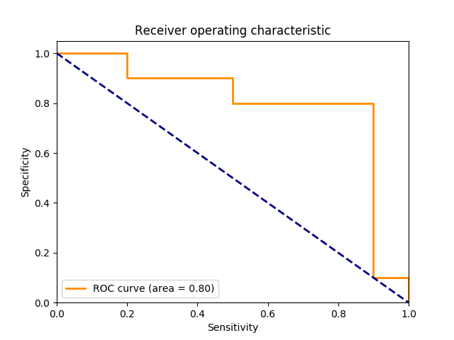
Summary metrics: Rotated ROC (Sen vs. Spec)
Pos examples
Score = 1
Neg examples
Specificity
= True Neg / Neg
AUROC = Area Under ROC
= Prob[Random Pos ranked
higher than random Neg]
Random Guessing
Agnostic to prevalence!
Score = 0
Sensitivity = True Pos / Pos
Notes:
AUC = Area Under Curve. Also called C-Statistic (concordance score). Represents how well the results are ranked. If you pick a positive e.g by random, and negative e.g by random, AUC = probability that positive eg is ranked > negative example. Measure of quality of discrimination.
Some people plot TPR (= Sensitivity) vs FPR (= 1 - Specificity).
Thresholds are points on this curve. Each point represents one set of point metrics.
Diagonal line = random guessing.
Grid view (top left to bottom right, postive = move right, negative = move down)
Agnostic to prevalence.

Slide 21
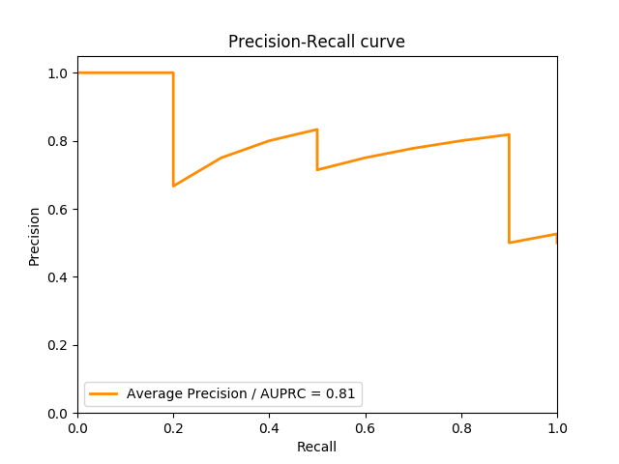
Summary metrics: PRC (Recall vs. Precision)
Pos examples
Score = 1
Neg examples
Precision
= True Pos /
Predicted Pos
AUPRC = Area Under PRC
= Expected precision for
Random threshold
Precision >= prevalence
Score = 0
Recall = Sensitivity = True Pos / Pos
Notes:
Precision Recall curve represents a different tradeoff. Think search engine results ranked.
End of curve at right cannot be lower than prevalence.
Area under PRC = Average Precision. Intuition: By randomly picking the threshold, what’s the expected precision?
While specificity monotonically decreases with increasing recall (the number of correctly classified negative examples goes down), precision can be “jagged”. Getting a bunch of positives in the sequence increases both precision and recall (hence curve climbs up slowly), but getting a bunch of negatives in the sequence drops the precision without increasing recall. Hence, by definition, curve has only slow climbs and vertical drops.

Slide 22
Summary metrics:
Score = 1
Score = 1
Model A
Model B
Score = 0
Score = 0
Two models scoring the same data set. Is one of them better than the other?
Notes:
Somehow the second model feels “better”.

Slide 23


Summary metrics: Log-Loss vs Brier Score
Same ranking, and therefore the same AUROC, AUPRC, accuracy!
Rewards confident correct answers, heavily penalizes confident wrong answers.
One perfectly confident wrong prediction is fatal.
-> Well-calibrated model
Proper scoring rule: Minimized at
Score = 1
Score = 1
Score = 0
Score = 0
Notes:
The metrics so far fail to capture this.
Accuracy optimizes for: Model gets $1 for correct answer, $0 for wrong.
Log-loss: Model makes a bet for $0.xy dollars that it’s prediction is correct. If correct, gets $0.xy dollars, else gets $(1-0.xy) dollar. Incentive structure is well suited to produce calibrated models. Take home is the GM of earned amounts.
Low-bar for exp(E[log-loss]) is 0.5
Log-loss on validation set measure how much did this “betting engine” earn.

Slide 24
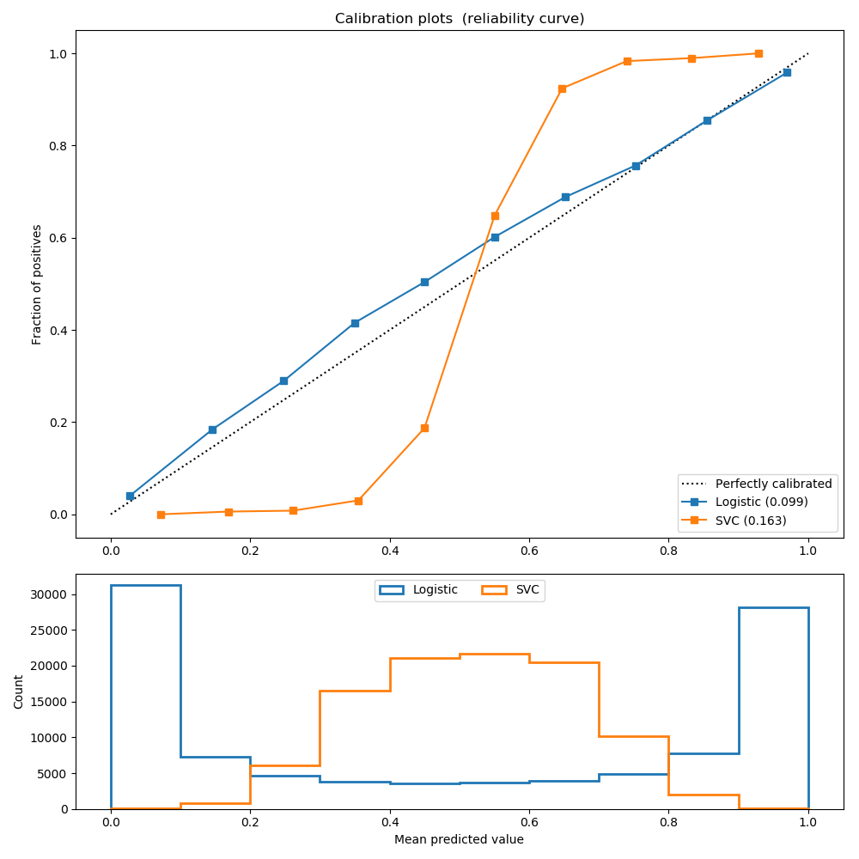
Calibration vs Discriminative Power
Logistic (th=0.5):
Precision: 0.872
Recall: 0.851
F1: 0.862
Brier: 0.099
SVC (th=0.5):
Precision: 0.872
Recall: 0.852
F1: 0.862
Brier: 0.163
Fraction of Positives
Output
Histogram
Notes:
View calibration plot and histogram together
When model is well calibrated, then histogram indicates level of discrimination
If model is not calibrated, histogram may not mean much at all (see SVC plot)
Brier score is another measure of calibration. Both brier score and log-loss are Proper Scoring Rules.

Slide 25
Unsupervised Learning
Log P(x) is a measure of fit in Probabilistic models (GMM, Factor Analysis)
High log P(x) on training set, but low log P(x) on test set is a measure of overfitting
Raw value of log P(x) hard to interpret in isolation
K-means is trickier (because of fixed covariance assumption)

Slide 26
Class Imbalance
Symptom: Prevalence < 5% (no strict definition)
Metrics: May not be meaningful.
Learning: May not focus on minority class examples at all
(majority class can overwhelm logistic regression, to a lesser extent SVM)

Slide 27
What happen to the metrics under class imbalance?
Accuracy: Blindly predicts majority class -> prevalence is the baseline.
Log-Loss: Majority class can dominate the loss.
AUROC: Easy to keep AUC high by scoring most negatives very low.
AUPRC: Somewhat more robust than AUROC. But other challenges.
In general: Accuracy < AUROC < AUPRC
Notes:
For accuracy, prevalence of majority class should be the low bar!
AUROC: 10% prevalence. top-10% are all negatives, next K are all positives, followed by rest of the negatives. AUPRC = 0.9 even though practically useless.

Slide 28
Rotated ROC
Score = 1
1%
“Fraudulent”
1%
Specificity
= True Neg / Neg
AUC = 98/99
98%
Score = 0
Sensitivity = True Pos / Pos

Slide 29
Multi-class
Confusion matrix will be N * N (still want heavy diagonals, light off-diagonals)
Most metrics (except accuracy) generally analyzed as multiple 1-vs-many
Multiclass variants of AUROC and AUPRC (micro vs macro averaging)
Class imbalance is common (both in absolute and relative sense)
Cost sensitive learning techniques (also helps in binary Imbalance)
Assign weights for each block in the confusion matrix.
Incorporate weights into the loss function.

Slide 30
Choosing Metrics
Some common patterns:
High precision is hard constraint, do best recall (search engine results, grammar correction): Intolerant to FP
Metric: Recall at Precision = XX %
High recall is hard constraint, do best precision (medical diagnosis): Intolerant to FN
Metric: Precision at Recall = 100 %
Capacity constrained (by K)
Metric: Precision in top-K.
……

Slide 31
Thank You!

