Slide 1
BIODIVERSITY IN US NATIONAL PARKS
A STUDY OF BIODIVERSITY IN SEVERAL NATIONAL PARKS

Slide 2
INFORMATION USED
A DATA FRAME CONTAINING SEVERAL ANIMAL AND VEGETABLE SPECIES WITH:
THE SCIENTIFIC NAME FOR EACH SPECIE
THE COMMON NAME FOR EACH SPECIE
THE CONSERVATION STATUS OF EACH SPECIE

Slide 3


INFORMATION EXTRACTED FROM THE DATA FRAME

Slide 4
USING SEVERAL TECHNIQUES FROM PANDAS AND MATPLOTLIB IN PYTHON WE MANAGED
SEPARATE THE SPECIES BY CATEGORY
conservation status
divide the species by protected or not protected
There are seven different categories
Mammal
Bird
Reptile
Amphibian
Fish
Vascular Plant
Nonvascular Plant
We managed to establish the different conservation statuts:
Species of Concern
Endangered
Threatened
In Recovery
We establish the number of species that are by any form of protection with the ones that doesn’t need for protection right away.

Slide 5
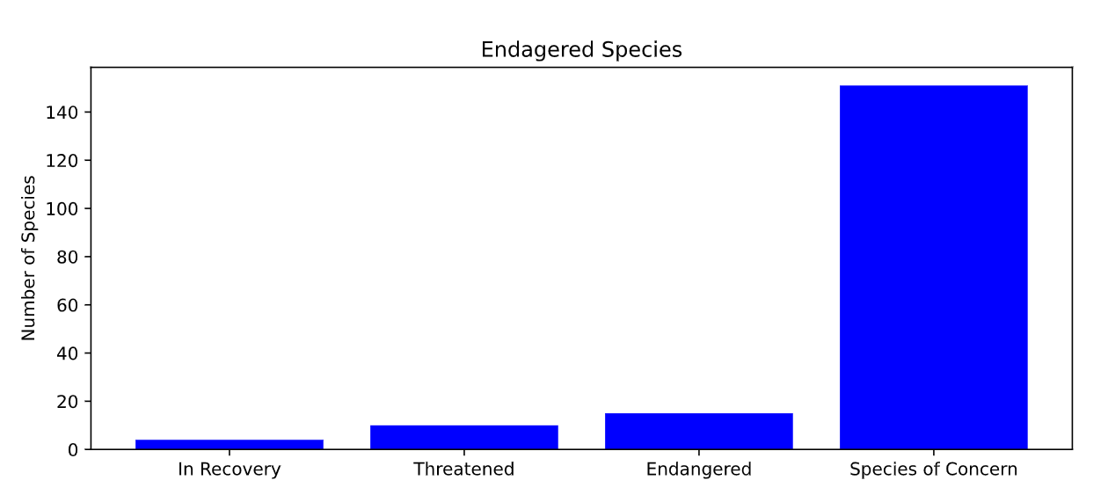
Bar chart of the number of species with some form of conservation

Slide 6
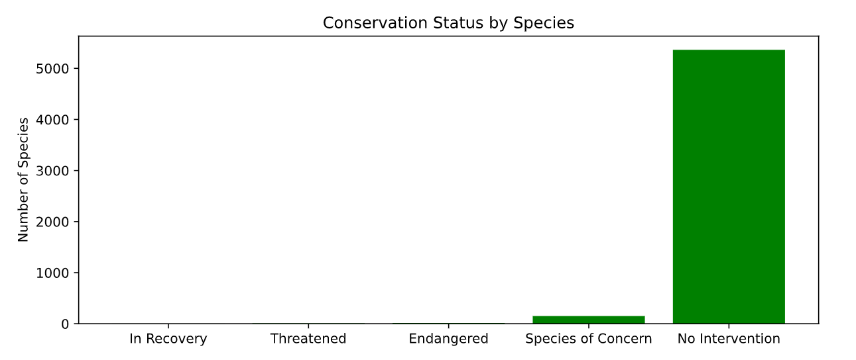
Comparative bar chart of all species protected and not protected

Slide 7
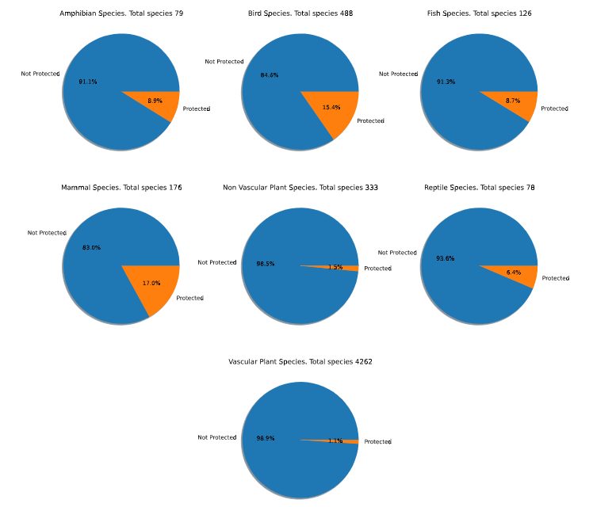
PIE CHARTS SHOWING THE PERCENTAGE OF PROTECED SPECIES FOR EACH CATEOGORY

Slide 8
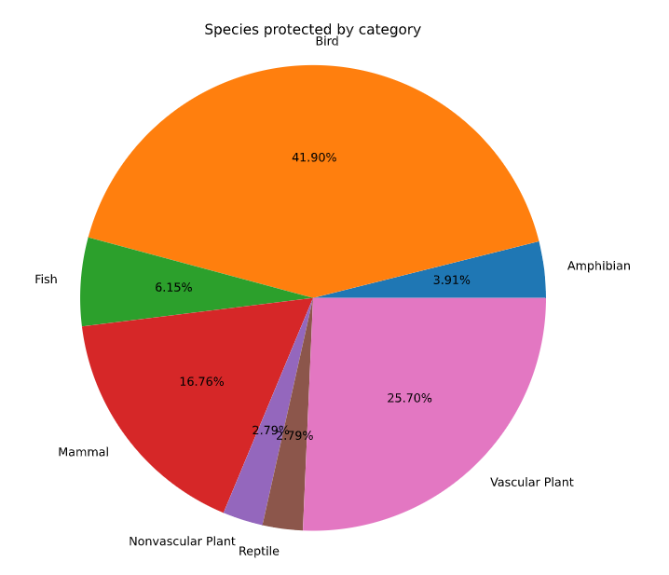
PIE CHART WITH SPECIES PROTECTED BY CATEGORY

Slide 9
RECOMENDATIONS FOR CONSERVATIONISTS
GENERATE IDEAS TO HELP THE MOST ENDANGERED SPECIES THRIVE AND GROW
ESTABLISH LIMITS FOR HUMAN PRESENCE IN ENDANGERED ECOSISTEMS
CONTINUE CATALOGING AND FOLLOWIN EACH SPECIE AND IT’S CONSERVATION STATUS
ESTABLISH PROGRAMS IN ORDER TO INCLUDE OTHER PROTECTED AREAS AROUND THE PARKS
GENERATE CONSCIOUSNESS IN PEOPLE, SPECIALLY THE YOUNGERS

Slide 10
ESTALISHING THE SAMPLE SIZE FOR FOOT AND MOUSTH DISEASE
In order to establish the sample size, mínimum detectable effect, and baseline convertion we looked for a reduction of a 5 percentage point for the foot and mouth disease in Yellowstone National Park and Bryce National Park.
Taking a 10 % of base from the Park Rangers we multiply the 0.05 (5 %) by 100 and divided that by 0.01 (10 % of base): 100 * 0.05 / 0.1
That gave us a base of 33,33 and sample size of 870 sheeps
With that information and the observations provided by each park we concluded that Park Rangers at Yellowstone will have to make observations for 1.7 weeks
And Park Rangers at Bryce will have to make observations for 3.5 weeks.

Slide 11
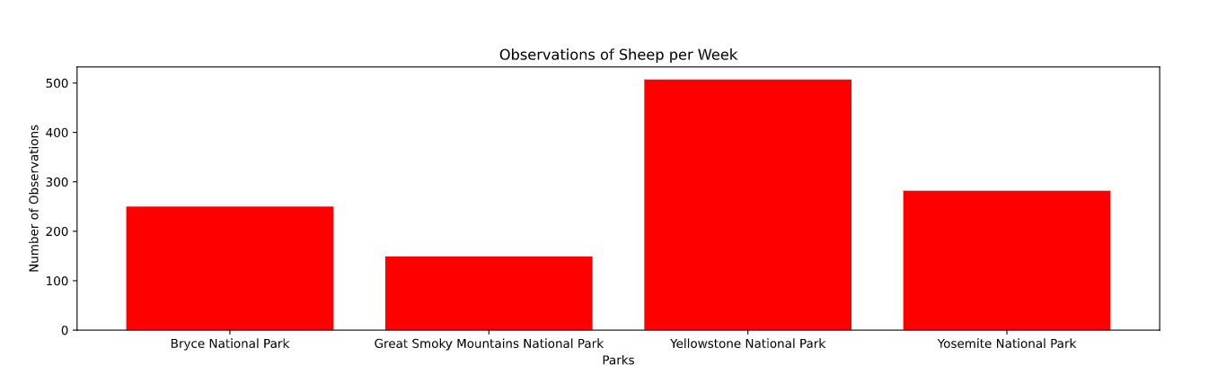
BAR CHART WITH SHEEP OBSERVATIONS BY PARK

