Slide 1
Analysis of the Netflix stock for 2017
Evolution of the Price of the stocks and a comparison with the dow jones industrial average

Slide 2
Visualizationes created for this report
Violin report with distribution of the prices por quarter
Comparative of earnings (actual and estimate per quarter
Comparative of earnings and revenues per quarter
Evolution of the Netflix stock Price and the dow jones industrial average

Slide 3
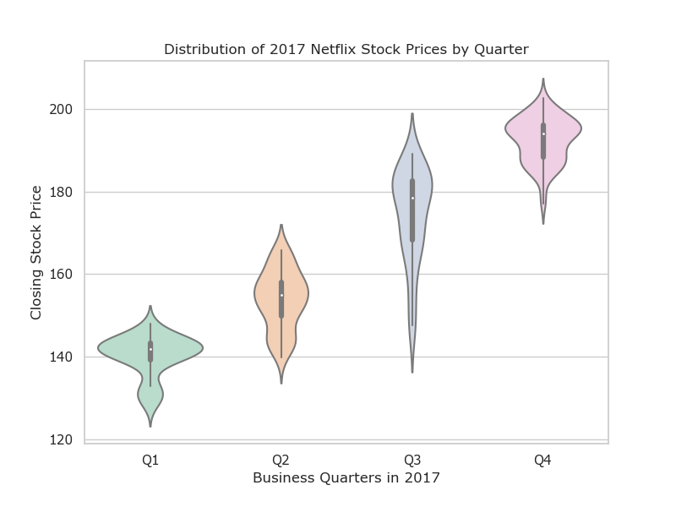
Violin report for the spread of the Netflix stock price
The report shows:
The stock price raised throughout the year
Prices ranged mostly between 140 and 190 USD.
The lowest price was in the first quarter and the highest was in the fourth quarter.
In the third quarter the stock experienced a bigger fluctuation than the rest of the quarters.

Slide 4
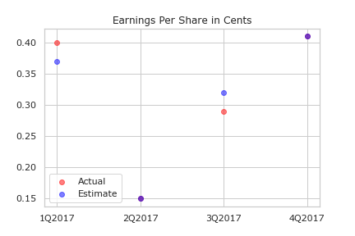
COMPARATIVE OF THE EARNINGS ESTIMATED WITH THE ACTUAL
Source: Yahoo
The chart shows that the earnings estimated were accurate both in the 2nd and the 4th quarter.
See purple dots

Slide 5
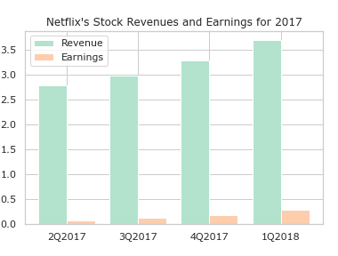
Comparative Bar chart of revenues and earnings
THIS CHART SHOWS THAT THE REVENUES AND EARNINGS INCREASED OVER THE YEAR.
ROUGHLY THE EARNINGS REPRESENTED A 10% OF THE REVENUES

Slide 6
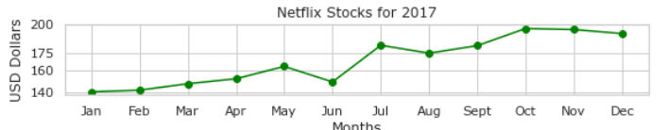
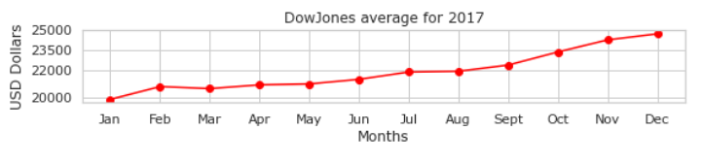
COMPARATIVE EVOLUTION FOR NETFLIX AND THE DOW JONES INDUSTRIAL AVERAGE
The Netflix Stock price behaved relatively equal to the Dow Jones Industrial Average. However it experienced a more volatile behavior especially during the month of June where it ended with a value closer to March.
Nevertheless the Netflix Stock gained a 40 % increase (140 to 196), just like the Dow Jones Industrial Average (20000 to 25000).

Slide 7
CONCLUTION
2017 WAS A GOOD YEAR FOR BOTH THE NETLIX STOCK PRICE AND THE DOW JONES INDUSTRIAL AVERAGE.
IT REMAINS TO BE SEEN HOW MUCH HIGHER THE STOCK CAN GET DURING THE YEAR 2018
THERE HAS BEEN SEVERAL REPORTS THAT AMAZON, APPLE AND DISNEY ARE PLANNING TO CREATE OR EXPAND THIER CURRENT STREAMING SERVICES.
THIS COULD HAVE A HUGE IMPACT ON THE STOCK PRICE FOR THE NETFLIX SHARE.

