Slide 1
Measurement and Prediction of Regional Trafﬁc Volume in Holidays
Zhenzhu Wang, Yishuai Chen, Jian Su, Yuchun Guo, Yongxiang Zhao， Weikang Tang
Beijing Jiaotong University
Beijing, China
Chao Zeng, Jingwei Chen
Join-Cheer Software Co., Ltd
Beijing, China

Slide 2
Outline
Meaning and background of the research
Measurement Traffic growth pattern
Model and prediction
Experiment results
Conclusion
Notes:
I will introduce our paper from the five aspects

Slide 3
Meaning of the research
Holiday trafﬁc is considerably heavy
Department of transportation plan investments
Forecast oil or electric energy demand and CO2 emissions
But lacking of model to predict this traffic volume increase.
Notes:
which could bring tremendous pressure on the road network. So Accurate regional traffic volume projection is important for department of transportation to plan investments and also helps forecast oil or electric energy demand and CO2 emissions.

Slide 4
Our contributions
We ﬁnd that trafﬁc volume in holidays is considerably higher than that in neighboring non-holidays
We propose a new holiday trafﬁc growth model to accurately predict holiday trafﬁc.

Slide 5
Outline
Meaning and background of the research
Measurement Traffic growth pattern
Model and prediction
Experiment results
Conclusion

Slide 6
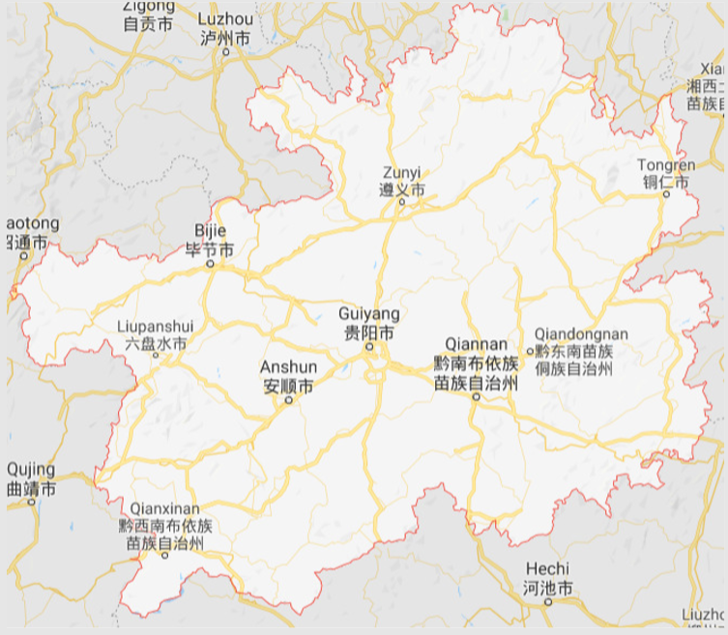
Data of the research
Guizhou province in China
The mileage of the province’s highway
network is 5.1K kilometers (i.e., 3.2K miles)
The data we research is from the 280 toll
stations in the network
Our measurement lasted for 4.5 years, from
Jan. 2010 to Jul. 2014
The average daily trafﬁc volume (number of
vehicles) is 378,766
Notes:
This is a map of Guizhou province

Slide 7
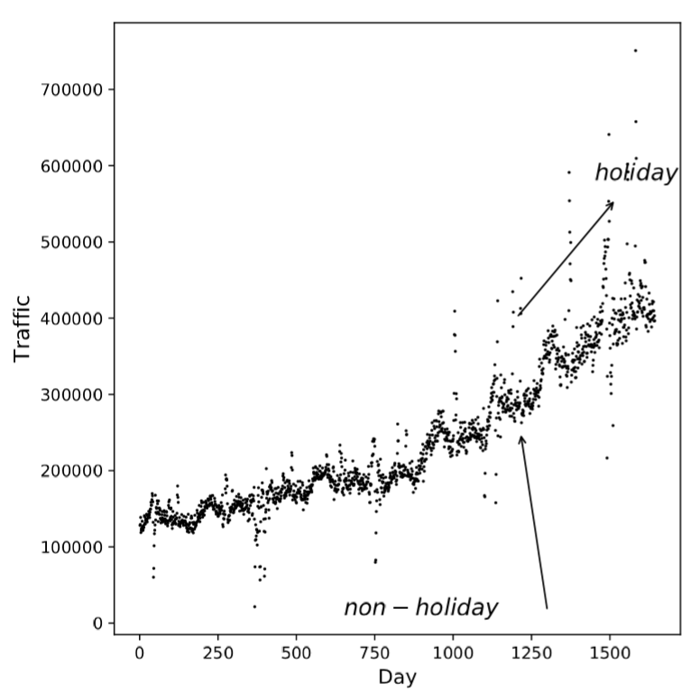
Total Data Trend
We plot all data (from 2010 to 2014). The increasing trends of both the nonholiday and holiday trafﬁc are not linear.
Notes:
LSTM，以及lab，还有指数，线性的描述

Slide 8
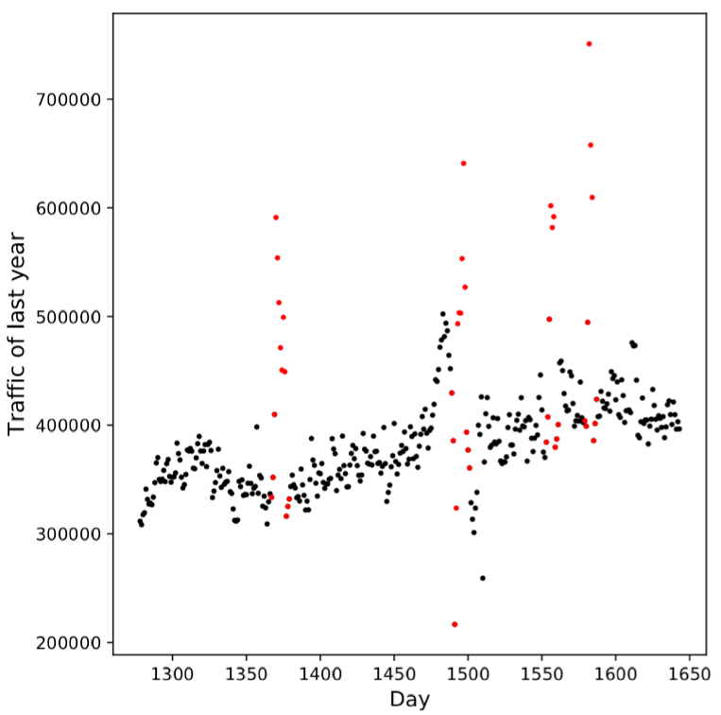
Last year data trend
Red: holiday
Black: non-holiday
The peak trafﬁc of a year occurs on one holiday
1.88 times higher than neighboring non-holidays

Slide 9
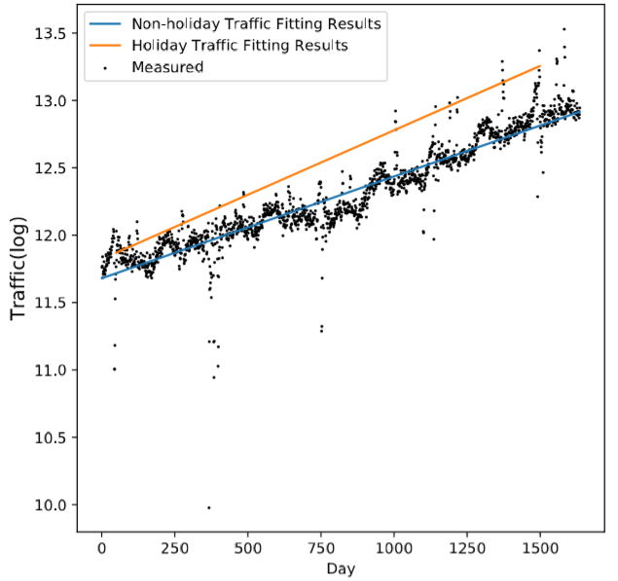
Exponential Growth of Long Term Trend
we ﬁt all non-holiday data (from 2010 to 2014) with an exponential growth model and plot the result in the Figure.(blue)
And We further ﬁt the trafﬁc of each holiday in the 4.5 years with an exponential growth model. As an example, we plot the fitting result of one day in National Day holidays in the figure. (orange)
The slope of the holiday is larger than that in non-holidays, which means that the increase rate of holidays is higher than that in non-holidays.
Notes:
Based on this find, we change our model.

Slide 10
Burst Trafﬁc in Holidays
We research the four trafﬁc burst periods which correspond to four main holidays in China.
Spring Festival: 7 days
Ching Ming Festival: 3 days
Labor Day: 3 days
National Day: 7 days

Slide 11
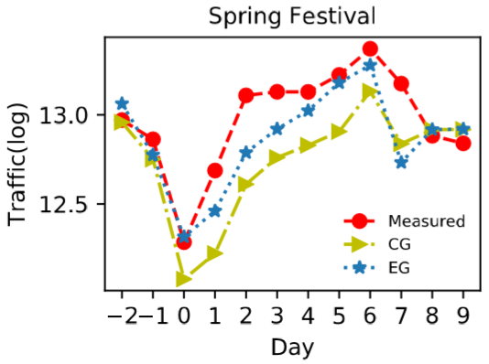
Trafﬁc in Spring Festival
First signiﬁcantly decreases: This is because on the day before the holiday, many people stay at home to spend the Spring Festival Eve with families, like what western people do on Christmas Eve.
Gradually increases: On the end day of the holiday period, the trafﬁc reaches its peak, as a large number of people leave home and go back to work.

Slide 12
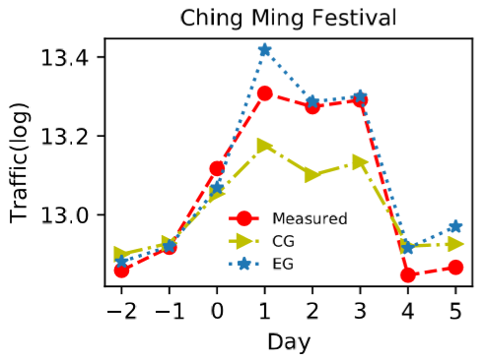
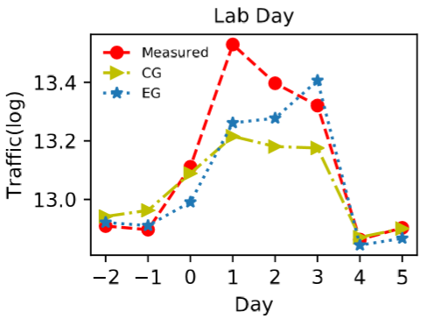
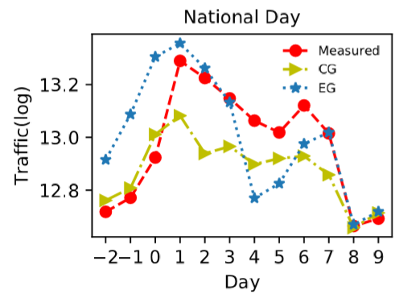
Burst Trafﬁc in Holidays
For Ching Ming Festival, Labor Day, and National Day holidays, the trafﬁc abruptly increases on the ﬁrst day of the holiday period.(from 0 day to 1 day)
During the holidays, the trafﬁc keeps relatively high, means a lot of people are on the road, until the end of the holidays.

Slide 13
Outline
Meaning and background of the research
Measurement Traffic growth pattern
Model and prediction
Experiment results
Conclusion

Slide 14
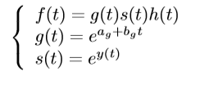
Long-Term Traffic Model
f(t) is the time series of the trafﬁc volume
g(t) is the trend component
s(t) is the seasonality component
h(t) is the holiday component
Notes:
This is a general prophet model. It has three components.
This is that we changed.

Slide 15
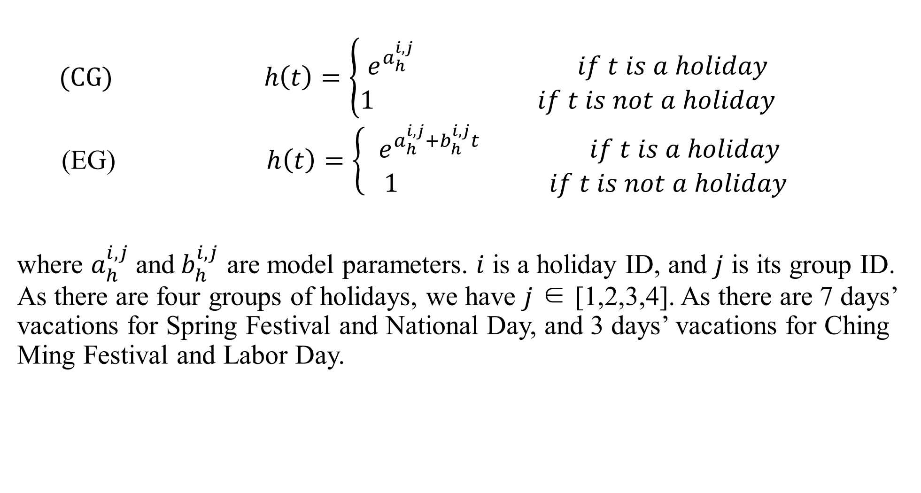
Holiday Component Model
(CG) $h\left(t\right)=\left\{\begin{aligned}e^{a_{h}^{i,j}} if t is a holiday \\ 1 if t is not a holiday\end{aligned}\right.$
(EG) $h\left(t\right)=\left\{ \begin{aligned}e^{a_{h}^{i,j}+b_{h}^{i,j}t} if t is a holiday \\ 1 if t is not a holiday\end{aligned} \right.$
where $a_{h}^{i,j}$and${ b}_{h}^{i,j}$ are model parameters. $i$ is a holiday ID, and $j$ is its group ID. As there are four groups of holidays, we have $j$ ∈ [1,2,3,4]. As there are 7 days’ vacations for Spring Festival and National Day, and 3 days’ vacations for Ching Ming Festival and Labor Day.
Notes:
CG is original prophet model,
EG is that we changed,
the increase rate is higher, so we think the holiday component change over time.

Slide 16
Outline
Meaning and background of the research
Measurement Traffic growth pattern
Model and prediction
Experiment results
Conclusion

Slide 17
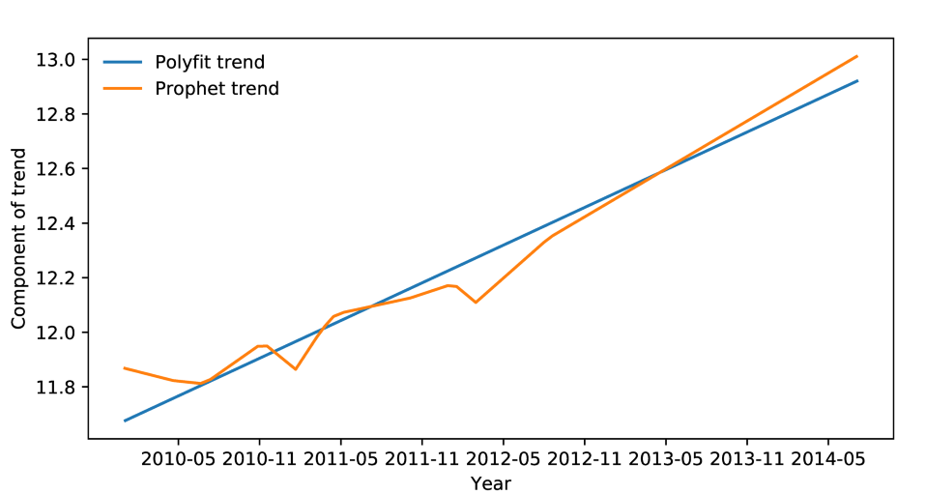
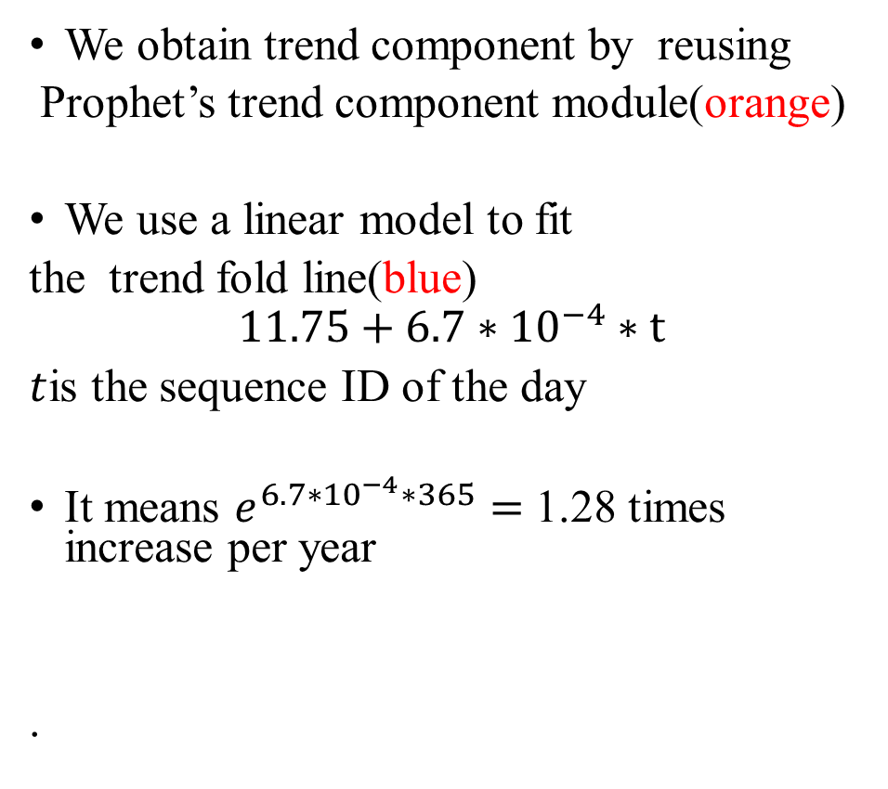
Trend component
We obtain trend component by reusing
Prophet’s trend component module(orange)
We use a linear model to fit
the trend fold line(blue)
$$11.75+6.7∗{10}^{−4}∗t$$
$t$is the sequence ID of the day
It means $e^{6.7∗{10}^{−4}∗365}=$1.28 times increase per year
.

Slide 18
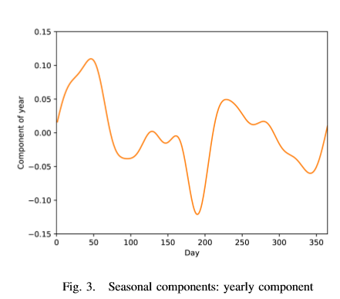
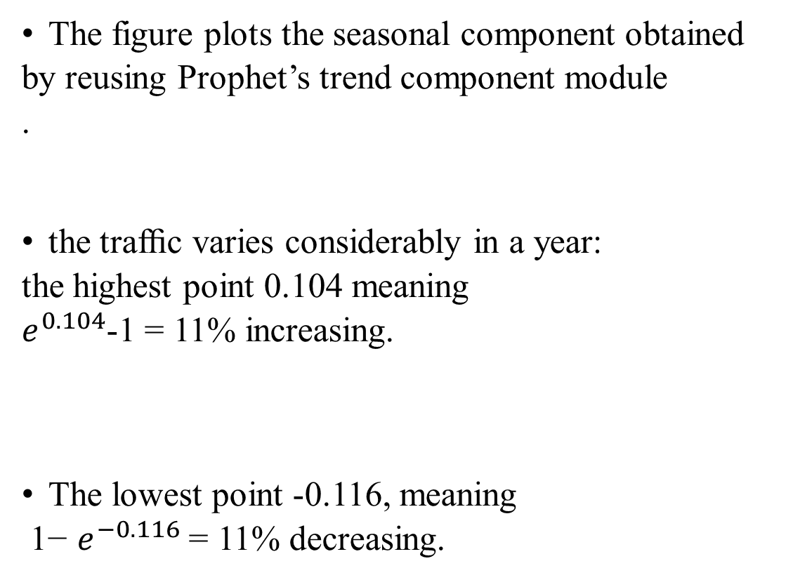
Seasonal component
The figure plots the seasonal component obtained
by reusing Prophet’s trend component module
.
the trafﬁc varies considerably in a year:
the highest point 0.104 meaning
$e^{0.104}$-1 = 11% increasing.
The lowest point -0.116, meaning
1− $e^{−0.116}$= 11% decreasing.
June

Slide 19
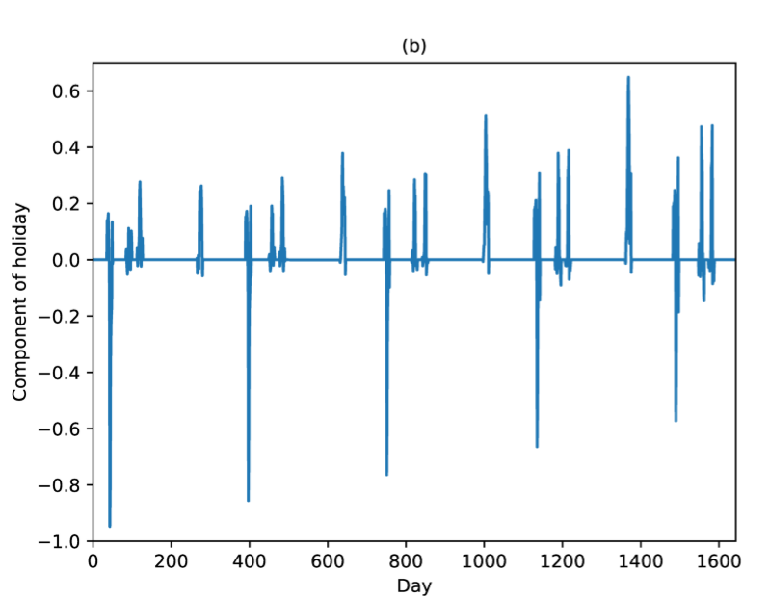
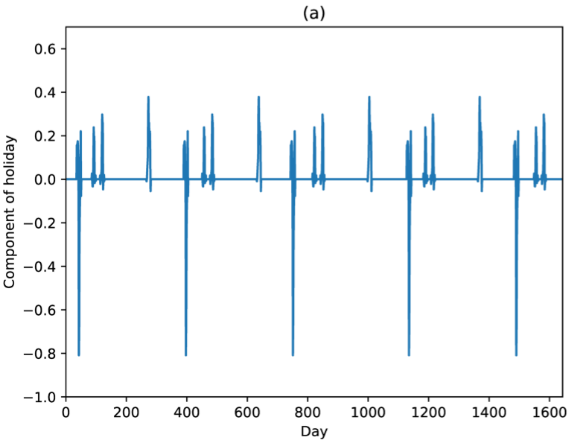
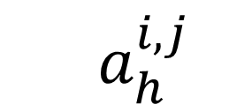

Holiday components
$${ a}_{h}^{i,j}$$
$$a_{h}^{i,j}+b_{h}^{i,j}t$$
Notes:
as shown in the figure a, the holiday components obtained by CG are constants.
For comparison, as shown in the figure b, the holiday components obtained by EG grows linearly over time.

Slide 20
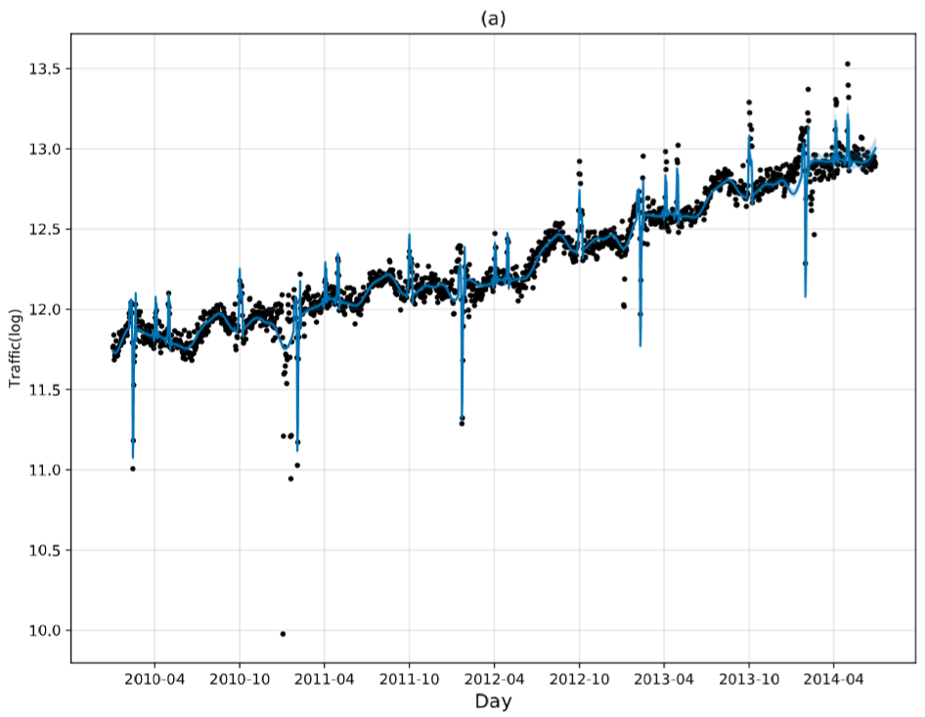
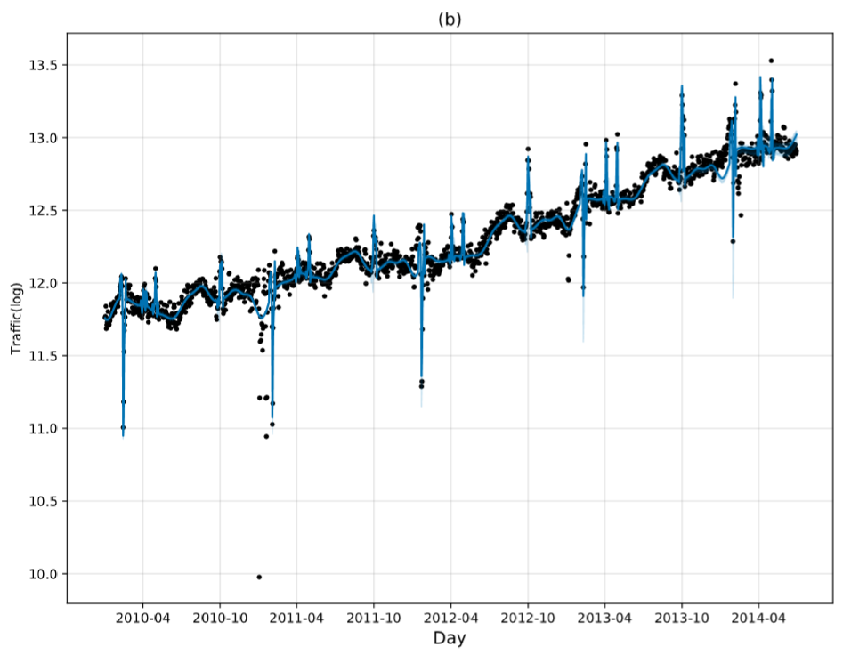
CG and EG performance
CG
EG
Notes:
CG model underestimates traffic volume after 2012. because CG models holiday’s component as a constant, which makes the later prediction results less than the real values.
For comparison, as shown in Fig. b, EG model predicts the holiday traffic better.

Slide 21
Baseline Models
We compare the performance of EG model against the following time series models:
  STL-ARIMA and STL-EST
  Holt–Winters
  Constant Growth (CG) model

Slide 22
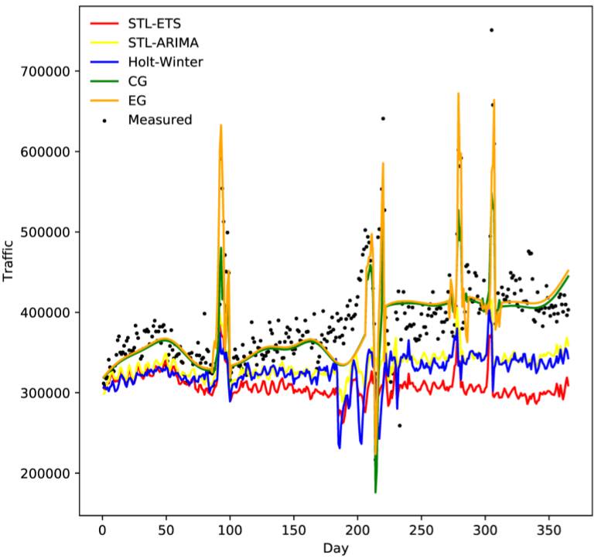
Result
As shown in the Fig, STL-ETS, STL-ARIMA and Holt-Winters all underestimate the both non-holiday and holidays trafﬁc.
EG has better performance than CG in predicting holidays traffic.
STL-ETS
STL-ARIMA
Holt-Winters

Slide 23
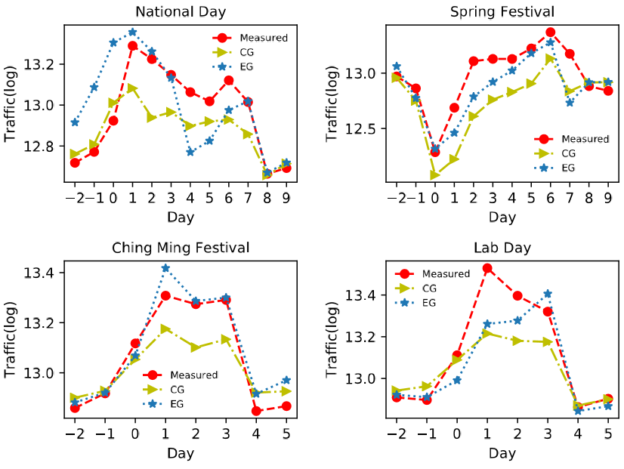
the EG is closer measurement than CG
Notes:
We can see this figure, the EG is closer measurement than CG
We check the traffic on Lab day from 2010 to 2014. we find the traffic on the last day heavier than on the first day only 2013 year.
therefore, it lead to the predict incorrectly in 2014. but the peak volume is better than result obtained by CG.
所以导致了14年也趋势也预测错误。但是假期的最高流量预测相比于CG也还是好的。
otherwise

Slide 24
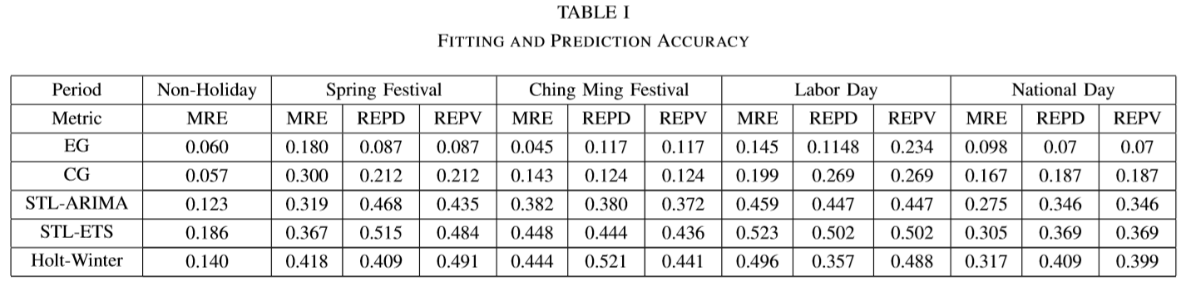
Result
MRE (Mean Relative Error)
REPV (Relative Error of Peak Volume) REPD (Relative Error of Peak Day)
If REPV is equal to REPD, that means the heaviest day is same with measurement during the
Group holidays. And they are smaller, the prediction is closer to measurement.
Notes:
These are some evaluation metrics
From this table, we can see EG have better performance than other baseline model in holidays

Slide 25
Outline
Opportunity and risk in big data era
Problem analysis
Solution and Algorithm
Experiment results
Conclusion

Slide 26
Conclusion
We conduct a comprehensive measurement analysis of the trafﬁc volume growth pattern in the network.
Proposed an Exponential Growth holiday component trafﬁc prediction model (EG).
Experimental results showed that the model considerably improves the holiday trafﬁc prediction accuracy compared with the existing models.

Slide 27
Thank you

