Slide 1

Basics of CSS Welcome everyone!!!

Slide 2

Please scan it for attendance

Slide 3
What is CSS?
CSS (Cascading Style Sheets) is a stylesheet language used to control the presentation and layout of HTML elements. It allows you to apply styles like colors, fonts, spacing, and positioning to make web pages visually appealing.

Slide 4
What are the CSS rules or rule sets?
Each rule set consists of:
Selector – The part before the curly braces (body in this case), which targets HTML elements.
Declaration Block – The part inside the curly braces { }, which contains declarations.
Declarations – Each individual style inside the block, written as property: value;.
Since your example is empty (body { }), it's just a CSS rule with no declarations yet.

Slide 5
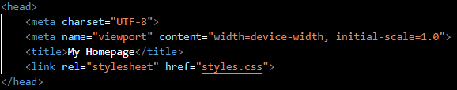
Set up the Head
<meta charset="UTF-8">
Specifies the character encoding for the document.
UTF-8 supports almost all characters and symbols from different languages.
<meta name="viewport" content="width=device-width, initial-scale=1.0">
Makes the website responsive on mobile devices.
width=device-width: Sets the page width to match the screen width.
initial-scale=1.0: Ensures the page loads at a normal zoom level.
<title>My Homepage</title>
Defines the title of the webpage (visible on the browser tab).
<link rel="stylesheet" href="styles.css">
Links an external CSS file (styles.css) to style the page.

Slide 6
What is <nav> </nav>?
The nav element represents a section of a page that links to other pages or to parts within the page: a section with navigation links.
On todays's section we will implement this tag into our website so we can start implementing interations from one site to another
What is href?
Hypertext REFerence It specifies the destination (URL or location) that the link will navigate to when clicked.

Slide 7
What is <a> </a>?
The <a> tag in HTML is an anchor element used to create hyperlinks. In your navigation menu, each <a> tag serves a specific purpose:
Internal Links (#home, #about, etc.)
The href="#home" means that clicking the link will scroll the page to the element with id="home".
These are called anchor links or jump links.
External or Relative Links (portfolio.html)
href="portfolio.html" is a relative link, which means it opens the portfolio.html file from the same directory.

Slide 8
Lets move from one page to another
You can create another HTML file for a different purpose and link it to the "main" page, Example:
<a href="portfolio.html">Portfolio</a>

Slide 9
Footer code
Make sure to use this in case you do not want anyone use your work!!!
<footer>
<p>&copy; 2025 My Homepage. All Rights Reserved.</p>
</footer>
<footer>: Defines the footer section of the webpage.
<p>: Paragraph element that contains the text.
&copy;: HTML entity for the copyright symbol (©).
2025: The year (you can dynamically update this using JavaScript).
"My Homepage. All Rights Reserved.": A standard legal notice.

Slide 10
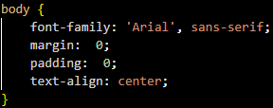
Finally let's see CSS!!!
This body CSS rule is used to:
Set the font to Arial (or a similar sans-serif font).
Remove default margins and padding from the body, ensuring a clean layout with no extra space around the content.
Center-align text or inline elements inside the body of the page.
These styles are commonly used to give a clean, consistent starting point for your webpage design.

Slide 11
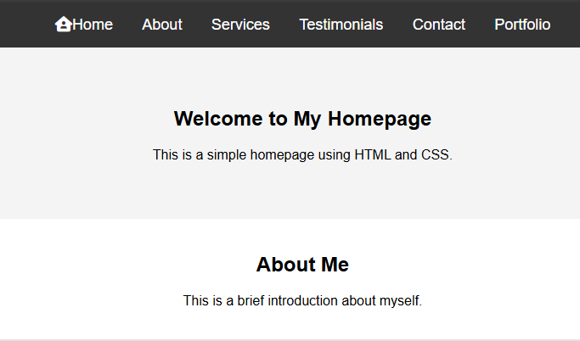
Insert an Icon
Remember we can implement tags inside of other tags to implement style, links, icons, etc. This is an example of how to do it:
<a href="#home"><i class="fa-solid fa-house-user"></i>Home</a>
Add style: i.fa-house-user {
margin-right: 5px;
}

Slide 12
Source Materials:
Designs:Material Design 3 - Google's latest open source design system
Today's class materials: https://github.com/BJcheng935/WDC-CSS-Materials.git
Font awesome library: font-awesome - Libraries - cdnjs - The #1 free and open source CDN built to make life easier for developers
Font awesome icons: Font Awesome

Slide 13

Mine Tracker Attendance

