Slide 1
Part 2: Game Engine
Project (Directory) Structure – sprite media
Minimum PC requirements

Slide 2
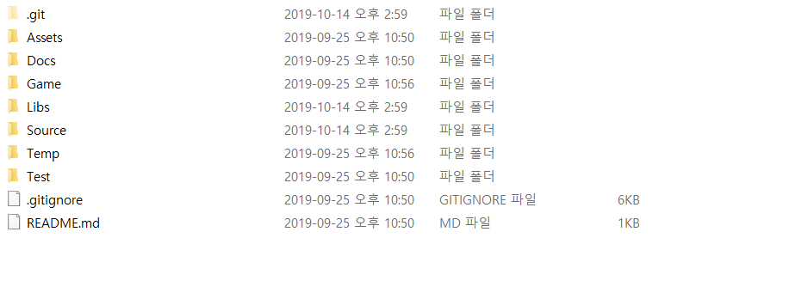
Base

Slide 3
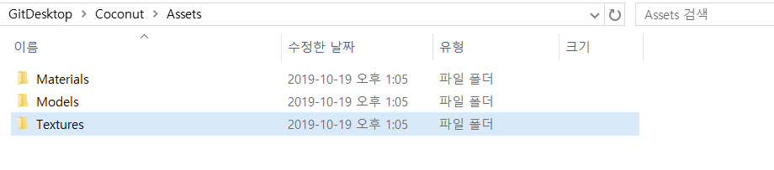
Assets Folder
Example Image
All the assets such as textures, materials, and 3d models will be stored under Assets folder.

Slide 4
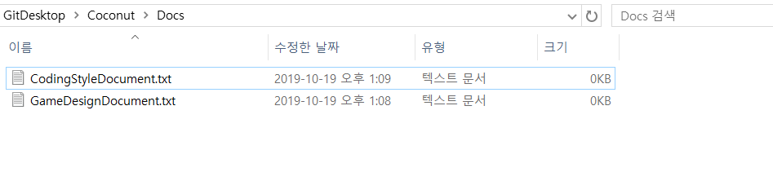
Docs Folder
Example Image
All the documents related to the project will be put under Docs Folder.

Slide 5
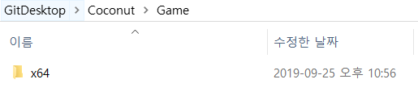
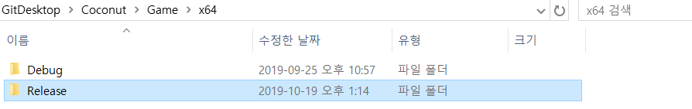
Game Folder
When we build a game with certain platform, folder that has a same name as platform will be created.
Folder contains Debug folder and Release folder underneath.
(configuration)

Slide 6
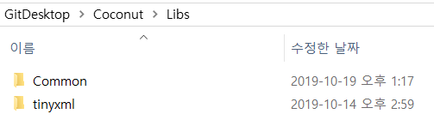
Libs Folder
Example Image
All external libraries to operate game will be stored under Libs folder.

Slide 7
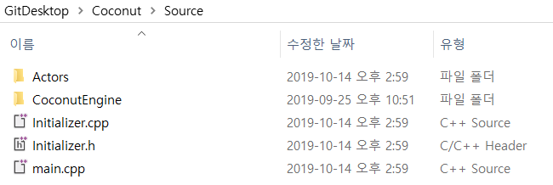
Source Folder
All cpp and header files we write will be stored here.

Slide 8
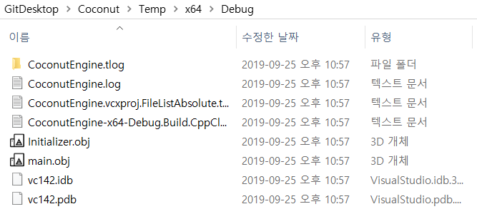
Temp Folder
Temp files that would be created during building a project will go here.

Slide 9
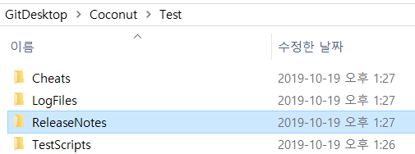
Test Folder

Slide 10
Minimum PC requirements
DirectX12 supported GPU.
Minimum 1GB Ram.
1GB for hardware storage.

