Slide 1
Intelligent Classification of Rural Infrastructure Projects
CAPSTONE PROJECT
Presented By:
BHOJANAPALLI NAGA VENKATA DURGA OM JNAANESH – KL University - CSE

Slide 2
OUTLINE
Problem Statement
Proposed System/Solution
System Development Approach
Algorithm & Deployment
Result (Output Image)
Conclusion
Future Scope
References

Slide 3
Problem Statement
The Pradhan Mantri Gram Sadak Yojana (PMGSY) is a flagship rural development program in India, initiated to provide all-weather road connectivity to eligible unconnected habitations. Over the years, the program has evolved through different phases or schemes (PMGSY-I, PMGSY-II, RCPLWEA, etc.), each with potentially distinct objectives, funding mechanisms, and project specifications. For government bodies, infrastructure planners, and policy analysts, efficiently categorizing thousands of ongoing and completed projects is crucial for effective monitoring, transparent budget allocation, and assessing the long-term impact of these schemes. Manual classification is time-consuming, prone to errors, and scales poorly.
Your specific task is to design, build, and evaluate a machine learning model that can automatically classify a road or bridge construction project into its correct PMGSY_SCHEME based on its physical and financial characteristics.

Slide 4
Proposed Solution
To effectively automate the classification of PMGSY road and bridge projects into their respective schemes, a comprehensive approach involving data preparation and model deployment must be followed.
Data Pre-processing:
Clean and normalize project datasets, handling missing values and outliers.
Encode categorical variables and balance class distribution to improve model learning.
Machine Learning Algorithm:
Select and train a suitable classifier (e.g., Random Forest or Logistic Regression) based on data characteristics.
Tune hyperparameters and perform cross-validation to optimize model performance.
Deployment:
Deploy the trained model on IBM Cloud with a REST API for real-time project classification.
Set up automated data pipelines to feed new project data into the model for continuous prediction.
Evaluation:
Measure model accuracy, precision, recall, and F1-score to assess classification quality.
Analyze confusion matrix and conduct error analysis to identify and address model weaknesses.

Slide 5
System Approach
Platform Used: IBM Watson Studio – Used for AutoAI pipeline creation, model training, and deployment.
Dataset Source: AI-KOSH dataset – Pradhan Mantri Gram Sadak Yojna (PMGSY).
Data Handling: IBM Watson’s built-in data flow managed preprocessing, including column selection and cleaning.
Model Selection & Training: AutoAI in IBM Watson automatically tested multiple algorithms and selected the best-performing one with hyperparameter tuning.
Deployment Environment: IBM Cloud Lite – Model deployed as a REST API for real-time access.
Interface: Prediction results are tested using the Watson with options to upload CSV, JSON, or manual input.

Slide 6
Algorithm & Deployment
1. Algorithm Selection:
Analyze the dataset's features (e.g., numeric, categorical, size, class distribution) to choose an appropriate machine learning algorithm such as Random Forest, Logistic Regression, or other ensemble/classification algorithms.
Consider the trade-offs: For example, Random Forest is robust and handles diverse data types well, which is suitable for project classification tasks.
2. Data Input:
Prepare the raw project data by cleaning, encoding categorical variables, and normalizing numeric attributes.
Format the data into a suitable structure (CSV) that aligns with the input requirements of the chosen ML model.
3. Training Process:
Split the dataset into training and validation sets.
Train the selected algorithm on the training portion, using techniques like cross-validation and hyperparameter tuning to optimize for accuracy.
Evaluate the model using validation data, adjusting parameters and pre-processing steps as needed.
4. Prediction Process:
Deploy the trained model (e.g., on IBM Cloud) as a RESTful API or web service.
For real-time predictions: New project data is sent to the API, which preprocesses the input, applies the trained model, and returns the predicted PMGSY scheme.
Continuously monitor performance by tracking prediction results and updating the model as new data becomes available.

Slide 7
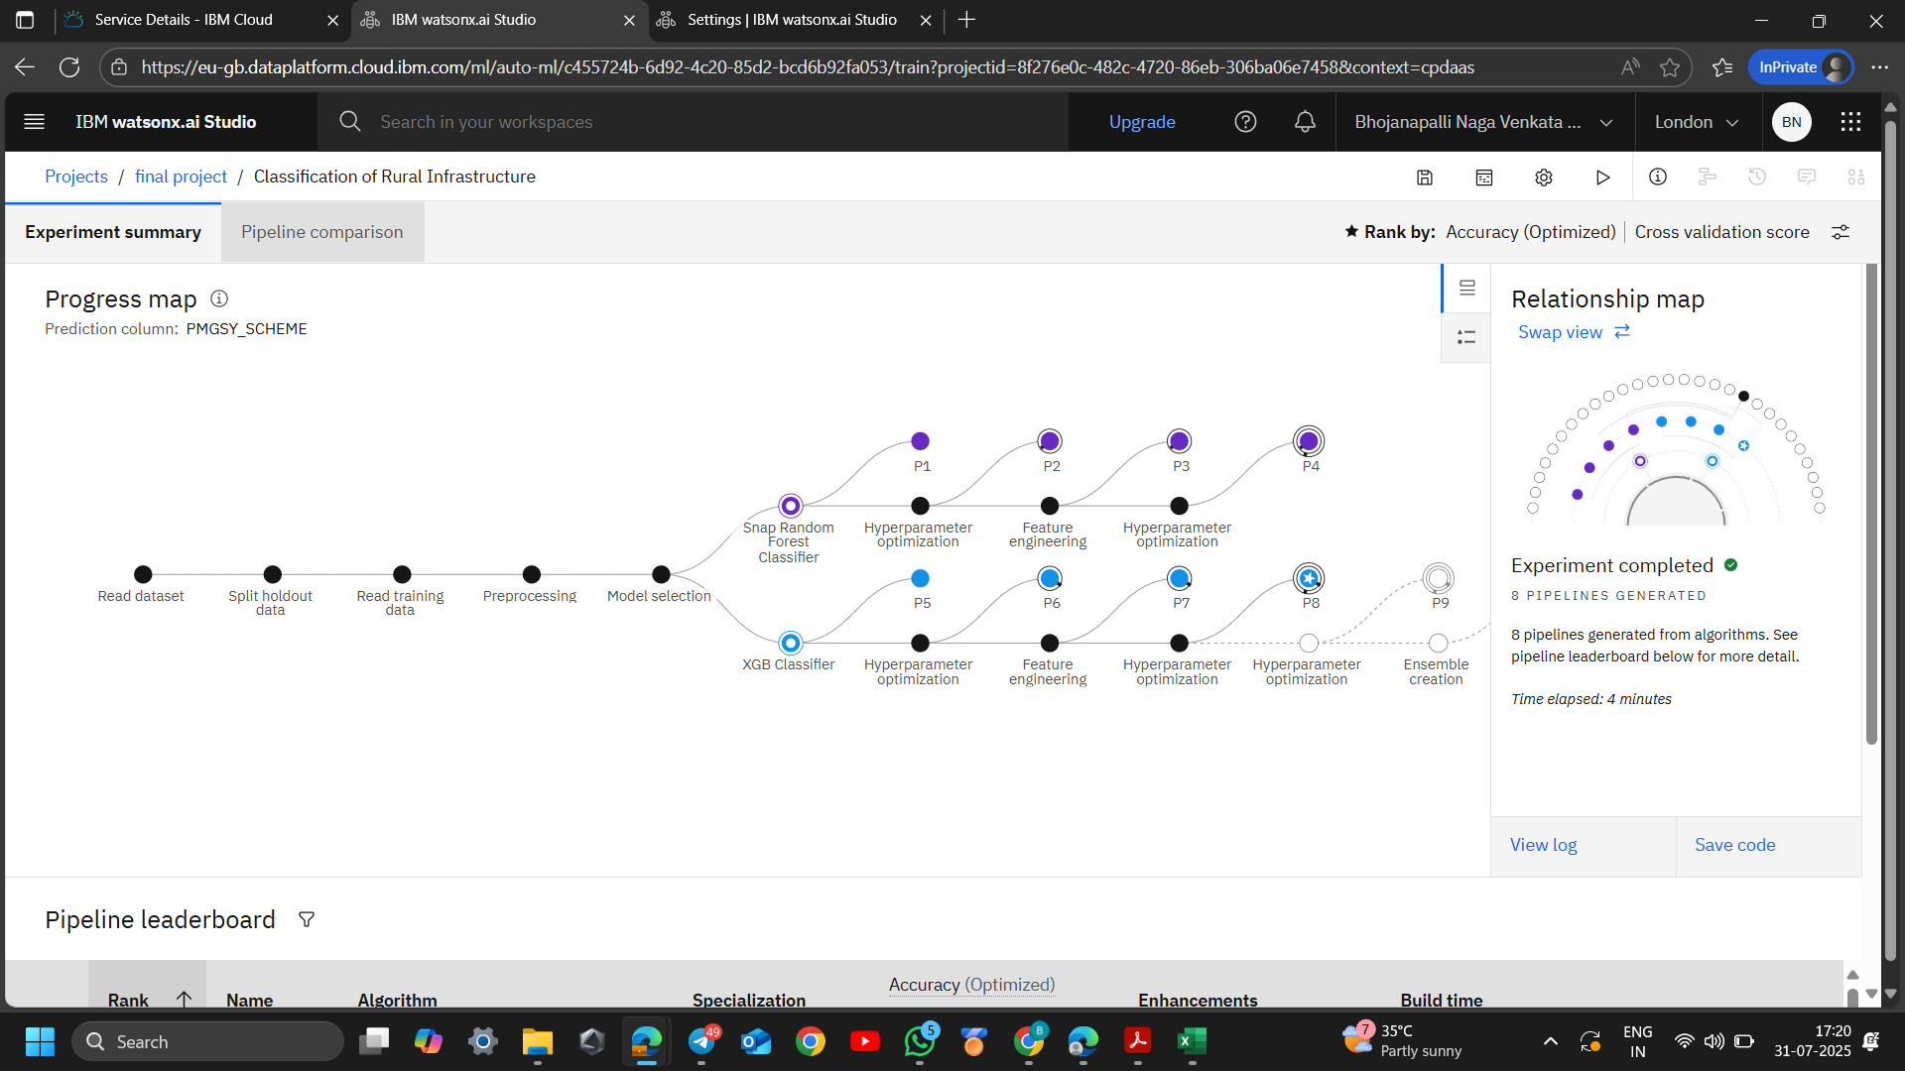
Result

Slide 8
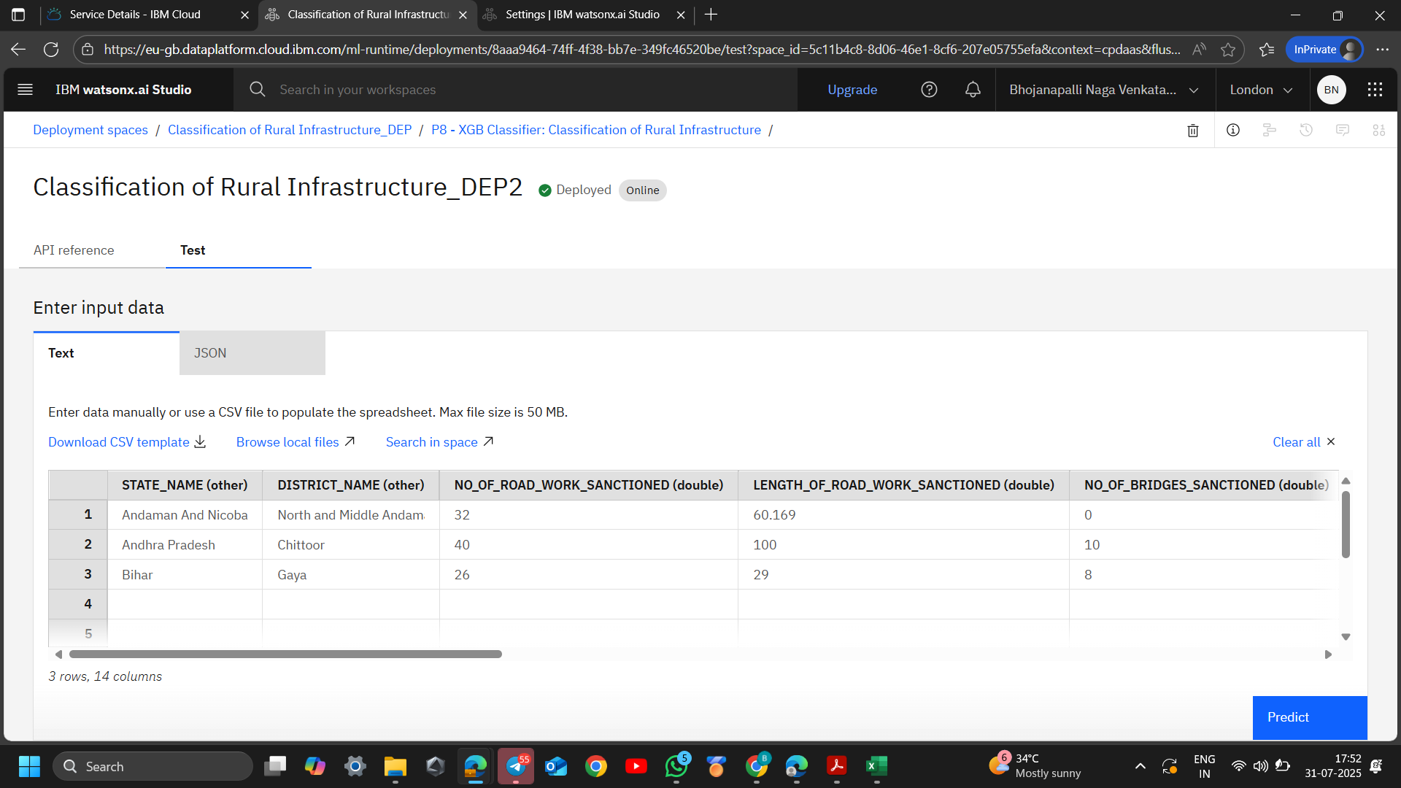
Result

Slide 9
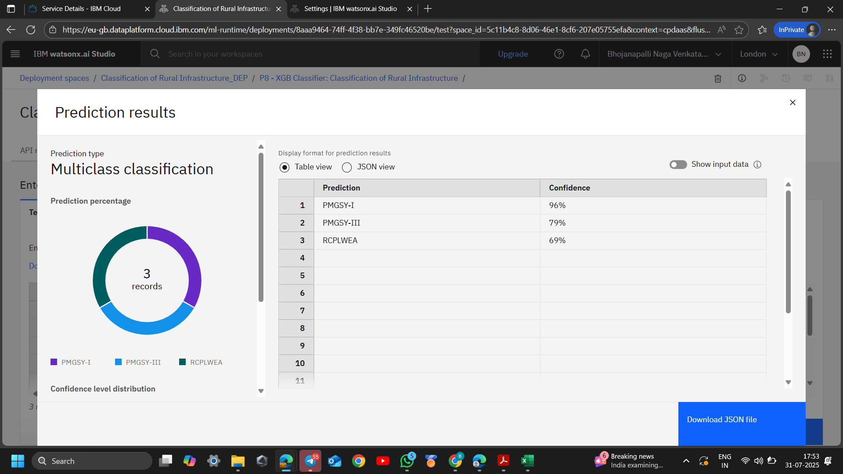
Result

Slide 10
Conclusion
Automated classification of PMGSY road and bridge projects was successfully developed using machine learning based on physical and financial data.
Data preprocessing, algorithm selection, and IBM Cloud deployment improved accuracy, scalability, and efficiency over manual methods.
The system helps streamline project monitoring, budget allocation, and supports real-time prediction for ongoing projects.
The framework allows continuous updates and can adapt as more data becomes available.
Future enhancements may include integrating more data sources, applying advanced algorithms, and expanding deployment features to better support rural infrastructure development.

Slide 11
Future scope
Use More Data:
Add geographic and satellite data to make predictions better.
Use real-time data from sensors or mobile apps to track projects live.
Improve the Algorithm
Try advanced models like deep learning to get more accurate results.
Automatically pick the best features to make the model faster and smarter.
Expand to More Areas
Scale the system to cover multiple cities, states, or all over India.
Customize the model based on local conditions and construction practices.
Use New Technologies
Make the model’s decisions easy to understand for officials using explainable AI.
Set up automatic model updates as new data comes in.
Help Policymakers and Collaborate
Create dashboards to visualize results and aid decision-making.
Work with government and researchers to share data and improve the system.

Slide 12
References
AI Kosh Dataset: https://aikosh.indiaai.gov.in/web/datasets/details/pradhan_mantri_gram_sadak_yojna_pmgsy.html
IBM Watson Studio and IBM cloud resources.

Slide 13
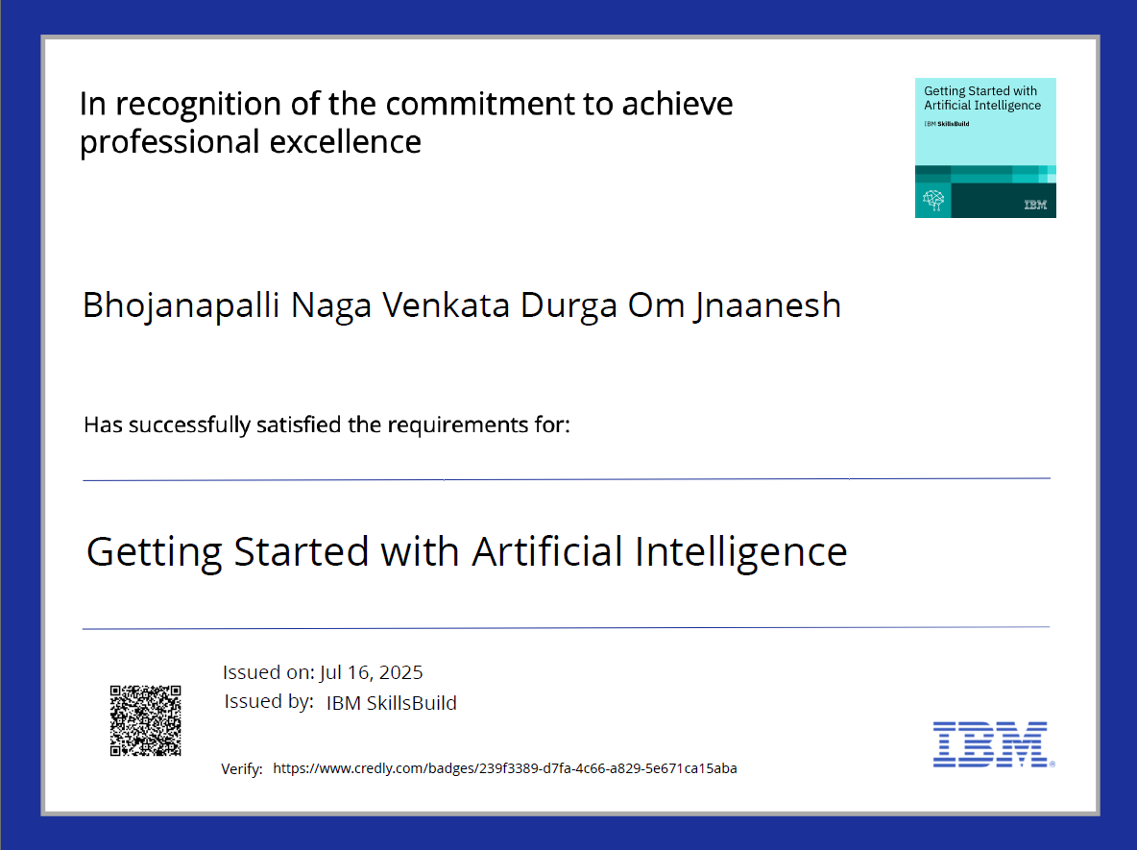
IBM Certifications

Slide 14
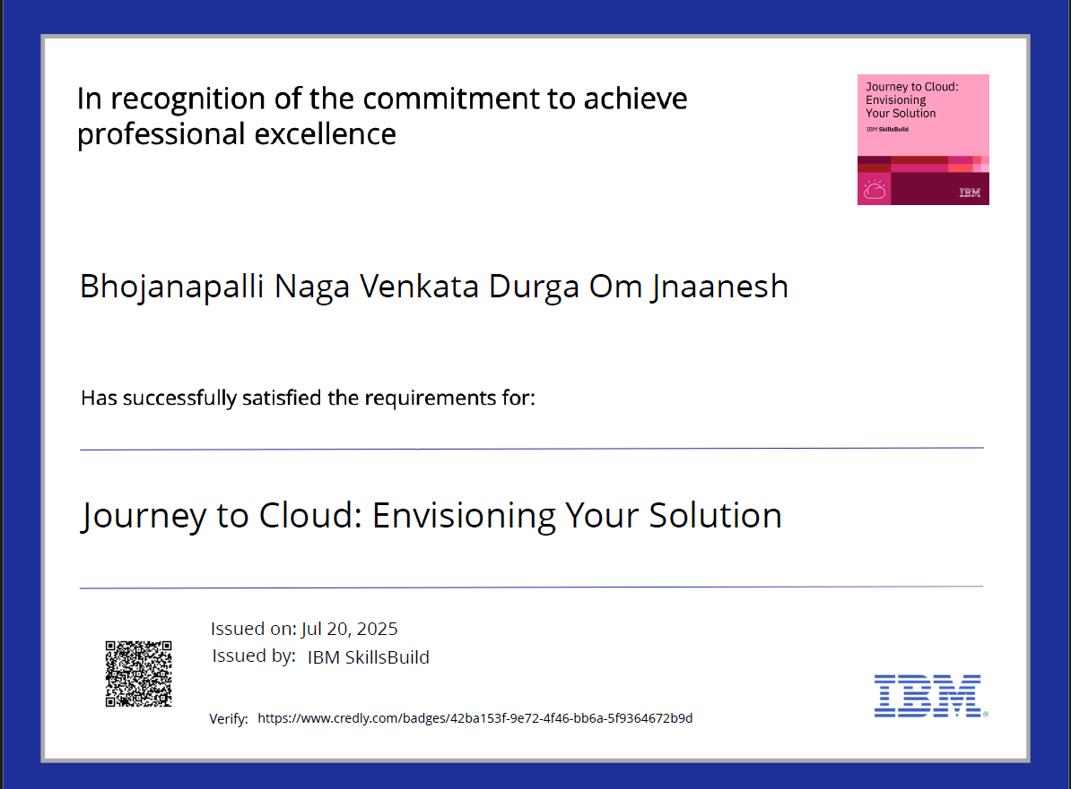
IBM Certifications

Slide 15
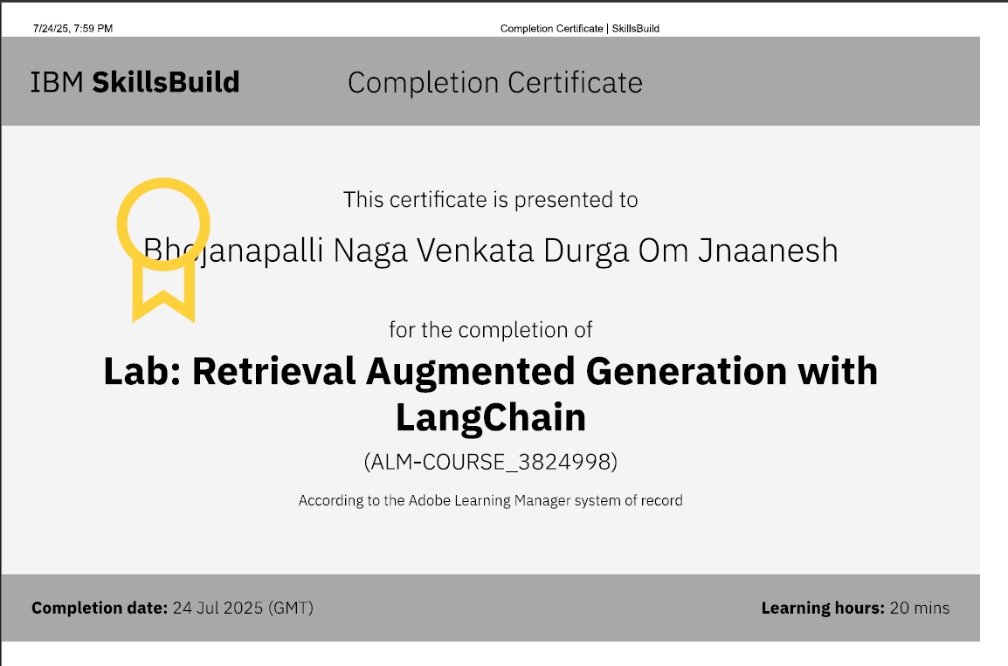
IBM Certifications

Slide 16
THANK YOU

