Slide 1
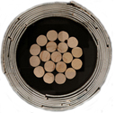

Conductor on Round Core (CORC) cables for
power transmission and high-field magnets
Danko van der Laan
Advanced Conductor Technologies LLC, Boulder, Colorado
&
University of Colorado / NIST, Boulder, Colorado
MAP HTS Magnet Workshop, Fermilab, May 31st 2012

Slide 2
Outline
1. Introduction of Advanced Conductor Technologies and the HTS magnet cable program at the University of Colorado.
2. Overview of CORC cable design.
3. Power transmission cables for Air Force applications.
4. Cable tests at 4.2 K and 20 T.
5. Current distribution in CORC cable.
6. Next steps.
7. Summary.

Slide 3
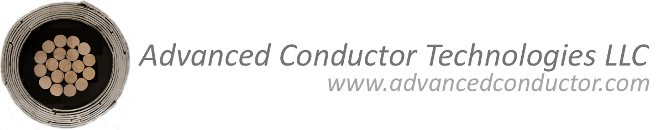
Advanced Conductor Technologies
Spin-off from the University of Colorado and NIST:
Advanced Conductor Technologies focuses on the commercialization of high-temperature superconducting Conductor on Round Core (CORC) cables for high-density power transmission and high-field magnets.
Current projects:
1. “REBCO coated conductor cables for fusion magnets”
- Phase I STTR from DOE-Fusion
- Subcontractor MIT (Joe Minervini, Leslie Bromberg, Makoto Takayasu)
2. “High-temperature superconducting SMES for airborne applications”
- Phase I STTR from the Air Force (AFRL)
- Subcontractor Ohio State University (Mike Sumption, Milan Majoros, Ted Collings)
3. “Superconducting Cable Connections”
- Phase I SBIR from the Navy
- Subcontractor Center for Advanced Power Systems (Sastry Pamidi)

Slide 4
Magnet cable program at University of Colorado
“RE-Ba₂Cu₃O_{7-δ} coated conductor cables for high-energy physics applications”
New program at the University of Colorado aims to develop HTS CORC cables for high-energy physics magnets. Program funded through CU, but physically still located at NIST.
- Funded for 3 years by DOE-HEP to the University of Colorado.
Goals:
The main goal is to raise the engineering current density of CORC cables to a level needed for future HEP magnets: 200 A/mm² J_{e} at 20 T would be a good start.
Provide the electromechanical testing infrastructure needed to develop HTS conductors for HEP applications.

Slide 5
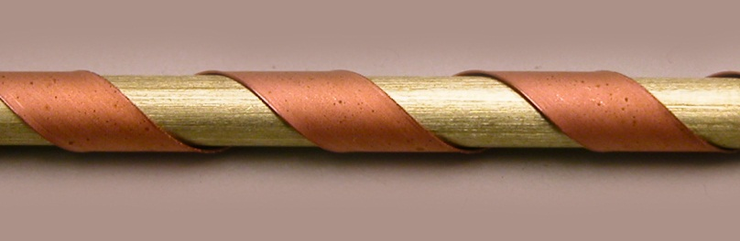
Introduction of the CORC cable design
Requirements for HTS cables:
Dc power transmission (Navy/Air Force): Low cable weight, high current, flexible.
High-field magnets (HEP/Fusion/Science):
- High-current and high-current density windings.
- Low conductor anisotropy.
- Round conductor.
- Homogeneous current distribution.
CORC cable design:
Spiral-winding CCs with YBCO under
compression around a small former.
D.C. van der Laan, SUST 22, 065013 (2009).
Benefits:
- Ultra-compact/low weight.
- No tape scrap.
- Round cable.
- Isotropic field-dependence.
- Optional cooling channel within former.
- Full conductor transposition/easy striation.
- High mechanical strength (no sharp edges).
- Standard cabling technique applicable.
- Current sharing/distribution adjustable.

Slide 6
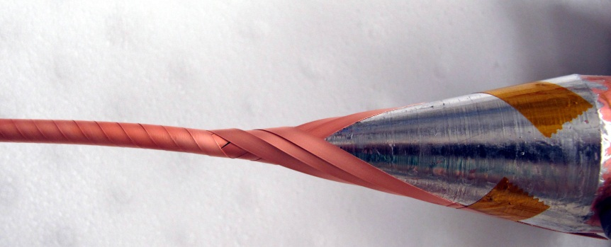
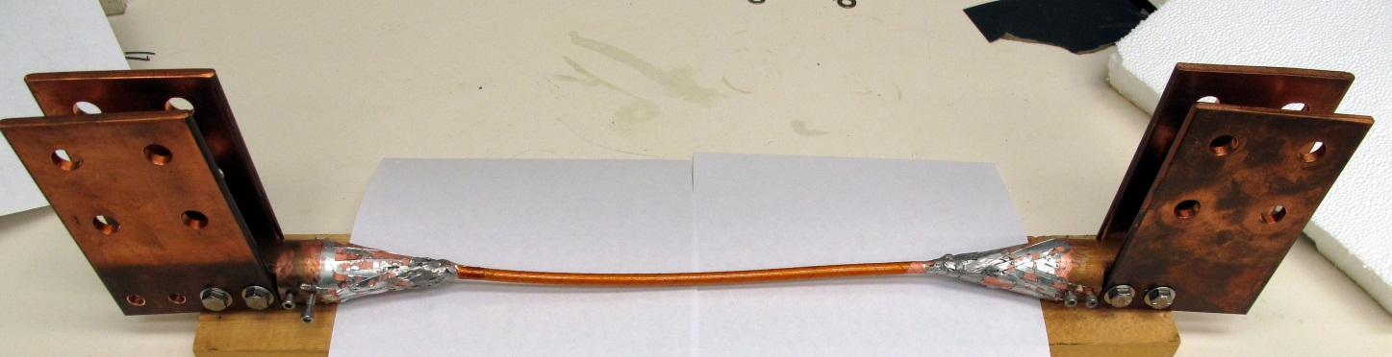
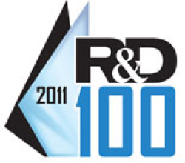
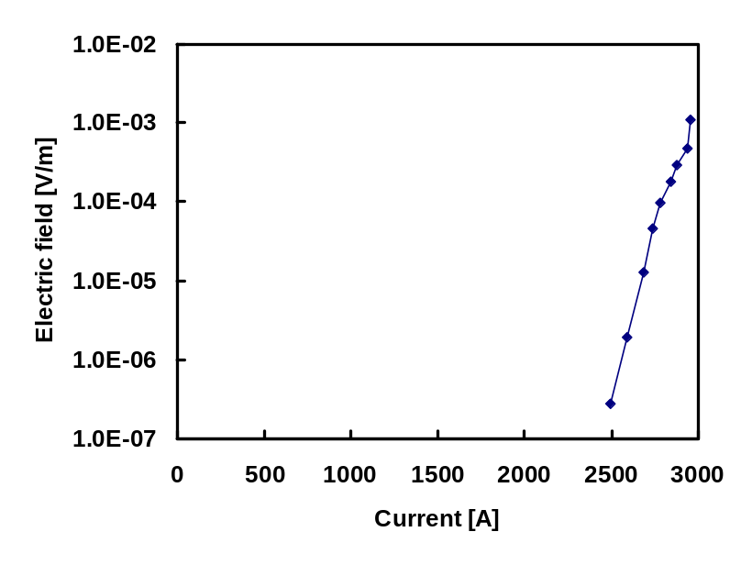
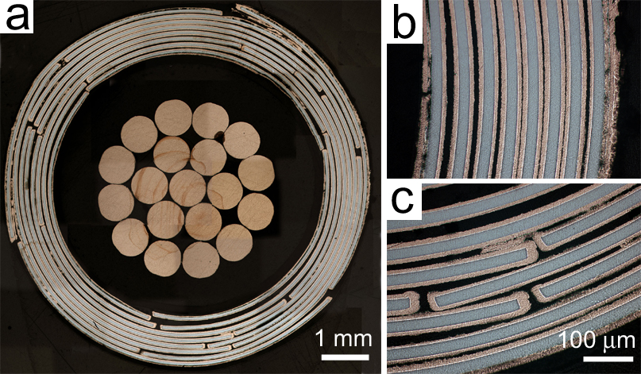
Initial high-current CORC cable (2010)
Cable:
- 5.5 mm former
- 8 layers,24 GBCO CC @ 130 A
- no insulation.
- Cable O.D. = 7.5 mm.
Final diameter 7.5 mm.
2796 A
76 K
D.C. van der Laan, X.F. Lu, and L.F. Goodrich, SUST 24, 042001 (2011).

Slide 7

Power transmission for Air Force applications
Collaborators: Timothy Haugan, Air Force Research Laboratory and Loren Goodrich, NIST.
Air Force power transmission is interested in:
- 5 MW dc power transmission at 270 V => 18,500 A.
Superconducting power transmission cable of 18,500 A at 50-55 K
=> 6200 A at 77 K
=> 6800 A at 76 K (Boulder LN₂ boiling).
Our approach (due to limited current of 5000 A):
=> 2 phase coaxial cable:
Our goal:
Phase 1
I_{c} (Phase 1) + I_{c} (Phase 2) = 6800 A
Phase 2

Slide 8
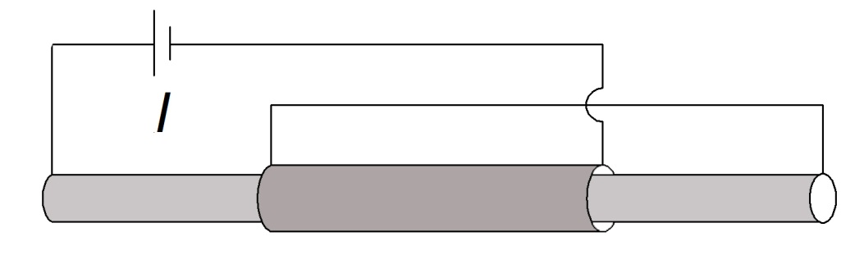
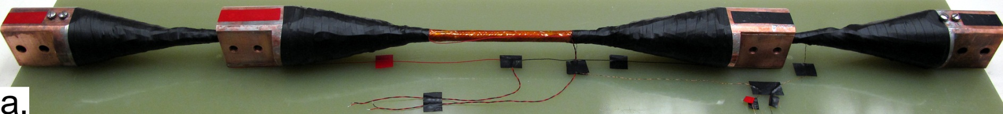
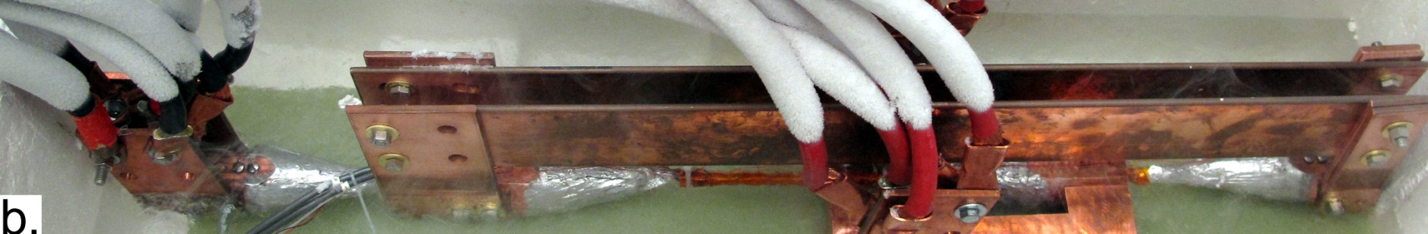
Air Force 5 MW cable Phase 1&2 parallel
Two-phase co-axial cable:
- 5.5 mm former.
- 5.8 cm OD copper end pieces.
- Phase 1: 10 layers, 39 tapes.
- Phase 2: 7 layers, 40 tapes.
- 10 mm outer diameter!
D.C. van der Laan, L.F. Goodrich, and T.J. Haugan, SUST 25, 014003 (2012).

Slide 9

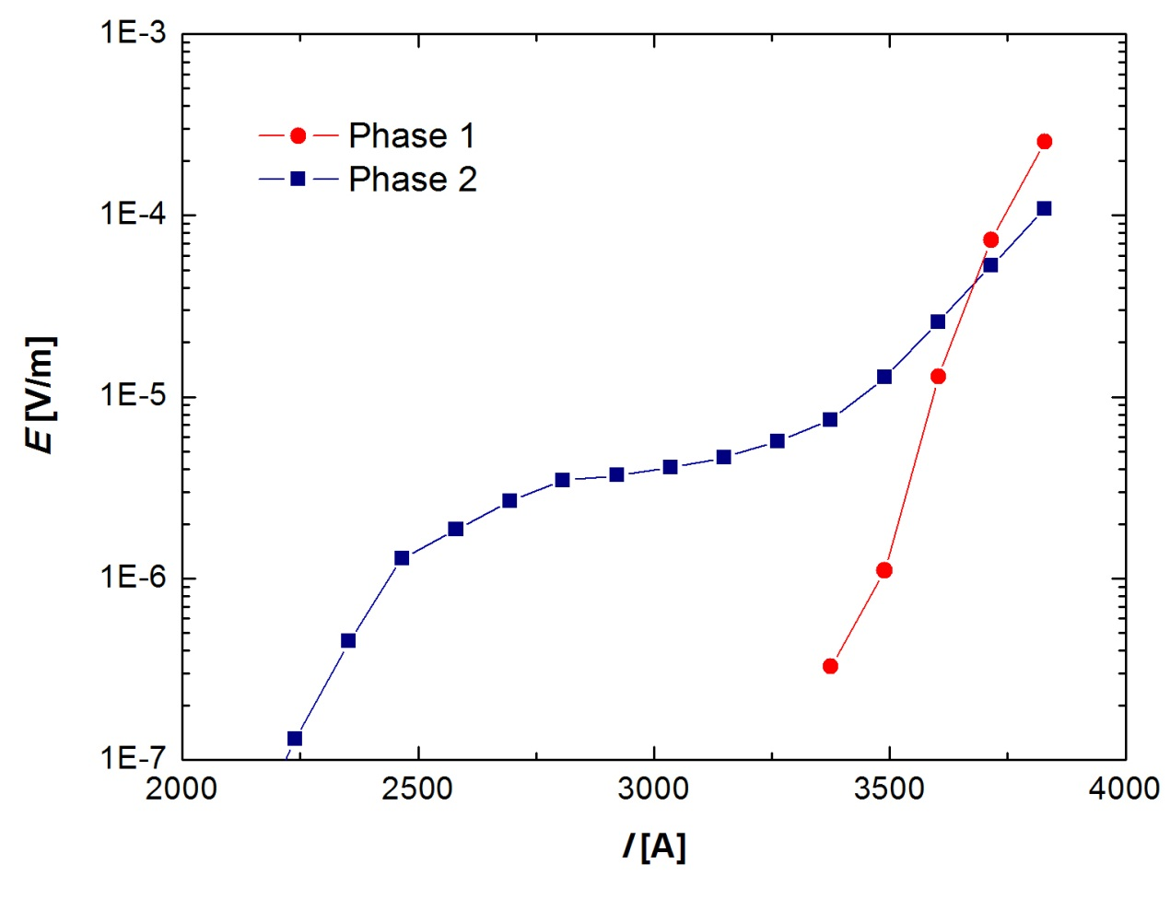
Air Force 5 MW cable Phase 1&2 parallel 76 K
I_{c} (Phase 1)=3745 A; I_{c} (Phase 2)=3816 A
I_{c} (total)= 7561 A (10 % less than stand-alone).
B_{self}= 302 mT
The cable exceeds the goal of 6800 A at 76 K!

Slide 10
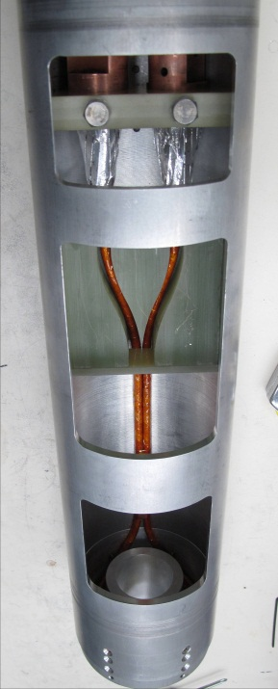
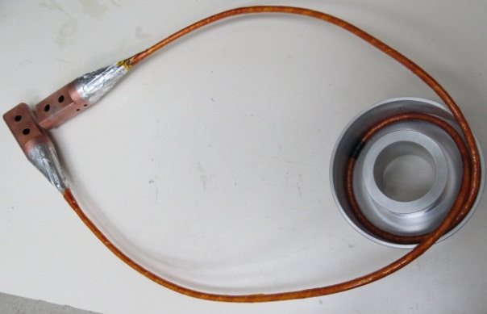
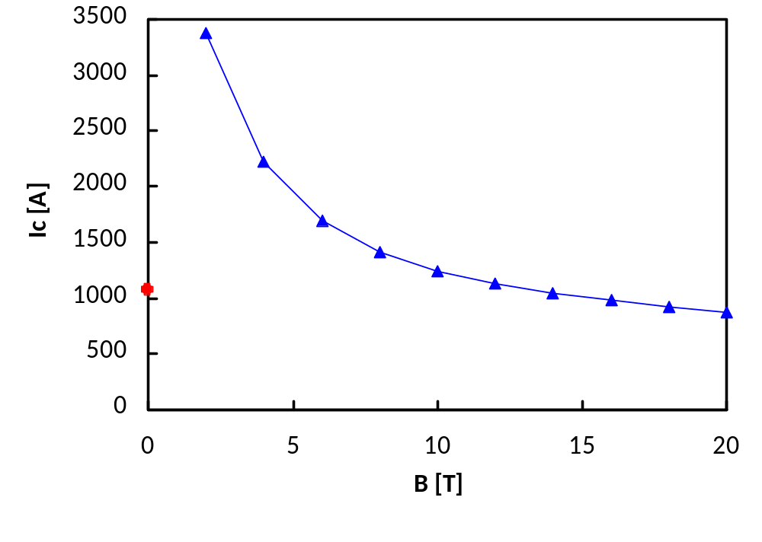

CORC cable testing at 4.2 K, 19.8 T at NHMFL
Cables tested at the NHMFL in 19.8 T background field:
Collaborators: Patrick Noyes, George Miller, Gerard Willering and Huub Weijers.
Cable (2011): 4 layers, 12 YBCO coated conductors:
I_{c} = 875 A @ 4.2 K, 19.8 T
J_{e} = 26 A/mm²
Supported in part by NSF, agreement DMR-0654118,
the State of Florida, and the U.S. Department of Energy.

Slide 11
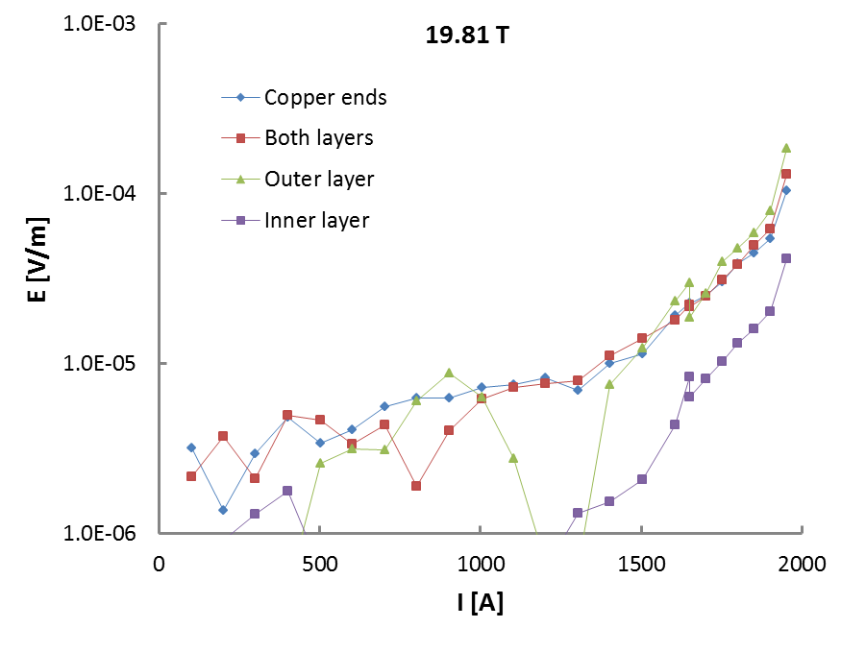
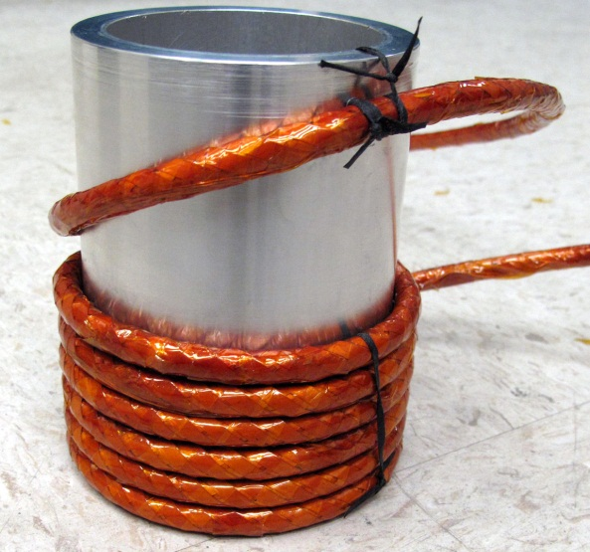
First double-layer magnet from CORC cable
Cable (2012): 20 YBCO tapes in 6 layers, 6 meters in length.
Magnet: 2 layers, 12 turns, 9 cm ID, 12 cm OD.
First layer:
I.D. 9 cm
I_{c} = 1966 A @ 4.2 K, 20 T
J_{e} = 50 A/mm²
Supported in part by NSF, agreement DMR-0654118,
the State of Florida, and the U.S. Department of Energy.

Slide 12
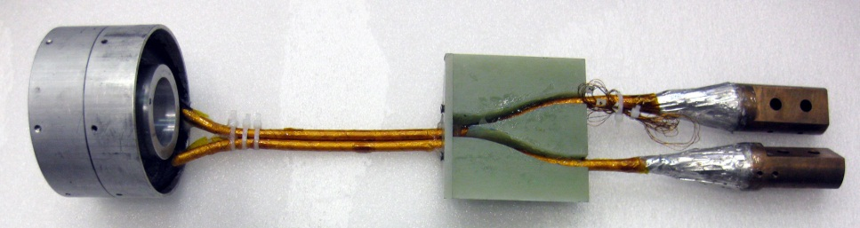
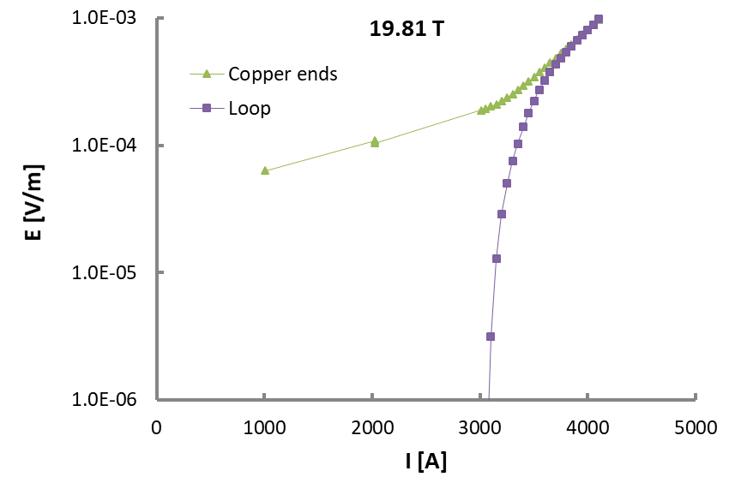
High-current CORC cable tested at 19.8 T
Cable (2012): 40 YBCO coated conductors, 13 layers:
I_{quench} = 4101 A @ 4.2 K, 19.8 T
J_{e} = 93 A/mm²
Supported in part by NSF, agreement DMR-0654118,
the State of Florida, and the U.S. Department of Energy.

Slide 13
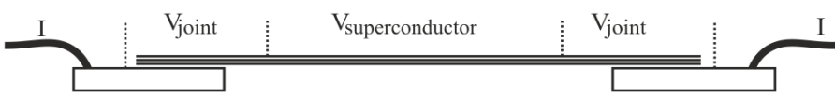
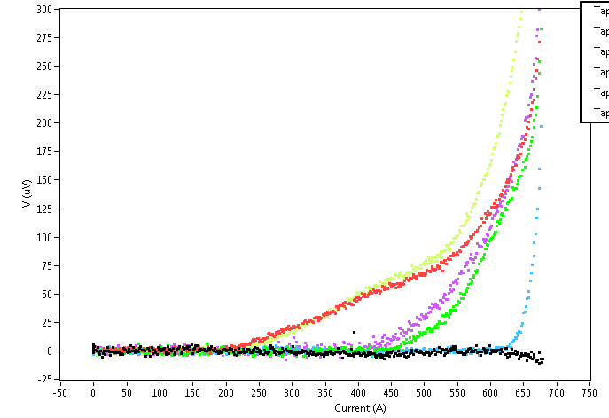
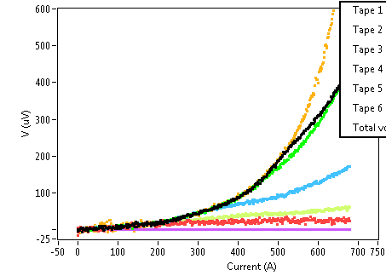
Current distribution in CORC cables at 19.8 T
From Gerard Willering (CERN/NHMFL):
Cable with inhomogeneous joints and possible defect:
V-superconductor
V-joint
Current distribution becomes uneven.
Joint resistance: 400-7000 nOhm.
Supported in part by NSF, agreement DMR-0654118,
the State of Florida, and the U.S. Department of Energy.

Slide 14
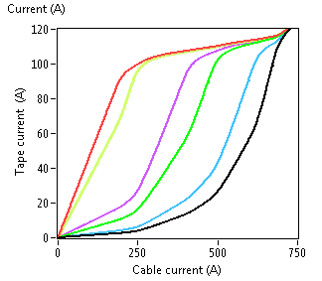
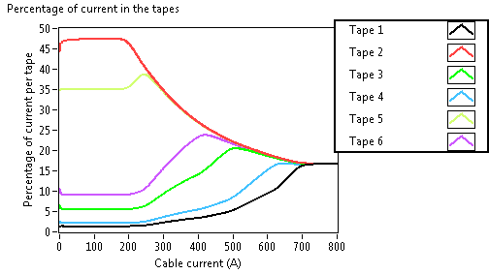
Inhomogeneous current distribution in CORC cables
Tape current vs. cable current
Tape contribution to cable current
19.8 T
19.8 T
Uneven current distribution under dc conditions is mainly caused by variation in R_{joint}.
Supported in part by NSF, agreement DMR-0654118,
the State of Florida, and the U.S. Department of Energy.

Slide 15
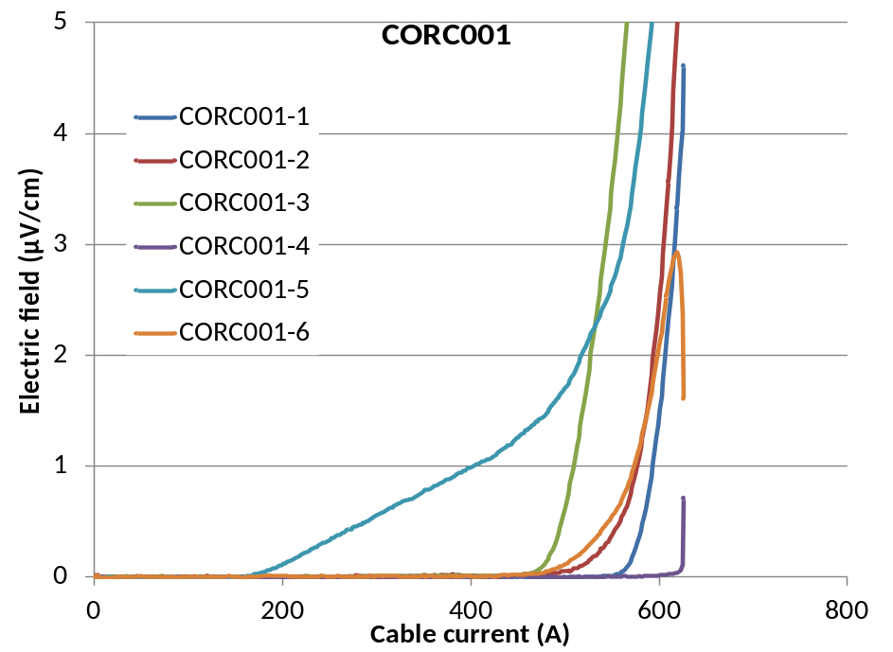
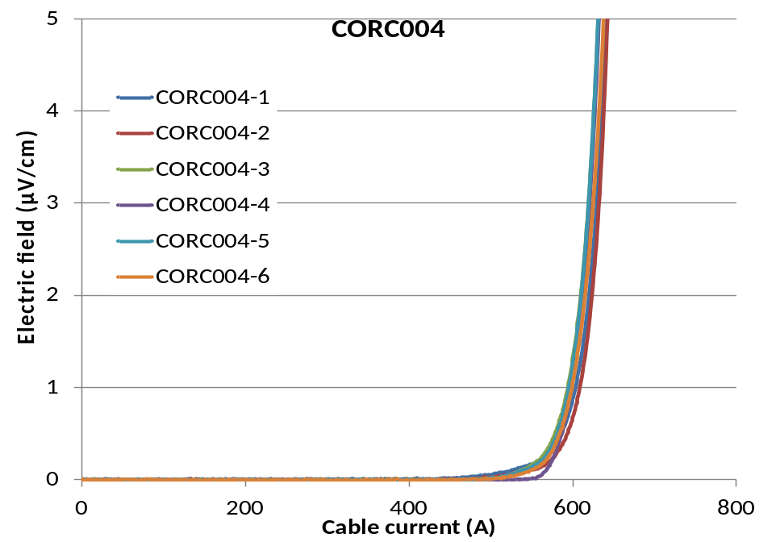
Comparison of superconducting voltages in CORC cables
Inhomogeneous CORC cable:
Homogeneous CORC cable:
E_{superconducting}, 77 K
E_{superconducting}, 77 K
Joint resistance: 400-7000 nOhm per tape.
Joint resistance: 430-800 nOhm per tape.
Voltage over superconducting part becomes much more homogeneous with better joints.

Slide 16
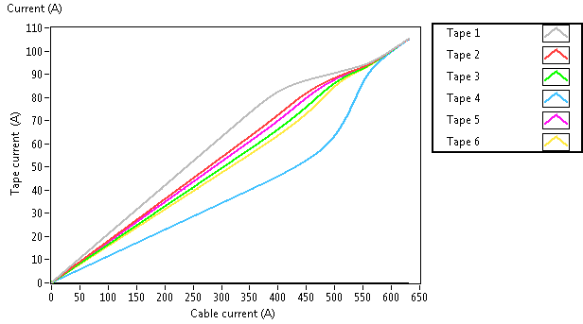
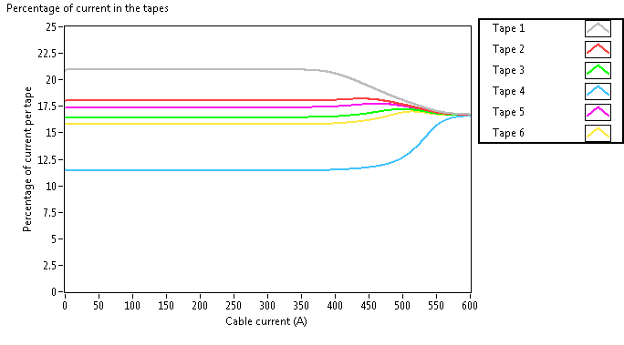
Comparison of current distribution in CORC cables
Homogeneous CORC cable:
Tape current vs. cable current
Tape contribution to cable current
Much better than:

Slide 17
What’s next:
- Higher in-field cable J_{e}: 200 A/mm² at 20 T will be a good start.
- Introduction of technical formers (SS-316, Cu, brass, titanium, hollow, etc.).
- Improving current distribution:
Static (mainly driven by resistance, local damage, etc.)
Dynamic (kA/s, where layer inductance starts to matter).
- Introduction of practical cable terminations.
- Studying the effect of tape splices on cable performance.
- Magnetization measurements (including striated conductors?).

Slide 18
Summary
Current status of CORC cables:
- Possibility of helically winding YBCO coated conductors around very small formers.
- Very-high current DC transmission cables are possible:
2800 A in 7.5 mm diameter
7561 A in 10 mm diameter
- First successful cable tests performed at 4.2 K in fields up to 20 T: 93 A/mm² reached.
- First magnet wound from an HTS cable tested at 20 T.
- Performed initial studies of current distribution in CORC cables.

