Slide 1


Team Details
a. Team name: BKD KUBO
b. Team leader name: Manuel III Ocaña
c. Problem Statement: BFSI: Intelligent Risk, Fraud & Financial Experiences
Members: Manuel III Ocaña — Product Lead & Solution Architect · Elson Mojica — Process & QA Lead (BFSI Operations)
Solution: InvoiceSentinel, a pre-payment AP fraud & risk desk for PH SMEs

Slide 2

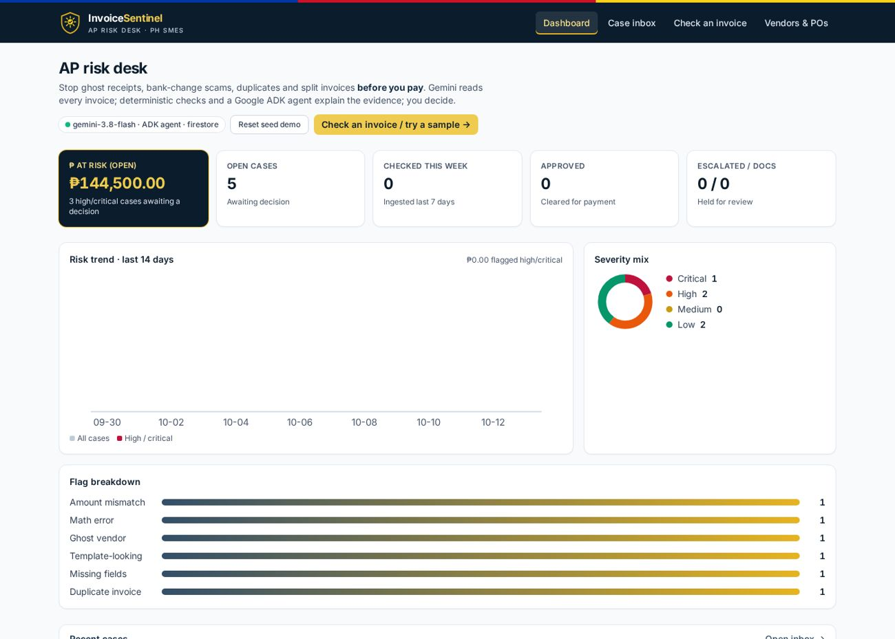
Brief about the idea
InvoiceSentinel checks every supplier invoice before it is paid and tells the AP analyst PAY, HOLD or VERIFY, with evidence.
• Problem: PH ghost receipts: the BIR alleges ₱25.5B in tax losses from 4 ghost firms (2019–21) and ₱1.41B against 23 buyer firms (2025). 68% of organizations saw an AP fraud attempt in 2024 (Basware).
• Who: SMEs with no fraud team, where one clerk reviews PDFs by eye.
• How: Gemini 3.8 Flash reads the invoice; deterministic code checks vendor master, PO, TIN, BIR RR 7-2024 and split invoices; a Google ADK agent explains in the user's language.
• Human in the loop: Approve / Escalate / Request docs, with an audit trail. Nothing is paid or sent automatically.
Live dashboard on Cloud Run: KPI cards, risk trend, flag breakdown

Slide 3
Opportunities
How is it different from existing ideas?
• OCR + rules tools need templates and can't judge "new bank, don't call us".
• Generic AI chat over a PDF has no vendor master, no PO, no audit trail.
• Opaque fraud scores can't be defended to auditors.
• InvoiceSentinel combines template-free Gemini reading with deterministic checks, evidence citations and a human decision.
How will it solve the problem?
• Flags the patterns that drain SMEs: ghost vendors, bank-account changes (BEC), duplicates, overbilling, PO mismatches, split invoices.
• Ranks the inbox by a deterministic 0–100 score, so high-risk invoices are reviewed first.
• Drafts a verification email to the contact on file, never the one on the invoice.
• BIR RR 7-2024 checklist keeps ghost receipts out of the books.
USP of the proposed solution
• Code for facts, AI for judgment: same input, same score (14 samples × 3 runs, zero variance).
• Explainable agent: Google ADK agent streams each tool step live and cites evidence IDs.
• PH-first: TIN, 12% VAT, BIR RR 7-2024, GCash/personal payees, Tagalog answers and emails.
• Affordable: ~₱0.31 Gemini cost per invoice.

Slide 4
List of features offered by the solution
Multimodal extraction
Gemini 3.8 Flash reads photos/PDFs into structured JSON (T=0, schema).
Vendor master & PO matching
Vendor, TIN, bank account, PO, quantities and prices; bank change = critical.
TIN validation
Format and branch-code checks, compared with the master record.
BIR RR 7-2024 checklist
Required invoice elements with section references; advisory only.
Split-invoice detection
Same vendor, close dates, combined total over the approval limit.
Deterministic risk score
Severity weights + floors; ranked inbox and ₱-at-risk KPIs.
Ask the case (Google ADK)
7 read-only tools; live streamed steps; answers end with PAY / HOLD / VERIFY.
Multilingual + verification email
Replies in English, Tagalog, etc.; email to the contact on file, never auto-sent.
Try a sample
14 fictional PH invoices, one click, no files needed.
Decisions & audit trail
Approve / Escalate / Request docs with notes; timestamped log.
Vendors & POs page
Edit the master data the checks use; approval limit in Settings.
Accessible, responsive UI
AA contrast, keyboard & focus states, ARIA labels, mobile layouts.

Slide 5
Process flow diagram or Use-case diagram
1 Upload
Photo, scan or PDF, or one click on Try a sample
2 Gemini reads
Fields, line items, payee & bank details as JSON
3 Code checks
Vendor master, PO, TIN, BIR RR 7-2024, split, VAT math → score
4 Agent explains
Ask in any language; ADK agent cites evidence, drafts email
5 Human decides
Approve / Escalate / Request docs → audit trail
Use case: AP analyst at an SME receives invoice from known vendor “Northstar IT” (sample 09)
• Upload → Gemini extracts vendor, TIN, PO, totals and the bank account printed on the invoice.
• Vendor master check: everything matches except the bank account (invoice Metrobank vs master BPI) → UNUSUAL_PAYMENT_CHANGE, critical, score 90.
• Analyst asks in Tagalog “Ligtas ba itong bayaran?” → agent calls vendor, PO, history, TIN and BIR tools → answers HOLD with evidence.
• Analyst drafts a Tagalog verification email to the master contact, calls the supplier, and escalates; the decision is logged.

Slide 6
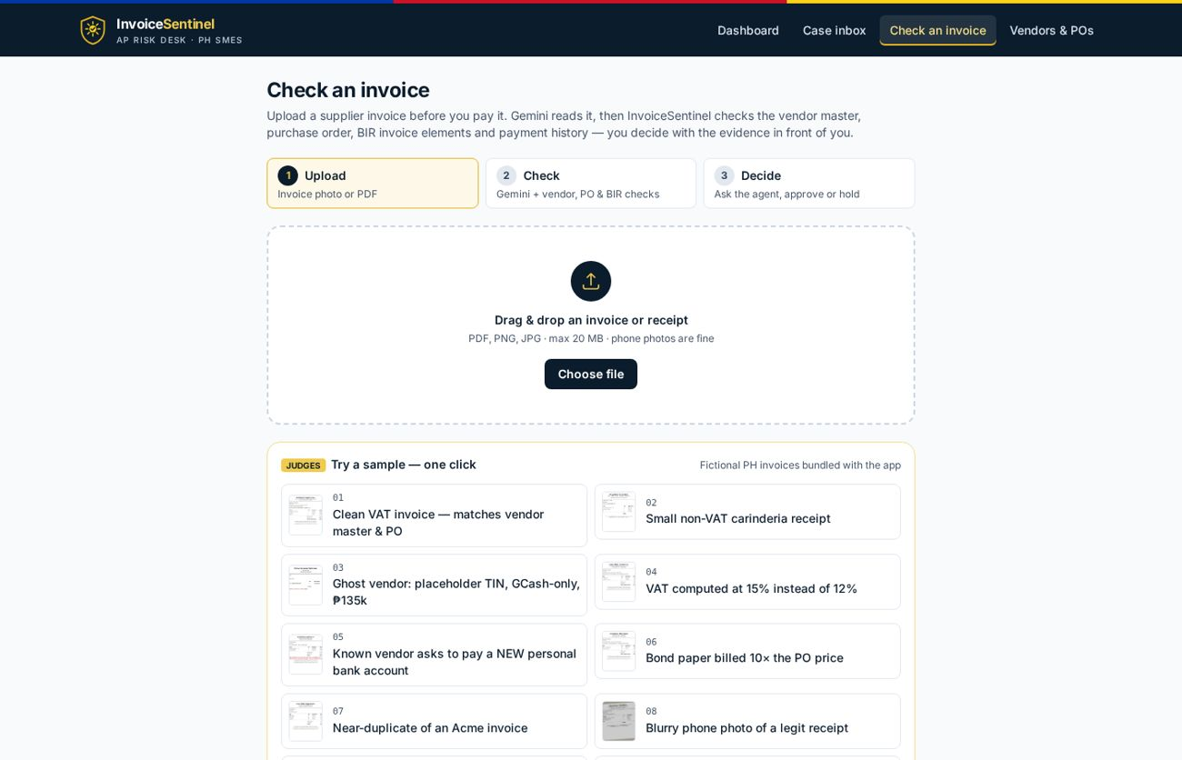
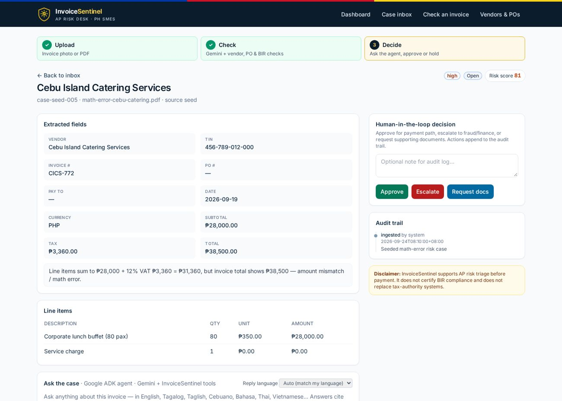
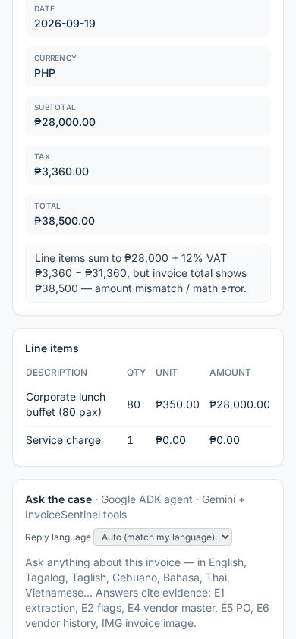
Wireframes/Mock diagrams of the proposed solution (optional)
Case: fields, risk cards, matching, decision panel
Mobile layout
Upload: guided stepper + Try a sample grid
• Implemented in the live prototype (screens shown are real, not mockups).
• Flow: Dashboard → Check an invoice → Case → Decide; Vendors & POs page for master data.

Slide 7
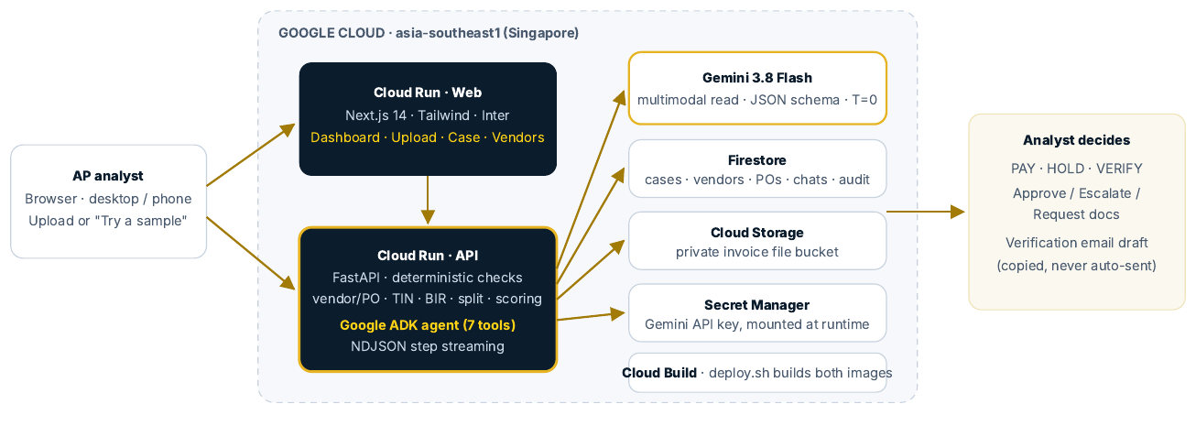
Architecture diagram of the proposed solution
Firebase Hosting
invoicesentinel.web.app → rewrites to Cloud Run web
• Firebase Hosting serves invoicesentinel.web.app and rewrites all paths to the Cloud Run web service; the browser calls the API directly (no 60 s Hosting limit on agent streams).
• Stateless Next.js and FastAPI containers on Cloud Run (asia-southeast1); state in Firestore and a private Cloud Storage bucket.
• Gemini key in Secret Manager; one-command deploy.sh builds both images with Cloud Build.

Slide 8
Technologies to be used in the solution
Google AI
Gemini 3.8 Flash (google-genai SDK): multimodal read, JSON schema, T=0 · Google ADK 2.11: LlmAgent with 7 tools, streamed events
Google Cloud & Firebase
Firebase Hosting (invoicesentinel.web.app → Cloud Run) · Cloud Run (web + API, min-instances 1) · Firestore · Cloud Storage · Secret Manager · Cloud Build · Artifact Registry
Backend
Python 3.12 · FastAPI · Pydantic · deterministic rule engine (vendor/PO matching, TIN, BIR RR 7-2024, split detection, scoring) · NDJSON streaming
Frontend
Next.js 14 · React · TypeScript · Tailwind CSS · Inter · custom SVG charts · responsive, WCAG AA-minded UI
Quality
Stability harness (14 fictional samples × 3 runs) · sample generator · Playwright screenshots

Slide 9
Estimated implementation cost (optional)
~₱0.31 per invoice
Gemini 3.8 Flash at 2026 promo pricing (~₱0.62 from Jan 2027). FX ₱62.77/US$.
Invoices / month | Typical user | Model cost 2026 | From 2027
200 | Small SME | ~₱62 | ~₱124
2,000 | Mid-market finance team | ~₱623 | ~₱1,246
50,000 | Shared services / bank SME portfolio | ~₱16,000 | ~₱31,000
• Infrastructure: Cloud Run scales to zero; at SME volumes usage fits the free tier. For judging, one warm instance per service (min-instances 1): ~US$23 (~₱1,450) per month; set to 0 afterwards.
• Storage: Firestore and Cloud Storage cost almost nothing at prototype scale.
• Scale levers: Gemini Batch API for overnight payment runs at half the token price; Flash by default.
• Source: Gemini Developer API pricing (updated Oct 9, 2026) and Cloud Run pricing. Per-invoice token use is an estimate.

Slide 10
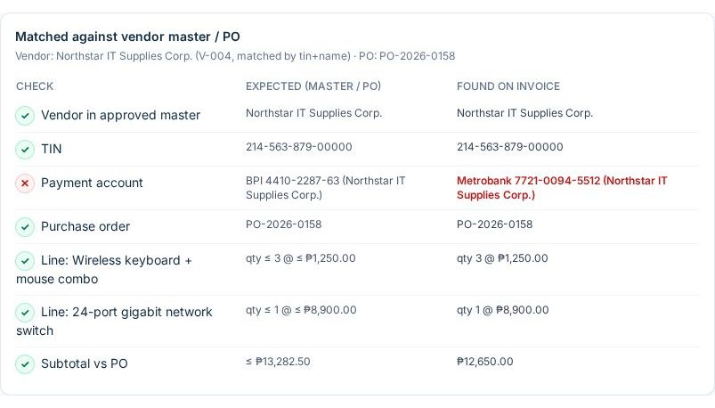
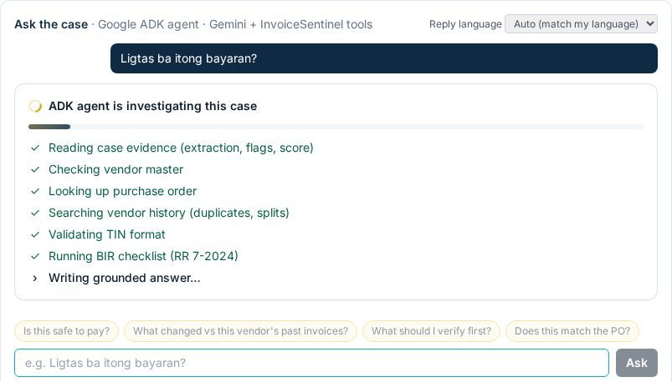
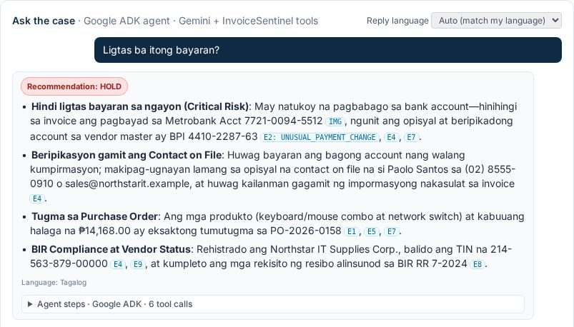
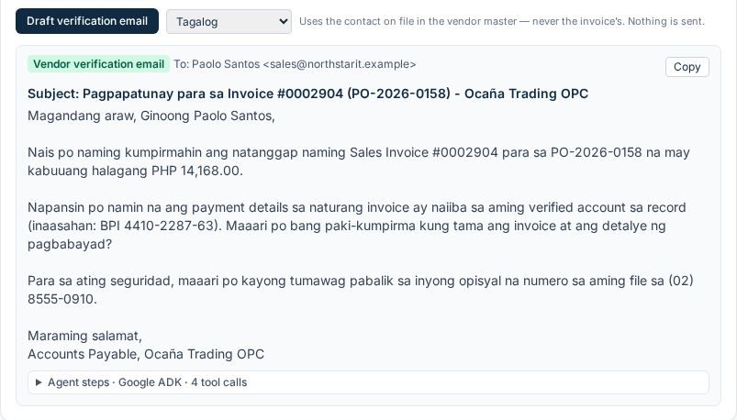
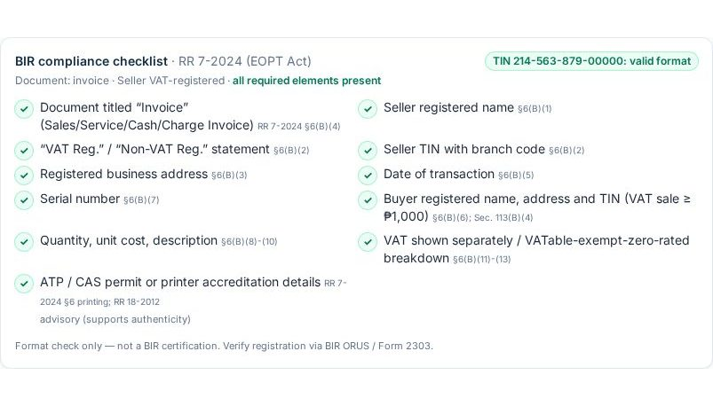
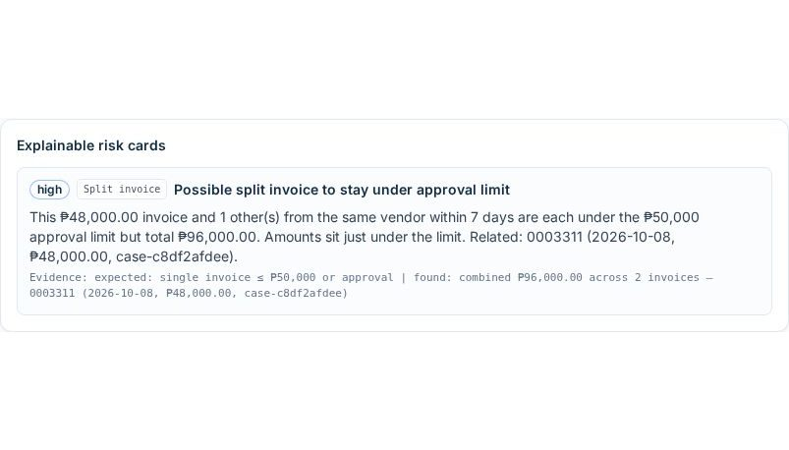
Snapshots of the prototype
Vendor master: bank account mismatch (sample 09)
Google ADK agent steps streaming live
Tagalog answer: HOLD with cited evidence
Tagalog verification email to the contact on file
BIR RR 7-2024 checklist + TIN validation
Sample 13 flagged as a split of sample 12

Slide 11
Prototype Performance report/Benchmarking
Flag (expected samples) | Detected
GHOST_VENDOR (03, 14) | 2 / 2
UNUSUAL_PAYMENT_CHANGE (05, 09) | 2 / 2
TIN_INVALID (03, 14) | 2 / 2
MATH_ERROR (04) | 1 / 1
OVERBILLING (06) | 1 / 1
DUPLICATE_INVOICE (07) | 1 / 1
PO_MISMATCH (06, 10) | 2 / 2
MISSING_PO (11) | 1 / 1
SPLIT_INVOICE (13 after 12) | 1 / 1
Clean invoices without fraud flags (01, 02, 08, 12) | 4 / 4
Metric (live, Cloud Run) | Result
Score stability, 14 samples × 3 runs | 0 spread, 14/14 in band
Upload → verdict (Gemini + checks) | ~18–24 s
Agent: first streamed step | ~5 s
Agent: full grounded answer | ~18–37 s
Verification email draft | ~20–25 s
Fictional PH test set, gemini-3.8-flash, Oct 12–13, 2026. Sample 08 (blurry photo) gets only a low-severity TIN-mismatch flag, not a fraud flag. Small test set: a labeled real-world evaluation set is on the roadmap.

Slide 12
Additional Details/Future Development (if any)
Q1 2027 · Pilot-ready
• Sign-in with analyst / approver roles (Identity Platform)
• Email-inbox intake of supplier bills
• CSV import of vendor master and POs
• Labeled PH evaluation set; precision/recall per flag
Q2 2027 · Integrations
• QuickBooks / Xero bill sync; hold payment on Escalate
• Batch review of payment runs (Gemini Batch API)
• Bank-account change history per vendor
Later · Ecosystem
• Pre-transfer check API for bank SME portals
• Claims-document review for insurers
• Tagalog / Cebuano UI
• BIR ATP / series lookups as signals
Guardrails stay fixed: a person decides every payment, every flag carries evidence, nothing is auto-sent, and the product never claims to certify BIR compliance. Paid-tier Gemini API: content is not used to train Google's models.

Slide 13
Provide links to your:
• GitHub Public Repository
https://github.com/BKDKUBO/invoice-sentinel
• Demo Video Link (3 Minutes)
https://drive.google.com/file/d/1QeAfyMxYIUnmQdOuLhxhQRP4CmUfL67a/view
• Final Product Link
https://invoicesentinel.web.app
(Firebase Hosting → Cloud Run; direct: https://invoicesentinel-web-1034883854575.asia-southeast1.run.app)
Try it: Check an invoice → Try a sample → 09 (known vendor, new bank). Reset demo restores seed data. All data is fictional.

Slide 14


