Slide 1
Multiple Regression and Gradient Descent
Chs. 15 & 8
Women in Data Science – ATX Meetup
9/8/16
Notes on DATA SCIENCE FROM SCRATCH, by Joel Grus Presenters: Anne Russell, CAP
Download he Jupyter notebook: https://github.com/womenindatascienceatx Akshata Mohan

Slide 2
Overview
Multiple Regression
Recall Simple Linear Regression
Introduce Multiple Regression
Model
Additional Assumptions
Example in Python
Interpretation
Goodness of Fit
Standard Error of Parameter Estimates
Bootstrapping
Interactions
Gradient Descent
Polynomial – set up
Example in Python
Mean Model
Weighted Parameters Model
Estimated Parameters Model
Stochastic Gradient Descent
Regularization
Define
Ridge Regression + Python
LASSO + Python
References

Slide 3
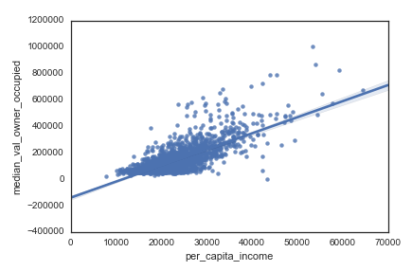

Simple Linear Regression (recall)
Response = Intercept + Slope*Input + Error
$$y_{i}=β_{0}+β_{1}x_{i}+ε_{i}$$
Recall assumptions:
Linearity
Homoscedasticity
Normality
No Autocorrelation
$$median_val_owner_occupied=−\$140,341+ 12.16∗per_capita_income$$
R² = 0.55
Notes:
Linearity: the data should be best described by a line (instead of a curve, etc.)
Check with residual plot, should get random distribution around y = 0
Homoscedasticity: variance should be constant for range of predictor values
Check with same residual plot, spread of residuals shouldn't get larger as a function of predictor value
Normality: errors should be normally distributed.
Check with Q-Q plot, should get the identity line
No autocorrelation of errors: each observation should be independent of the others
Check with residual plot, there shouldn't be a pattern

Slide 4
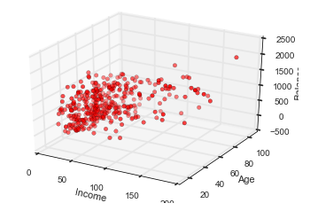
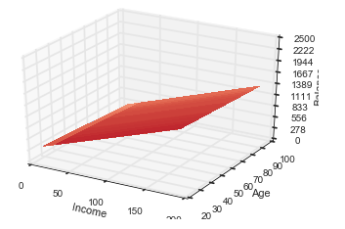

Multiple Regression Model
Response = function (multiple x’s)
$$y_{i}=β_{0}+β_{1}x_{i1}+⋯+β_{k}x_{ik}+ε_{i}$$
Raw Data Values
Predicted Values
Balance
Balance
Credit data
Balance v. Income and Age
Notes:
Credit data set used in: "An Introduction to Statistical Learning, with applications in R" (Springer, 2013), G. James, D. Witten, T. Hastie and R. Tibshirani.

Slide 5
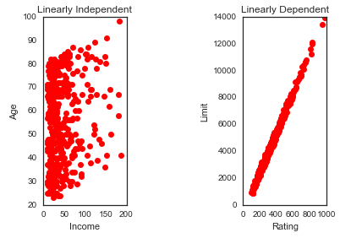
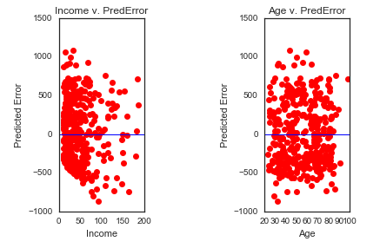
Additional Assumptions
x_{i}’s are linearly independent ➔
x_{i}’s are all uncorrelated with the errors, ε_{i}
Age and Income can be included in the same model.
Only ONE of Limit or Rating should be included in a model.

Slide 6
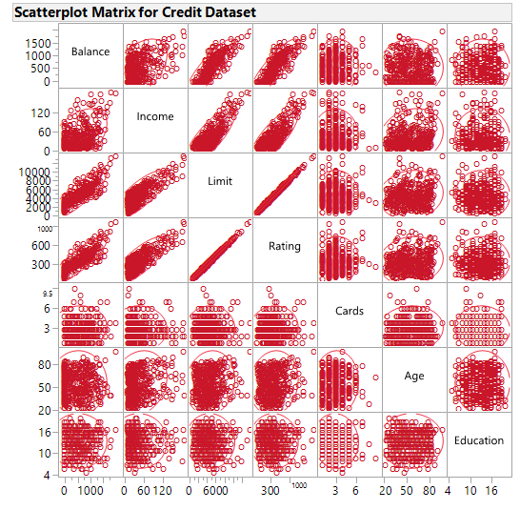
Avoiding Collinearity
Look at scatterplot matrix to find obvious collinearity
Like Limit and Rating
Use Variance Inflation Factor (VIF)

Slide 7
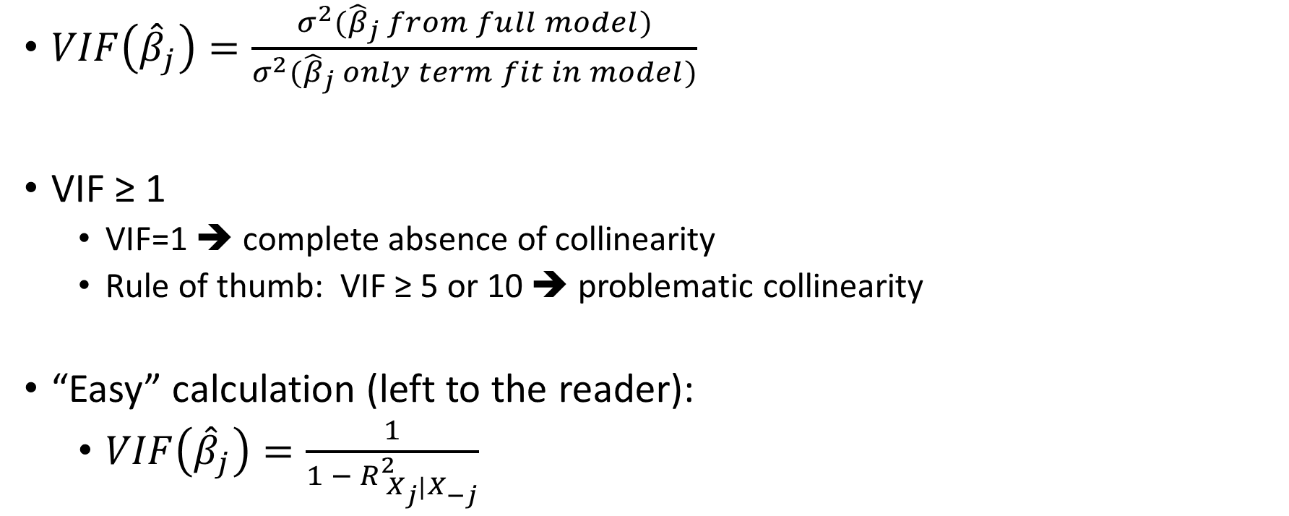
Variance Inflation Factor
$VIF\left({\hat{β}}_{j}\right)=\frac{σ^{2}({\hat{β}}_{j} from full model)}{σ^{2}({\hat{β}}_{j} only term fit in model)}$
VIF ≥ 1
VIF=1 ➔ complete absence of collinearity
Rule of thumb: VIF ≥ 5 or 10 ➔ problematic collinearity
“Easy” calculation (left to the reader):
$VIF\left({\hat{β}}_{j}\right)=\frac{1}{1 − R_{{ X}_{j}|X_{−j}}^{2}}$
R² from regression of X_{j} onto all of the other predictors.
Notes:
Source of information regarding Variance Inflation Factor: - "An Introduction to Statistical Learning, with applications in R" (Springer, 2013), G. James, D. Witten, T. Hastie and R. Tibshirani.

Slide 8
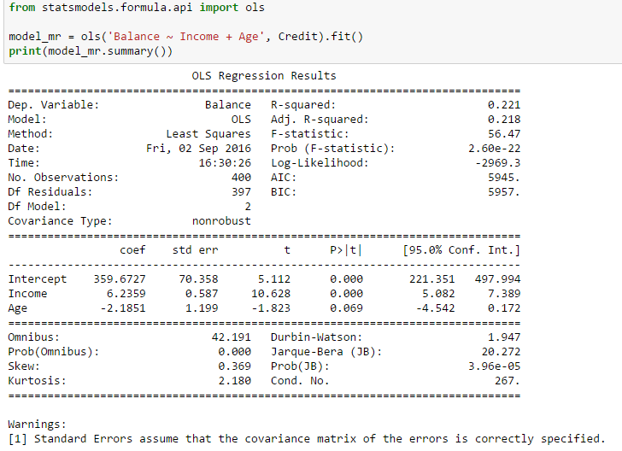
Multiple Regression in Python
Not the greatest R²!
Assuming α=0.05:
Income coefficient (+6.24 with Pr>|t| = 0.000) significantly different from 0
~95% confident true Income coefficient is 6.24±2(0.587)
Age coefficient (-2.19 with Pr>t=0.069) not significantly different from 0
95% confident true Age coefficient is between -4.542 and +0.172
Predicted Balance = 359.67 + 6.24*Income – 2.19*Age
OR
Predicted Balance = 359.67 + 6.24*Income
Notes:
Break for Python notebook.

Slide 9
Bootstrapping
Create new samples of size N by sampling N items with replacement
Each “item” is a row in your data: ( y, {x_{i}} ) -tuple
In the Multiple Regression:
Use these samples to create a sampling distribution of the coefficients
Boosts confidence in estimates

Slide 10
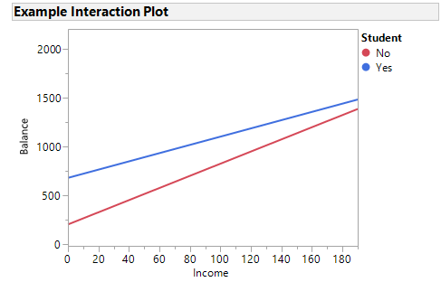
Interactions
The effect of one feature depends on the level of another feature
i.e., in the graph below, we say “there is an interaction between Income and Student because the effect of Income depends on the level of Student.”
showing Interaction
Notes:
For discussion purposes, chose to use a categorical variable, Student (Yes/No). However, discussion of including categorical variables in regression and the use of dummy variables to incorporate them into a regression model are beyond the scope of Grus’ Chapter 15, Multiple Regression.

Slide 11
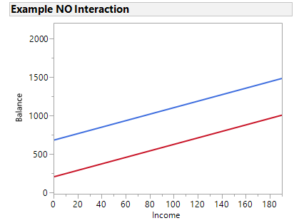

Interactions
Model with an ${(x}_{i1}∗x_{i2}$) interaction term
If the model includes an interaction term, always include the main features, even if their coefficients’ p-values are not significant (the hierarchical principle).
$$y_{i}=β_{0}+β_{1}x_{i1}+⋯+β_{k}x_{ik}+β_{12}{(x}_{i1}∗x_{i2})+ε_{i}$$
Interaction Plot showing NO interaction
showing Interaction

Slide 12
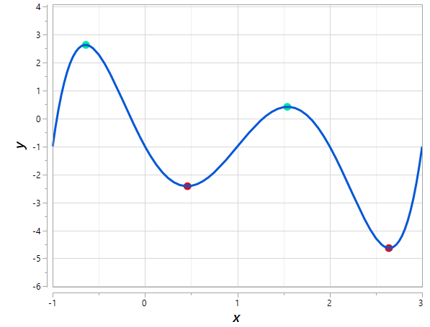
Gradient Descent
Local maxima
Methods to find max or min of a function
Random starting point
Small steps taken in the direction desired.
Relies on finding slopes = 0
Beware saddle points
Not always guaranteed
Local minima

Slide 13
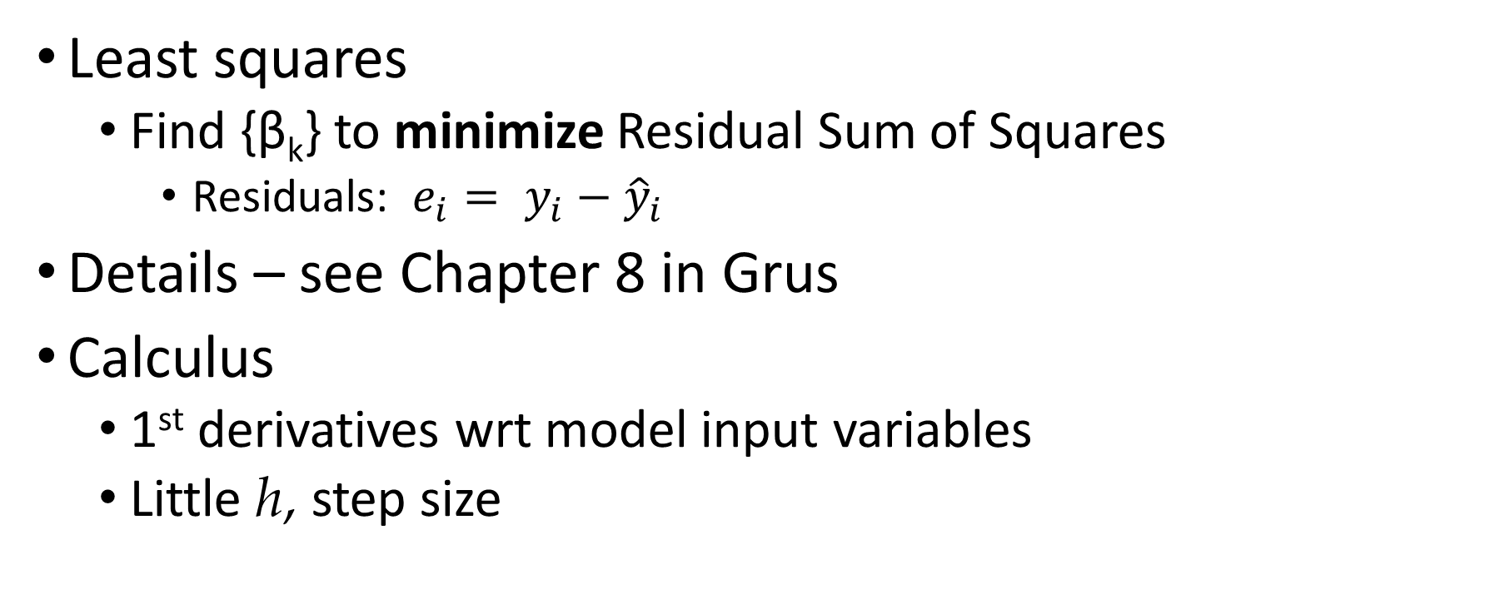
Gradient Descent
Least squares
Find {β_{k}} to minimize Residual Sum of Squares
Residuals: $e_{i}= y_{i}−{\hat{y}}_{i}$
Details – see Chapter 8 in Grus
Calculus
1st derivatives wrt model input variables
Little h, step size

Slide 14
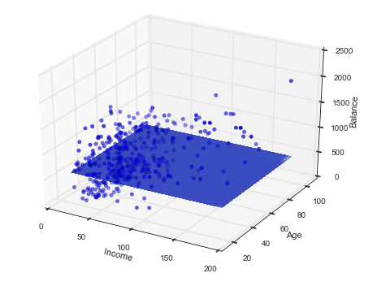
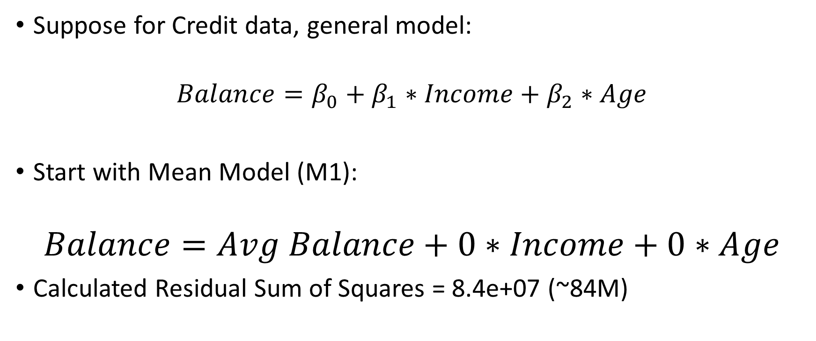
Gradient Descent in Python – Mean Model
Suppose for Credit data, general model:
$$Balance=β_{0}+β_{1}∗Income+β_{2}∗Age$$
Start with Mean Model (M1):
$$Balance=Avg Balance+0∗Income+0∗Age$$
Calculated Residual Sum of Squares = 8.4e+07 (~84M)

Slide 15
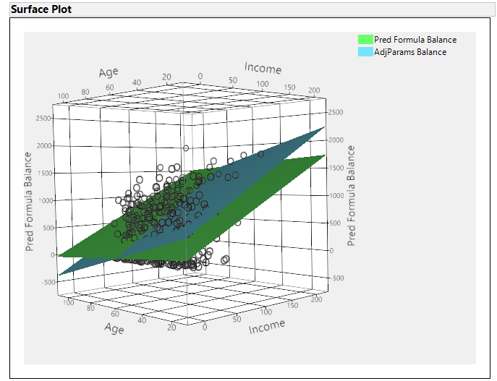

Gradient Descent – Adjusted Parameters Model
Hand-waving to “descend” to next model:
Adjusted Parameters Model (M2):
$$Balance=773+7∗Income−9∗Age$$
Calculated Residual Sum of Squares = 7.3e+07 (~73M)
Better than the Mean Model
Can we do better?
Notes:
Used min, max, median of response and predictors, rounding them to find plane that passes thru them and rounding some more to get the prediction equation above.

Slide 16

Gradient Descent – Estimated Parameters Example
More hand-waving allows us to “descend” to the Multiple Regression model:
Estimated Parameters Model (M3):
$$Balance=359.67+6.24∗Income−2.18∗Age$$
Calculated Residual Sum of Squares = 6.6e+07 (~66M)
Uses all the data
Slow method
Notes:
From MR model.

Slide 17
Stochastic Gradient Descent (SGD)
Works on data set one random point at a time
➔ faster, especially when data set is very, very large
Scikit-learn has an SGD module
Lots of other “descent” methods as well.

Slide 18
Regularization
Adding Penalty to error terms as number of parameters gets larger.
Budget constraint for coefficients
Reduce tendency to overfit the model
Occam’s razor or KISS
Ridge regression (hoarders)
penalty proportional to sum of squares of the β coefficients.
LASSO regression (sparse)
Penalty proportional to sum of absolute values of the β coefficients.
Elastic Net regression (useful in presence of highly correlated inputs)
Penalty proportional to combination of Ridge and LASSO
Notes:
Chapter 6 of "An Introduction to Statistical Learning, with applications in R" (Springer, 2013), G. James, D. Witten, T. Hastie and R. Tibshirani, has greater detail

Slide 19
Ridge Regression
Key points
Rescale values encouraged (standardization recommended)
Non-significant β coefficients shrink towards 0.
Tuning parameter, λ (or α in Python) ≥ 0
Setting λ = 0 ➔ standard least squares estimates
In Python Statsmodel:
ols.fit_regularized(method='coord_descent',
maxiter=1000,
alpha=10.0, # tuning parameter
L1_wt=0) # Ridge regression

Slide 20
LASSO Regression
Key points
Rescale values (?)
Non-significant β coefficients forced to 0
Not amenable to gradient descent method.
Tuning parameter, λ (or α in Python) ≥ 0
Setting λ = 0 ➔ standard least squares estimates
In Python Statsmodel:
ols.fit_regularized(method='coord_descent',
maxiter=1000,
alpha=10.0, # tuning parameter
L1_wt=1) # LASSO regression

Slide 21
References
http://www-bcf.usc.edu/~gareth/ISL/ - "An Introduction to Statistical Learning, with applications in R" (Springer, 2013), G. James, D. Witten, T. Hastie and R. Tibshirani.
“Data Science from Scratch” (O’Reilly, 2015), J. Grus.

