Slide 1
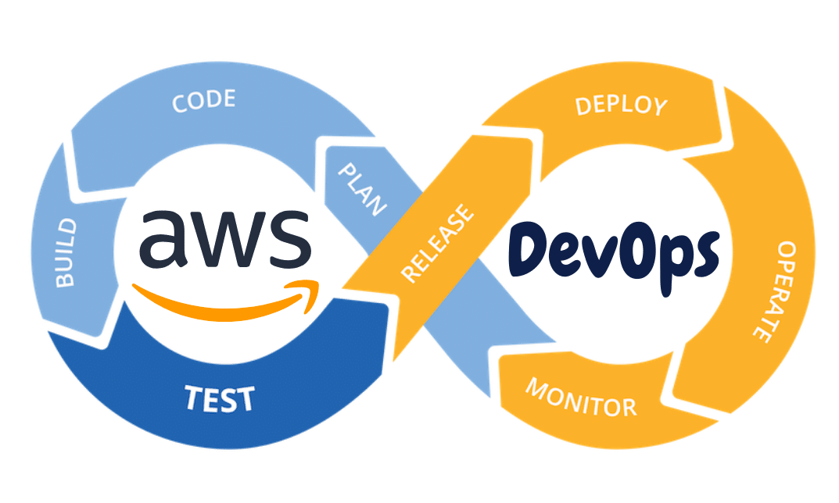
Devops – Version control systems – Git, Github
Unleashing DevOps Potential: Git and GitHub for Efficient Version Control in the Agile Era

Slide 2
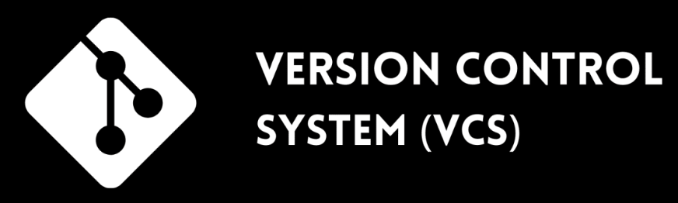
What is a Version Control System
Time Travel for Your Code: VCS acts like a time machine, allowing you to revisit different stages of your code, just like reviewing drafts of a story.
Tracking Changes Made Easy: VCS keeps a record of file changes over time, enabling you to easily identify and review modifications made in each version.
Reliable Undo and Restore: VCS empowers you to revert to previous file versions, ensuring you can recover from accidental deletions or incorrect modifications.
Seamless Collaboration and Conflict Prevention: VCS facilitates collaboration by merging changes made by multiple contributors, avoiding conflicts and promoting efficient teamwork.
(Note: Examples of VCS include Git, Subversion (SVN), and Mercurial. They offer features like authorship tracking, version organization, and branch management.)
By utilizing VCS, you can simplify code management, enhance collaboration, and ensure efficient project development and delivery.

Slide 3
Evolution of (VCS): A Brief History
Centralized Version Control Systems (CVCS) - In the early days, developers relied on CVCS like CVS and SVN. - These systems had a central repository storing the code, with developers checking out and committing changes directly.
Distributed Version Control Systems (DVCS) - DVCS, such as Git and Mercurial, revolutionized VCS. - Introduced in the mid-2000s, DVCS allowed developers to clone entire repositories, making collaboration and offline work easier.
Git - A Game Changer - Created by Linus Torvalds in 2005, Git quickly became the industry standard for VCS. - Its decentralized nature, speed, and powerful branching and merging capabilities made it a popular choice.
Branching and Merging - VCS systems evolved to provide efficient branching and merging mechanisms. - Branches enable parallel development, allowing teams to work on features, bug fixes, and experiments without affecting the main codebase.

Slide 4
Evolution of (VCS): A Brief History
Continuous Integration and Continuous Deployment (CI/CD):
- VCS played a crucial role in the rise of CI/CD practices. - Automated build and deployment processes are tightly integrated with VCS, enabling seamless software delivery.
Cloud-based VCS and Collaboration Tools:
- Cloud platforms like GitHub, GitLab, and Bitbucket gained popularity, providing hosted VCS solutions. - These platforms offer collaboration features, issue tracking, code review, and more, facilitating efficient teamwork.
Modern VCS and Beyond: - VCS systems continue to evolve, focusing on performance, scalability, and ease of use. - Integration with other development tools, such as project management and code review platforms, enhances the development workflow.
VCS has come a long way, transforming software development by enabling efficient collaboration, code versioning, and project management.

Slide 5
Comparison: Centralized Version Control Systems (CVCS) vs. Distributed Version Control Systems (DVCS)
Centralized Version Control Systems (CVCS) | Distributed Version Control Systems (DVCS)
In a CVCS, there is a central repository that stores the entire codebase and its history. | In a DVCS, every developer has a local copy of the entire repository, including the full history.
Developers typically check out a working copy from the central repository to make changes. | Developers can work offline, committing changes to their local repository without requiring a network connection.
Requires a constant network connection to access the central server. | Collaboration happens through synchronization and merging of repositories.
Collaboration and file sharing occur through the central repository. | Allows for branching and merging operations, facilitating parallel development and experimental features.
Examples of CVCS include CVS and SVN. | Examples of DVCS include Git and Mercurial.

Slide 6
Comparison: (CVCS) vs. (DVCS)
Key Differences Repository Structure: CVCS has a central repository, while DVCS has both a local repository for each developer and a central repository for synchronization.
Network Dependency: CVCS requires a constant network connection to access and commit changes to the central repository. DVCS allows developers to work offline, committing changes to their local repository, and synchronizing later.
Collaboration: CVCS relies on the central repository for collaboration and file sharing. DVCS enables collaboration through synchronization and merging of local repositories.
Branching and Merging: DVCS excels in branching and merging, allowing for parallel development and experimental features. CVCS typically has limited or less efficient branching and merging capabilities.
Flexibility and Scalability: DVCS provides more flexibility and scalability, especially for distributed teams and large codebases, due to its decentralized nature.

Slide 7
Git and GitHub: Streamlining Development and Collaboration
Git is a distributed version control system (DVCS) that allows developers to track changes made to their codebase. It was created by Linus Torvalds in 2005 and has become the most widely used version control system in the software development industry.
GitHub, on the other hand, is a web-based hosting service for Git repositories. It provides a platform for developers to collaborate, share, and manage their Git repositories. GitHub offers additional features such as issue tracking, pull requests, code review, and project management tools. The combination of Git and GitHub solves several problems commonly faced by IT companies:
Version Control and Code History: Git enables developers to track changes made to their codebase over time. It allows them to easily switch between different versions, view commit history, and understand who made what changes. This ensures code integrity and provides a clear audit trail.
Collaboration and Teamwork: GitHub facilitates collaboration among developers by providing a centralized platform for sharing code, managing branches, and merging changes. It allows multiple developers to work on the same project simultaneously, resolving conflicts and ensuring a smooth collaboration workflow.
Code Reviews and Quality Assurance: GitHub's pull request feature enables code reviews, where team members can review proposed changes before merging them into the main codebase. This promotes code quality, catches errors or bugs early, and encourages collaboration and knowledge sharing within the team.

Slide 8

Jenkins: Automating DevOps for Efficient Software Delivery
Powering Continuous Integration and Deployment for Agile Software Development

Slide 9

Introduction to Jenkins
What is Jenkins? Jenkins is a software tool that automates various stages of the software development lifecycle. It functions as a server running on a machine, executing tasks based on developers' instructions.
Problems Solved by Jenkins in DevOps
Eliminating Manual Tasks: Jenkins eliminates the need for manual actions like building and deploying software, reducing human error and saving time.
Continuous Integration (CI): Jenkins enables seamless integration of code changes from multiple developers, ensuring they work well together.
Continuous Deployment (CD): Jenkins automates the process of deploying software to different environments, making it faster and more reliable.

Slide 10
Use cases involving Jenkins in a CI/CD pipeline
CICD Usecases
Git Integration: Jenkins can connect to a Git repository and automatically trigger builds whenever new code changes are pushed. Example: Whenever a developer commits changes to the project on Git, Jenkins can automatically start building and testing the code. | Maven Integration: Jenkins can use Maven, a build automation tool, to compile, package, and test Java projects. Example: After Jenkins retrieves the code from Git, it can use Maven to build the project, resolve dependencies, and run tests.
SonarQube Integration: Jenkins can integrate with SonarQube, a code quality management platform, to perform code analysis and identify issues. Example: After the build process, Jenkins can trigger SonarQube scans to check for code smells, bugs, and vulnerabilities. | Ansible Integration: Jenkins can use Ansible, an infrastructure automation tool, to perform additional deployment and configuration tasks. Example: After deploying the application to Tomcat, Jenkins can use Ansible to configure the necessary server settings or perform other custom tasks.

Slide 11
Jenkins Plugins: Enhancing Automation and Efficiency
Jenkins plugins are software extensions that provide additional functionality to the Jenkins automation server.
They allow users to customize and extend Jenkins according to their specific needs.
Plugins can be installed directly from the Jenkins plugin manager, making it easy to add new features and capabilities.
Jenkins plugins cover a wide range of functionalities, including:
Source code management systems integration (Git, Subversion, etc.).
Build and test automation tools integration (Maven, Gradle, JUnit, etc.).
Deployment and orchestration tools integration (Docker, Kubernetes, Ansible, etc.).
Reporting and analysis tools integration (JUnit, Cobertura, Checkstyle, etc.).
Notifications and alerts (Slack, Email, etc.).
Plugins help automate repetitive tasks, streamline workflows, and improve overall productivity.
With thousands of available plugins, Jenkins can be tailored to fit various development and deployment scenarios.
Jenkins plugins are continuously updated and maintained by the Jenkins community, ensuring compatibility and stability.

Slide 12
Jenkins Pipeline: Streamline Your Software Delivery
Jenkins Pipeline is a framework for defining and managing continuous integration and delivery (CI/CD) workflows. It allows you to script and automate the steps involved in building, testing, and deploying software applications. With Jenkins Pipeline, you can define your entire build process as code, enabling easy versioning, reuse, and sharing across teams. It provides a flexible and powerful way to create and manage complex pipelines, ensuring consistent and reliable software delivery.
Types of Jenkins Pipelines:
Scripted Pipeline
Declarative Pipeline
Multibranch Pipeline
Template Pipeline
External Pipeline

Slide 13
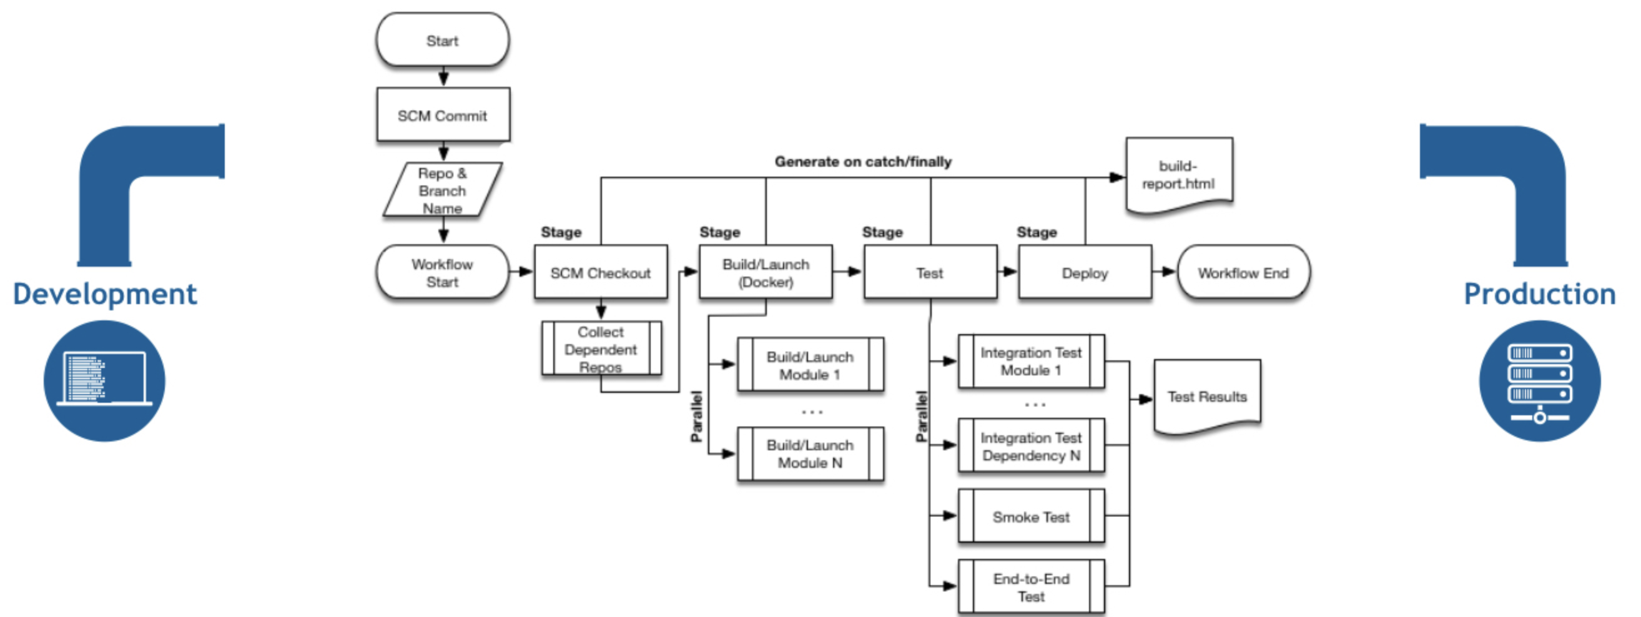
Jenkins Pipeline: Streamline Your Software Delivery
Scripted Pipeline | Declarative Pipeline | Multibranch Pipeline
Written in Groovy scripting language. Provides maximum flexibility and control. Allows complex logic and customizations. Requires more advanced Groovy scripting skills. | Uses a more structured syntax for defining pipelines. Focuses on simplicity and readability. Provides built-in stages and steps for common CI/CD tasks. Suitable for beginners and teams adopting CI/CD practices. | Automatically creates pipelines for each branch in a version control repository. Enables parallel testing and deployment of multiple branches. Ideal for projects with multiple feature branches or release branches.

Slide 14
Jenkins Pipeline: Streamline Your Software Delivery
Scripted Pipeline | Declarative Pipeline | Multibranch Pipeline
Imagine you are baking a cake. In this analogy, the cake represents your software application, and the baking process represents the build and deployment process. With a Scripted Pipeline, you have full control over every step of the baking process. You can customize the recipe, choose the ingredients, and specify how each ingredient is mixed and baked. You have the flexibility to add special decorations, frosting, or even multiple layers. Similarly, in a Scripted Pipeline, you write a script (using the Groovy scripting language) that defines your build and deployment steps. You can specify the tools to be used, such as compiling the code, running tests, and creating a deployable package. You have the freedom to include additional logic, error handling, and notifications. | With a Declarative Pipeline, it's like following a predefined recipe for baking a cake. The recipe already specifies the required ingredients and steps, making it easier for anyone to follow. In the context of software development, a Declarative Pipeline provides a structured and simplified approach to defining your build and deployment process. Instead of writing custom scripts for each step, you use a predefined set of stages and steps provided by the Declarative Pipeline syntax. Think of these stages and steps as the instructions in a cake recipe. You have specific stages like "Build," "Test," and "Deploy," and each stage consists of predefined steps that are commonly required in a CI/CD workflow. | Imagine you have a recipe book that contains various cake recipes, each tailored for a specific occasion. In this analogy, the cake recipes represent different branches of your software application, and the recipe book symbolizes your version control repository. With a Multibranch Pipeline, it's like having a magic chef who automatically selects the appropriate recipe from the recipe book based on the occasion. The chef knows which ingredients and instructions to use for each cake, making sure everything is in line with the occasion's requirements. In the software development world, a Multibranch Pipeline automates the creation of pipelines for each branch in your version control repository. Each branch represents a different development effort or a specific feature of your software.

