Slide 1
Network Intrusion Detection SYSTEM using machine learning
CAPSTONE PROJECT
Presented By:
1. B K Rama Krishna Vamshi- St. Peter’s Engineering College- Computer Science and Engineering

Slide 2
OUTLINE
Problem Statement (Should not include solution)
Proposed System/Solution
System Development Approach (Technology Used)
Algorithm & Deployment
Result (Output Image)
Conclusion
Future Scope
References

Slide 3
Problem Statement
Design a machine learning-based Network Intrusion Detection System (NIDS) capable of analyzing network traffic to accurately detect and classify cyber-attacks—such as DoS, Probe, R2L, and U2R—while distinguishing them from normal activity. The system should leverage structured datasets and provide reliable early warnings to enhance network security.

Slide 4
Proposed Solution
Develop a machine learning model for the dataset provided. Preprocess the data, train classifiers like Random Forest or XGBoost, and evaluate performance using standard metrics. The model will classify network traffic and detect intrusions in real-time or batch mode, enhancing network security.
Data Collection:
Use Kaggle Dataset for Training and Testing the Model
Data Preprocessing:
Clean and preprocess the collected data to handle missing values, outliers, and inconsistencies.
Machine Learning Model:
Designing a machine learning Model, (like Random Forest, Snap Logistic Regression)to predict Network Intrusion based on given data.
Evaluation:
Assessing the model's performance using appropriate metrics such as Mean Absolute Error (MAE), Root Mean Squared Error (RMSE), or other relevant metrics.
Fine-tune the model based on feedback and continuous monitoring of prediction accuracy.

Slide 5
System Approach
The "System Approach" section outlines the overall strategy and methodology for developing and implementing the rental bike prediction system. Here's a suggested structure for this section:
System requirements
IBM Cloud Platform
IBM WatsonX.AI Studio
IBM Cloud Storage

Slide 6
Algorithm & Deployment
Algorithm Selection:
Decision Tree Classifier and Snap Decision Tree Classifier.
Data Input:
Network Service Protocol, Network Service, Service Flag.
Training Process:
Supervised Learning Model using Network Intrusion Dataset.
Prediction Process:
The Supervised Learning model deployed on WatsonX.AI Studio with API endpoint for real-time predictions

Slide 7
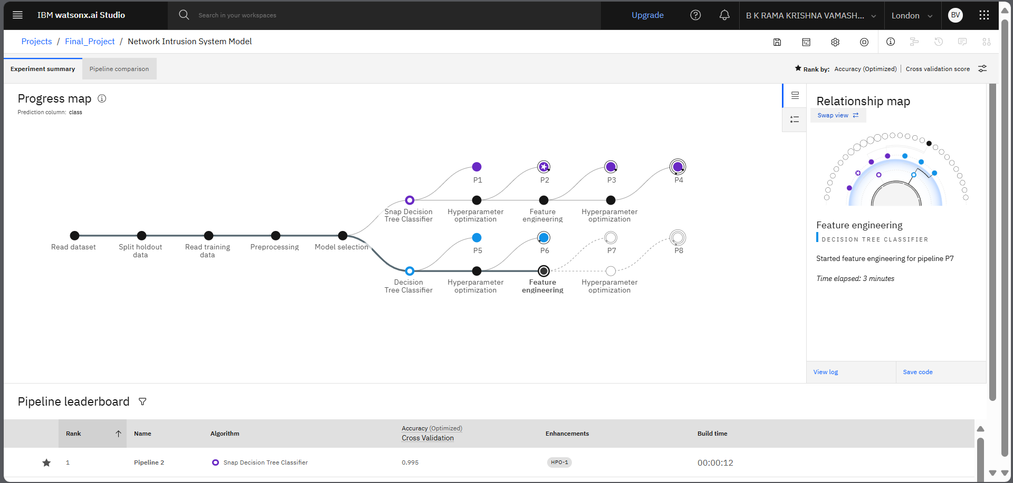
Result
Classification Model-1

Slide 8
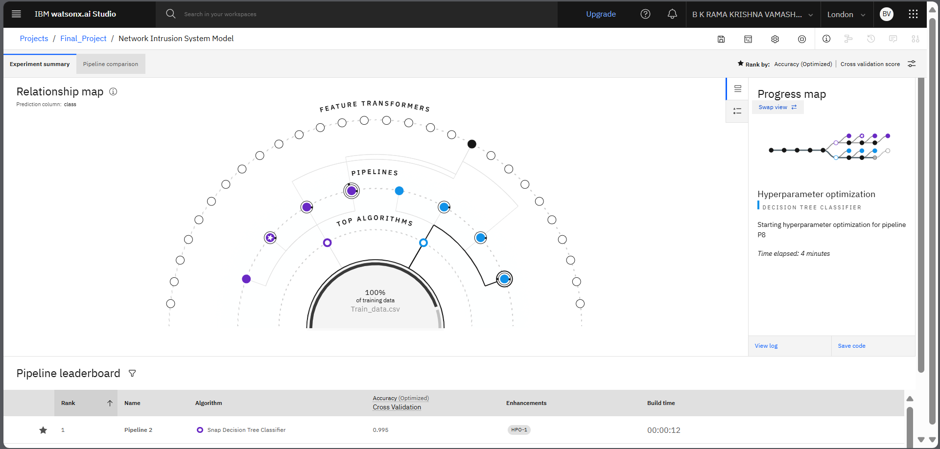
Result
Classification Model-2

Slide 9
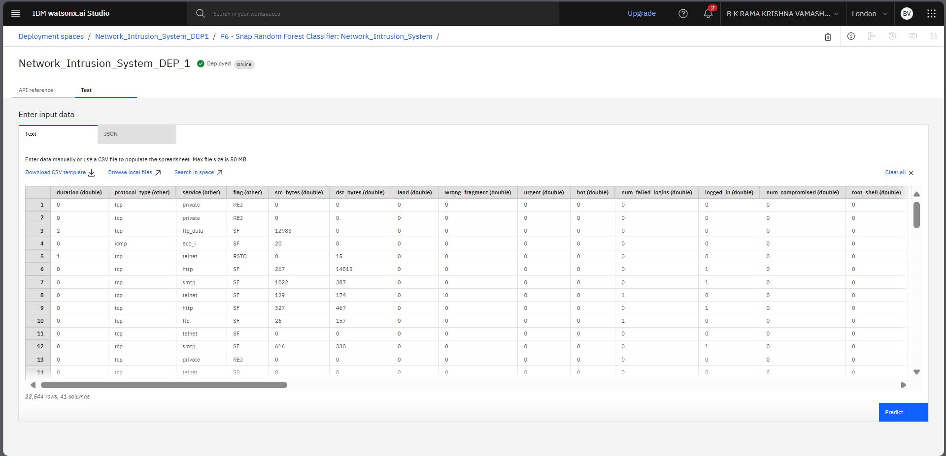
Result
Input Data

Slide 10
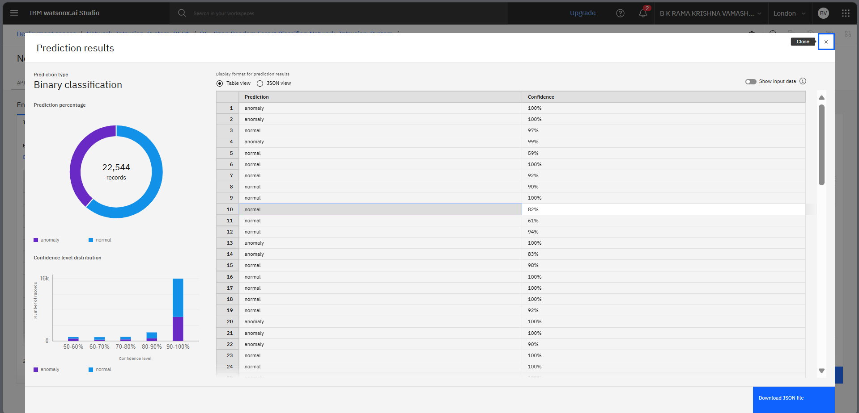
Result
Output Data

Slide 11
Conclusion
A machine learning-based Network Intrusion Detection System was developed using the simulated military network dataset to detect and classify Network Intrusions. By extracting 41 features from TCP/IP connections, models like Decision Tree and Snap Decision Tree Classifier effectively distinguished between normal and various attack types (DoS, Probe, R2L, U2R). This solution enhances early detection and strengthens network security.

Slide 12
Future scope
Future enhancements include deploying the NIDS in real-time network environments using streaming data, integrating deep learning models like LSTM for sequential analysis, and adapting the system for encrypted traffic.

Slide 13
References
Kaggle Dataset: https://www.kaggle.com/datasets/sampadab17/network-intrusion-detection
Train.csv
Test.csv

Slide 14

IBM Certifications
Getting Started With AI Certification

Slide 15

IBM Certifications
Journey to Cloud Certification

Slide 16

IBM Certifications
Credly RAG LAB Certification

Slide 17
THANK YOU

