Slide 1

Face Image Retrieval Using OC-LBP And Color Feature
Project id:14216
By
B.Kiran 201511726
Rukmani Sahu 201511710
Under the guidance of
Mrs. Manisha Patro
B.Kiran (Roll#CSE201511726) & Rukmani Sahu (Roll#CSE201511710)
Notes:
B-TECH PROJECT MID-SEM PRESENTATION 2011
BY KHUSHBU KHAN & ISAN SAHOO

Slide 2
Topic to be discussed:
Introduction
Aim/Objective of the project
Methodology
Output
Reference
B.Kiran (Roll#CSE201511726) & Rukmani Sahu (Roll#CSE201511710)

Slide 3
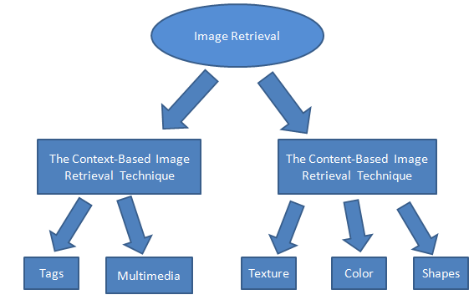
Introduction:
Content Based Image Retrieval
B.Kiran (Roll#CSE201511726) & Rukmani Sahu (Roll#CSE201511710)

Slide 4
Introduction:
CBIR( content based image retrieval ) system is used for image retrieval.
Image Database
Query Image
Feature Extraction
Features Storage Database
Feature Extraction
Comparison
…
image1
image2
Image 3
Image n
B.Kiran (Roll#CSE201511726) & Rukmani Sahu (Roll#CSE201511710)
Notes:
B-TECH PROJECT MID-SEM PRESENTATION 2011
BY KHUSHBU KHAN & ISAN SAHOO
4

Slide 5
Aim/Objective of project:
Combining color and texture feature.
CBIR implementation.
Performance analysis.
Image
Color Channel Separation
Texture Descriptor
Histogram
Extraction
Distance Measurement
Image Extraction
B.Kiran (Roll#CSE201511726) & Rukmani Sahu (Roll#CSE201511710)
Notes:
B-TECH PROJECT MID-SEM PRESENTATION 2011
BY KHUSHBU KHAN & ISAN SAHOO
5

Slide 6
Methodology:
FEI Database:
The software used is MATLAB 2013b.
The tool used is Image Processing Tool box.
FEI database (Frontal Image).
The size of database are 400 and 2800.
This database consist of 200 classes.
B.Kiran (Roll#CSE201511726) & Rukmani Sahu (Roll#CSE201511710)
Notes:
B-TECH PROJECT MID-SEM PRESENTATION 2011
BY KHUSHBU KHAN & ISAN SAHOO
6

Slide 7


Methodology:
LBP:
LBP stands for Local Binary Pattern.
It is a type of visual descriptor used to increase the dimension of images.
A binary pattern will be extracted by taking 8 neighbours.
Equation :-
2^{P}
Condition:-
S
B.Kiran (Roll#CSE201511726) & Rukmani Sahu (Roll#CSE201511710)

Slide 8
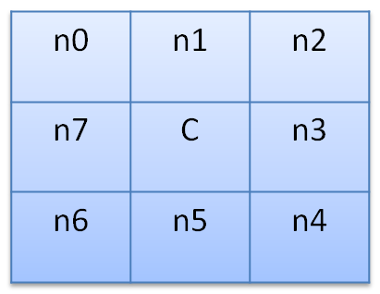
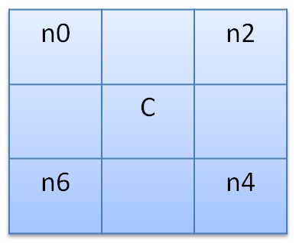
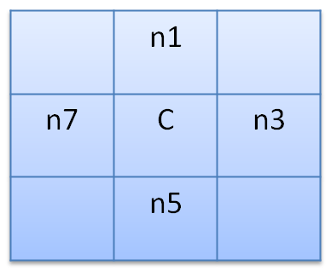
Methodology:
OC-LBP:
It is the advanced version of LBP.
S(n0-nc)x2⁰+
S(n1-nc)x2¹+
S(n2-nc)x2²+
S(n3-nc)x2³+
S(n4-nc)x2⁴+
S(n5-nc)x2⁵+
S(n6-nc)x2⁶+
S(n7-nc)x2⁷+
S(n1-nc)x2⁰+
S(n3-nc)x2¹+
S(n5-nc)x2²+
S(n7nc)x2³+
S(n0-nc)x2⁰+
S(n2-nc)x2¹+
S(n4-nc)x2²+
S(n6-nc)x2³+
[Orthogonal LBP1 Orthogonal LBP2]
B.Kiran (Roll#CSE201511726) & Rukmani Sahu (Roll#CSE201511710)
Notes:
B-TECH PROJECT MID-SEM PRESENTATION 2011
BY KHUSHBU KHAN & ISAN SAHOO
8

Slide 9
Methodology:
Color channels:
We will consider 150 % error.
HSV (hue, saturation, value)
RGB (Red, Green, Blue)
YCbCr (Green (Y), Blue (Cb), Red (Cr))
\
B.Kiran (Roll#CSE201511726) & Rukmani Sahu (Roll#CSE201511710)
Notes:
B-TECH PROJECT MID-SEM PRESENTATION 2011
BY KHUSHBU KHAN & ISAN SAHOO
9

Slide 10

Methodology:
Distance Measurement:
Euclidean Method: It is the straight-line distance between two pixels and is evaluated using Euclidean norm.
\
The formula of Euclidean Distance is as follows: d(p,q)=d(q,p)=
B.Kiran (Roll#CSE201511726) & Rukmani Sahu (Roll#CSE201511710)
Notes:
B-TECH PROJECT MID-SEM PRESENTATION 2011
BY KHUSHBU KHAN & ISAN SAHOO
10

Slide 11



Methodology:
Performance Analysis:
Precision=
Recall =
F-score=
B.Kiran (Roll#CSE201511726) & Rukmani Sahu (Roll#CSE201511710)
B.Kiran (Roll#CSE201511726) & Rukmani Sahu (Roll#CSE201511710)
Notes:
B-TECH PROJECT MID-SEM PRESENTATION 2011
BY KHUSHBU KHAN & ISAN SAHOO
11

Slide 12
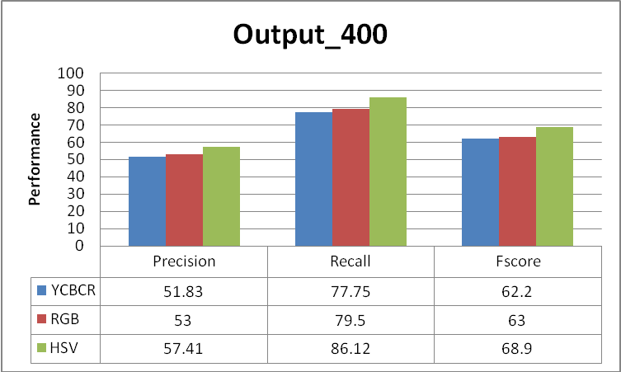
Output
Graphical representation
1) FEI database(400 images):-
B.Kiran (Roll#CSE201511726) & Rukmani Sahu (Roll#CSE201511710)
B.Kiran (Roll#CSE201511726) & Rukmani Sahu (Roll#CSE201511710)
Notes:
B-TECH PROJECT MID-SEM PRESENTATION 2011
BY KHUSHBU KHAN & ISAN SAHOO
12

Slide 13
Output
Graphical representation
2) FEI database(2800 images):-
B.Kiran (Roll#CSE201511726) & Rukmani Sahu (Roll#CSE201511710)
B.Kiran (Roll#CSE201511726) & Rukmani Sahu (Roll#CSE201511710)
Notes:
B-TECH PROJECT MID-SEM PRESENTATION 2011
BY KHUSHBU KHAN & ISAN SAHOO
13

Slide 14
Reference:
Zhu, Chao Bichot, Charles.Edmond Chen, Liming , “Image Region Description using orthogonal combination of linear binary pattern enhanced with color information”, pattern Recognition,2013,46,1949-1963.
S. Mangijao Singh and K. Hemachandran “Content-Based Image Retrieval using Color Moment and Gabor Texture Feature” IJCSI International Journal of Computer Science Issues, Vol. 9, Issue 5, No 1, September 2012.
B.Kiran (Roll#CSE201511726) & Rukmani Sahu (Roll#CSE201511710)
Notes:
B-TECH PROJECT MID-SEM PRESENTATION 2011
BY KHUSHBU KHAN & ISAN SAHOO
14

Slide 15
Thank you
B.Kiran (Roll#CSE201511726) & Rukmani Sahu (Roll#CSE201511710)
Notes:
B-TECH PROJECT MID-SEM PRESENTATION 2011
BY KHUSHBU KHAN & ISAN SAHOO
15

