Slide 1
Stress Analysis in Social Media
Sichitiu Marian Paul

Slide 2
Motivation
People express stress on social media nowadays
Could Machine Learning be used to evaluate stress levels of the posts?
Ex: Identify which company’s interview process have more stress from glassdoor reviews

Slide 3
Dataset
Dreaddit
3500 Reddit posts with binary labels
stressful, non-stressful
Everything sets me off and I'm almost having a panic attack. I'm going to my dads soon and that also makes me anxious because I'm afraid that I'm not in the mental state to go there and I want to stay at my moms but he really isn't happy when I do that. Anyway when she complains or is feeling bad I comfort her and I've never raised my voice at her even when frustrated. When she thinks I disagree with her she raises her voice, I have to talk about what she wants to in general right now because she gets impatient easily. I feel like vomiting because she also has so many redeeming factors but I don't want to lose her as a friend.

Slide 4
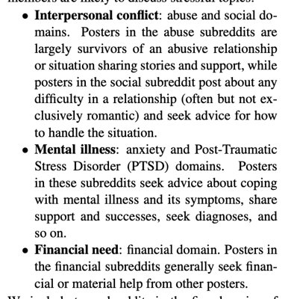
DATASET
Dreaddit, a dataset of lengthy social media posts in five categories, each including stressful and non-stressful text and different ways of expressing stress, with a subset of the data annotated by human annotators.

Slide 5
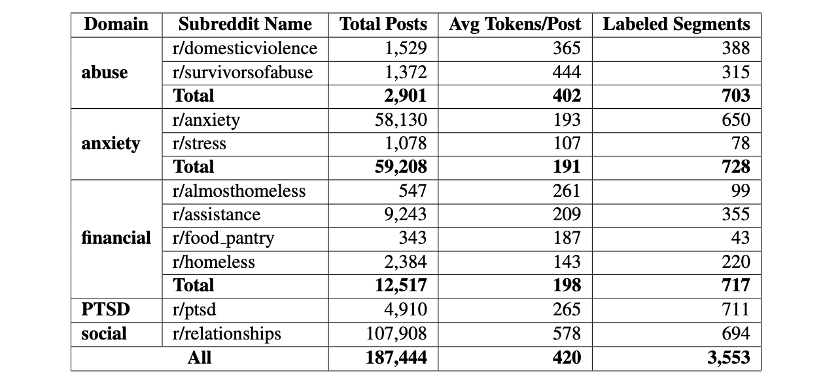
dataset
Reddit subforums

Slide 6
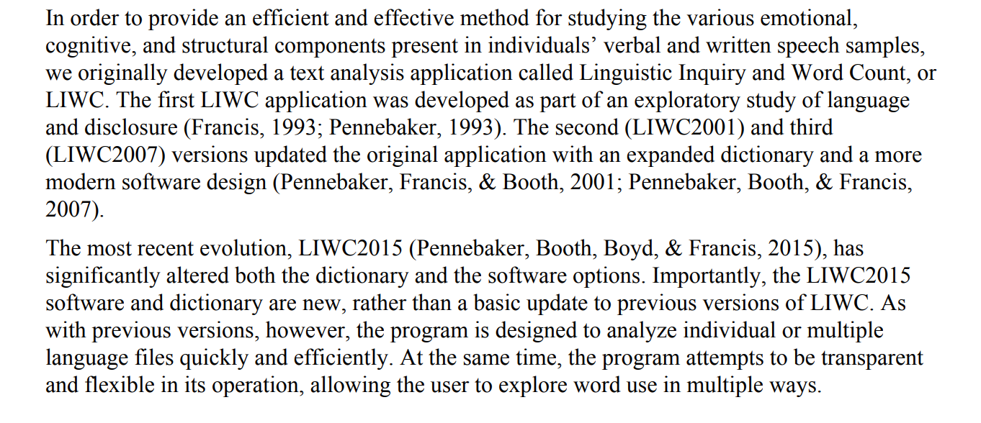
FEATURES . Liwc-2015 features
Linguistic Inquiry and Word Count (LIWC) (Pennebaker et al., 2015), a lexicon-based tool that gives scores for psychologically relevant categories such as sadness or cognitive processes, as a proxy for topic prevalence and expression variety.

Slide 7
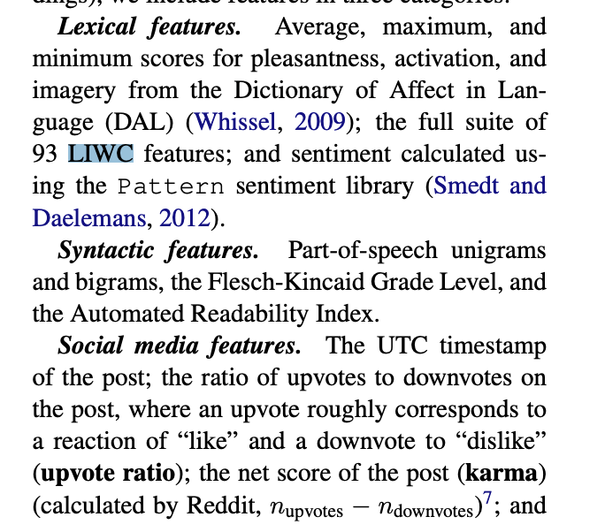
Features
The data set also contains 136 features(liwc-2015 features) lexical features ,social media features and sintactic features

Slide 8
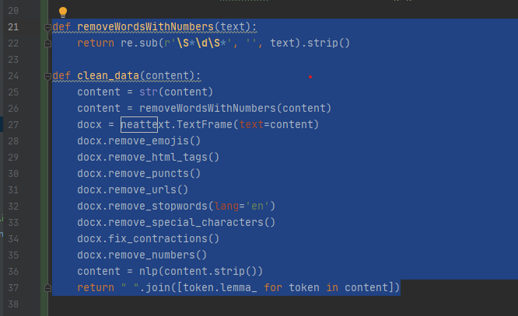
Data CLEANING
nlp = spacy.load("en_core_web_sm", disable=['parser', 'ner'])

Slide 9
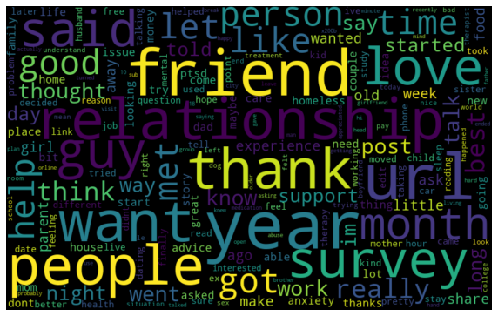
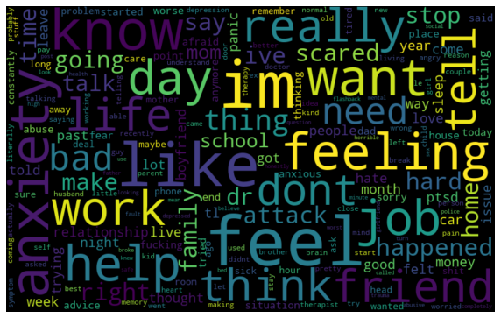
Feature Extraction: TF-IDF (1-gram)
Num of Features: 10030
Non-Stress Posts
Stress Posts

Slide 10
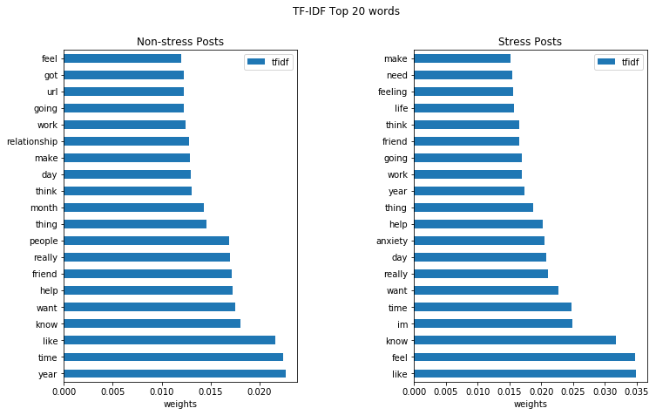
TF-IDF Top 20 Words in 2 labels

Slide 11
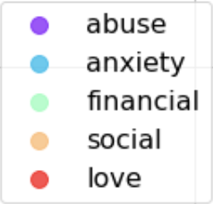
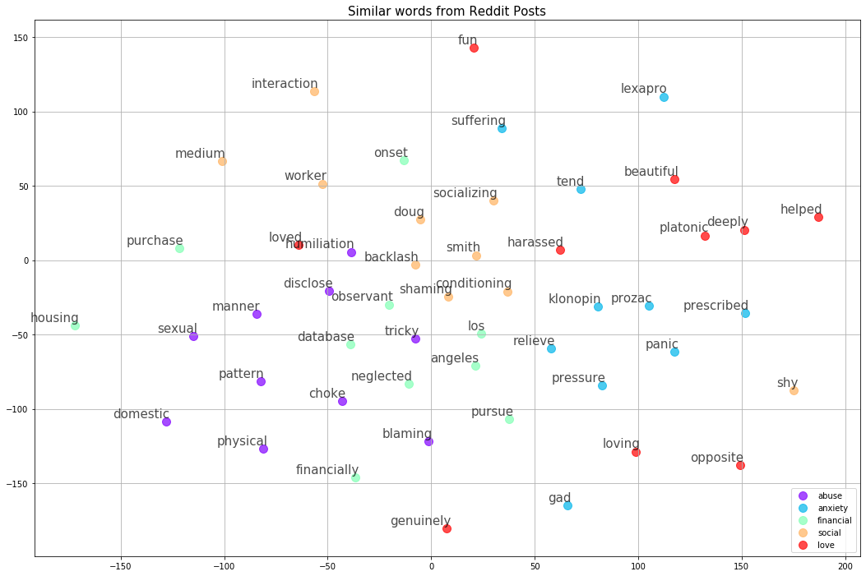
Word2Vec Features
Top 10 most similar words
Notes:
the page only show that for one word what other words often appear together (most similar)

Slide 12
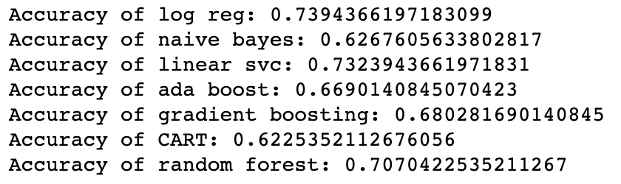
Classification
Classification Model with TF-IDF (1-gram)
BEST

Slide 13
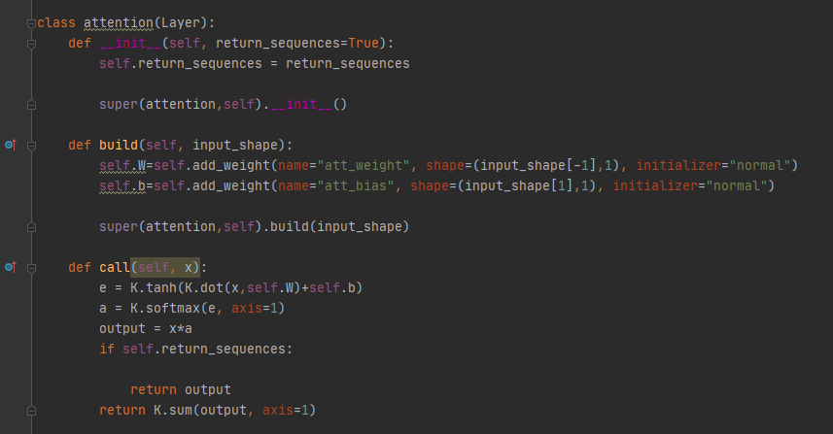
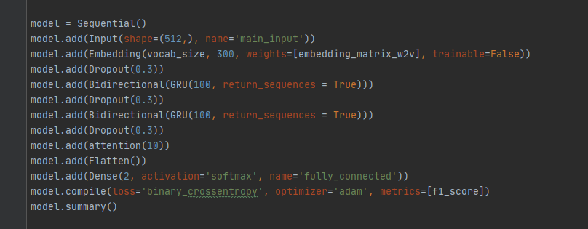
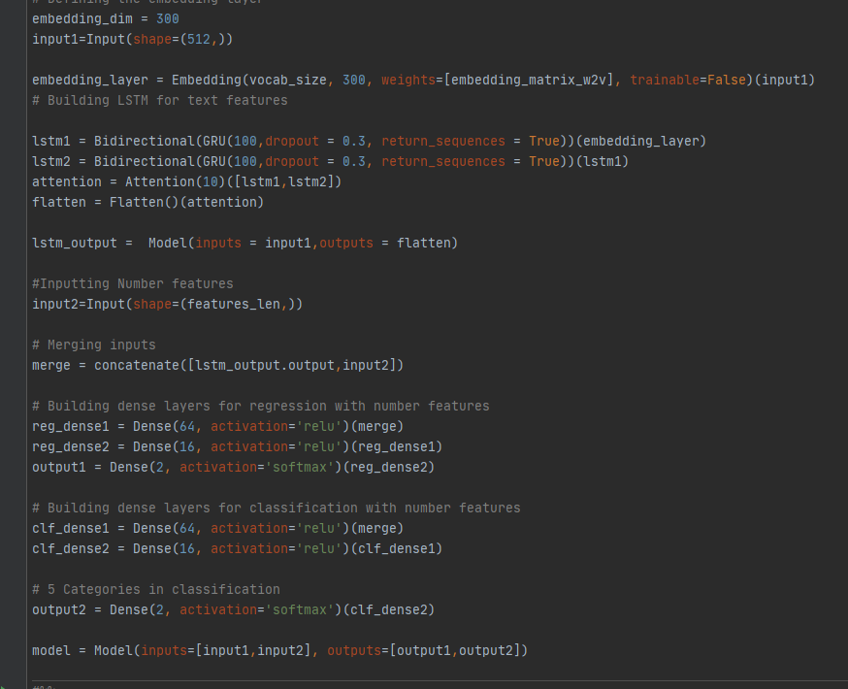
BiLSTM
Attention Mechanism and arhitecture singleInput and multiInput

Slide 14
BILSTM
- GoogleNews-vectors-negative300.bin as input word2vec
-Early stopping with patience = 5
-Learning rate 0.0001 with Adam Optimizer
-Sequence Length of 512
-Batch size 64
-Weight Decay with ReduceLROnPlateau

Slide 15
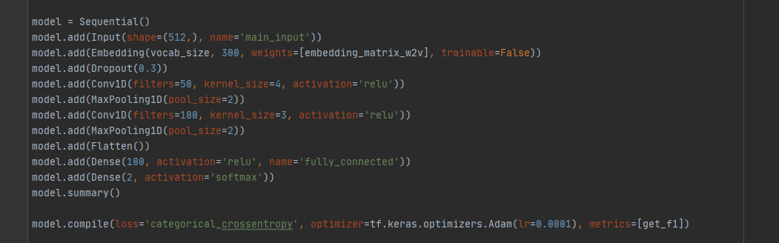
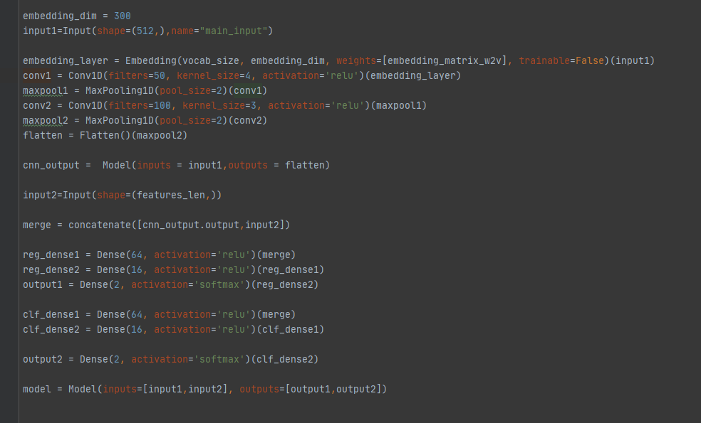
CNN
Arhitecture singleInput and multiInput

Slide 16
CNN
- GoogleNews-vectors-negative300.bin as input word2vec
-Early stopping with patience = 5
-Learning rate 0.0001 with Adam Optimizer
-Sequence Length of 512
-Batch size 64
-Weight Decay with ReduceLROnPlateau

Slide 17
LoGISTIC-REGRESSION
Models:
TFIDF(1 grams and 3 grams) ,
domain word2vec(trained with gensim)
word2vec pretrained(GoogleNews-vectors-negative300.bin),
bert embeddings(bert-base-uncased)

Slide 18
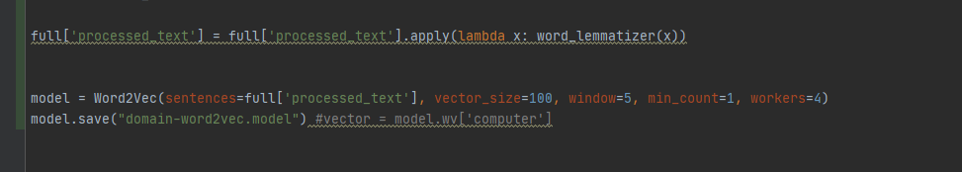
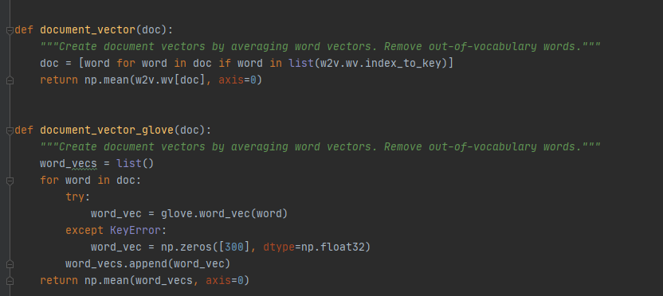
Logistic regression + Word2vec

Slide 19
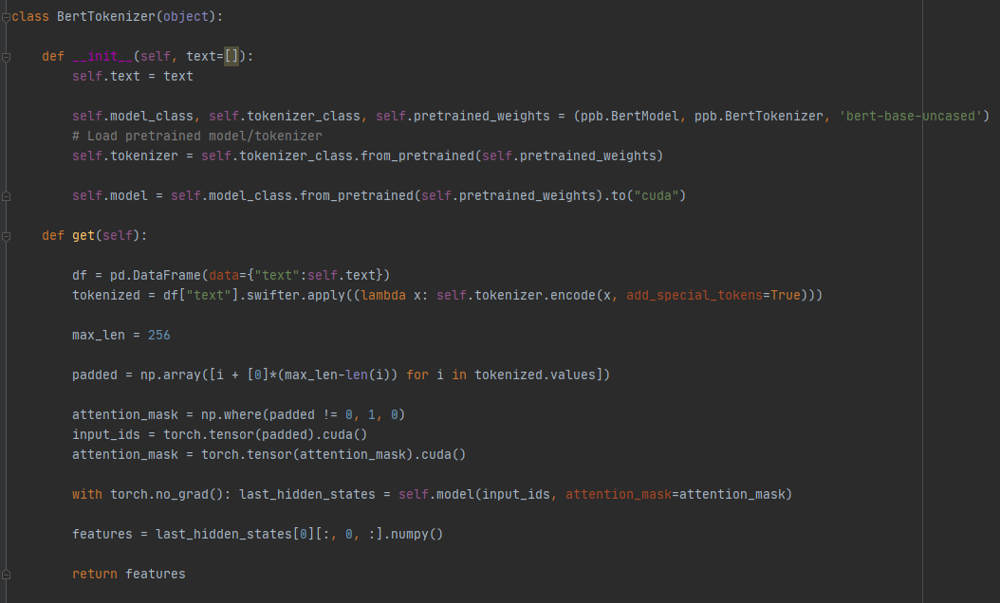
Logistic regression

Slide 20
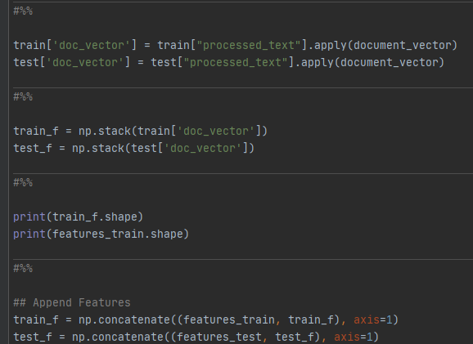
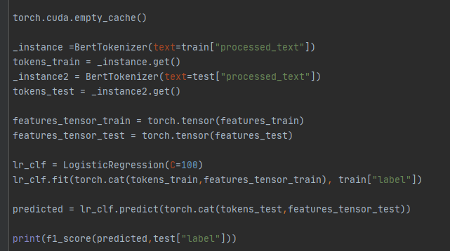
Logistic regression + bert features

Slide 21
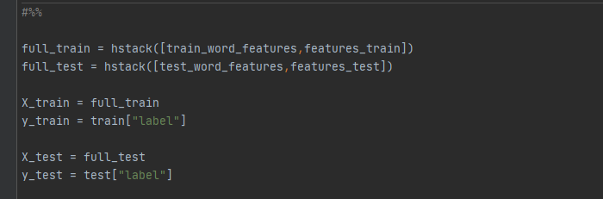
Logistic regression 1-3 grams with features

Slide 22
BERT
Model : bert-base-uncased
Applied on raw data with only lowercasing
Used simple-transformers library
Gives best results
Limited by max length(out of memory cuda)

Slide 23
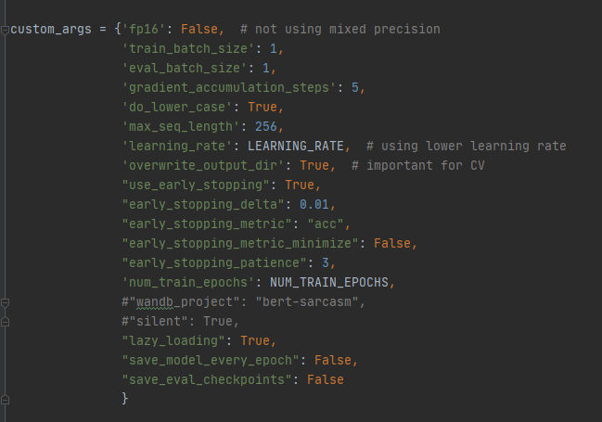
Bert

Slide 24
MY RESULTS
My Results: F1-score
-CNN + features : 0.7260375022888184
-CNN : 0.696022689342498
-GRU: 0.71282350626768
-GRU + features: 0.7385580334375915
-1-grams baseline sklearn models: 0.7396470588235294
-Logreg + 1-3-grams + features: 0.765625
-bert: 0.796713643680769 (due to lower sequence length)
-logreg + pretrained word2vec + features: 0.7716899224806202
-logreg + domain word2vec + features: 0.786038961038961
-logreg + bert embeddings + features: 0.772238961038961 (due to lower sequence length)

Slide 25
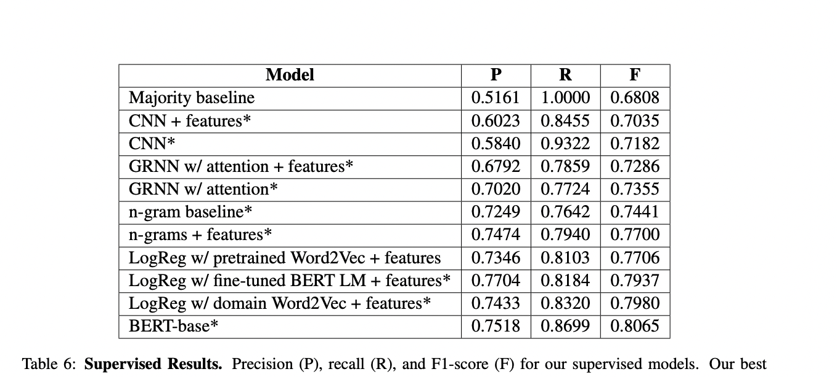
PAPER results
Paper results

Slide 26
Questions ?

