Slide 1
Boolean Logic
Creating logic gates with Minecraft

Slide 2
Learning Objectives
Know the three basic logic gate operators
Work out the output of given inputs using a truth table

Slide 3
All the instructions and data inside a computer are stored using binary.
Computer memory uses many small transistors and capacitors to store data. A transistor is a tiny switch that is activated by the electronic signals it receives. The digits 1 and 0 used in binary reflect the on and off states of a transistor.
These transistors can be wired together to make a circuit which performs simple, logical calculations. These simple circuits are called logic gates.
There are three fundamental logic gates that you need to know about.

Slide 4
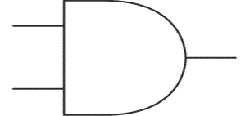
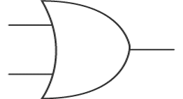
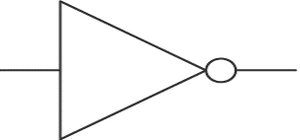
Logic Gates (3 main types)
A
A
Q
Q
A
Q
B
B
AND
OR
NOT

Slide 5
NOT Gate
A NOT gate has just one input. The output of the circuit will be the opposite of the input. If 0 is input, then the output is 1. If 1 is input, then 0 is output.
If A is the input and Q is the output, the truth table would look like this:
A | Q
1 | 0
0 | 1
A
Q

Slide 6
AND Gate
An AND gate has two inputs. AND tells us that both inputs have to be 1 in order for the output to be 1.
If A and B are the inputs and Q is the output, the truth table would look like this:
A | B | Q
0 | 0 | 0
0 | 1 | 0
1 | 0 | 0
1 | 1 | 1
A
Q
B

Slide 7
OR Gate
The OR gate has two inputs. One or both inputs must be 1 to output a 1, otherwise it outputs 0.
If A and B are the inputs and Q is the output, the truth table would look like this:
A | B | Q
0 | 0 | 0
0 | 1 | 1
1 | 0 | 1
1 | 1 | 1
A
Q
B

Slide 8
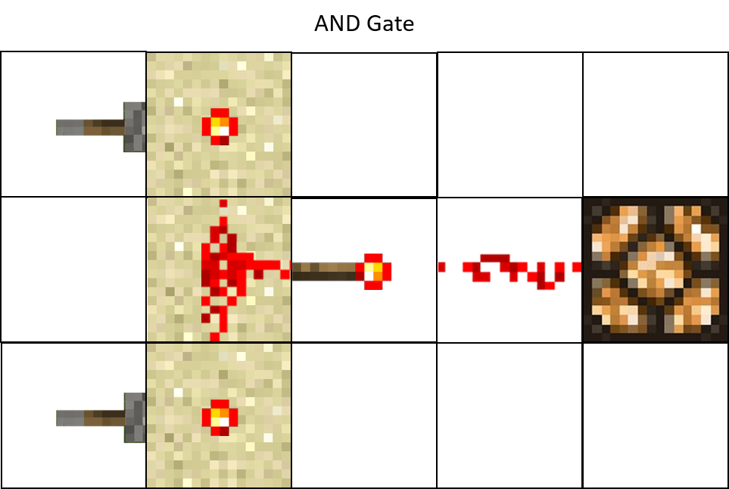
Minecraft Logic
Because redstone has 2 states (on or off), we can use it to create logic gates in Minecraft (See example below)
AND Gate using redstone
AND Gate
Redstone Lamp
A
A
Q
Q
B
To light up the redstone lamp, both levers must be switched to ON
B
Lever

Slide 9
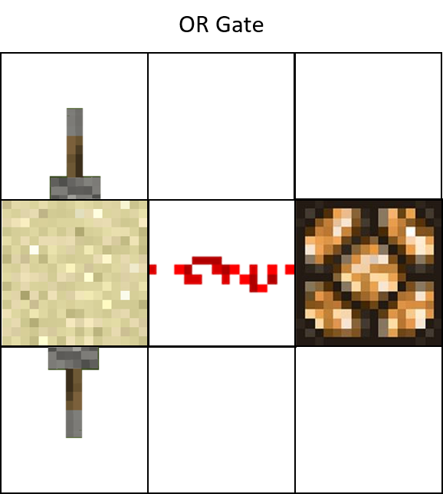
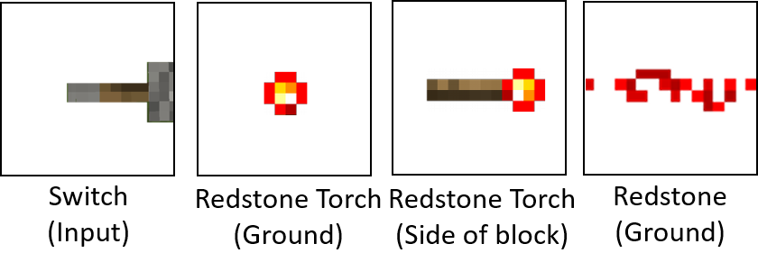
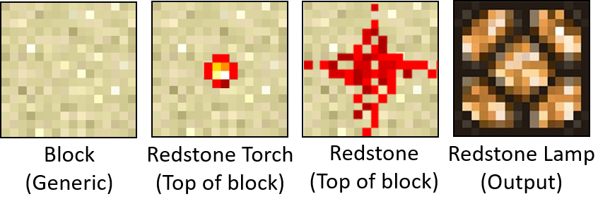
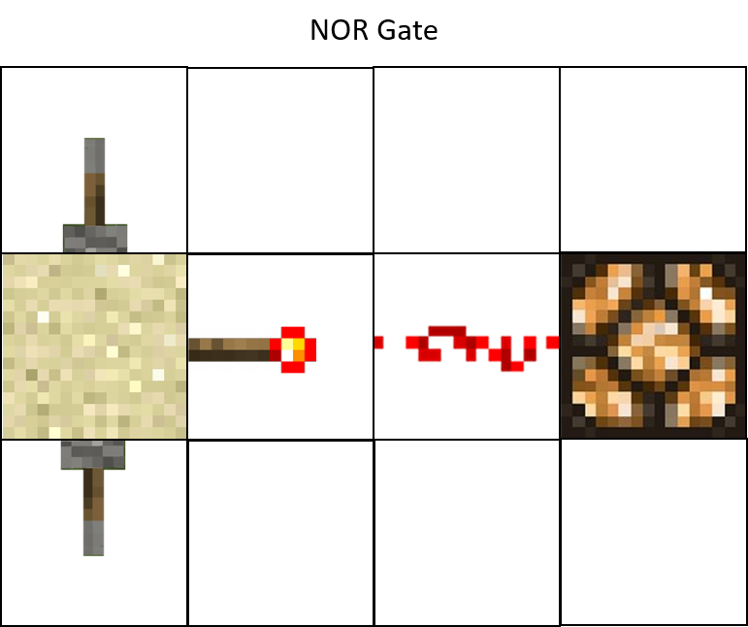
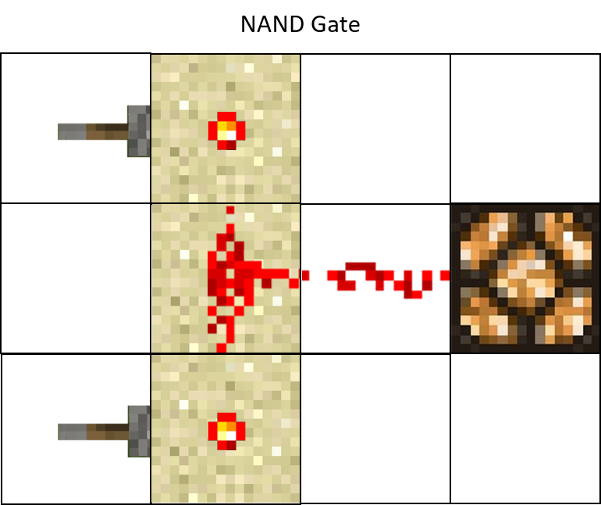
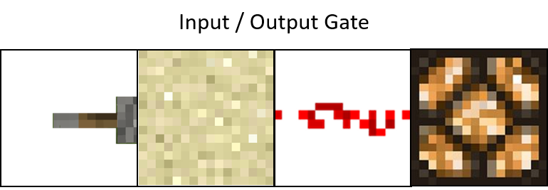
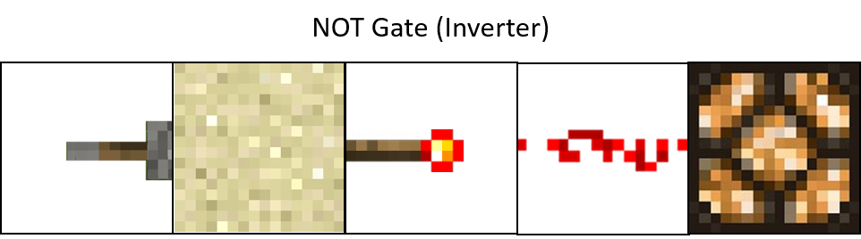
Minecraft Logic Gates
Key

Slide 10
Challenge
Complete the ‘Logic Gates Worksheet’
Use the build area to create your own logic circuits. Replace the redstone lamp with other redstone powered objects such as doors, pistons or even TNT!

