Slide 1
Aircraft Risk Assessment
Analyzing Aviation Data to Identify Safe Aircraft Models for Business Expansion

Slide 2
Introduction
The company is diversifying into aviation and requires risk insights for safe operations.
This project involves analyzing aviation accident data to determine aircraft with minimal risk.
Insights will guide investments in models ensuring safety and cost-efficiency.

Slide 3
Business Understanding
The company aims to purchase and operate aircraft for commercial and private enterprises.
Key objective: Identify aircraft with the lowest operational risks.
Focus: Minimize accidents, fatalities, and financial liabilities.

Slide 4
Data Understanding
Dataset Overview:
88,889 rows, 31 columns
Key columns: Aircraft Make, Model, Weather Conditions, Accident Severity, etc.
Goal: Understand accident trends to recommend safe aircraft models.
Focus: Identify factors influencing accident rates and severity.

Slide 5
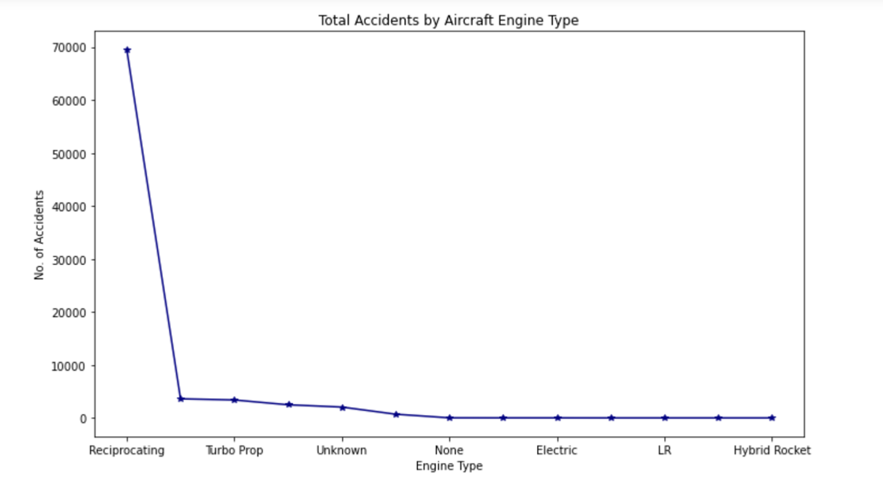
Data Analysis
Applied descriptive and inferential statistics to analyze accident data.
Key Insights:
Total Accidents by Aircraft Engine Type.

Slide 6
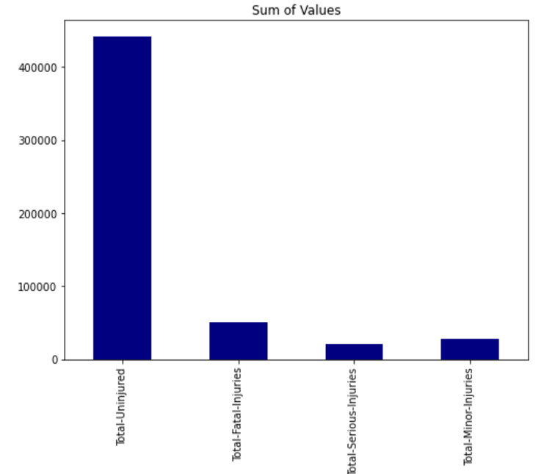
Total Injuries incurred over the years due to the accidents .

Slide 7
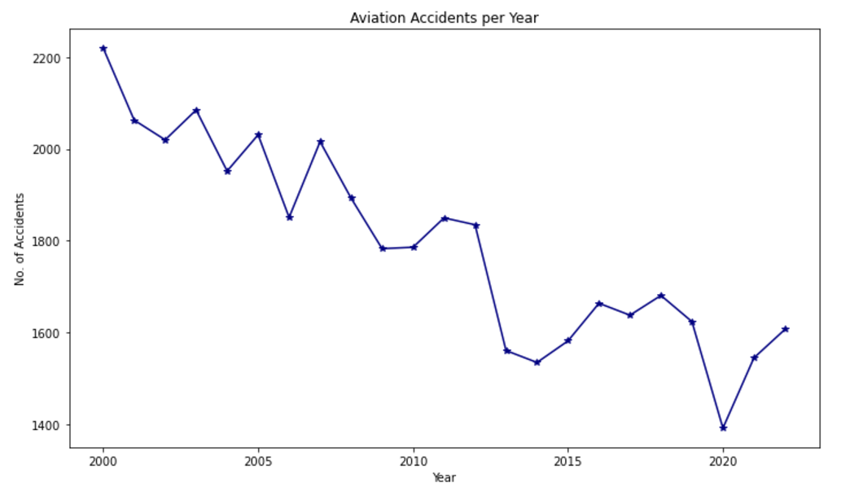
Aviation Accidents per Year.

Slide 8
Recommendations
Focus on aircraft engines with fewer accidents.
Prioritize manufacturers with a better safety track record.
Invest more on passenger safety in the airplane to reduce the number of injuries.

Slide 9
Evaluation & future improvement ideas
Perform operational cost analysis for recommended aircraft models.
Engage vendors and manufacturers for acquisition.
Collect additional data on pilot experience, maintenance history, and routes.

Slide 10
Contact information
Thank You.
Name: Stanley Macharia.
LinkedIn profile: https://www.linkedin.com/in/stanley-macharia-60a439240/

