Slide 1
BRITISH AIRWAYS
Customer Booking
Prediction Model
Machine Learning Analysis — Heathrow Terminal 3 Capacity Planning
Dataset: 50,000 bookings | Features: 17 | Model: Random Forest (200 trees)
Kashish Yadav · British Airways Virtual Experience

Slide 2
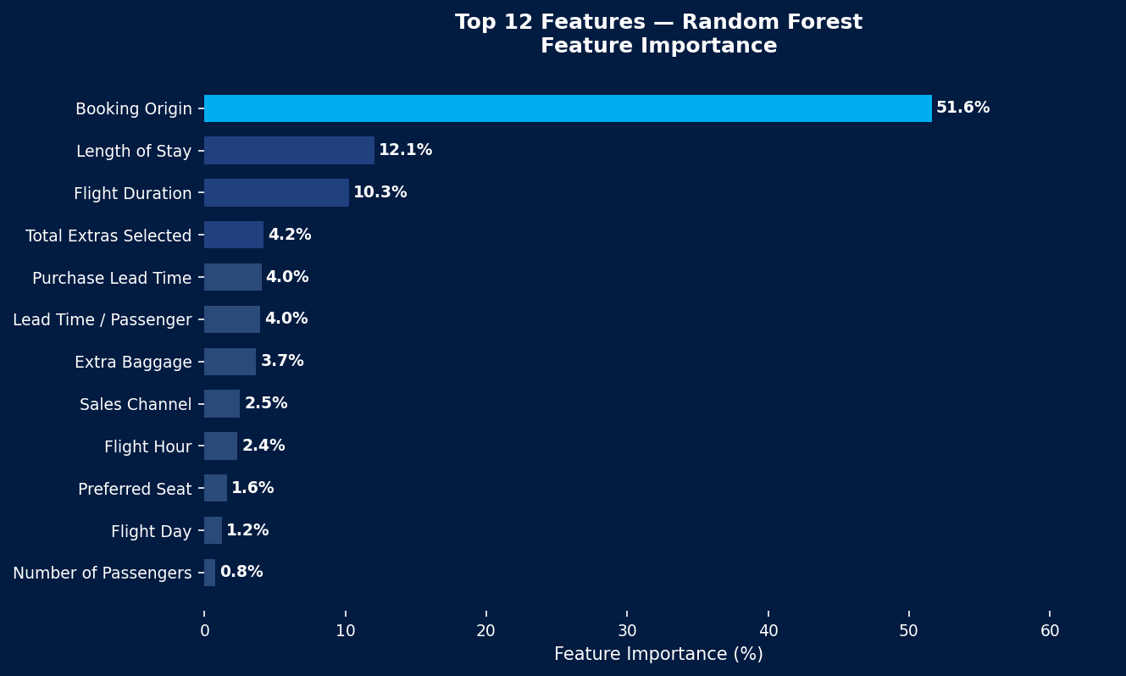
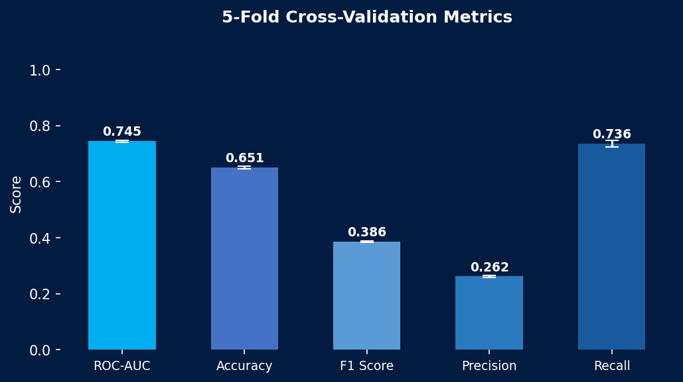
Model Performance & Feature Importance
0.745
65.1%
73.6%
0.386
ROC-AUC
Accuracy
Recall
F1 Score
Discrimination
5-Fold CV
True Positive Rate
Precision-Recall
5-Fold Stratified Cross-Validation · Random Forest · class_weight='balanced' · 200 estimators

Slide 3
Key Insights & Business Recommendations
📊 Model Findings
💡 Recommendations
Booking Origin
Target by Origin
51.6% importance — strongest predictor. Customers from certain origins book far more reliably.
Prioritise proactive marketing to high-converting booking-origin segments identified by the model.
Length of Stay
12.1% importance — longer stays correlate with higher booking completion.
Long-Stay Incentives
Upsell packages and early-bird discounts for passengers with stays > 7 days.
Flight Duration
10.3% — long-haul routes see more committed conversions.
Bundle Extras Early
Prompt seat/meal/baggage selection in checkout — extras correlate strongly with conversion.
Extras Selected
4.2% — passengers choosing add-ons are more likely to complete.
Model Limitations
Purchase Lead
ROC-AUC of 0.745 is promising but class imbalance (85/15) limits precision (0.26). Enrich data with loyalty tier and historical behaviour for a more precise model.
4.0% — early planners complete bookings at higher rates.
Random Forest Classifier · 50,000 customer bookings · British Airways Virtual Experience Programme

