Slide 1


Quby

Slide 2

Problema

Slide 3
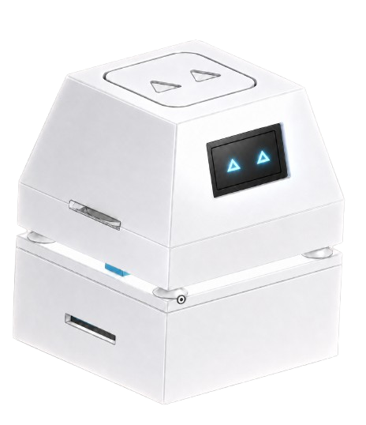
Soluţia
Quby
Docked at Home, Ready Anywhere

Slide 4

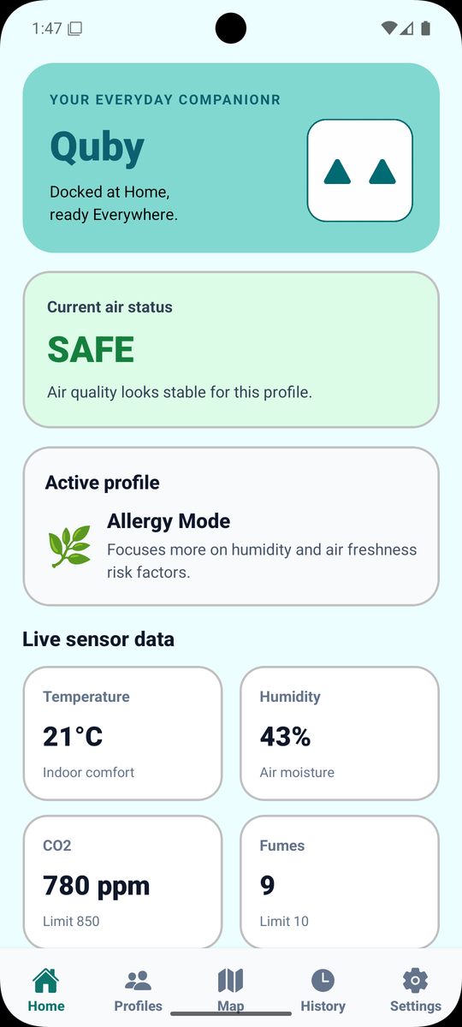
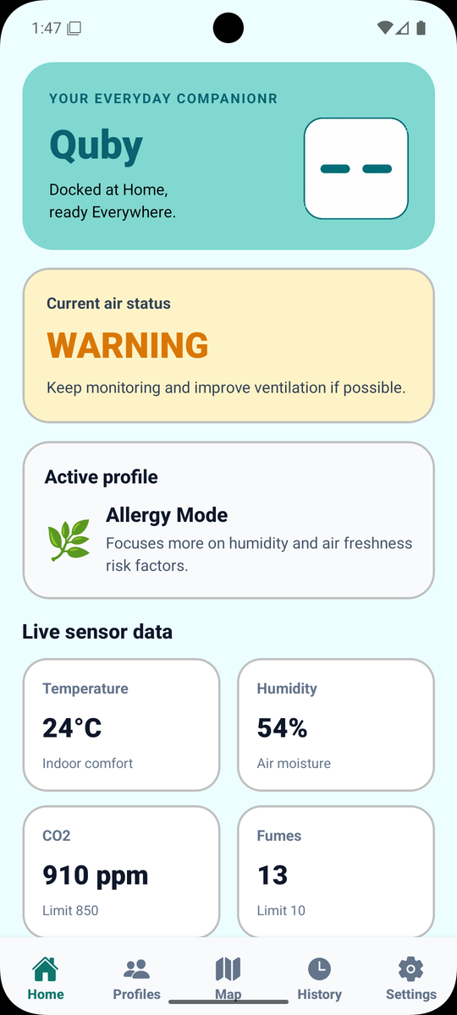
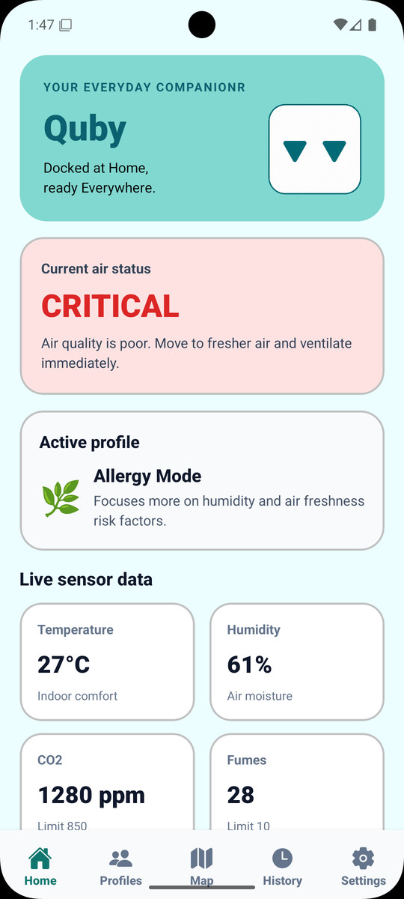
Health in Your Pocket

Slide 5
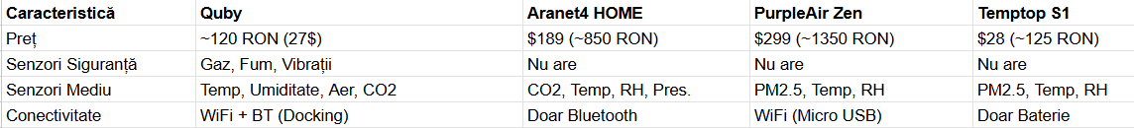
Quby vs. Competitors

Slide 6
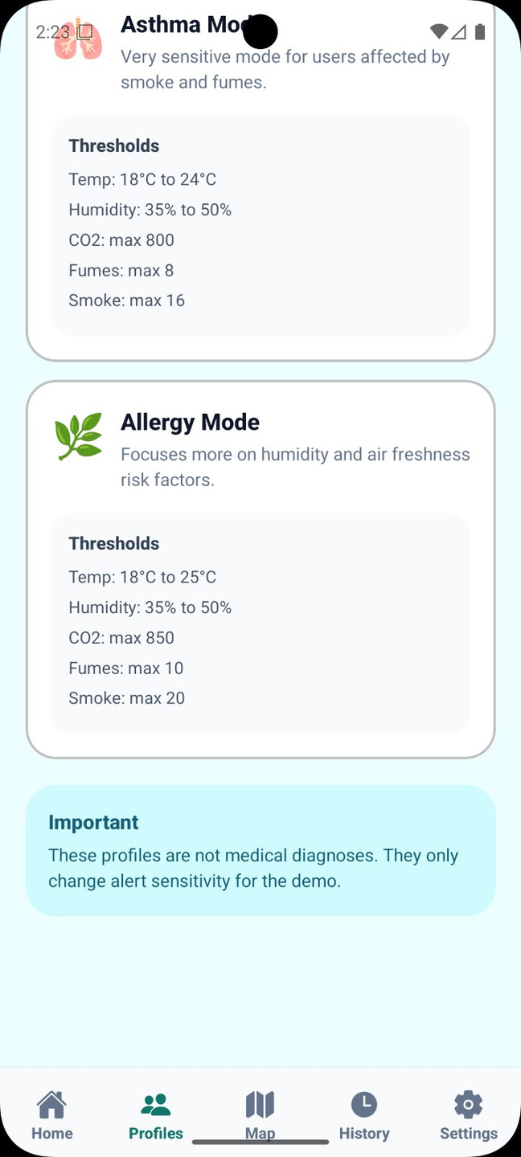
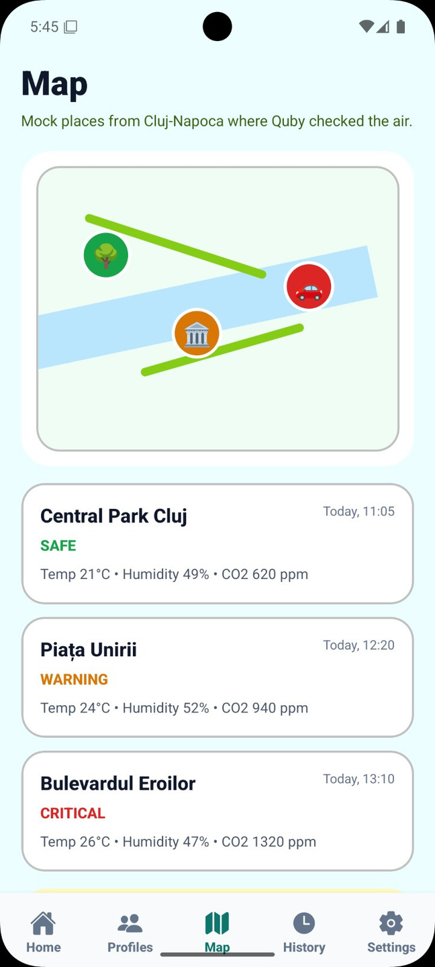
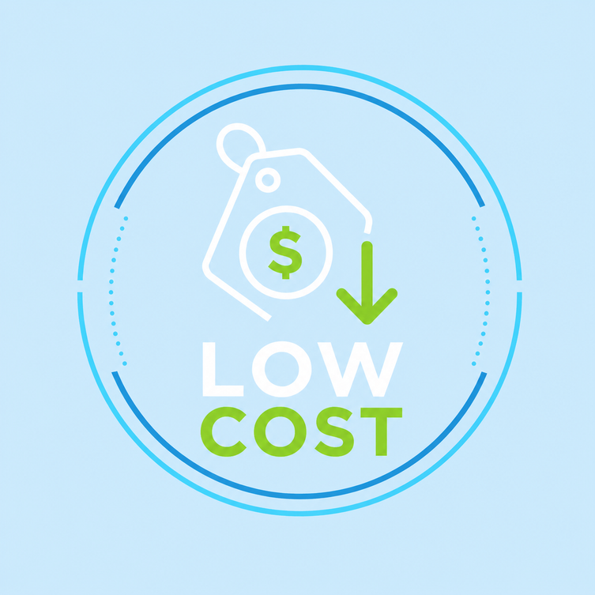
Ce oferim în plus?
User
customization
User based
location data map
Affordable

Slide 7
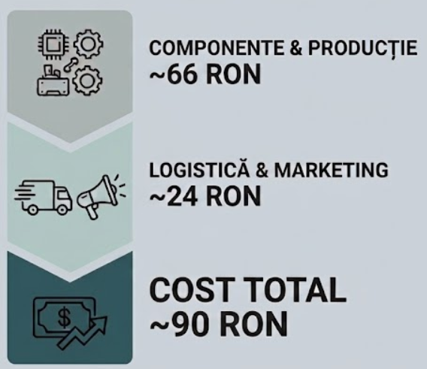
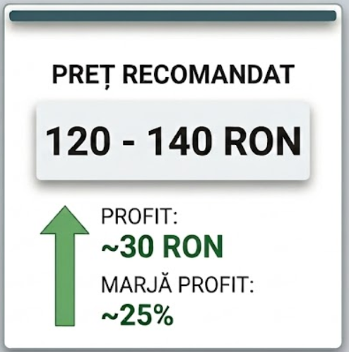
Costuri (per unitate)

Slide 8
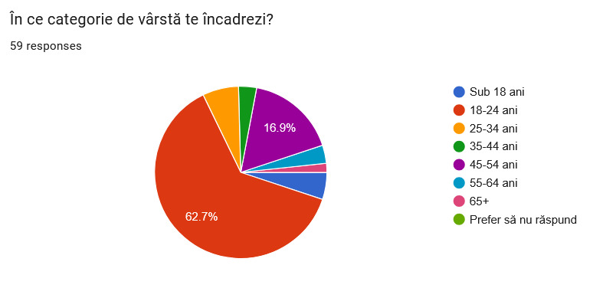
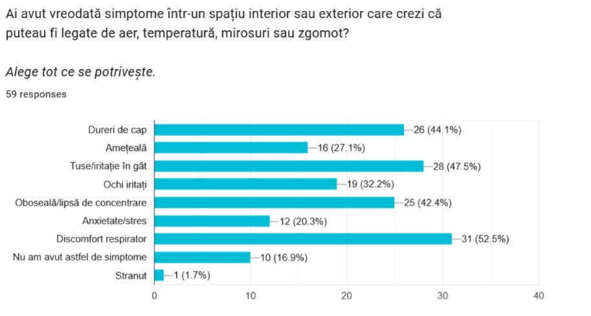
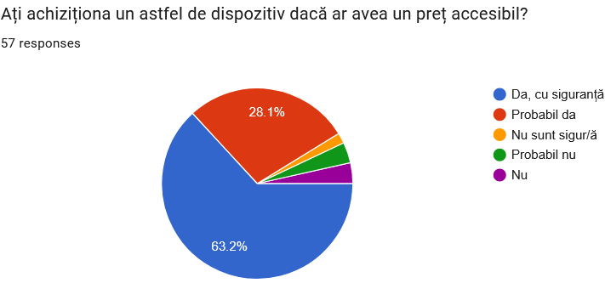
Business validation

Slide 9


Implementări Viitoare
OFFLINE BLUETOOTH MODE
PREMIUM PLAN & DATABASE SYNC.
GOOGLE MAPS & SMART ASSISTANT INTEGRATION

Slide 10

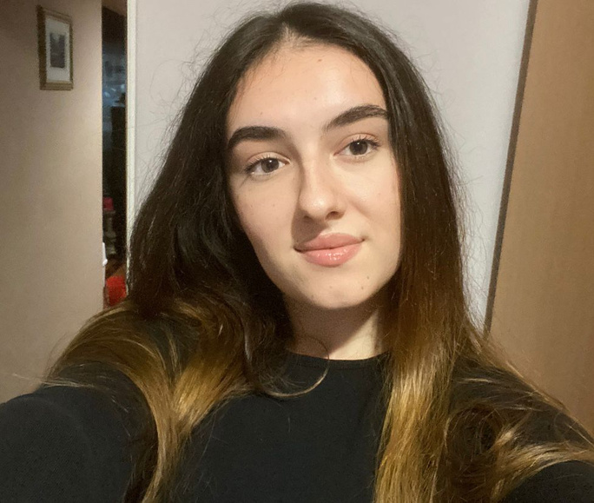

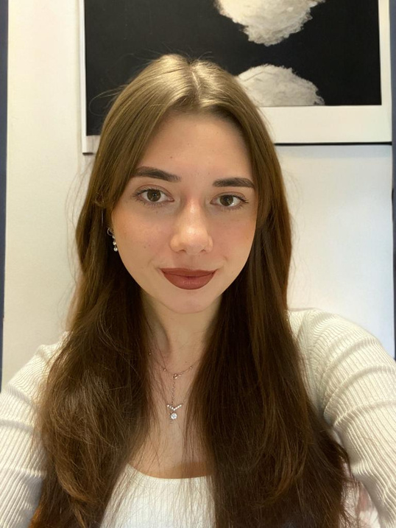
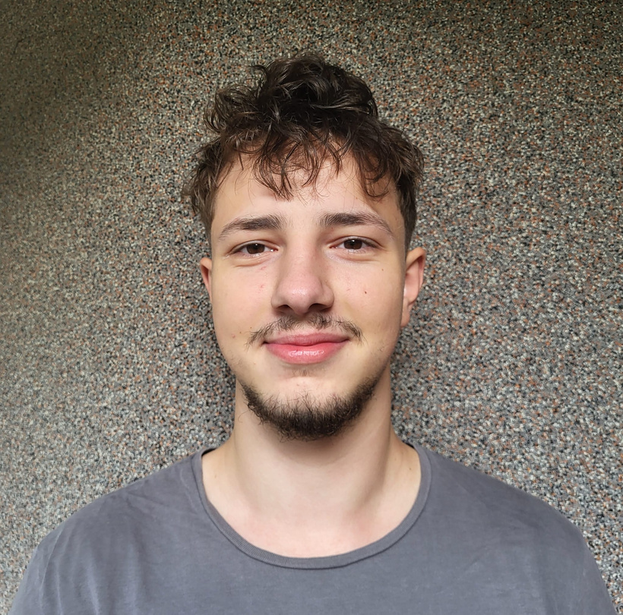
Echipa noastră
URECHE RAFAEL-MATEI
IRIMIEȘ AYANA
COȚA SARA
MOJE ALEXIA-MARIA
RUSU MIHNEA

Slide 11
Vă mulțumim pentru atenție!

