Slide 1

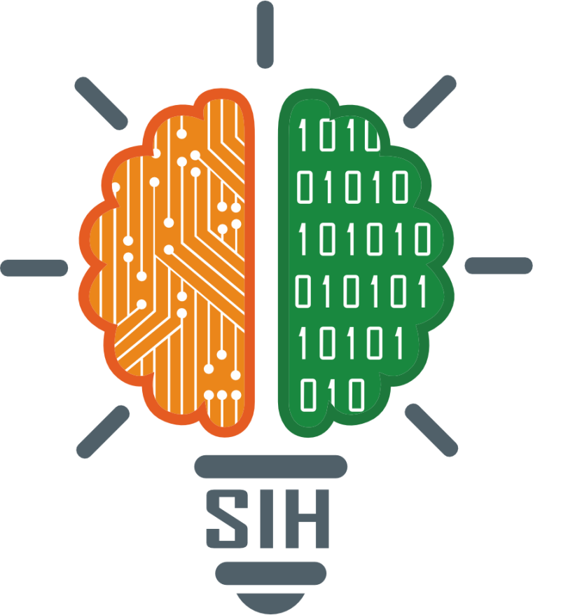
SMART INDIA HACKATHON 2024
TITLE PAGE
Problem Statement ID : sih1638
Problem Statement Title: AI-Driven Crop
Disease Prediction and Management System
Theme:-
PS Category:- Software
Team ID:-
Team Name (Registered on portal) :-AGROTECH

Slide 2
IDEA TITLE
AGRO
TECH
Crops Disease Prediction and Management system:
The system aims to address the challenge of crop diseases in agriculture.
Traditional manual inspections for disease detection can be time-consuming and less effective.
Proposed Solution:
The AI-Driven Crop Disease Prediction and Management System leverages advanced machine learning algorithms.
It integrates data from various sources: satellite imagery, weather forecasts, and soil health sensors.
By analyzing these data points, the AI model identifies patterns and anomalies that indicate potential diseases.
After recognizing the disease, it provides various solutions to overcome the problem and minimizing losses.
How it works:
Farmers use a user-friendly mobile and web application to input crop information and upload images.
The system provides real-time predictions, detailed reports on disease progression, risk levels, and recommended actions.
Early detection and measures help minimize crop losses and maximize profit for farmers.

Slide 3
TECHNICAL APPROACH
AGRO
TECH
Technical approach
Programming Languages:
Python: The primary programming language used for developing machine learning models, data analysis, and backend logic.
TypeScript: For developing the frontend interface of the web application, ensuring a seamless user experience.
Firebase: For storing and managing large datasets collected from various sources.
Frameworks & Libraries:
TensorFlow: For developing and training deep learning models for image recognition and disease prediction.
OpenCV: For image processing, particularly in analyzing crop images uploaded by farmers.
React-Native & Fast Api: To develop the interface of the application, handling API requests and communication between app and model.
Classification: For classification we will use CNN , Restnet50 which can provide detailed and more concise outputs.
NLP Models: Finetuning Pretrained models like Chatgpt,Transformers for generating information like causes of the disease,providing solutions and cures for the disease and the steps to prevent the disease from occurring in the future.
Methodology and implementation
Data Collection & Preprocessing:
Collect data from various sources (satellite imagery, IoT sensors, weather data, historical crop disease datasets).
Preprocess the data (cleaning, normalization, feature extraction).
Model Development:
Develop image recognition models using deep learning (for crop disease classification).
Train predictive models using historical data and environmental variables.
Integration & Deployment:
Integrate machine learning models with a cloud-based backend.
Develop a user-friendly mobile/web application interface.
Testing & Validation:
Rigorously test the system (including field trials) to validate predictions.
Collect user feedback and iterate on model performance.
Feasibility & Viability Analysis:
Assess technological, operational, and economic feasibility.
Address potential challenges (data quality, farmer adoption, infrastructure).
Impact & Benefits:
Positive impact on farmers (early disease detection, informed decisions).
Economic benefits (cost savings, higher profitability).
Environmental benefits (sustainable practices, climate resilience).

Slide 4
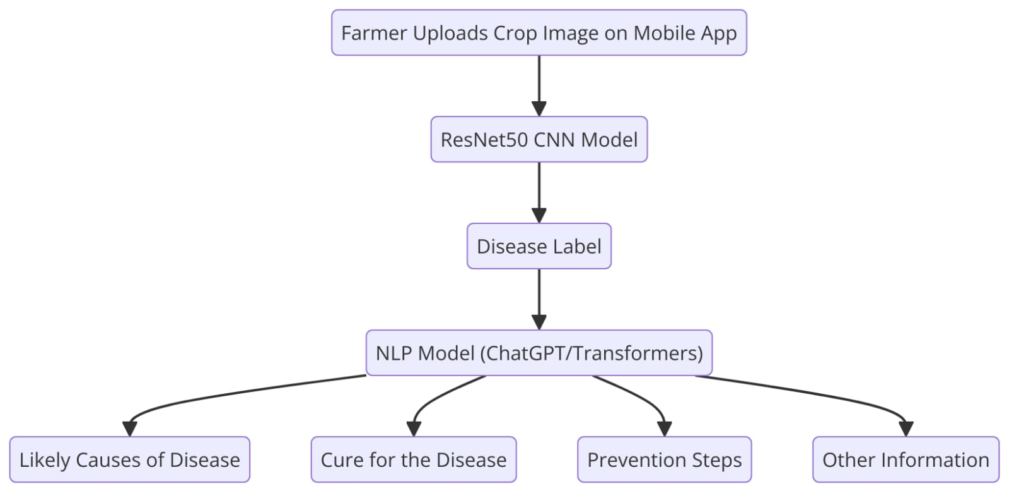
Flowchart

Slide 5
FEASIBILITY AND VIABILITY
AGRO
TECH
Feasibility
Technological Feasibility:
Advanced AI Algorithms: The maturity of AI and machine learning technologies, particularly in image recognition and predictive analytics, supports the feasibility of developing accurate disease detection models.
IoT and Data Integration: The availability of IoT devices and satellite data makes real-time environmental monitoring and data collection practical. These technologies are cost-effective and scalable.
Operational Feasibilty
User Accessibility: The system is designed to be user-friendly, with a mobile and web interface that can be easily adopted by farmers of varying technological expertise.
Scalability: The modular design of the system allows it to be scaled across different regions and crop types, making it adaptable to diverse agricultural environments.
Economic Feasibility:
Cost Efficiency: By predicting diseases early and optimizing resource use, the system can reduce operational costs for farmers. Additionally, the use of open-source technologies and cloud infrastructure minimizes the initial development and deployment costs.
Market Demand: There is a growing demand for precision agriculture solutions, driven by the need for sustainable farming practices and the global push towards food security. This solution aligns well with current market trends.
Stratergies to overcome challenges
Improving Data Quality and Access:
Solution: Partner with agricultural institutions, government agencies, and local communities to gather extensive and high-quality datasets. Implement data augmentation techniques to enhance the diversity and robustness of training data.
Solution: Continuously update the model with new data to improve its accuracy and adaptability to different regions and conditions.
Farmer Education and Engagement:
Solution: Conduct workshops and training sessions to educate farmers on the benefits and ease of use of the system. Provide hands-on demonstrations and success stories to build trust.
Solution: Develop a support system that includes local agricultural experts who can assist farmers in using the technology effectively.
Enhancing Connectivity Solutions:
Solution: Develop an offline mode for the mobile app, allowing farmers to capture and upload data when connectivity is restored. Explore partnerships with telecom providers to improve network access in rural areas.
Solution: Implement edge computing solutions where some data processing occurs locally on the device, reducing the need for constant internet access.
Adapting to Environmental Changes:
Solution: Incorporate adaptive algorithms that can learn from new data and environmental changes over time. Regularly update the system to account for new variables introduced by climate change.
Solution: Collaborate with climate scientists to integrate climate models into the prediction system, ensuring that it remains relevant and accurate even under changing conditions.

Slide 6
IMPACT AND BENEFITS
AGRO
TECH
Potential impact:
Farmers:
Early Disease Detection: Empowerment through technology, leading to higher yields and income stability.
Informed Decision-Making: Access to real-time data and predictions for better crop management.
Agricultural Communities:
Improved Food Security: Reduces crop losses, ensuring more reliable harvests.
Knowledge Transfer: Enhances farming practices across the community.
Policy Makers:
Data-Driven Policies: Enables more effective agricultural strategies and resource allocation.
Benefits of the Solution:
Social:
Farmer Well-being: Reduces stress and uncertainty in farming.
Rural Development: Drives technological adoption and economic growth in rural areas.
Economic:
Cost Savings: Reduces unnecessary pesticide use and increases market competitiveness.
Higher Profitability: Improved crop quality and yield boost income for farmers.
Environmental:
Sustainable Practices: Minimizes chemical usage and optimizes resource management.
Climate Resilience: Helps farmers adapt to changing climate condition

Slide 7
RESEARCH AND REFERENCES
AGRO
TECH
Research Papers & Articles:
"Deep Learning for Crop Disease Detection:" A comprehensive study on the application of deep learning models in identifying crop diseases from images. Link
"IoT in Agriculture: Applications, Challenges, and Future Trends:" Explores the role of IoT in modern agriculture, including real-time data collection and analysis for disease prediction. Link
Technical Documentation:
TensorFlow Documentation: Official documentation for TensorFlow, detailing the use of this framework for building AI models. Link
OpenCV Documentation: Resources and tutorials for using OpenCV in image processing and computer vision. Link
Case Studies:"Precision Agriculture Case Study:" A case study demonstrating the successful implementation of AI and IoT in improving crop yield and disease management. Link
Books:
"Artificial Intelligence in Agriculture" by Pradeep M.: This book covers various AI techniques applied in agriculture, including disease prediction systems. Link
Websites & Online Resources:
Google Earth Engine: Provides satellite imagery and data analytics capabilities for agricultural research. Link
FAO Agricultural Data: Extensive datasets on global agriculture, useful for training and validating AI models. Link
Government and Institutional Reports:
"The State of Food Security and Nutrition in the World 2023:" A report by the FAO providing insights into global food security challenges and the role of technology in addressing them. Link
"Agricultural IoT Solutions by USDA:" U.S. Department of Agriculture’s overview of IoT applications in farming. Link

