Slide 1
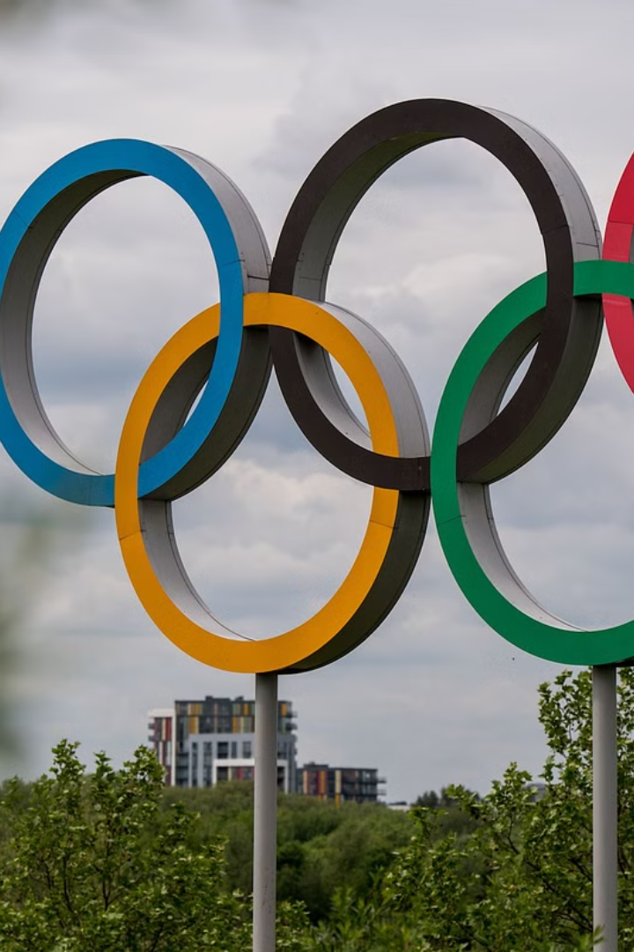
CAPSTONE PROJECT
DONE BY: ASHWIN B
B L N WAJITH ALI
MOHD ZAID

Slide 2



Nature of the Dataset
Comprehensive
Global
Multidimensional
The dataset covers 100+ years of Olympic history, including athlete demographics, event details, and medal results.
Data from every Olympic Games, representing athletes from countries around the world.
Includes variables like athlete age, gender, home country, event type, and more to analyze performance trends.

Slide 3
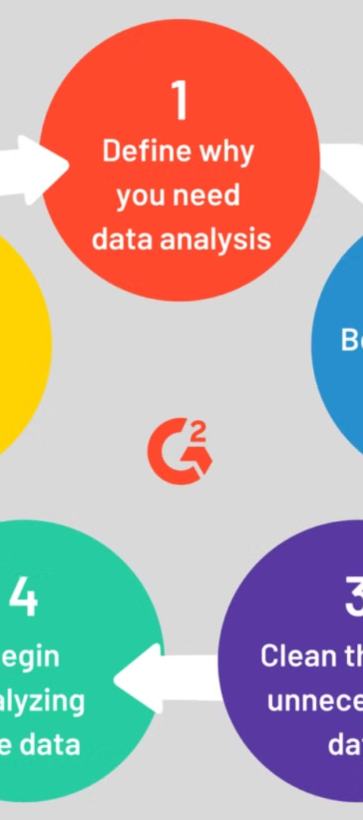
Approach for Data Analysis
1
Data Exploration
Understand the dataset structure, identify key variables, and uncover initial patterns.
2
Feature Engineering
Create new derived variables to better capture factors influencing performance.
3
Predictive Modeling
Apply machine learning techniques to build models that predict medal outcomes.

Slide 4
Graph Analysis and Insights
Medal Trends
Athlete Profiles
Event Dynamics
Analyzed medal counts over time to identify shifts in country performance and emerging athletic powers.
Examined demographics like age, gender, and home country to understand factors correlated with success.
Studied event-level data to pinpoint which sports and disciplines produce the most competitive results.

Slide 5
Key Observations
Athlete Age
Home Advantage
Peak performance tends to occur in the late 20s, with a decline in the 30s.
Host countries see a significant boost in medal counts, especially in certain sports.
Emerging Powers
Dominance in Specific Events
Countries like China have risen to prominence, challenging traditional Olympic powerhouses.
Some countries and athletes display consistent excellence in particular sports or disciplines.

Slide 6



Business Approach
Talent Scouting
Identify promising young athletes and provide targeted training and development support.
Event Optimization
Focus resources on sports and disciplines where the country has the best chance of medal success.
Sponsorship Strategy
Invest in athletes and teams with the highest potential for media exposure and commercial impact.

Slide 7




Challenges Faced
Data Gaps
Bias Concerns
Evolving Rules
Multifaceted Factors
Incomplete or inconsistent data for certain events and athletes over the decades.
Addressing potential biases in judging, event scheduling, and other factors.
Accounting for changes in Olympic event categories and scoring systems over time.
Disentangling the many interrelated variables that influence athlete performance.

Slide 8

Thank You

